Slide 1

Aerospike Advanced Concepts
Lists

Slide 2
Objective
After successful completion of this module you should be able to:
Use the Operate API
Understand List operations
Code a solution in
C#
Java

Slide 3
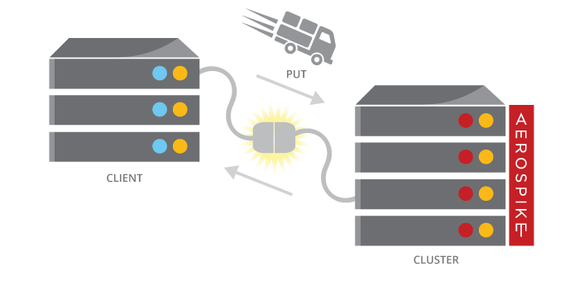
Lists
Lists are supported in most modern languages. The Client API translates the language types to the database type of List.
Stored in a single Bin
Must fit in the record max size (128k)
Lists can contain other Lists and Maps
Stored in a database native format, e.g.
write it in C#
read it in Java
Read and Write whole list

Slide 4
Individual List Operations
Append - appends value to end of a list
AppendItems - appends a list to end of a list
Insert - inserts value at the specified index
InsertItems - inserts a list starting at the specified index
Pop - returns item at specified index and removes item from list
PopRange - returns items starting at specified index to the end of list, and removes those items
Remove - removes item at specified index from list
RemoveRange - removes n items from list starting at specified index
Set - sets a value at specified index
Trim - removes items that do not fall into range specified by index and count range
Clear - removes all items
Size - returns size of list
Get - returns item at specified index
GetRange - returns n items starting at specified index
123
523
789
497

Slide 5
Code Examples - Java
Operate using ListOperation
Append 1 element
Append a list of values
Pop 1 item from
client.operate(writePolicy, key,
ListOperation.append(listBin, Value.get(99L)));
List<Value> inputList = new ArrayList<Value>();
inputList.add(Value.get(55));
inputList.add(Value.get(77));
client.operate(writePolicy, key,
ListOperation.appendItems(listBin, inputList));
record = client.operate(writePolicy, key,
ListOperation.pop(listBin, -1),
ListOperation.size(listBin));

Slide 6
Code Examples – C#
Operate using ListOperation
Append 1 element
Append a list of values
Pop 1 item from
client.Operate(writePolicy, key,
ListOperation.Append(listBin,
Value.Get(99L)));
List<Value> inputList = new List<Value>() {
Value.Get(55),
Value.Get(77) }; client.Operate(writePolicy, key,
ListOperation.AppendItems(listBin,
inputList));.
record = client.Operate(writePolicy, key,
ListOperation.Pop(listBin, -1),
ListOperation.Size(listBin));

Slide 7
Queries on Lists
Queries need:
Secondary Index
CollectionType
Filters
Integer: Range & Equality
String: Equality
Examples:
Records containing the value 49
= (A,C)
Records containing values between 61 and 70
= (A,B)
21
A:
cat
blue
43
2.56
49
62
22
B:
dog
red
41
7.23
49
66
C:
21
bird
green
36
6.91
48
60

Slide 8

Creating a Secondary Index on a List
Before executing a query, a secondary index must be created.
A secondary index is created using:
Namespace (database)
Set (table)
Bin (column) name and type – STRING or NUMERIC (integer)
Index Collection Type
The easiest way to create an index is with aql, which is an SQL-like utility.
It can also be done with the Client API
IndexTask task = client.CreateIndex(null, namespace, set,
indexName, binName, IndexType.NUMERIC,
IndexCollectionType.LIST); task.Wait();
Notes:
on a LisCreating an Index
An index consumes RAM for every index entry, and background index creation can take a substantial amount of resources. Index creation should be scheduled carefully on an operational system. An Index is created using:
Namespace (database)
Set (table) including the null Set
Bin name AND type (column)
Remember: a named Bin can have a different type in different records – No Schema.
The best way to create and manage indexes in an Aerospike cluster is using the aql tool.
CREATE INDEX tweetcount_index ON test.users (tweetcount) NUMERIC
aql is officially distributed as part of the server tools package. It is a Linux command line tool that implements Aerospike Query Language (AQL) which is a SQL like language. A java based aql implementation and an Eclipse plugin is available at Aerospike Labs http://www.aerospike.com/community/labs/
You can also create indexes with the client API. Creating indexes takes time and resources and should NOT be done in your production code.

Slide 9
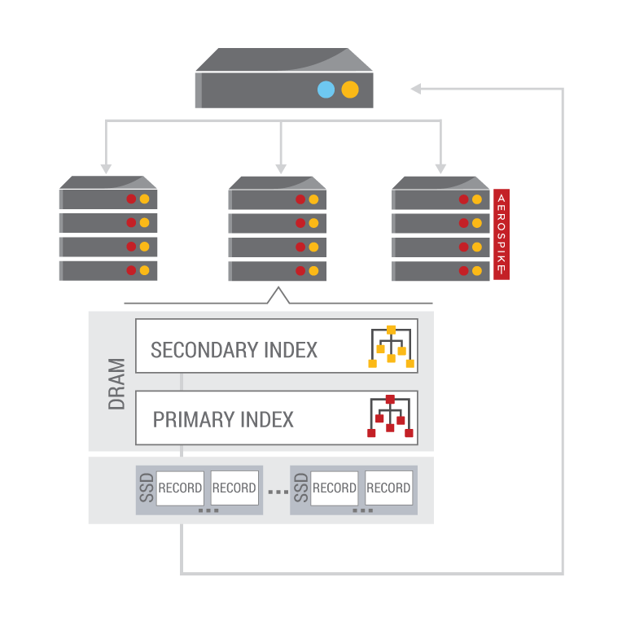
Steps to execute a Query
To execute a Query, perform the following steps:
Prepare a Statement
Namespace and Set
Bins to return
Single Filter
Execute Statement
Process results
Iterate through the results

Slide 10
Preparing a Statement
A Statement provides parameters to a query. These are:
Namespace (database)
Set (table)
Bins (columns) to be returned
A Filter (where clause)
Equality – Strings and Integers
Range – Integers only
// C# Statement stmt = new Statement(); stmt.Namespace = ns; stmt.SetName = set; stmt.SetFilters(Filter.Range(listBin, IndexCollectionType.LIST, 300, 350));
// Java
Statement stmt = new Statement();
stmt.setNamespace(ns);
stmt.setSetName(set);
stmt.setFilters(Filter.range(listBin, IndexCollectionType.LIST, 300, 350));

Slide 11
Processing results
You process the results of your query by iterating through the RecordSet.
next() fetches the next element and will block until one is available
getRecord() or Record returns the Record from the current element
getKey() or Key returns the Key from the current element
Remember to close the RecordSet

Slide 12
Exercises: Lists

Slide 13
Exercises and Answers
Directory layout
csharp
answers
exercises
Java
answers
exercises
Java: Maven project
C#: Visual studio (and Xamarin) solution

Slide 14
Java: Lists
Find the ListsExercises.java file in the exercises directory. Replace the TODOs with working code
// TODO append 99 to the list
// TODO append the inputList to the list
// TODO pop the last element off the list, return it and the new size of the list
// TODO set a filter to perform a range query on the values between 300 and 350
// TODO Query using the statement

Slide 15
C#: Lists
Find the Program.cs file in the exercises directory. Replace the TODOs with working code
// TODO save a List to Aerospike
// TODO append 99 to the list
// TODO append the inputList to the list
// TODO pop the last element in the list, return it and the new size of the list
// TODO set a filter to perform a range query on the values between 300 and 350
// TODO Query using the statement

Slide 16


