Slide 1

Aerospike Advanced Concepts
Maps

Slide 2
Objective
After successful completion of this module you should be able to:
Use the Operate API
Understand
Map Policy
Map operations
Code a solution in
C#
Java

Slide 3
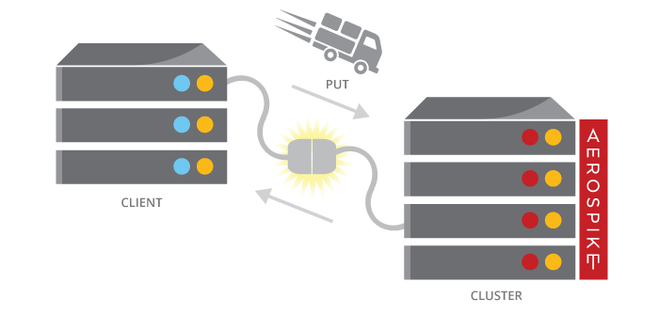
Maps (Dictionaries)
Maps, Dictionaries or Associative Arrays, are supported in most modern languages. The Client API translates the language type to the database type of Map.
Stored in a single Bin
Maps have an index and a rank
Must fit in the record max size (128k)
Maps can contain other Lists and Maps
Stored in a database native format, e.g.
write it in C#
read it in Java
Read and Write whole map, or item by item

Slide 4
Map Policy
Map Policy Controls the structure and operations on a map. It can be changed over lifetime of the Map
Properties:
Write Mode
Map Order
Map Write Mode
UPDATE – overwrite existing or create new
UPDATE_ONLY overwrite existing, fail if not exist
CREATE_ONLY fail if exist, create
Map Order
UNORDERED – no order, like a normal map or dictionary
KEY_ORDERED – order by the key
KEY_VALUE_ORDERED – order by key first, then by value

Slide 5
Map Operations - General
Primary Key
AB=H
dog
red
BC=29
7.23
MN=B
XY=QR
Operation | Description
Set Map Policy | Sets map policy attributes, these can be changed after the map is created
Clear | Removes all items in map
Size | Returns size of map
Increment | Valid only for numbers, increments values by specified amount for all items identified by key and returns final result
Decrement | Valid only for numbers, decrements values by specified amount for all items identified by key and returns final result

Slide 6
Map Operations – By key
Primary Key
AB=HS
dog
red
BC=29
7.23
MN=B1
XY=QR
Operation | Description
Get By Key | selects map item identified by key and returns selected data specified by the return type
Get By Key Range | selects map items identified by key range (begin key inclusive, end key exclusive). If begin key is null, the range is less than end key. If end key is null, the range is greater than equal to begin key
Remove By Key | removes map item identified by key and returns removed data specified by the return type
Remove By Key List | removes map items identified by a list of keys and returns removed data specified by the return type
Remove By Key Range | removes map items identified by key (begin key inclusive, end key exclusive). If begin key is null, the range is less than end key. If end key is null, the range >= begin key. Returns removed data specified by the return type.
Put | writes key/value item and returns map size
Put Items | writes each map item to map and returns the new map size

Slide 7
Map Operations – By value
Primary Key
AB=HS
dog
red
BC=29
7.23
MN=B1
XY=QR
Operation | Description
Get By Value | selects map items identified by value and returns selected data specified by the return type
Get By Value Range | selects map items identified by value range (begin value inclusive, end value exclusive). If begin value is null, the range is less than the end value. If end value is null, the range is >= the begin value. Returns selected data specified by the return.
Remove By Value | removes map items identified by value and returns removed data specified by the return type
Remove By Value List | removes a list of map items returns removed data specified by the return type
Remove By Value Range | removes map items identified by value range (begin value inclusive, end value exclusive). If the begin value is null, the range is less than the end value. If the end value is null, the range is >= the begin value. Returns removed data specified by the return type

Slide 8
Map Operations – By index
Index operations access items by their offset from the start of the map,
Example:
Index 0: First item in map.
Index 2: 3rd item in map.
Index -1: Last item in map.
Index -3: Third to last item in map.
Index 1 Count 2: Second and third items in map.
Index -3 Count 3: Last three items in map.
Index -5 Count 4: Range between fifth to last item to second to last item inclusive.
Primary Key
0:AB=HS
dog
red
1:BC=29
7.23
2:MN=B1
3:XY=QR
Operation | Description
Get By Index | selects the map item identified by index and returns selected data specified by the return type
Get By Index Range | selects map items starting at specified index to the end of map and returns selected data specified by the return type – can be limited by a count
Remove By Index | removes the map item identified by index and returns removed data specified by the return type
Remove By Index Range | removes the map items starting at specified index to the end of map and returns removed data specified by the return type – can be limited by a count

Slide 9
Map Operations – By rank
Rank Operations access items by their rank (sorted index) in the map,
Example:
Rank 0: Item with lowest value rank in map.
Rank 2: 2nd lowest ranked item in map.
Rank -1: Item with highest ranked value in map.
Rank -3: Item with third highest ranked value in map.
Rank 1 Count 2: Second and third lowest ranked items in map.
Rank -3 Count 3: Top three ranked items in map.
Primary Key
AB=HS
dog
red
BC=29
7.23
MN=B1
XY=QR
Operation | Description
Get By Rank | selects the map item identified by rank and returns selected data specified by the return type
Get By Rank Range | selects map items starting at specified rank to the end of map and returns selected data specified by the return type – can be limited by a count
Remove By Rank | removes the map item identified by rank and returns removed data specified by the return type
Remove By Rank Range | removes the map items starting at specified rank to the end of map and returns removed data specified by the return type – can be limited by a count

Slide 10
Code Examples - Java
Operate using MapOperation
// Create Map policy
MapPolicy mapPolicy = new MapPolicy(
MapOrder.KEY_ORDERED,
MapWriteMode.UPDATE_ONLY
);
// Add 1 element to the map and print the result
client.operate(writePolicy, key, MapOperation.put(mapPolicy,
mapBin, Value.get("cat"),
Value.get(7)));
// Add elements to the map and read the whole map.
Map<Value, Value> anotherMap = new HashMap<Value, Value>(){{
put(Value.get("dogs"), Value.get(1));
put(Value.get("mice"), Value.get("B"));
}};
client.operate(writePolicy, key,
MapOperation.putItems(mapPolicy, mapBin, anotherMap));
// Delete a key/value from the map and also return new size of map.
record = client.operate(writePolicy, key,
MapOperation.removeByKey(mapBin, Value.get("dogs"), MapReturnType.KEY),
MapOperation.size(mapBin));

Slide 11
Code Examples – C#
Operate using MapOperation
// Create Map policy
MapPolicy mapPolicy = new MapPolicy( MapOrder.KEY_ORDERED, MapWriteMode.UPDATE_ONLY ); // Add 1 element to the map and print the result client.Operate(writePolicy, key, MapOperation.Put(mapPolicy, mapBin,
Value.Get("cat"), Value.Get(7))); // Add elements to the map Dictionary<Value, Value> anotherMap = new Dictionary<Value, Value>(){ {Value.Get("dogs"), Value.Get(1)},
{Value.Get("mice"), Value.Get("B")} };
client.Operate(writePolicy, key, MapOperation.PutItems(mapPolicy, mapBin, anotherMap));
// Delete a key/value from the map and also return new size of map. record = client.Operate(writePolicy, key, MapOperation.RemoveByKey(mapBin, Value.Get("dogs"), MapReturnType.KEY), MapOperation.Size(mapBin));

Slide 12
Queries on Maps
Queries need:
Secondary Index
Collection Type
Map Keys
Map Values
Filters
Integer: Range & Equality
String: Equality
Examples:
Records containing the key BA
= (A,C)
Records containing values between 40 and 90
= (A,B)
BA=X
A:
cat
blue
DC=Y
2.56
DI=B
FB=41
BB:H
B:
dog
red
DA=I
7.23
AI=87
FF=w
C:
BA=Q
bird
green
CF=C
6.91
DH=Y
FA=V
Map keys
Map values

Slide 13

Creating a Secondary Index on a List
Before executing a query, a secondary index must be created.
A secondary index is created using:
Namespace (database)
Set (table)
Bin (column) name and type – STRING or NUMERIC (integer)
Index Collection Type
The easiest way to create an index is with aql, which is an SQL-like utility.
It can also be done with the Client API
IndexTask task = client.CreateIndex(null, namespace, set,
indexName, binName, IndexType.NUMERIC,
IndexCollectionType.MAPVALUES); task.Wait();

Slide 14
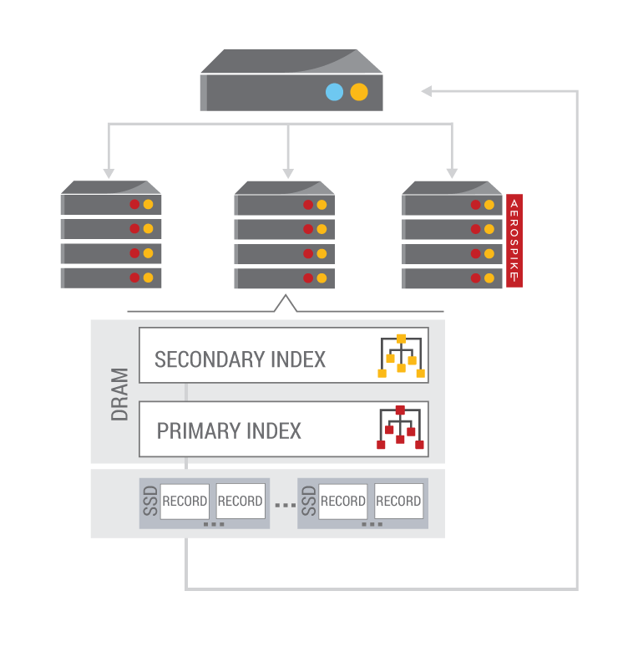
Steps to execute a Query
To execute a Query, perform the following steps:
Prepare a Statement
Namespace and Set
Bins to return
Single Filter
Execute Statement
Process results
Iterate through the results

Slide 15
Preparing a Statement
A Statement provides parameters to a query. These are:
Namespace (database)
Set (table)
Bins (columns) to be returned
A Filter (where clause) on Map Keys or Map Values
Equality – Strings and Integers
Range – Integers only
// C# Map values Statement stmt = new Statement(); stmt.Namespace = ns; stmt.SetName = set; stmt.SetFilters(Filter.Range(mapBin, IndexCollectionType.MAPVALUES, 300, 350));
// Java
stmt = new Statement();
stmt.setNamespace(ns);
stmt.setSetName(set);
stmt.setFilters(Filter.contains(mapBin, IndexCollectionType.MAPKEYS, "dogs7"));

Slide 16
Processing results
You process the results of your query by iterating through the RecordSet.
next() fetches the next element and will block until one is available
getRecord() or Record returns the Record from the current element
getKey() or Key returns the Key from the current element
Remember to close the RecordSet

Slide 17
Exercises: Maps

Slide 18
Exercises and Answers
Directory layout
csharp
answers
exercises
Java
answers
exercises
Java: Maven project
C#: Visual studio (and Xamarin) solution

Slide 19
Java: Maps
Find the MapsExercises.java file in the exercises directory. Replace the TODOs with working code
// TODO save a map to Aerospike
// TODO an element to a map 'cat = 7'
// TODO add a map of values to the stored map
// TODO delete the 'dogs' element
// TODO set a filter to perform a range query on the map values in the map
// TODO Query using the statement

Slide 20
C#: Maps
Find the Program.cs file in the exercises directory. Replace the TODOs with working code
// TODO save a map to Aerospike
// TODO an element to a map 'cat = 7'
// TODO add a map of values to the stored map
// TODO delete the 'dogs' element
// TODO set a filter to perform a range query on the map values between 300 and 350
// TODO Query using the statement

Slide 21


