Slide 1

Aerospike Advanced Concepts
Maps

Slide 2
Objective
After successful completion of this module you should be able to:
Use the Operate API
Understand Map operations
Code a solution in
C#
Java

Slide 3
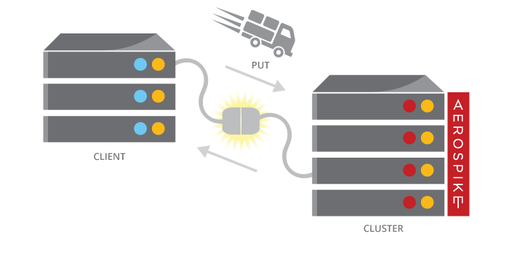
Maps (Dictionaries)
Maps, Dictionaries or Associative Arrays, are supported in most modern languages. The Client API translates the language type to the database type of Map.
Stored in a single Bin
Maps have an index and a rank
Must fit in the record max size (128k)
Maps can contain other Lists and Maps
Stored in a database native format, e.g.
write it in C#
read it in Java
Read and Write whole map

Slide 4
Map Operations – By key
Key operations access items by key
GetByKey
GetByKeyRange
RemoveByKey
RemoveByKeyList
RemoveByKeyRange
Decrement/Increment
Put
PutItems

Slide 5
Map Operations – By value
Value operations access items by the value
GetByValue
GetByValueRange
RemoveByValue
RemoveByValueList
RemoveByValueRange

Slide 6
Map Operations – By index
Index operations access items by their offset from the start of the map, for example:
Index 0: First item in map.
Index 4: Fifth item in map.
Index -1: Last item in map.
Index -3: Third to last item in map.
Index 1 Count 2: Second and third items in map.
Index -3 Count 3: Last three items in map.
Index -5 Count 4: Range between fifth to last item to second to last item inclusive.
GetByIndex/Range
GetByIndexRange
RemoveByIndex
RemoveByIndexRange

Slide 7
Map Operations – By rank
Rank Operations access items by their rank (sorted index) in the map, for example:
Rank 0: Item with lowest value rank in map.
Rank 4: Fifth lowest ranked item in map.
Rank -1: Item with highest ranked value in map.
Rank -3: Item with third highest ranked value in map.
Rank 1 Count 2: Second and third lowest ranked items in map.
Rank -3 Count 3: Top three ranked items in map.
GetByRank
GetByRankRange
RemoveByRank
RemoveByRankRange

Slide 8
Map Policy

Slide 9
Code Examples - Java
Operate using MapOperation
// Create Map policy
MapPolicy mapPolicy = new MapPolicy(
MapOrder.KEY_ORDERED,
MapWriteMode.UPDATE_ONLY
);
// Add 1 element to the map and print the result
client.operate(writePolicy, key, MapOperation.put(mapPolicy,
mapBin, Value.get("cat"),
Value.get(7)));
// Add elements to the map and read the whole map.
Map<Value, Value> anotherMap = new HashMap<Value, Value>(){{
put(Value.get("dogs"), Value.get(1));
put(Value.get("mice"), Value.get("B"));
}};
client.operate(writePolicy, key,
MapOperation.putItems(mapPolicy, mapBin, anotherMap));
// Delete a key/value from the map and also return new size of map.
record = client.operate(writePolicy, key,
MapOperation.removeByKey(mapBin, Value.get("dogs"), MapReturnType.KEY),
MapOperation.size(mapBin));

Slide 10
Code Examples – C#
Operate using MapOperation
// Create Map policy
MapPolicy mapPolicy = new MapPolicy( MapOrder.KEY_ORDERED, MapWriteMode.UPDATE_ONLY ); // Add 1 element to the map and print the result client.Operate(writePolicy, key, MapOperation.Put(mapPolicy, mapBin,
Value.Get("cat"), Value.Get(7))); // Add elements to the map Dictionary<Value, Value> anotherMap = new Dictionary<Value, Value>(){ {Value.Get("dogs"), Value.Get(1)},
{Value.Get("mice"), Value.Get("B")} };
client.Operate(writePolicy, key, MapOperation.PutItems(mapPolicy, mapBin, anotherMap));
// Delete a key/value from the map and also return new size of map. record = client.Operate(writePolicy, key, MapOperation.RemoveByKey(mapBin, Value.Get("dogs"), MapReturnType.KEY), MapOperation.Size(mapBin));

Slide 11
Queries on Maps
Queries need:
Secondary Index
CollectionType
Filters
Integer: Range & Equality
String: Equality
Examples:
Records containing the key 49
= (A,C)
Records containing keys between 61 and 70
= (A,B)
21:X
A:
cat
blue
43:Y
2.56
49:B
62:D
22:H
B:
dog
red
41:I
7.23
49:B
66:w
C:
21:Q
bird
green
36:C
6.91
48:Y
60:V

Slide 12

Creating a Secondary Index on a List
Before executing a query, a secondary index must be created.
A secondary index is created using:
Namespace (database)
Set (table)
Bin (column) name and type – STRING or NUMERIC (integer)
Index Collection Type
The easiest way to create an index is with aql, which is an SQL-like utility.
It can also be done with the Client API
IndexTask task = client.CreateIndex(null, namespace, set,
indexName, binName, IndexType.NUMERIC,
IndexCollectionType.MAPVALUES); task.Wait();

Slide 13
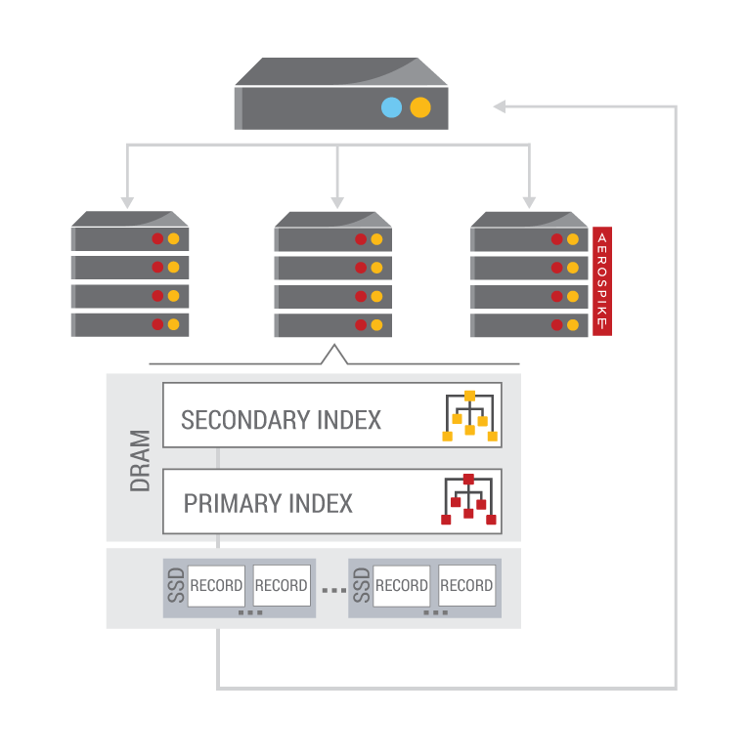
Steps to execute a Query
To execute a Query, perform the following steps:
Prepare a Statement
Namespace and Set
Bins to return
Single Filter
Execute Statement
Process results
Iterate through the results

Slide 14
Preparing a Statement
A Statement provides parameters to a query. These are:
Namespace (database)
Set (table)
Bins (columns) to be returned
A Filter (where clause) on Map Keys or Map Values
Equality – Strings and Integers
Range – Integers only
// C# Map values Statement stmt = new Statement(); stmt.Namespace = ns; stmt.SetName = set; stmt.SetFilters(Filter.Range(mapBin, IndexCollectionType.MAPVALUES, 300, 350));
// Java
stmt = new Statement();
stmt.setNamespace(ns);
stmt.setSetName(set);
stmt.setFilters(Filter.contains(mapBin, IndexCollectionType.MAPKEYS, "dogs7"));

Slide 15
Processing results
You process the results of your query by iterating through the RecordSet.
next() fetches the next element and will block until one is available
getRecord() or Record returns the Record from the current element
getKey() or Key returns the Key from the current element
Remember to close the RecordSet

Slide 16
Exercises: Maps

Slide 17
Exercises and Answers
Directory layout
csharp
answers
exercises
Java
answers
exercises
Java: Maven project
C#: Visual studio (and Xamarin) solution

Slide 18
Java: Maps
Find the Program.java file in the exercises directory. Replace the TODOs with working code
// TODO save a map to Aerospike
// TODO an element to a map 'cat = 7'
// TODO add a map of values to the stored map
// TODO delete the 'dogs' element
// TODO set a filter to perform a range query on the map values in the map
// TODO Query using the statement

Slide 19
C#: Maps
Find the Program.cs file in the exercises directory. Replace the TODOs with working code
// TODO save a map to Aerospike
// TODO an element to a map 'cat = 7'
// TODO add a map of values to the stored map
// TODO delete the 'dogs' element
// TODO set a filter to perform a range query on the map values between 300 and 350
// TODO Query using the statement

Slide 20


