Slide 1

School of Electronics Engineering
Master Thesis Review

Slide 2
An IoT Based Autonomous Sensor System for Aeroponics
MELVIN P BABY- 19MES1019
Guide: Dr. ABRAHAM SUDHARSON PONRAJ

Slide 3
Contents
Objective
Motivation
Base Paper
Block Diagram
Hardware Components
Simulation Diagram
Working
Results
Timeline
References

Slide 4
OBJECTIVE
To increase the yield of the plant cultivation through autonomous aeroponic system due to rapid decrease in availability of irrigated land and increase in population.

Slide 5
MOTIVATION
The land available for cultivation is gradually decreasing due to the effect of global warming.
To increase the yield due to increase in population which inturn results in demand for food.
Disease free plant cultivation
Less human interference

Slide 6
BASE PAPER
Imran Ali Lakhiar, Gao Jianmin, Tabinda Naz Syed, Farman Ali Chandio, Noman Ali Buttar, Waqar Ahmed Qureshi, "Monitoring and Control Systems in Agriculture Using Intelligent Sensor Techniques: A Review of the Aeroponic System", Journal of Sensors, vol. 2018, Article ID 8672769, 18 pages, 2018.
https://doi.org/10.1155/2018/8672769

Slide 7
Autonomous system
An autonomous system is defined as a system that detects its operating environment and senses the operating parameters, changes its operating behavior in that environment and adapts to the changes and events occurring in that environment.
The system take appropriate actions according to the requirements that arise in dynamic environment. It has main four characteristics that are mentioned below:
Self configuration
Self healing
Self protection
Self optimization

Slide 8
Aeroponics system
Aeroponics is one of the modern methods for plant cultivation practiced around the world.
In this system plant is cultivated under complete control conditions in the growth chamber by providing a small mist of the nutrient solution in replacement of soil through atomization nozzles on periodical basis.

Slide 9
Aeroponics vs Hydroponics
AEROPONICS | HYDROPONICS
Roots are exposed and sprayed with a mist containing nutrients | Roots are submerged into water
Plants are grown in a humid, fog like environment where continual or timed misting keeps the roots from drying out and supplies the nutrient solution. | Hydroponics systems deliver nutrients via the water in which plants are absorbed.
Maintenance- Aeroponic systems can have fluctuating levels of pH and nutrient solution as a result of their constant mist flow and you will have to test your solution more often as a result. | When the water in the reservoir becomes lower you’ll have to add in water, and do larger water changes every couple of weeks.

Slide 10
BLOCK DIAGRAM Autonomous system
CLOUD
RELAY
BOARD
ACTUATOR
M
I
C
R
O
C
O
N
T
R
O
L
L
E
R
GROWING CHAMBER
DHT11
PH METER
TDS METER
CAMERA MODULE

Slide 11
HARDWARE COMPONENTS
Ph meter
NodeMcu Esp8266
TDS meter
DHT 11
SERVO MOTOR
Camera module

Slide 12
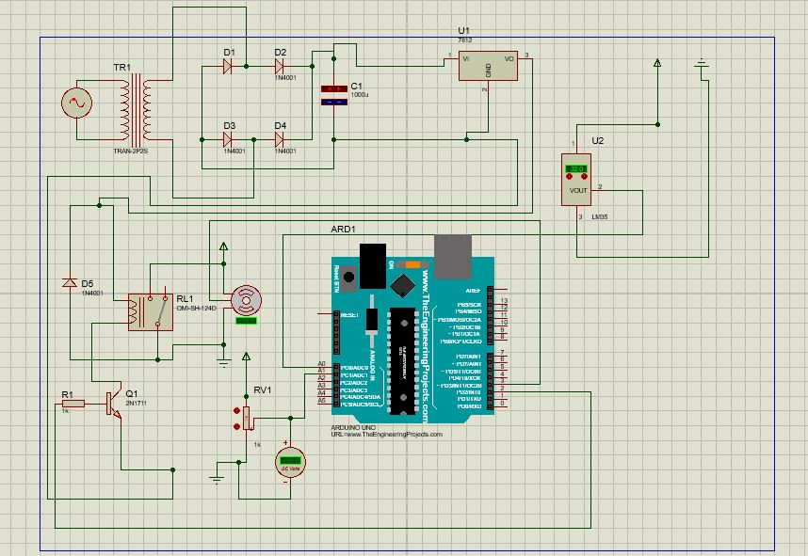
SIMULATION DIAGRAM
Fig 1 : Simulation diagram

Slide 13
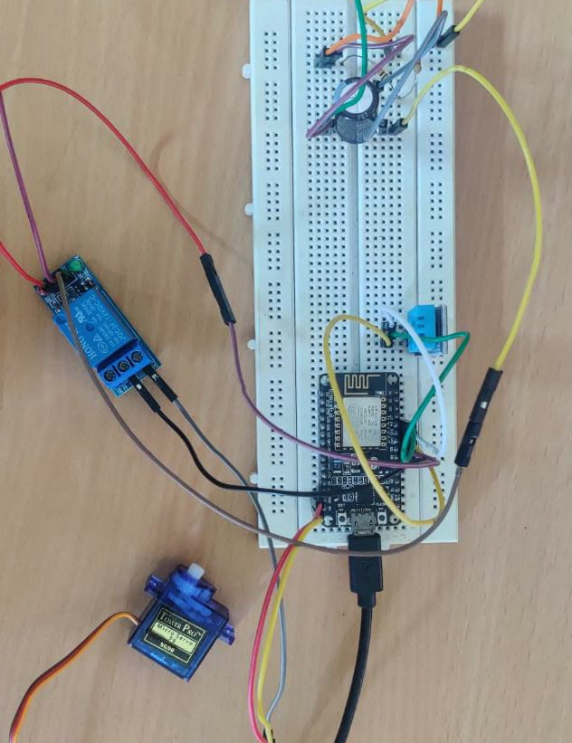
WORKING
Fig 2 Working model

Slide 14
Parameters
The basic parameters that need to be monitored and controlled for smart farming of potato plants are
Ph value (5.0-6.0)
Temperature (15^{օ}-25º )c
The humidity inside the chamber ideally should be 100% moisturised.
The light inside the chamber box should be darker and 8-10 hours of sufficient light should be provided to the plant.

Slide 15
Convolution Neural Network
CNN is a multi-layer and a feed-forward neural network with one or more convolutional layer followed with fully connected layers.
The CNN model is used for disease detection and classification, the model includes an Input layer, Convolutional layers, Pooling layers, fully connected layers, and output layer.

Slide 16
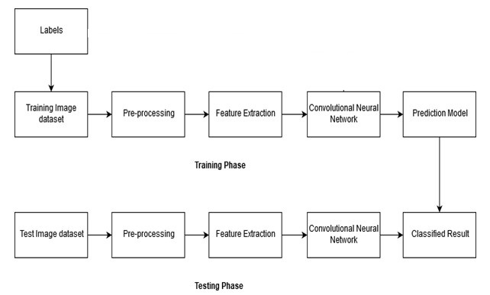
Block Diagram
Fig 6: Block diagram

Slide 17
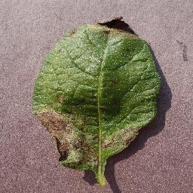
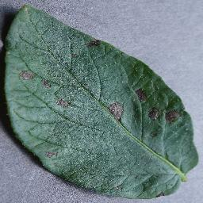
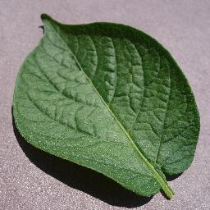
Types of diseases found in potato plant
Early blight diseases
Late blight diseases
Fig 3: Late blight
Fig 4: Early blight
Fig 5: Healthy potato leaf

Slide 18
Dataset
The dataset used in this study consist of potato leaf images from PlantVillage dataset.
The dataset includes 1000 late blight images, 1000 early blight images and 210 healthy potato leaf images.

Slide 19
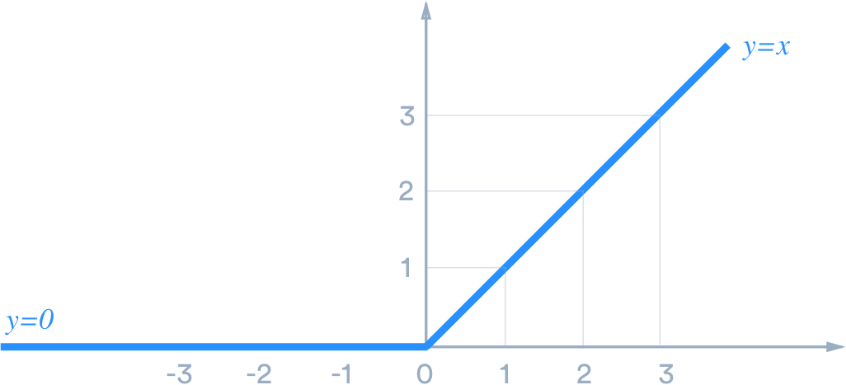
Relu function(Rectified linear unit function)
ReLU is a piecewise linear function that will output the input directly if it is positive, otherwise, it will output zero.
Fig 7: Relu function

Slide 20
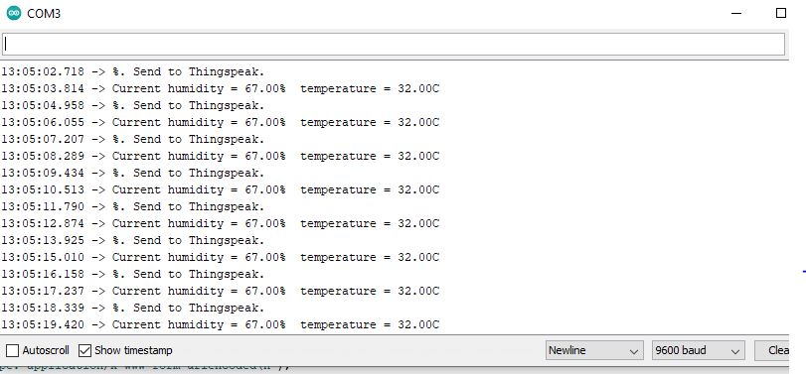
RESULTS
Fig 8: Serial monitor reading temperature and humidity values

Slide 21
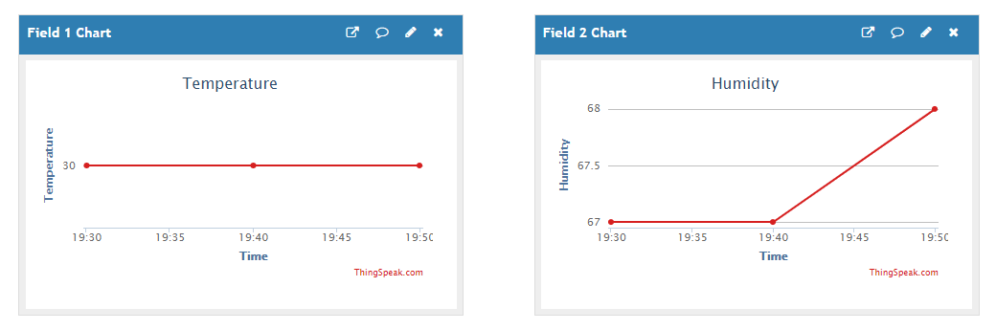
Fig 9: Sending data to thingspeak

Slide 22

Fig 10 : Sensor fault detection

Slide 23

Fig 12 : Email Alert

Slide 24
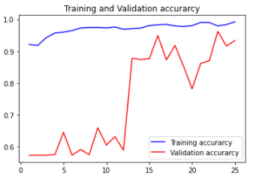
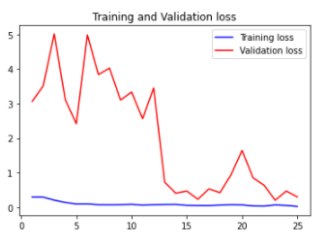
Fig 13 : Training and
Validation accuracy
Fig 14: Training and Validation loss
Training accuracy : 93.37
Testing accuracy : 93.3734

Slide 25
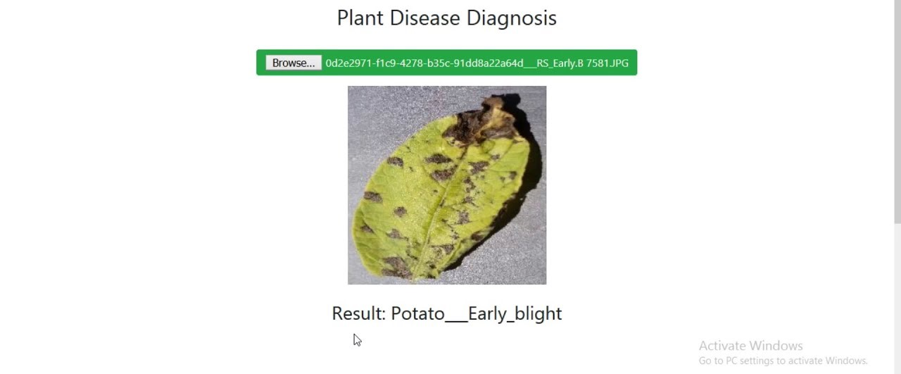
Fig 15 : Plant disease diagnosis

Slide 26
COST ANALYSIS

Slide 27
S/NO. | ITEM | UNIT QUANTITY | UNIT PRICE (RS) | AMOUNT (RS)
1 | NODE MCU | 1 | 422 | 422
2 | Servo motor | 1 | 197 | 197
3 | 12V Relay | 1 | 200 | 200
4 | DHT11 | 1 | 240 | 240
5 | 220v to 12v Step down | 1 | 599 | 599
6 | Electrolytic capacitor | 1 | 5 | 5
7 | Breadboard and jumper cables | 1 | 195 | 195
8 | Camera module | 1 | 399 | 399
9 | Resistors(1 kohm) | 1 | 48 | 48
 | Total |  |  | 2305

Slide 28
CONCLUSION AND FUTURE WORK
An autonomous sensor system is developed for aeroponics system such that to increase the yield of the plant cultivation due to rapid decrease in availability of irrigated land and increase in population.
In future, the use of a field programmable gate array (FPGA) and system-on-chip
(SoC)-based architecture would enhance high performance device monitoring and
control when deployed to large agricultural farmland.

Slide 29
TIMELINE
MONTH | WORK TO BE DONE
REVIEW 1 | LITERATURE REVIEW AND DEVELOPMENT OF MODEL
REVIEW 2 | IMPLEMENTATION AND EXCECUTION
REVIEW 3 | Final Prototype and Research Paper

Slide 30
REFERENCES
Imran Ali Lakhiar, Gao Jianmin, Tabinda Naz Syed, Farman Ali Chandio, Noman Ali Buttar, Waqar Ahmed Qureshi, "Monitoring and Control Systems in Agriculture Using Intelligent Sensor Techniques: A Review of the Aeroponic System", Journal of Sensors, vol. 2018, Article ID 8672769, 18 pages, 2018.
J. James and M. P. Maheshwar, “Plant growth monitoring system, with dynamic user-interface,” in 2016 IEEE Region 10 Humanitarian Technology Conference (R10-HTC), pp. 1–5, Agra, India, December 2016.
D. Pimentel, B. Berger, D. Filiberto et al., “Water resources: agricultural and environmental issues,” Bioscience, vol. 54, no. 10, pp. 909–918, 2004.

