Slide 1
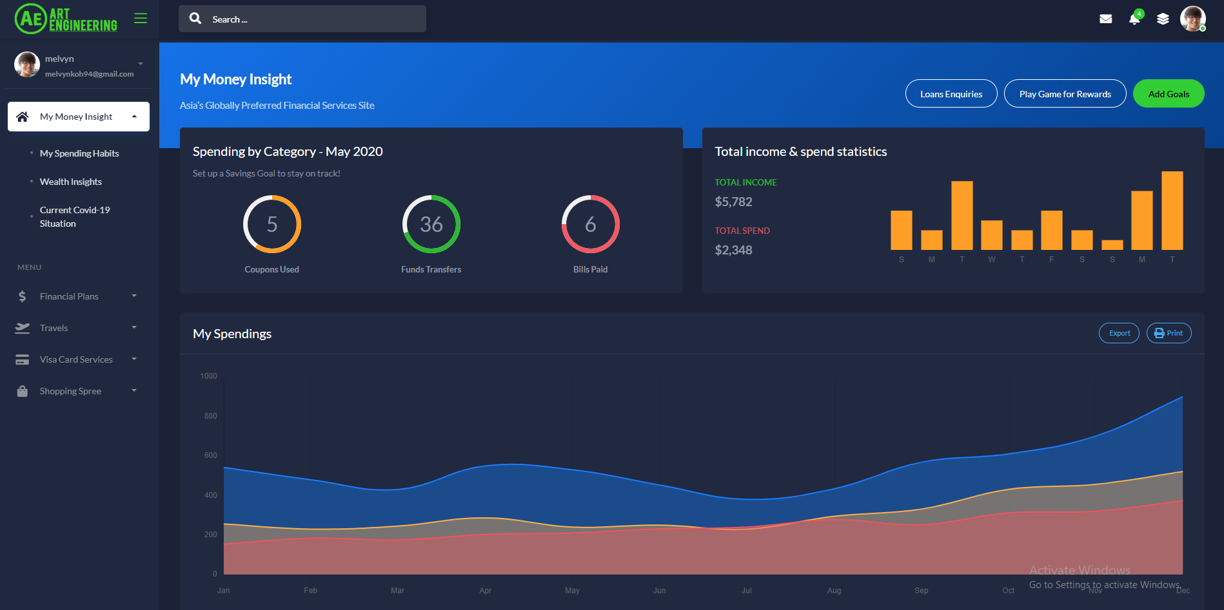


TEAM ART ENGINEERING
RAZER FINTECH DIGITAL HACKATHON

Slide 2



PROBLEM (Problem Statement #4)
Financial services and products today lack the innovation to address the experiential youth lifestyle.
Robust spending on authentic experiences
Strong online shopping habits
Preference for non-financial features
Youths fail to see banks as lifestyle partners

Slide 3
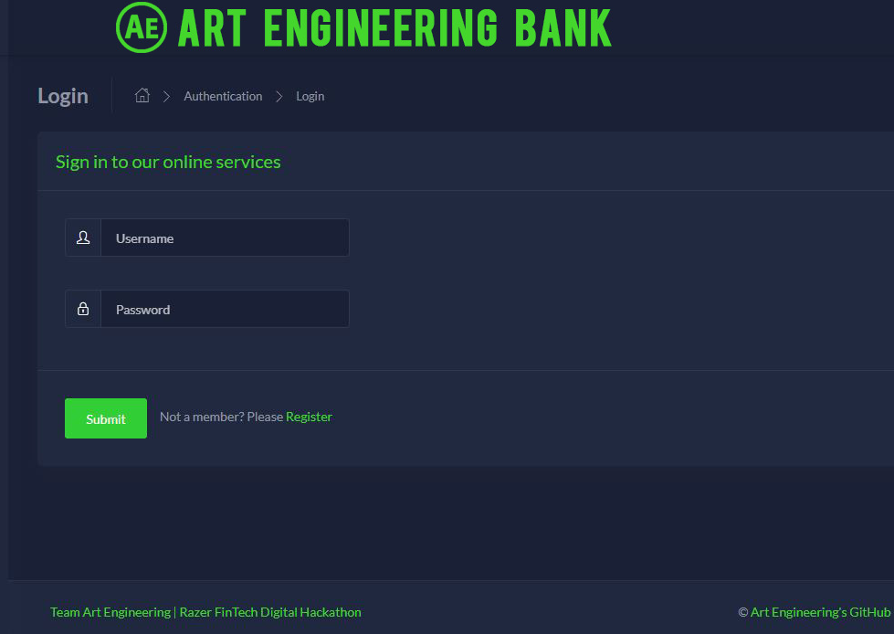

Objective
A One-stop App, Incorporating the Lifestyle of Youths
With liberal spending habits amongst the youths in various aspects, this web application is customized to integrate financial services into their lifestyle.
Sign-in page

Slide 4





SOLUTION
A One-stop App, Integrating the Lifestyle of Youths
[APIs used: Visa, Mambu, Perx, Mathdro]
Stamp Card
Earn 1 stamp for every transaction of at least $50 for each merchant.
Available Term Loan
Obtain small/large loans to finance big ticket items at attractive rates.
VISA
Card Services
Manage and track spending of all Visa cards
Travel Planner
Conveniently locate all ATM machines and Visa-accepting merchants around the world during one’s vacation, and latest exchange rates

Slide 5

Money Insight
Visa API
Summarize spending by category
Track total income & spend
Clear visualization of spending over the year

Slide 6

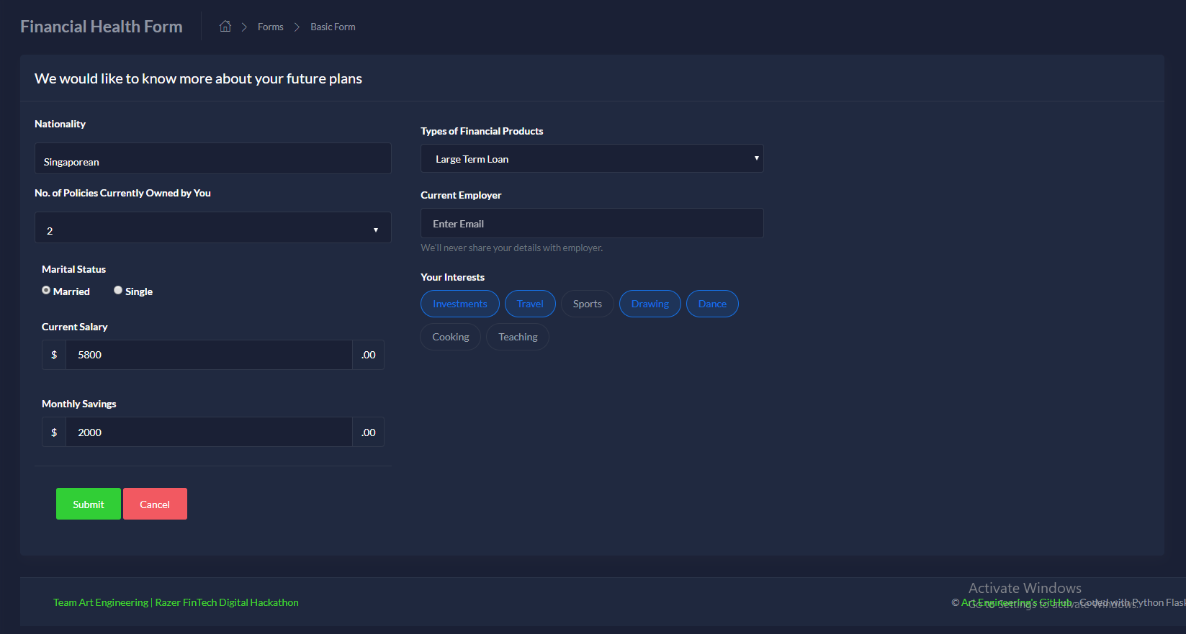
Financial Health Form
Visa API
Youths input their personal and financial information, which will be assessed.

Slide 7
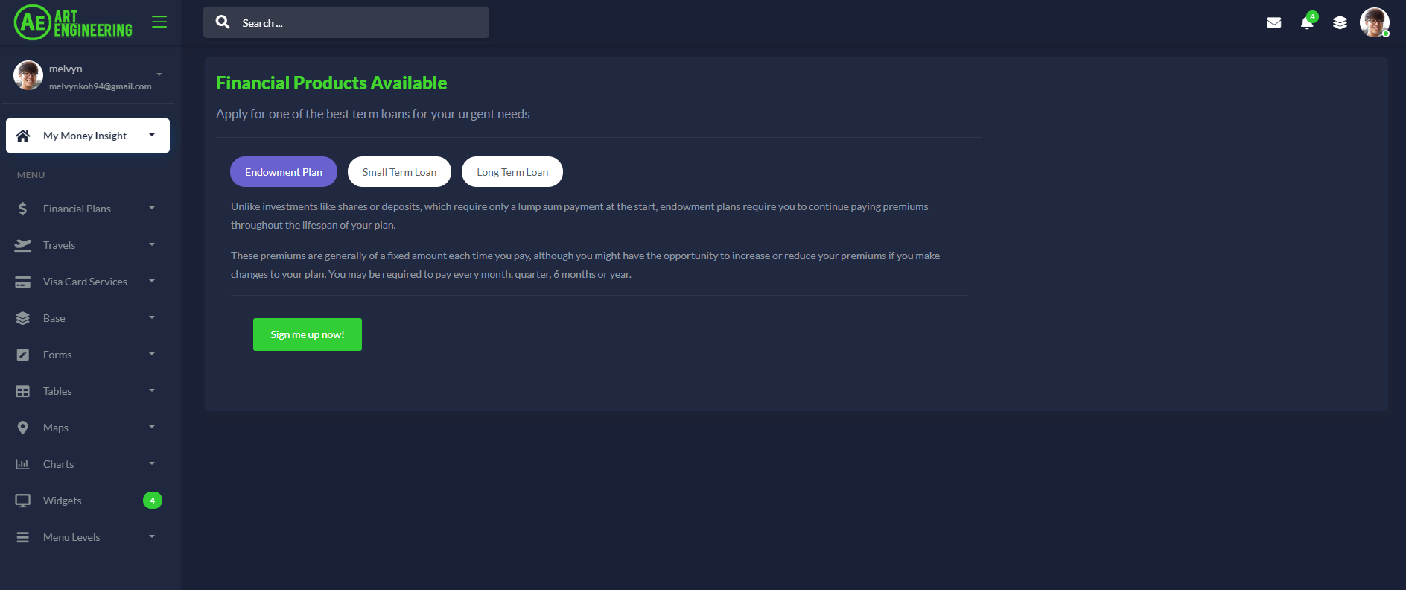
Financial Products
Mambu API
Endowment Plan
To encourage and help youths to save despite robust spending habits.
Small/Large Term Loan
To finance big expenses at low interest rates

Slide 8
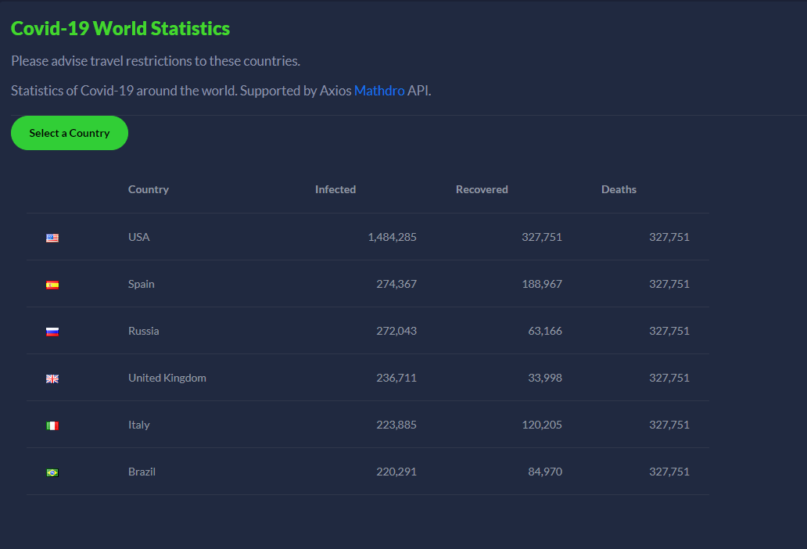
COVID-19 Affecting Travel Plans
Mathdro API
Given current COVID-19 situation across the globe, this is a useful tool to track which countries are still severely impacted and advise youths on travel restrictions, so that they can defer their travel plans.

Slide 9

THANK YOU!
By:
Melvyn Koh
Isabelle Ng

