Slide 1
DATA ANALYTICS · JAN–AUG 2020
NYC Traffic Accident Analysis
Testing the rush hour myth against 75,896 reported collisions
Aditya · Melwin · Kavya · Shravan · Mariyamol
Source: NYC Open Data — Motor Vehicle Collisions (Crashes)

Slide 2
PROBLEM STATEMENT
Testing what everyone assumes about rush hour
The common belief
Our goal
Why it matters
Most people assume mornings and evenings are the most dangerous times to drive, simply because the roads are full of cars.
Use the NYPD collision data to check whether that is actually true — or whether worse crashes happen at other hours, when roads are empty and drivers speed.
Deployment of police cars and ambulances depends on knowing when crashes concentrate, and by what measure — count or severity — an hour is genuinely “dangerous.”
2

Slide 3
TEAM
Team roles & progress matrix
A
Aditya
M
Melwin
K
Kavya
Data Engineer
Trend Analyst
Visual Architect
Cleaned the data and set up the time filters.
Built the month timeline and location charts.
Designed the final layout and heatmap templates.
S
Shravan
M
Mariyamol
Data Investigator
Data Analyst
3
Prepped the final slides and cause analysis.
Joined the team to support trend analysis and cause investigation alongside Melwin and Shravan.

Slide 4
SCOPE
The four questions this project answers
These are the guiding business questions assigned for the NYC Traffic Accidents dataset. Every finding in this deck is built to answer one of them directly.
RQ1
Compare the % of total accidents by month. Do you notice any seasonal patterns?
RQ2
Break down accident frequency by day of week and hour of day. When do accidents occur most frequently?
RQ3
On which particular street were the most accidents reported? What % of all reported accidents does that represent?
RQ4
What was the most common contributing factor overall (Vehicle 1)? What about for fatal accidents specifically?
4

Slide 5
DATA SOURCE
What we started with
Source
NYC Open Data — Motor Vehicle Collisions (Crashes), NYPD-reported
Time window
January 1 – August 30, 2020
Raw records
75,896 individual collision reports
Raw columns
29 fields: date/time, location, injuries, fatalities, contributing factors, vehicle types
Unit of analysis
One row = one reported collision (not one vehicle or one person)
This window happens to span the sharpest disruption to New York traffic in a generation — the COVID-19 stay-at-home period — which becomes relevant later when we account for it rather than ignore it.
5

Slide 6
PREPARATION
Cleaning the dataset before trusting it
Raw open-data exports are rarely analysis-ready. Before any chart was built, the dataset went through a fixed sequence of checks so that every later chart rests on the same, verifiable ground.
01
02
03
Duplicate removal
Date & time parsing
Feature engineering
Checked every COLLISION_ID for repeats.
Converted text fields into real date/time values.
Derived Hour, day of week, weekend flag, and rush-hour flag.
0 duplicates found
75,896 parsed cleanly
6 new columns added
04
05
06
Severity flags
Borough gaps
Text standardization
Marked each row as injury / fatal based on victim counts.
34.4% of rows had no borough listed. Rather than deleting a third of the data, blanks were labeled “Unknown” and excluded only from borough-specific charts.
Trimmed and upper-cased street names for consistent grouping.
20,743 injury · 143 fatal
26,074 rows labeled
Applied dataset-wide
6

Slide 7
METHOD
Two different questions hide inside one myth
“Most dangerous” is ambiguous. We split it into two measurable, independent questions and answer each on its own terms before combining them into a verdict.
Volume
Severity
Which hours produce the most crashes?
Which hours produce the worst crashes?
Counts total collisions per hour of day. This is what most people picture when they think of “rush hour danger” — more cars, more opportunities to collide.
Measures the share of crashes involving injury or death, independent of how many crashes occur. Empty roads can invite higher speeds — and higher speed changes outcomes, not counts.
Rush hour, defined for this study, as weekday 7–9 AM and 4–7 PM.
7

Slide 8
RESULTS
2020 was not a normal year to measure traffic
RQ1
“Compare the % of total accidents by month — any seasonal patterns?”
Answer to RQ1
Yes — a strong seasonal pattern, but not a weather-driven one.
Jan–Mar hold a stable 15–19% of total accidents each, ordinary winter driving.
April collapses to just 5.4% of the total as COVID stay-at-home orders emptied the roads.
May–Aug rebound steadily back toward 12–13% as restrictions eased.
8

Slide 9
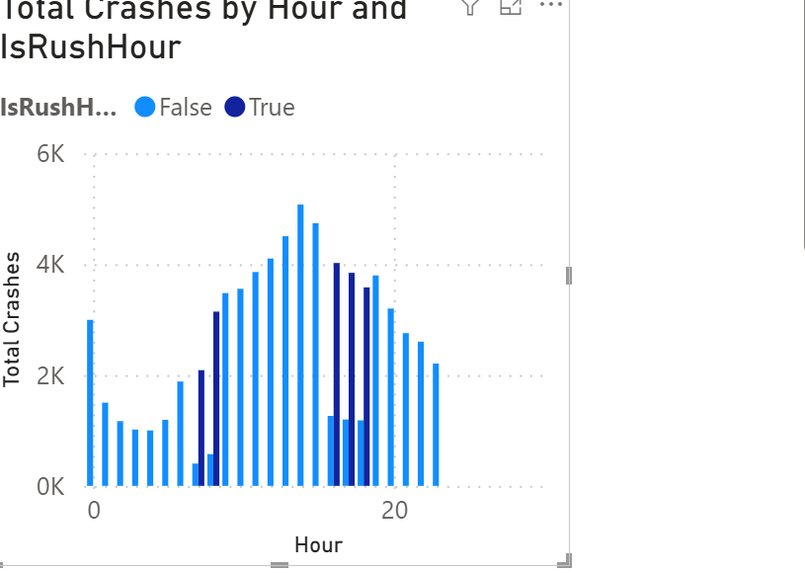
RESULTS · BUILT IN POWER BI
Crash volume climbs through the day, peaking late afternoon
RQ2
“Break down frequency by hour of day — when do accidents occur most?”
Answer to RQ2 (hour)
Volume rises gradually from early morning through a broad afternoon plateau (hours 12–18), peaking around 4–5 PM — not in a sharp double-spike at the two commute windows. The evening rush registers strongly; the morning rush barely stands out from the surrounding hours.
9

Slide 10
RESULTS
Weekends behave differently from weekdays
RQ2
“Break down frequency by day of week and hour of day.”
Crash volume by day of week, broken into six-hour blocks. Darker cells mark higher counts.
Day | 12–6 AM | 6–12 PM | 12–6 PM | 6–12 AM
Friday | 1521 | 3609 | 6784 | 3812
Saturday | 2634 | 5320 | 6104 | 3450
Sunday | 2589 | 4890 | 5720 | 3120
Monday | 1180 | 3510 | 6890 | 4180
Tuesday | 1090 | 3320 | 6650 | 4050
Wednesday | 1150 | 3400 | 6790 | 4160
Thursday | 1210 | 3480 | 6910 | 4200
Answer to RQ2 (day)
The 12–6 PM block is consistently the heaviest across every day — not a narrow commute window. Friday and Saturday nights carry visibly more overnight crashes than weeknights, pointing to a social/leisure driving pattern distinct from the commute story.
10

Slide 11
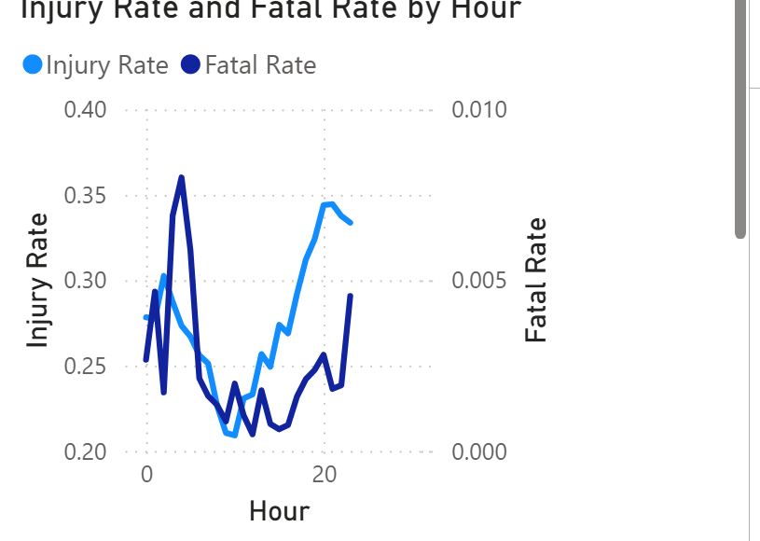
RESULTS · BUILT IN POWER BI · THE CORE TEST
Fewer crashes at night, but a larger share turn fatal
Beyond RQ2
The severity half of the volume-vs-severity framework from slide 7.
What it shows
Both curves dip during the working day and climb toward night. The fatal-rate line spikes hardest between 3–5 AM — exactly the hours with the fewest total crashes from slide 9. Fewer collisions overall, but a disproportionate share are deadly.
11

Slide 12
RESULTS · THE VERDICT DATA
Rush hour vs. the rest of the day, head to head
Synthesis
Combines RQ2 (frequency) with the severity measure to test the myth directly.
Verdict
Volume: rush hour runs only about 7% more crashes per hour than the rest of the day — far weaker than the myth implies.
Fatality: a non-rush-hour crash is more than twice as likely to be fatal (0.21%) as a rush-hour crash (0.10%).
Injury rate is nearly identical between the two — the real difference is concentrated in the most severe outcomes.
12

Slide 13
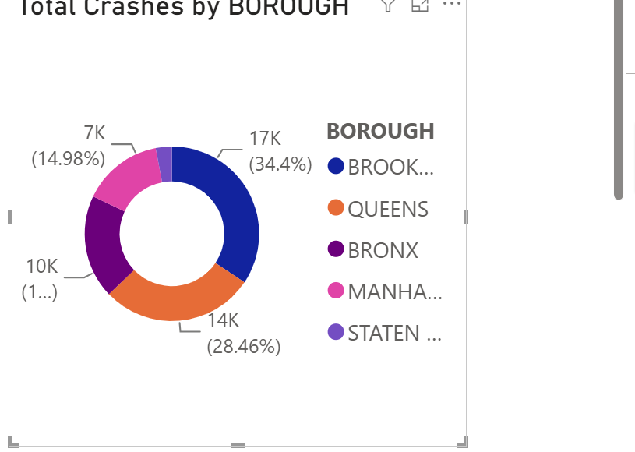
RESULTS · BUILT IN POWER BI · SUPPLEMENTARY CONTEXT
Two boroughs carry most of the burden
What this tells us
Brooklyn and Queens together account for nearly 63% of all reported crashes with a known borough. Both are large, high-throughput boroughs with dense arterial roads and expressway access — which lines up with the street-level pattern on the next slide.
Not one of the four assigned research questions, but included as location context that supports the street-level answer to RQ3.
13

Slide 14
RESULTS
Danger concentrates on the highways, not side streets
RQ3
“Which street had the most accidents — what % of the total does that represent?”
Answer to RQ3: the Belt Parkway is the single most dangerous street, with 1,254 crashes — 1.65% of all 75,896 reported collisions, and 66% more than the second-highest street. Every entry on this list is a high-speed expressway or parkway, confirming that speed and traffic density, not neighborhood streets, drive citywide street-level risk.
14

Slide 15
RESULTS
What drivers actually did differently during rush hour
RQ4a
“What was the most common contributing factor overall?”
Answer to RQ4a: Driver Inattention / Distraction is the most common known contributing factor overall (25.6% of all crashes) and it appears almost equally in rush and non-rush hours. What does shift with rush hour is tailgating and right-of-way violations — both about 1.3 points more common, consistent with dense, stop-and-go traffic.
15

Slide 16
RESULTS
Fatal crashes point to a different cause entirely
RQ4b
“...and what about for fatal accidents specifically?”
Answer to RQ4b
Among the 143 fatal crashes, Unsafe Speed ties as the single largest known cause (23.8%), well ahead of its 3.6% share of crashes overall. Distraction — the top overall cause — drops to fourth place here. This directly supports the night-time findings: when roads are empty, speed becomes the defining factor in whether a crash turns fatal.
16

Slide 17
CONCLUSION
Bringing every finding back to the four questions
RQ1
Seasonal pattern?
Yes — crashes fell 71% in April 2020 during lockdown, then rebounded steadily through August.
RQ2
When do crashes peak?
Volume climbs through the day, peaking 4–5 PM; the 12–6 PM block is heaviest on every day of the week.
RQ3
Most dangerous street?
Belt Parkway — 1,254 crashes, 1.65% of all reported collisions citywide.
RQ4
Top contributing factor?
Driver inattention overall, but Unsafe Speed dominates specifically among fatal crashes.
The rush hour myth: true on raw numbers, backwards on outcomes — non-rush-hour crashes are over twice as likely to be fatal.
17

Slide 18
HONESTY CHECK
What this analysis does not claim
No exposure data
2020 was not a typical year
We measure crashes, not crash risk per mile driven. Without traffic-volume counts, we cannot say a given hour is riskier per driver — only that it produces more or fewer, and more or less severe, crashes.
COVID-19 stay-at-home orders emptied roads for months. Hour-of-day shape is likely still informative, but absolute crash counts should not be read as a normal year's baseline.
Contributing factor is self-reported
Borough gaps
26.4% of records list “Unspecified” as the contributing factor, and the remaining categories rely on officer judgment at the scene, not independently verified causes.
Just over a third of records had no borough recorded. These were excluded only from borough-specific charts, not from the time-based findings, but the gap itself is worth flagging to a reader.
18

Slide 19
Thank you
We're ready for your questions.
Aditya · Melwin · Kavya · Shravan · Mariyamol

