Slide 1
NANO Nuclear Energy
Rating:
SELL
DCF Implied Stock Price
$16.11
NANO Nuclear Energy is a pre-revenue developer of advanced nuclear microreactors focused on commercializing its KRONOS design.
Implied Downside
-11.54%

Slide 2



Investment Thesis — SELL
Unproven & Prolonged Regulatory Pathway | Commercialization Concentrated in One Asset | Delays Drive Dilution Risk
• No microreactor CP or OL approvals • FOAK designs face prolonged NRC scrutiny • Market pricing assumes faster execution | • KRONOS is the only defined NRC licensing pathway. • Fuel processing and transport remain early-stage and non-material. | • Extended pre-revenue cash burn • Capital intensity rises toward construction • Equity funding heightens dilution risk

Slide 3
Business Description- Nano Nuclear Energy
What They Do?
Early-stage advanced nuclear microreactor developer
Targets industrial, remote & defense markets
Flagship Asset - KRONOS MMR™
15 MWe microreactor
Business Model
Near-term: consulting & nuclear services revenue
Long-term: reactor commercialization
Vertical integration ambitions (fuel processing & transport)
Notes:
Early-stage advanced nuclear developer
15 MWe microreactor focus
Targets industrial, remote & defense markets

Slide 4
Reactor Portfolio Remains Early-Stage and Licensing Dependent
KRONOS MMR™ (15 MWe per unit) | Flagship and most advanced reactor program Only reactor design currently advancing toward NRC licensing Commercialization and revenue are contingent on KRONOS execution
ZEUS™ | Early-stage portable microreactor; no defined licensing timeline.
LOKI MMR™ | Earliest-stage program in portfolio; no defined licensing timeline.
Notes:
While the company has disclosed ancillary fuel and transportation initiatives, these segments remain early-stage and are not expected to generate material revenue prior to successful reactor licensing and deployment. Therefore, our commercialization outlook remains KRONOS-dependent.”

Slide 5
Advanced Nuclear Microreactors – Industry Structure & Commercial Reality
Market Structure | Commercial Reality:
~$40–45B global nuclear market Microreactors remain entirely pre-commercial No commercialization precedent exists | Regulatory approval drives value inflection FOAK execution risk remains elevated Capital intensity limits near-term visibility
Valuation assumes successful commercialization

Slide 6
Advanced Reactor Peer Comparison
Company | Reactor Type | Regulatory Stage
Oklo (Aurora) | Microreactor (75MWe) | COLA Resubmission Stage
X-energy (Xe-100) | SMR (80 Mwe) | Advanced Pre-CP Engagement
TerraPower (Natrium) | SMR (345 MWe | Pre-CP + DOE Backed
Kairos Power (Hermes) | SMR (140MWe) | CP Under NRC Review
Nano Nuclear Energy | Microreactor (15MWe) | Early Pre-CP Planning
Nano remains materially behind peers in regulatory licensing progress.
Notes:
Early Pre-CP Planning

Slide 7
Construction Permit & Operating License: Critical Path to Commercialization
Construction Permit | Operating License
• Mandatory approval required before reactor construction | • Required before commercial power generation
• NRC review is discretionary and time-uncertain | • Submitted only after reactor construction
• No U.S. microreactor has received CP approval to date | • Sequential approval delays cash flow generation

Slide 8





NRC Licensing Milestones & Commercial Development Timeline
Pre-Development
Pre-Application
Construction Permit
Operating License
Commercial
Scaling
Nano Nuclear Energy is currently here
Notes:
Construction Permit approval is the first binding regulatory gate and remains a prerequisite to commercialization.

Slide 9
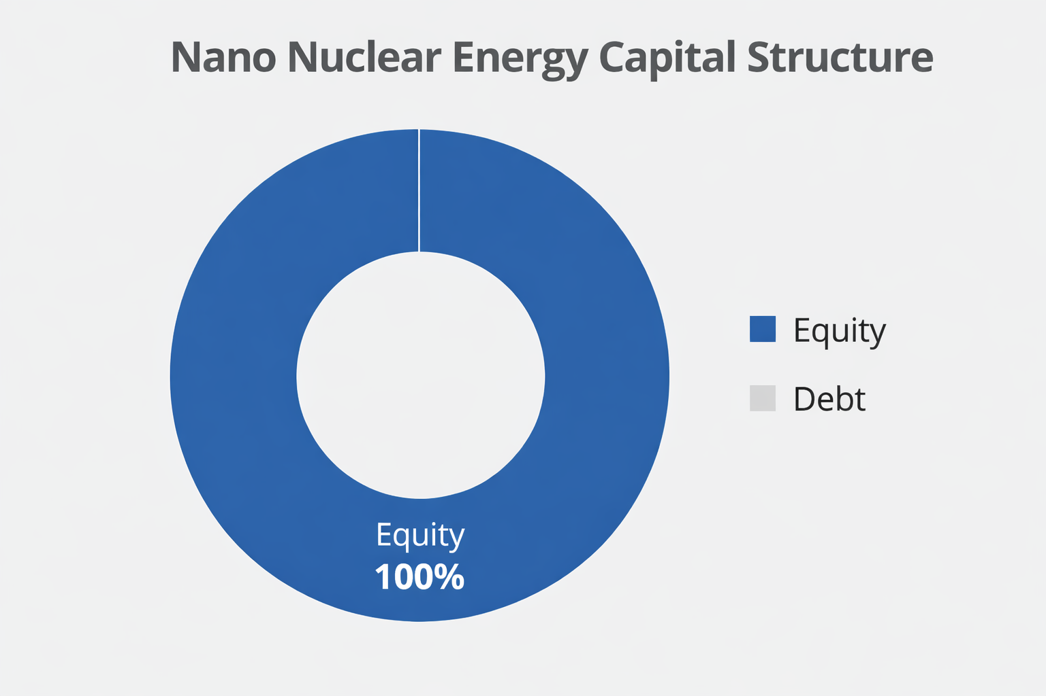
Capital Structure & Liquidity Position
Liquidity and Cash Position
$203M Cash & ST Investments $2.8M Total Interest-Bearing Debt $200.5M Net Cash Position Current Ratio ≈53.4x
Cash Burn Profile
FY25 FCF: -$(28)M ~7-year runway at current burn Runway likely declines as licensing & capex scale
Capital Structure
$212M equity raised through FY25 52.3M fully diluted shares outstanding No meaningful financial leverage

Slide 10
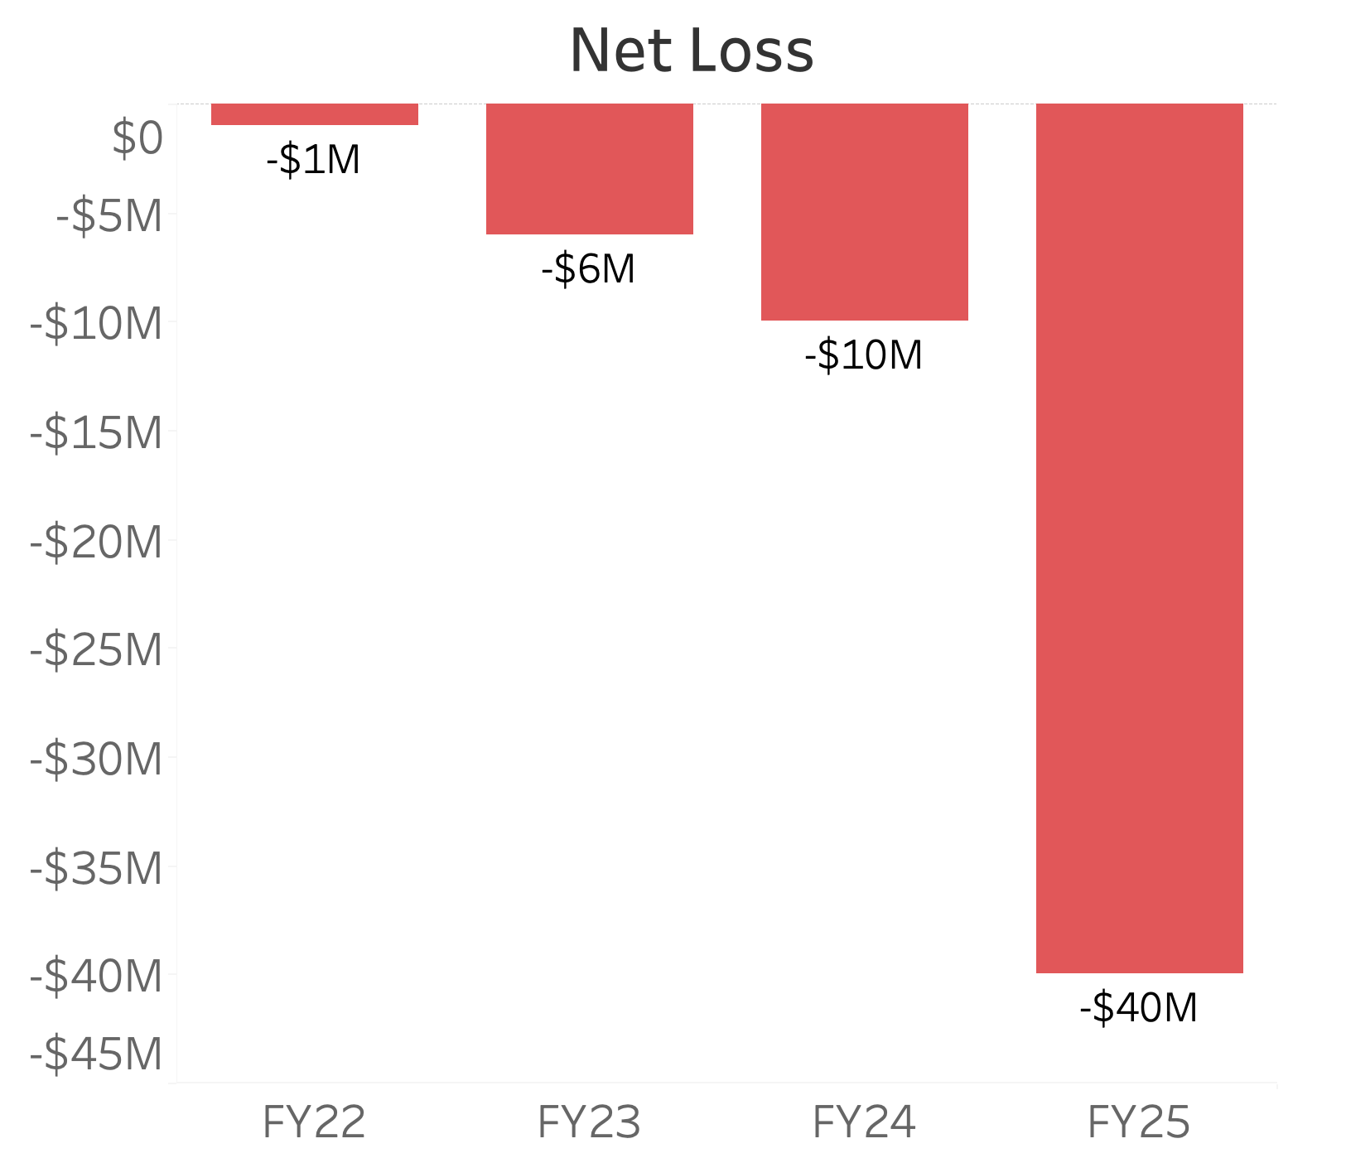
Operating Loss Acceleration & Cost Drivers
Pre-Revenue Stage • SG&A represented ~95–100% of operating losses (FY22–FY25) • SG&A increased ~4x YoY (FY24 → FY25) • Equity issuance funded operating cash burn

Slide 11
Optimistic Operating & Commercialization Assumptions for Financial Model
Revenue Growth
2033-2037 Revenue CAGR: 42% Reactor commercialization begins 2033 (2 units → 7 units by 2037)
Revenue Mix Shift
• Reactor segment scales to ~25-28% of revenue • Consulting remains core revenue driver pre-full deployment
Margins Expansion
• Gross margins expand from 39.5% → 71% - EBITDA margins exceed 60% during scale • Implies strong operating leverage
Unit Economics
- $40M revenue per 15 MWe KRONOS unit - ~$130M capex per unit (~$8.7k/kW)

Slide 12
Our Valuation Framework
Primary Method: Intrinsic DCF
Cash flows assume successful KRONOS commercialization beginning in 2033 5-year discrete forecast (2033–2037) Terminal value estimated using perpetual growth method 17.1% WACC incorporates licensing, execution, and commercialization risk.
Cross-Check: DCF Exit Multiple Method
Terminal Value cross checked using EV/EBITDA Multiple 6x EV/EBITDA Multiple will be used here
Notes:
We anchored terminal multiple to observed EV/EBITDA trading ranges of mature power generation businesses (Damodaran data), consistent with stabilized operating assets.
Why choose EV/EBITDA
Why not choose RV?

Slide 13
Intrinsic Valuation – DCF Results
Primary Method: Intrinsic DCF
Enterprise Value. 656.90M
Add: Net Cash 200.50M
= Equity Value 857.40M
Shares Outstanding (Diluted) 53.2M
Implied Share Price $16.11
Current Price (As of Feb 16, 2026) $24.79
Implied Downside
-35%
Rating:
SELL

Slide 14
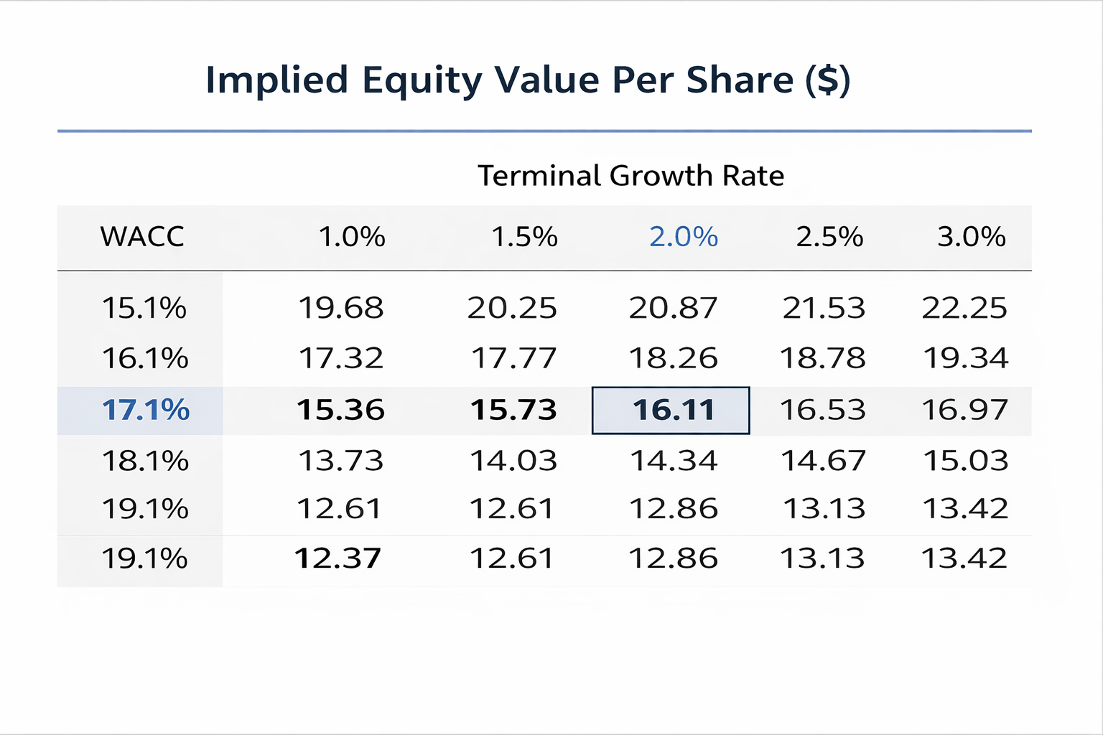
Sensitivity Analysis – Implied Share Price
• Base case ≈$16/share
• Valuation highly sensitive to WACC
• Cost of capital drives downside risk

Slide 15
Valuation Cross-Check – Exit Multiple Method
Cross Check: Exit Multiple
Enterprise Value 966.30M
Add: Net Cash 200.50M
= Equity Value 1,166.80M
Shares Outstanding (Diluted) 53.2M
Implied Share Price $21.93
Current Price (As of Feb 16, 2026) $24.79
Implied Downside
-11.54%
EV/EBITDA Multiple
6x
Conservative relative to forecast
Exit multiple cross-check supports SELL recommendation.
Notes:
Exit multiple cross-check supports SELL recommendation.

Slide 16
Investment Risks
Operational & Regulatory Risks | Financial & Capital Risks
Licensing & Cost Escalation Risks Liquidity & Execution Risks | External Funding Dependence Equity Dilution Risk
These risks may extend timelines, increase capital needs, and constrain shareholder returns.

Slide 17
ESG Factors Increase Cost of Capital and Commercialization Risk
Environmental
Social
Governance
      FOAK safety validation
      Environmental compliance burden
Community acceptance risk
Deployment complexity
No CP / OL approval
Equity reliance & ESG capital limits
Impact: Elevated Cost of Capital & Delayed Cash Flows

Slide 18
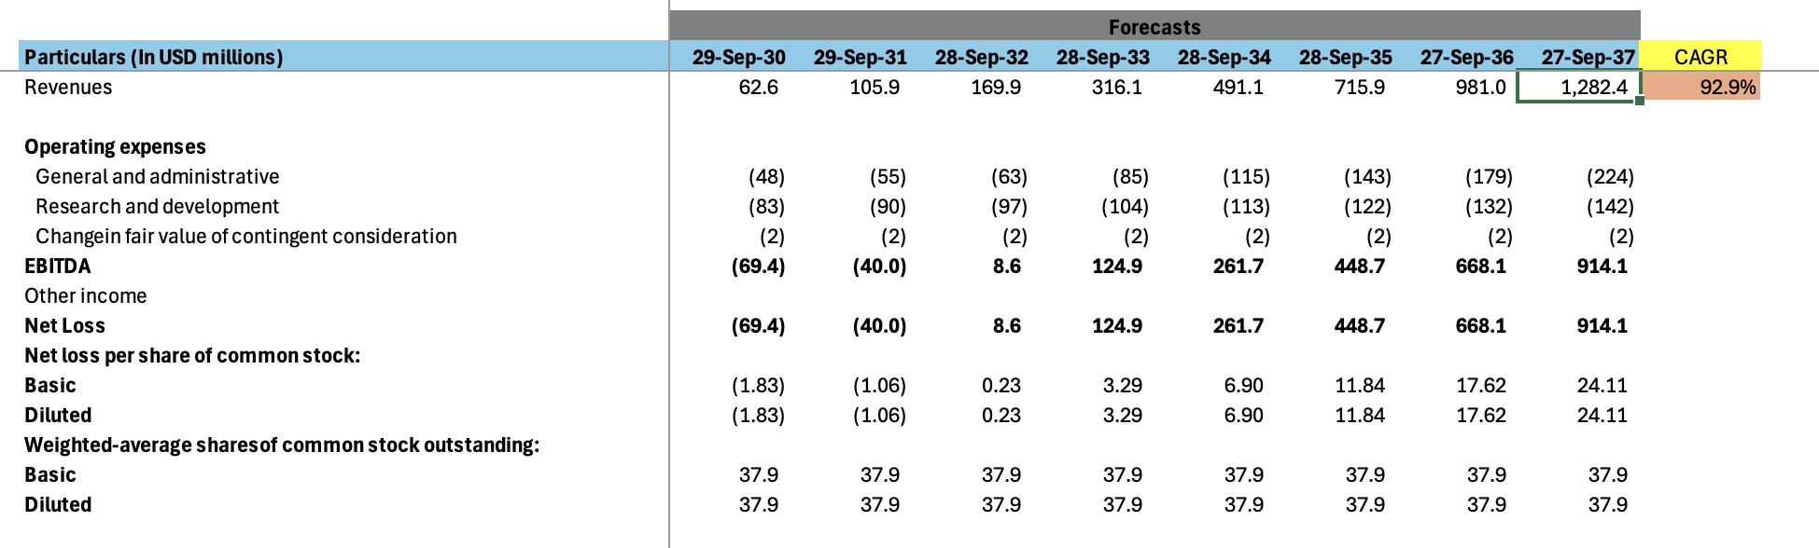
Appendix A- Forecast Income Statement (USD Millions)

Slide 19
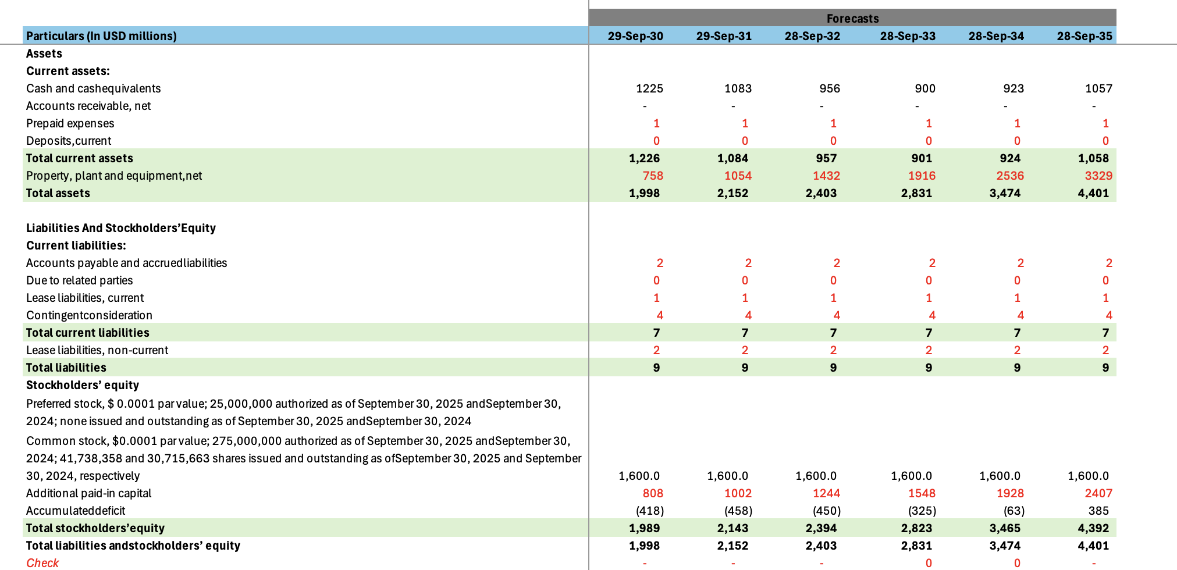
Appendix B- Forecast Balance Sheet

Slide 20
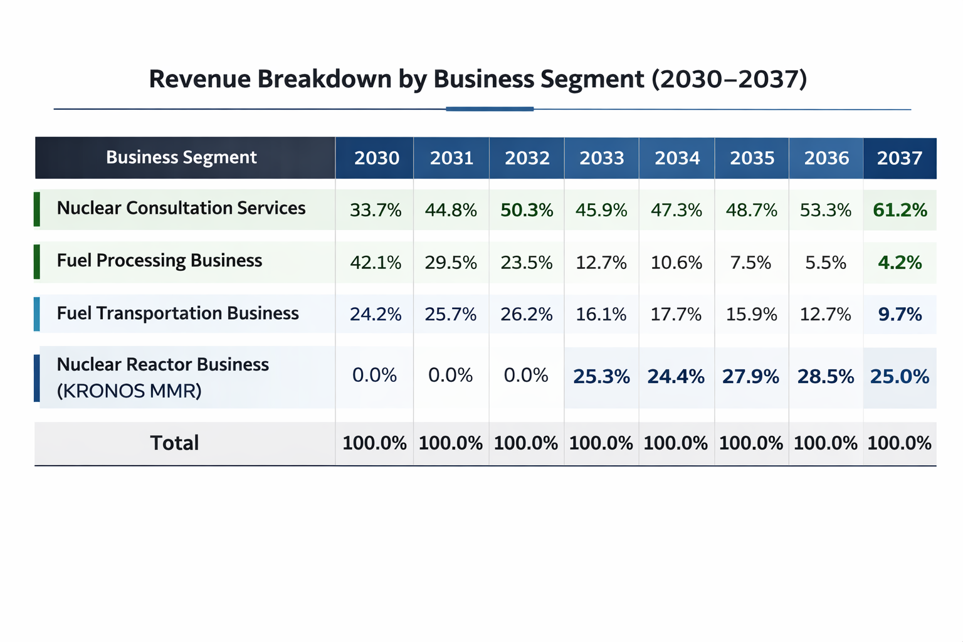
Appendix C- Revenue Breakdown by Segment

Slide 21
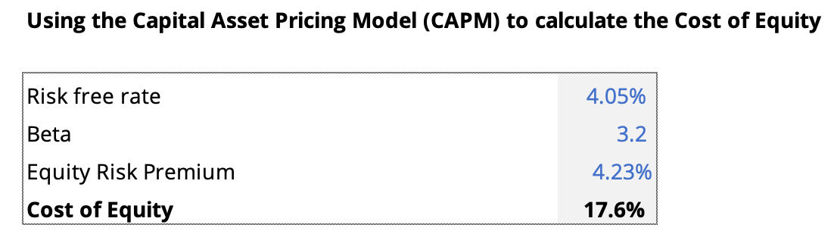
Appendix D - Cost of Equity Calculation
CAPM Formula: Re = Rf + β × ERP
We used 10-year Treasury Yield for our Risk-free rate from FactSet
Acquired Equity Risk Premium from Jan 2026 Implied ERP Damodaran

Slide 22
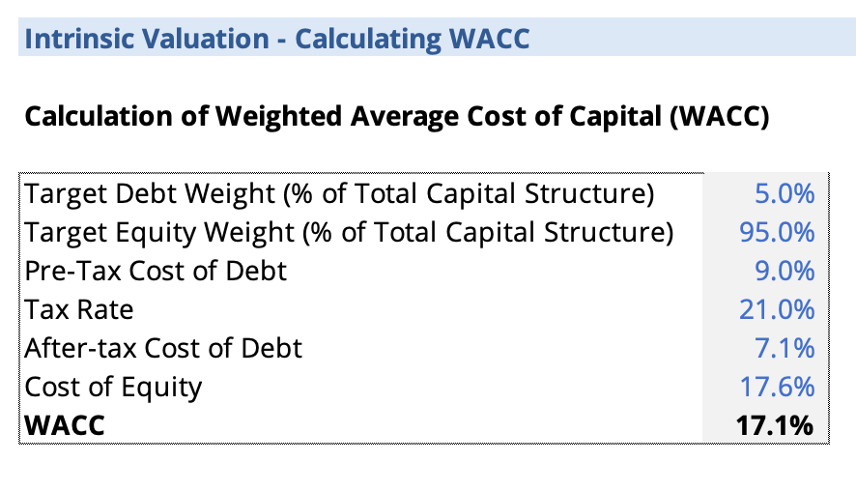
Appendix E - WACC Calculation
WACC=(After-tax Cost of Debt * Weight of Debt)+ (Cost of Equity * Weight of Equity)
Our Capital Structure is based on company’s pre-revenue status, limited near-term cash flows, heavy equity reliance (Market Cap > EV)
Federal Corporate tax rate of 21%

Slide 23
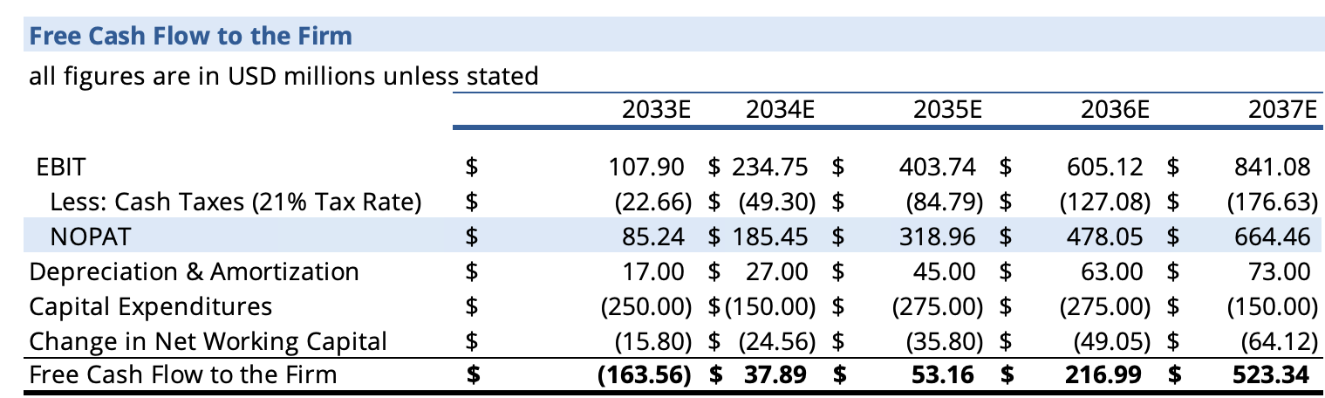
Appendix F- Free Cash Flow to the Firm (FCFF) Calculation

Slide 24
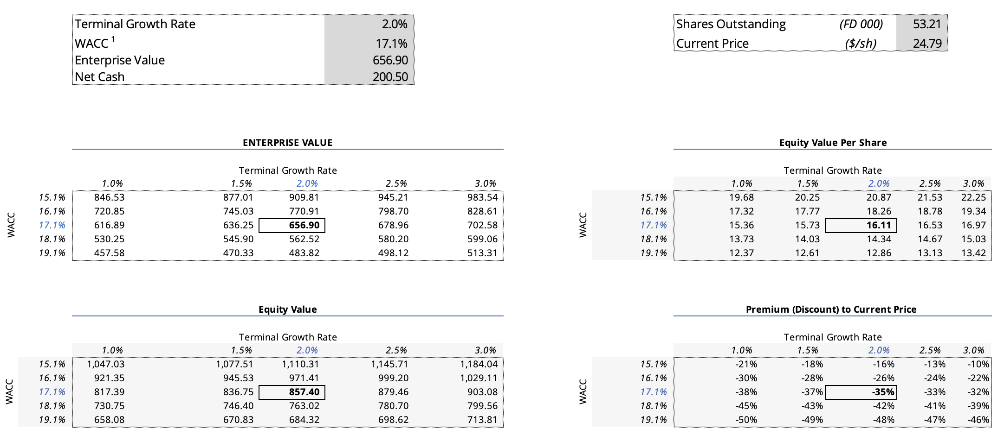
Appendix G- Perpetual Growth Sensitivity Analysis

Slide 25
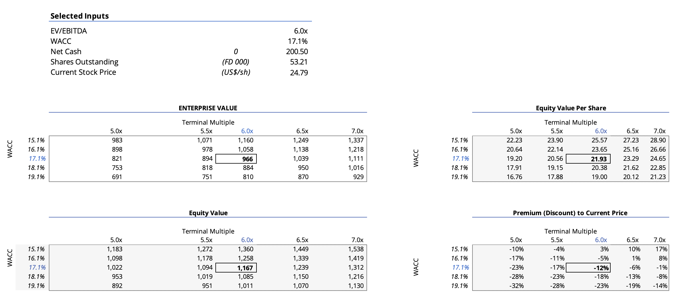
Appendix H- Exit Multiple Sensitivity Analysis

Slide 26
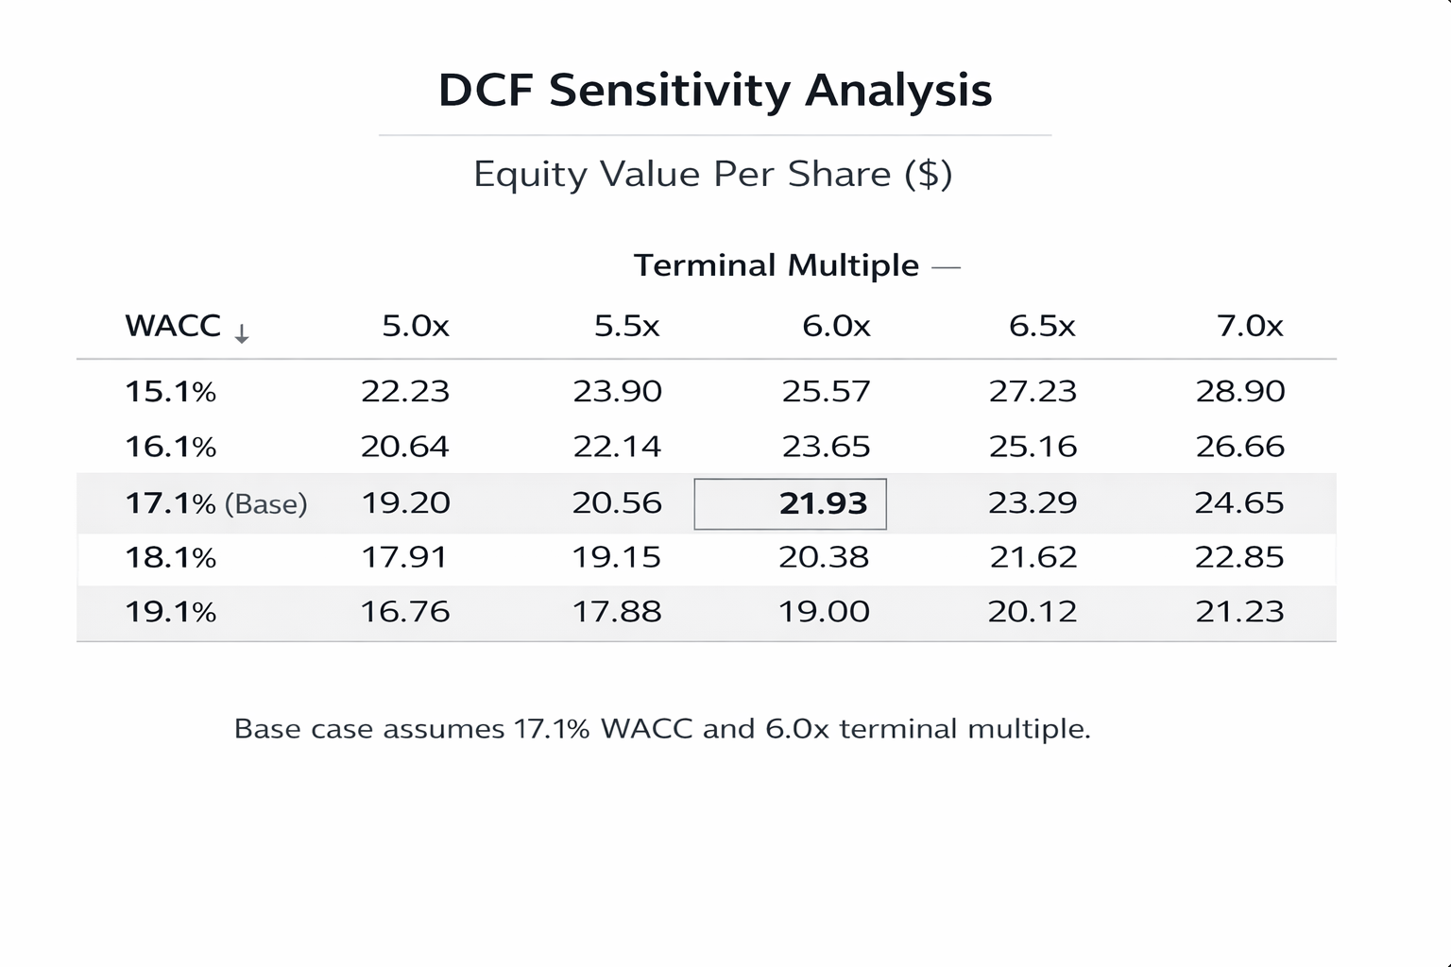
Appendix I- Exit Multiple: Implied Stock Price Sensitivity Analysis Results:

Slide 27
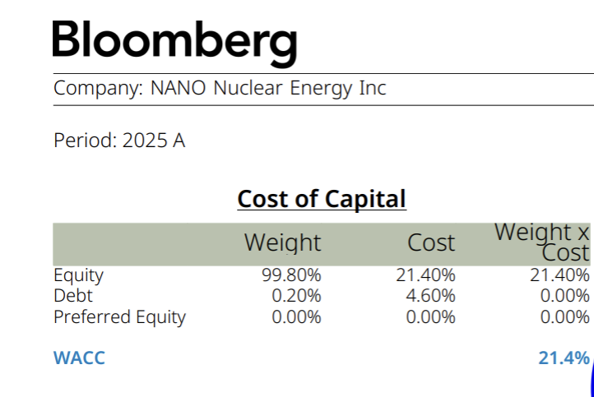
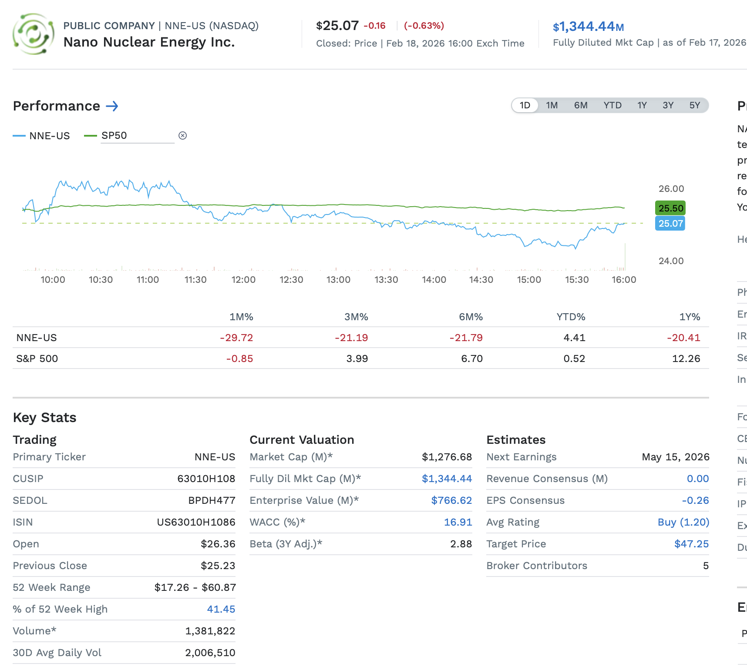
Appendix J - Bloomberg and FactSet WACC

Slide 28
Appendix K-Porter Five Forces – Advanced Microreactors
Threat of New Entrants: Low due to high regulatory and capital barriers.
Supplier Power: High given dependence on HALEU fuel and specialized nuclear components.
Buyer Power: Moderate as customers are concentrated and price-sensitive.
Threat of Substitutes: Moderate from natural gas and renewables competing on cost and speed.
Competitive Rivalry: Increasing as firms race toward regulatory approval and first deployments.
Notes:
Increasing as firms race toward regulatory approval and first deployments.

