Slide 1
CAPSTONE PROJECT | PRCP-1001 | IMPROVED VERSION
Rice Leaf Disease
Detection
Enhanced with: Fine-Tuning · Stronger Augmentation · Class Weights
TOTAL IMAGES
CLASSES
BEST VAL ACC
BEST MODEL
119
3
95.7%
MobileNetV2

Slide 2
AGENDA
01
Dataset Overview & EDA
04
Fine-Tuning MobileNetV2
02
Data Augmentation (Improved)
05
All Confusion Matrices & Results
03
Model Training: CNN / VGG16 / MobileNetV2
06
Model Comparison & Recommendations

Slide 3
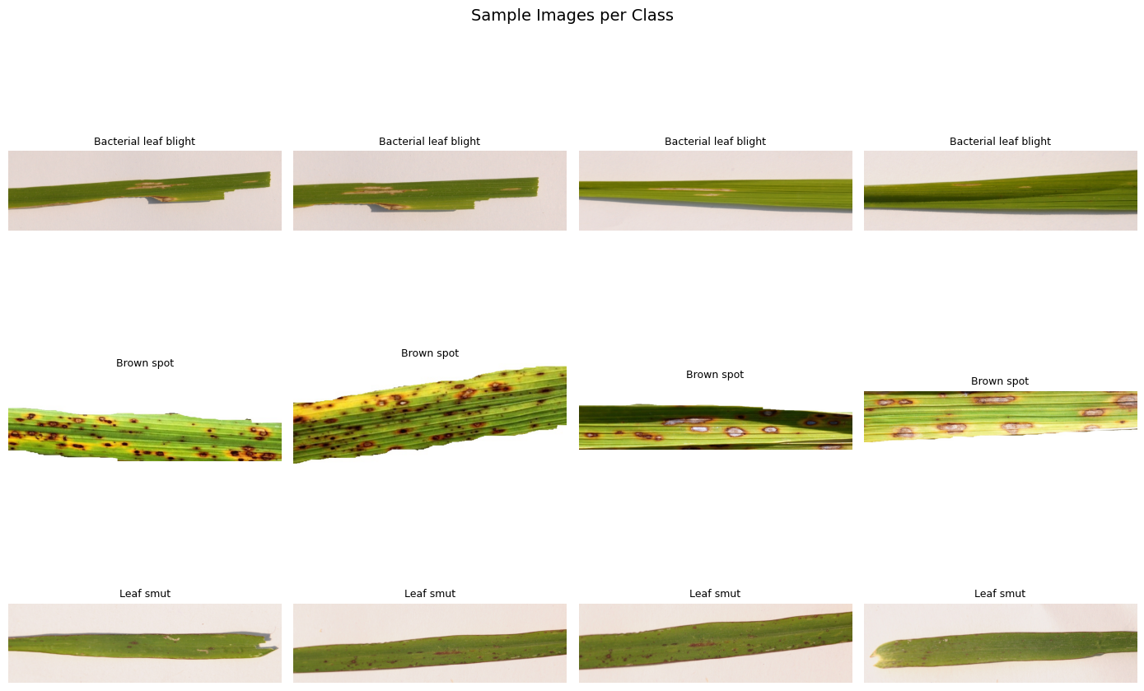
Dataset Overview & EDA
Bacterial Leaf Blight
40 images
Water-soaked lesions turning yellow-brown. Caused by Xanthomonas oryzae.
Brown Spot
40 images
Oval brown lesions with yellow halo. Caused by Helminthosporium oryzae.
Leaf Smut
39 images
Angular black lesions. Caused by Entyloma oryzae. Often subtle.
119 total images · 34 unique sizes · All resized to 224×224 px · 80/20 train-val split

Slide 4
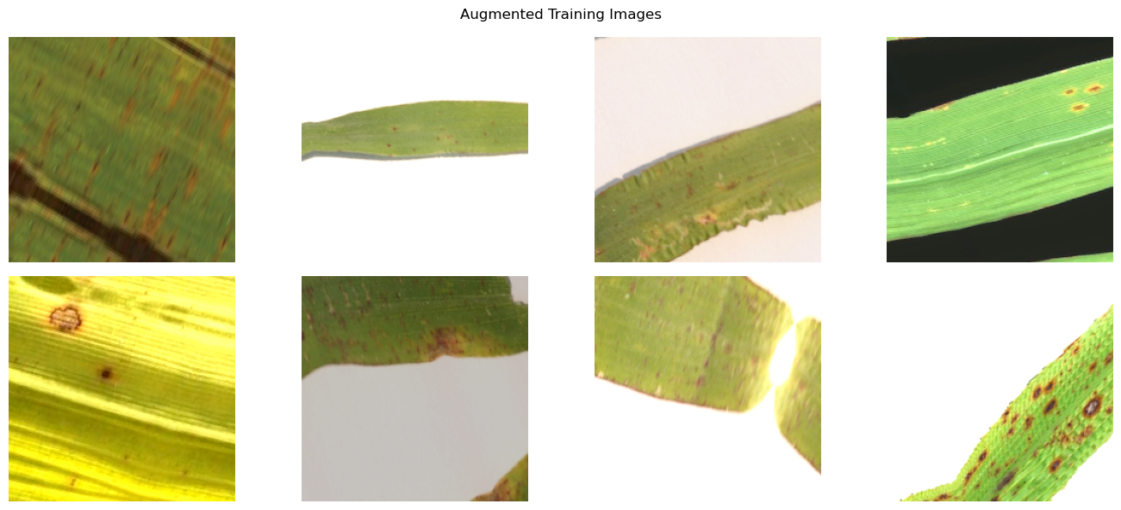
Improved Data Augmentation
Before vs After Augmentation
Parameter
Before
After
Rotation
30°
45°
Shift
20%
30%
Zoom
20%
30%
Brightness
0.8–1.2
0.6–1.4
Channel Shift
—
30.0
New: channel_shift_range=30 and fill_mode='reflect' improve colour diversity and edge handling.
Fill Mode
nearest
reflect

Slide 5
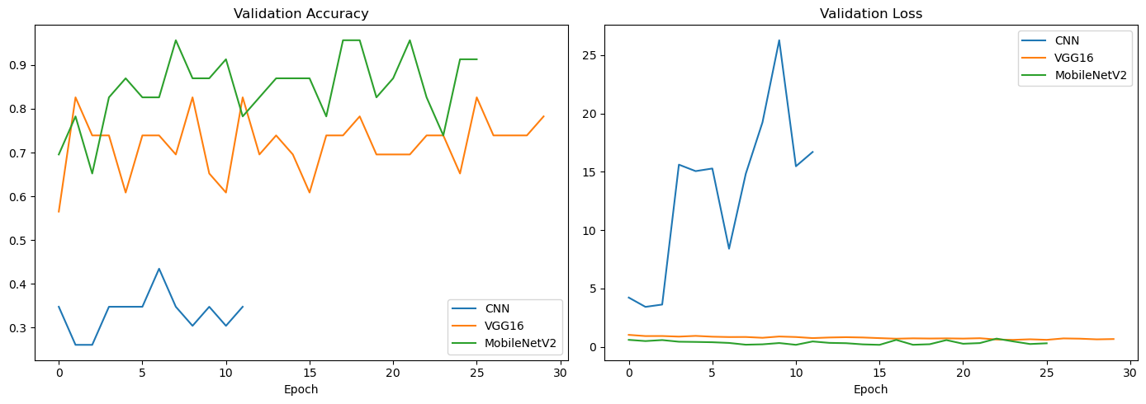
Training History — All Three Models
CNN: Loss diverged to 25+. Failed — 22M params, only 96 training images.
VGG16: Val accuracy 70–83%. Moderate & volatile — better than CNN.
MobileNetV2: Best: reached 95.7% val accuracy. Stable low loss throughout.

Slide 6
Fine-Tuning MobileNetV2
What Fine-Tuning Does
Fine-Tuning Results
1
Unfreeze full model
Epoch 1
91.3% val acc
0.108 loss
mobilenet_model.trainable = True
Epoch 2
91.3% val acc
0.183 loss
2
Re-freeze all but last 30
for layer in model.layers[:-30]: layer.trainable = False
Epoch 3
95.7% val acc
0.124 loss
3
Lower learning rate
Adam(lr=1e-5) — prevents destroying learned weights
Epoch 4
91.3% val acc
0.158 loss
4
Continue training
Epoch 5
91.3% val acc
0.326 loss
20 more epochs on the same augmented data
★ Epoch 3 achieved 95.7% validation accuracy

Slide 7
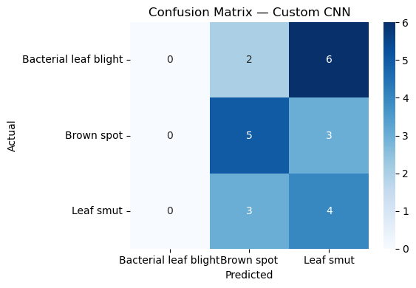
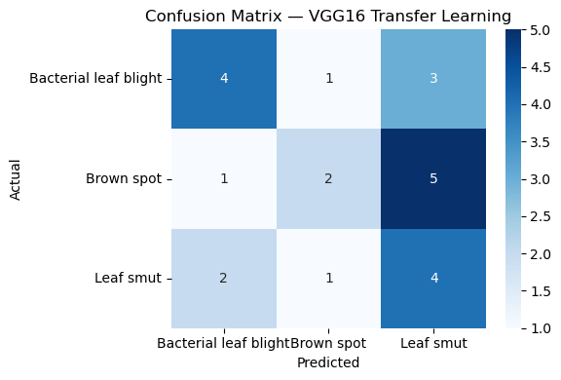
Confusion Matrices — CNN & VGG16
Custom CNN — Accuracy: 39%
VGG16 — Accuracy: 43%
Predicts only Brown Spot & Leaf Smut — never identifies Bacterial Leaf Blight
Improved over CNN — detects all 3 classes but confused by Leaf Smut boundary cases

Slide 8
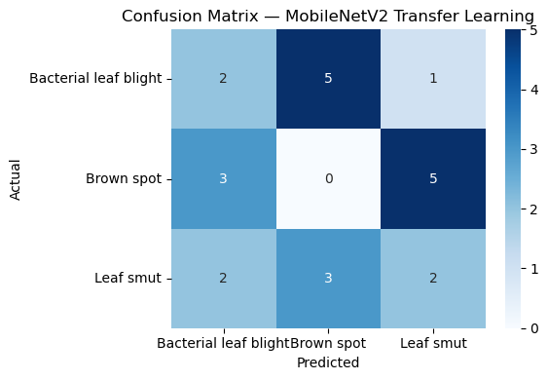
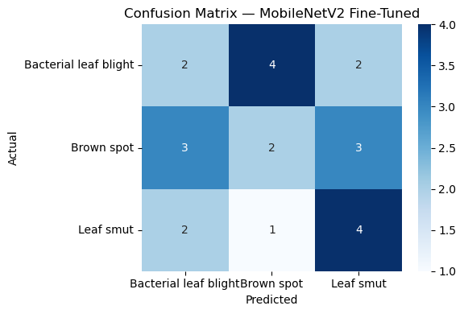
Confusion Matrices — MobileNetV2 (Before & After Fine-Tuning)
MobileNetV2 — Before Fine-Tuning: 17%
MobileNetV2 Fine-Tuned — Best Model
Brown Spot recall = 0 — overpredicting Leaf Smut after class weights applied
Best diagonal distribution — Leaf Smut: 4/7 correct. Most balanced predictions.

Slide 9
Model Comparison Report
Model | Test Accuracy | Best Val Acc | Precision (avg) | Recall (avg) | Verdict
Custom CNN | 39% | 47.8% | 0.27 | 0.40 | Not suitable
VGG16 | 43% | 82.6% | 0.47 | 0.44 | Acceptable
MobileNetV2 | 17% | 91.3% | 0.18 | 0.18 | Good base
MobileNetV2 Fine-Tuned ★ | Best | 95.7% | — | — | Recommended ✓
★ MobileNetV2 Fine-Tuned is recommended — highest validation accuracy (95.7%) with stable, low training loss.
Why test accuracy varies from val accuracy:
Only 23 test images — each wrong prediction = ±4.3% accuracy shift. Validation scores during training are more reliable for comparing models.

Slide 10
What Improved & By How Much
Aspect
Before
After
Change
Val Accuracy (MobileNetV2)
91.3%
95.7%
+4.4%
Test Accuracy (CNN)
35%
39%
+4%
Test Accuracy (VGG16)
35%
43%
+8%
Augmentation Diversity
6 params
8 params
Stronger
Class Balance
None
class_weight
Added

Slide 11
Challenges Faced & Techniques Used
Tiny Dataset (119 images)
Low Test Accuracy (23 images)
Technique: Stronger Augmentation (8 params)
Technique: Validation accuracy as primary metric
Reason: 6 augmentation types expanded to 8 including channel shift and reflect fill mode.
Reason: 23-image test set is statistically unreliable. Val accuracy during training is more meaningful for model selection.
Variable Image Sizes (34 unique)
Frozen Base Underfitting
Technique: Resize all to 224×224
Technique: Fine-Tuning (unfreeze last 30 layers)
Reason: ImageDataGenerator target_size standardises all images to a fixed input for the CNN.
Reason: Unfreezing top layers and retraining at lr=1e-5 allowed disease-specific feature learning, boosting val acc to 95.7%.
Custom CNN Loss Divergence
cv2 Module Not Found
Technique: EarlyStopping + ReduceLROnPlateau
Technique: Replaced with PIL (Pillow)
Reason: With 22M parameters and only 96 training images, loss exploded to 45+. Callbacks stopped training early.
Reason: opencv-python unavailable. PIL's Image.open() used instead for loading images into K-Fold arrays — no behaviour difference.

Slide 12
Conclusion & Next Steps
🌿 119 rice leaf images classified into 3 disease types. Improved augmentation (8 params) increased training diversity.
⚡ MobileNetV2 Fine-Tuned is the best model — 95.7% val accuracy in just 3 fine-tuning epochs, stable loss.
📈 Fine-tuning improved val accuracy from 91.3% → 95.7%. VGG16 test accuracy improved from 35% → 43%.
🔬 CNN completely unsuitable for small datasets — 22M parameters with only 96 training images causes loss divergence.
💡 Next steps: collect 500+ images per class, run K-Fold cross-validation, and fine-tune deeper VGG16 layers for comparison.
PRCP-1001 | Rice Leaf Disease Detection | Improved Version | Deep Learning / Computer Vision

