Slide 1
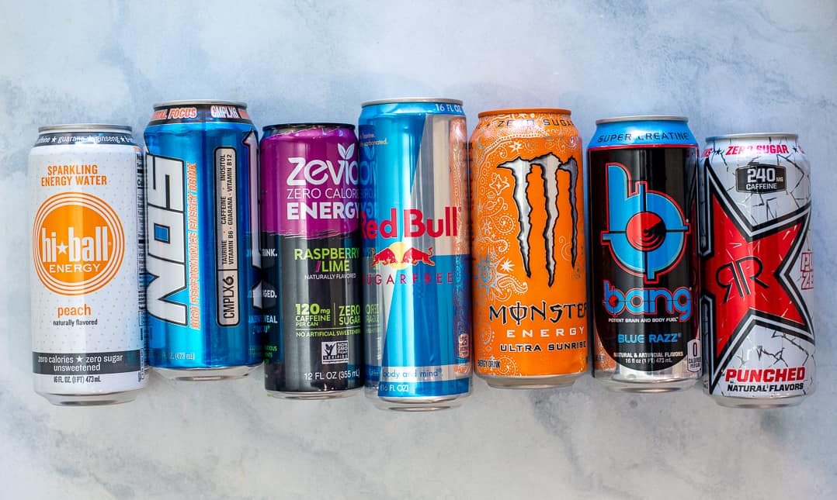
ENERGY DRINKS
Name : Melwin Shajan
Roll No : 021330224024

Slide 2
Introduction
Energy drinks have carved out a significant niche in today’s fast-paced world, offering a convenient and effective way to boost energy and sharpen focus. Designed to enhance alertness and performance, these beverages are often fortified with caffeine, vitamins, and other energy-boosting ingredients. They appeal to a diverse range of consumers, from busy professionals seeking an extra edge during demanding work hours to students looking for a quick pick-me-up during late-night study sessions.
The appeal of energy drinks lies in their ability to deliver a swift burst of vitality, thanks to their carefully formulated blend of stimulants and nutrients. As more people turn to these drinks to help manage their busy lives, they continue to evolve and innovate, catering to the growing demand for effective and enjoyable energy solutions.

Slide 3
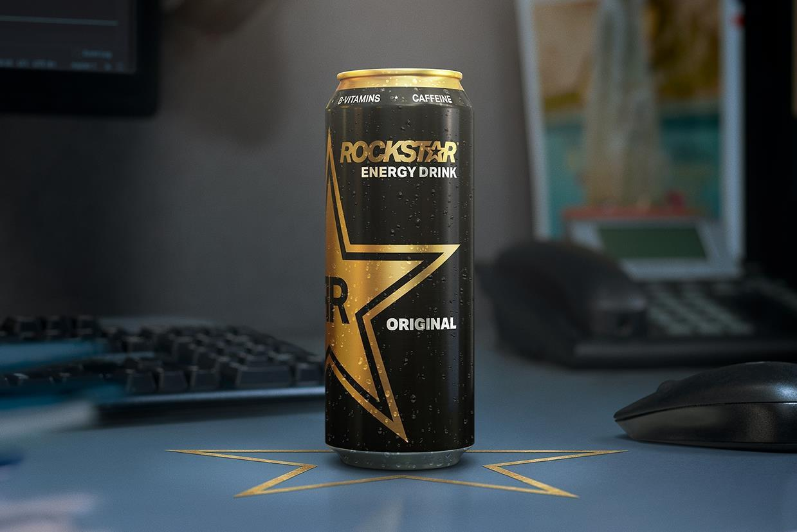
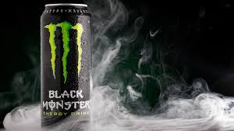
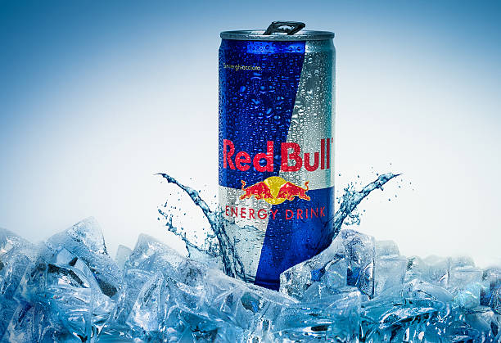
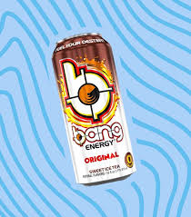
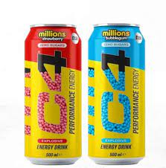
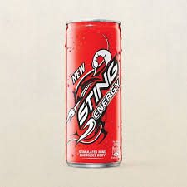
BRAND OFFERING THE PRODUCT

Slide 4
RAW MATERIALS REQUIRED TO MANUFACTURE
Caffeine
Sugars
Artificial Sweeteners
Taurine
B Vitamins (B2, B3, B6, B12)
Carbonated Water
Flavors
Colors
Preservatives
Acid
Stabilizers and Emulsifiers

Slide 5
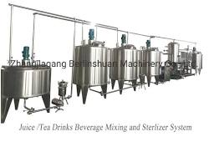
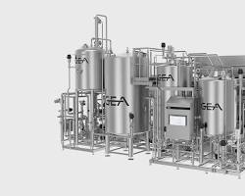
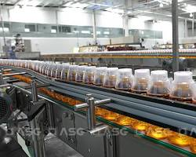

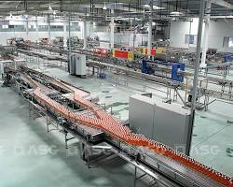
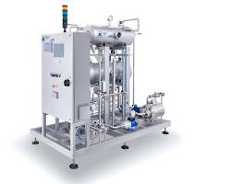
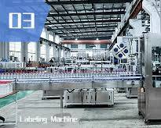
Tools and Equipment for Manufacturing
Mixing tanks
Pasteurizer
Filling machine
Sealing machine
Packaging machine
Carbonation
Labelling machine

Slide 6
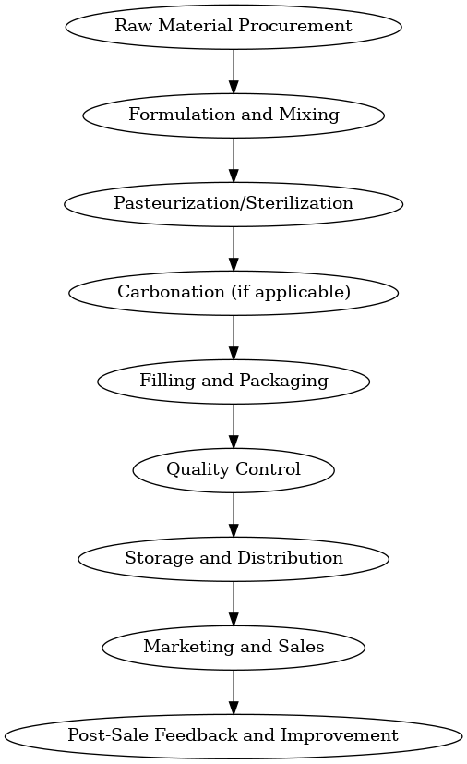
Transformation Process

Slide 7
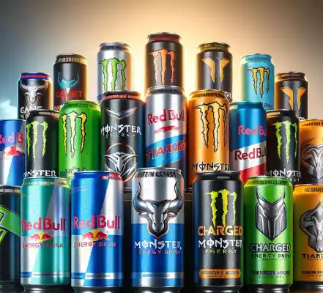
Finished Product
The finished product is a ready-to-drink energy beverage that is packaged in bottles or cans. The product is designed to provide a quick and temporary boost of energy, alertness, and focus.

Slide 8
Packaging Aspect, Material Handling, Transportation, Warehousing and Inventory Management
Packaging: Energy drinks are typically packaged in aluminium cans or plastic bottles to provide a lightweight, durable, and recyclable container.
Material Handling: The energy drink products are handled with care during the manufacturing process, transportation, and warehouse storage to prevent any damage or contamination.
Transportation: Energy drinks are transported by various modes, including trucks, trains, and ships, depending on the distribution network and the target markets.
Warehousing: Energy drinks require temperature-controlled storage facilities to maintain the quality and freshness of the products, especially during prolonged storage.
Inventory Management: Energy drink manufacturers and distributors employ advanced inventory management systems to track the production, distribution, and sales of their products, ensuring efficient supply chain management and timely replenishment.

Slide 9
Conclusion
Energy drinks are beverages designed to provide a quick boost of energy and mental alertness. Containing high levels of caffeine, sugar, and other stimulants like taurine and guarana, they aim to enhance physical performance and cognitive functions. The market has seen substantial growth due to busy lifestyles and the demand for high-energy activities, with major brands like Red Bull and Monster leading the industry through innovative flavours and marketing strategies. These drinks are particularly popular among young adults and athletes, often associated with extreme sports and high-adrenaline events. However, despite their widespread appeal, energy drinks face scrutiny over health concerns related to excessive caffeine consumption and potential cardiovascular risks. This balance of high demand and health debates makes the energy drink market a dynamic and evolving sector.

Slide 10
THANK YOU

