Slide 1
Cyclic Redundancy Check

Slide 2
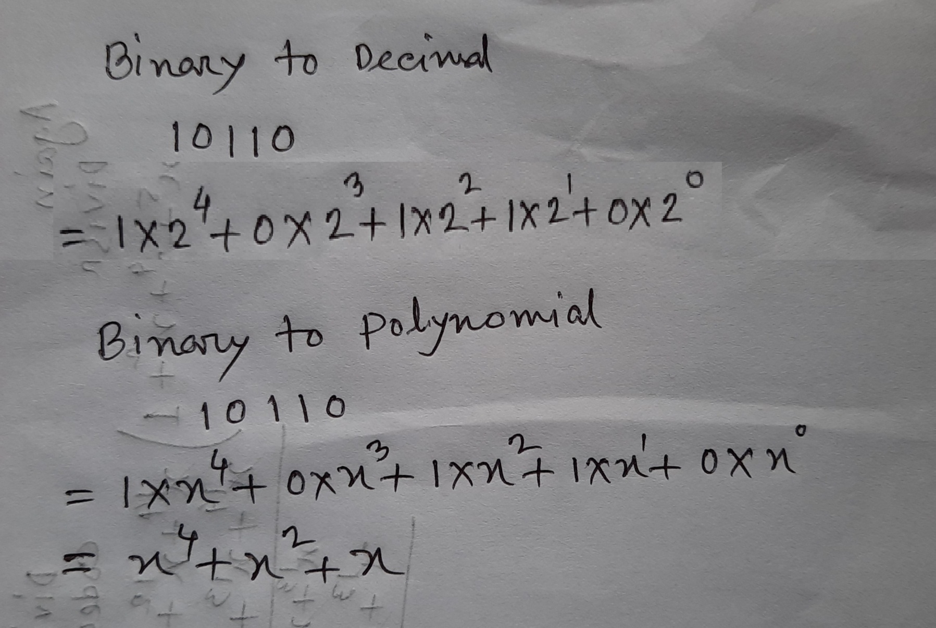
Binary to Polynomial

Slide 3
The Cyclic Redundancy Check (CRC)
Chapter 10: Error Detection Coding
Cyclic Redundancy Check
The major goal in designing error detection algorithms is to maximize the probability of detecting errors using only a small number of redundant bits. Cyclic redundancy checks use some mathematics to achieve this goal.
For example, an 8-bit message consisting of the bits 10011010 corresponds to the polynomial,
M(x) = 1×x⁷ +0×x⁶ + 0×x⁵ +1×x⁴ + 1×x³ + 0×x² +1×x¹ + 0×x⁰
= x⁷ +x⁴ + x³ +x

Slide 4
For the purposes of calculating a CRC, a sender and receiver have to agree on a divisor or generator polynomial, G(x). G(x) is a polynomial of degree k. For example, G(x) = x³ + x² + 1. In this case, k = 3.
x⁸ +x² +x + 1
x¹⁰ + x⁹ + x⁵ +x⁴ +x+1
x¹² + x¹¹ +x³ +x² +1
x¹⁶ + x¹⁵ +x² +1
x¹⁶ + x¹² +x⁵ +1
x³² + x²⁶ +x²³ + x²² +x¹⁶ +x¹² + x¹¹+ x¹⁰ +x⁸ +x⁷ +x⁵ +x⁴ +x² + x + 1
Common CRC polynomials CRC C(x)
CRC-8 CRC-10 CRC-12 CRC-16
CRC-CCITT CRC-32

Slide 5
Steps of determining transmitted polynomial
We wanted to create a polynomial T(x) for transmission that is derived from the original message M(x), is k bits longer than M(x), and is exactly divisible by G(x).
We can do this in the following way:
Multiply M(x) by x^{k}, that is, add k zeros at the end of the message. Call this zero-extended message x^{k} M(x).
Divide x^{k} M(x) by G(x) and find the remainder R(x).
Subtract the remainder from x^{k} M(x) to get T(x).
It should be obvious that what is left at this point is a message that is exactly divisible by G(x).

Slide 6
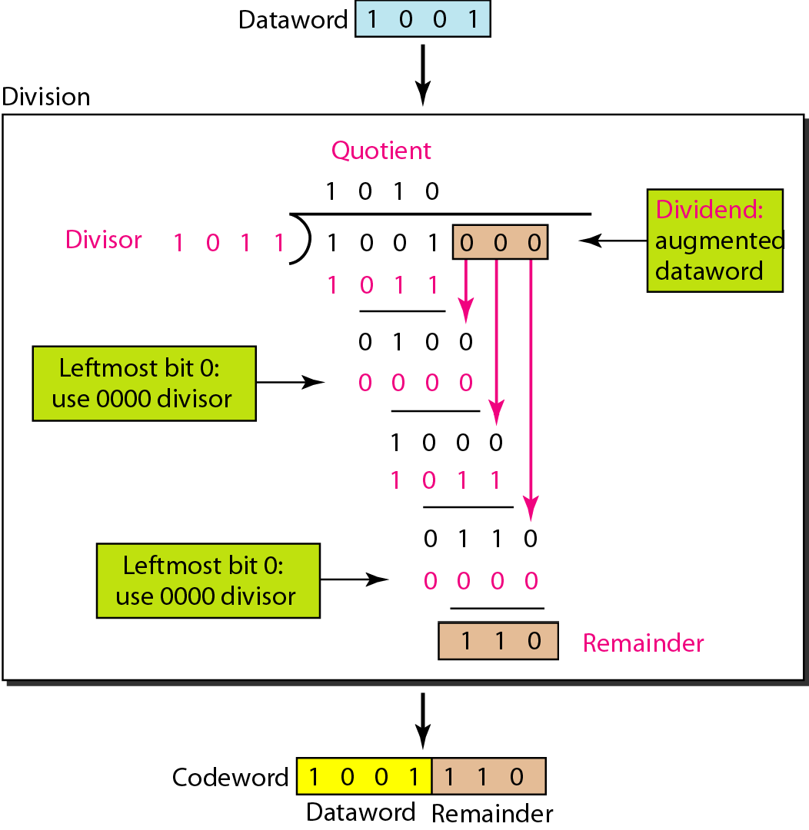
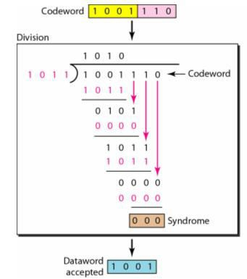
Example-1: If the message bit 1001 is transmitted from the sender and the generator/divisor bit is 1011, then what is the CRC code added with the end of the data? Will the receiver accept the data or not? Explain. In binary division, the subtraction operation is essentially a bitwise XOR operation.

Slide 7
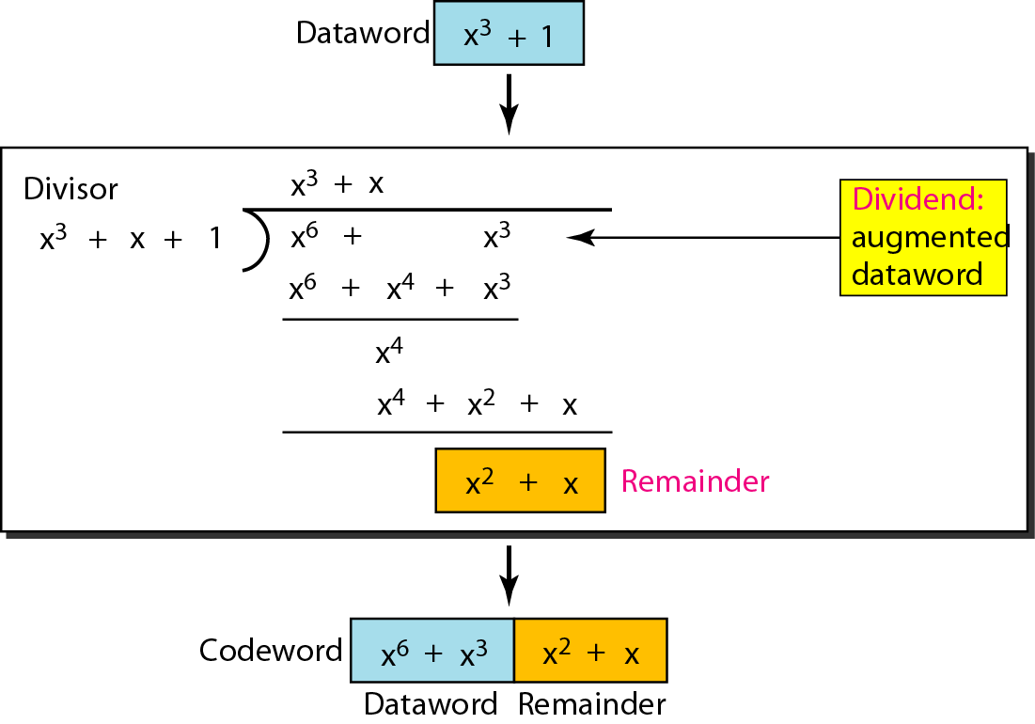
Example-1 (Using polynomial)

Slide 8
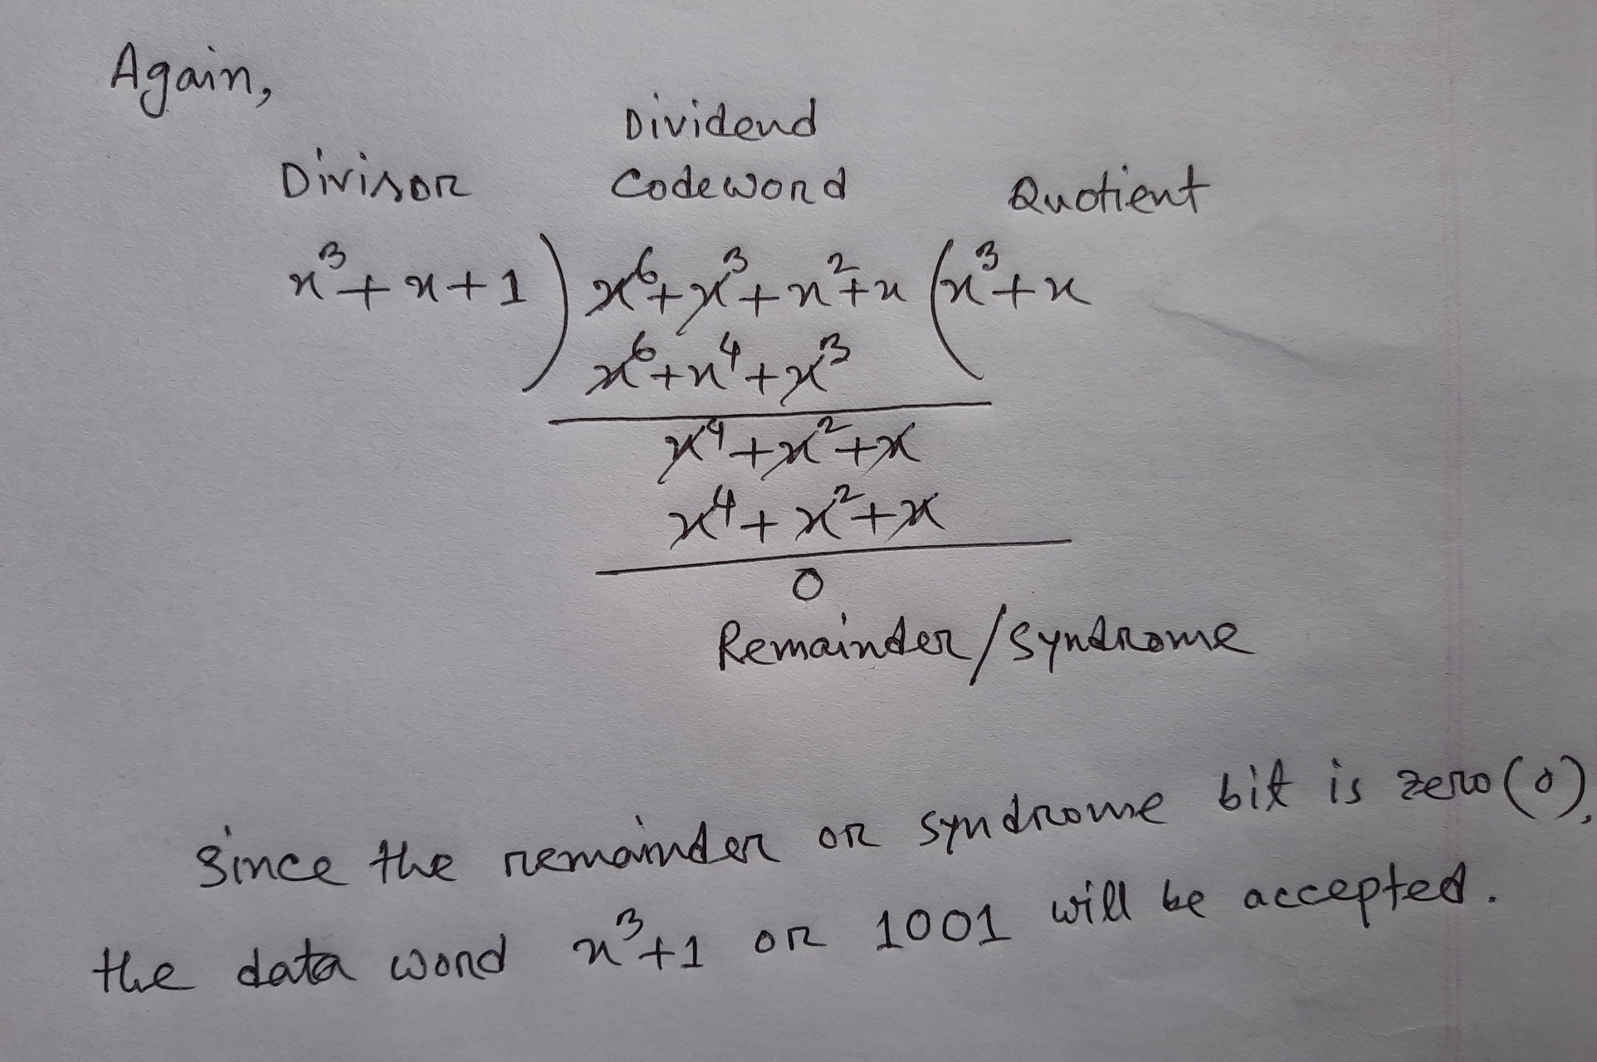
Example-1: (Using polynomial) Continued

Slide 9
Example-2:
Given, Message bit string | M = 1 0 1 0 0 0 1 1 0 1 | (10 bits)
Generator bit string | G = 1 1 0 1 0 1 | (6 bits)
Determine R(x) and T(x).
Given, Message bit string,
M = 1 0 1 0 0 0 1 1 0 1 (10 bits)
Generator bit string, G = 1 1 0 1 0 1 (6 bits)
Determine R(x) and T(x).
∴ M (x) = x⁹ + x⁷ + x³ + x ² + x⁰
Degree of G(x), r = 5.
G(x) = x⁵ + x ⁴ + x ² + x⁰
Message after appending 5 zeros becomes,
1 0 1 0 0 0 1 1 0 1 0 0 0 0 0
The corresponding polynomial,
x⁵ M (x) = x¹⁴ + x¹² + x⁸ + x ⁷ + x⁵

Slide 10
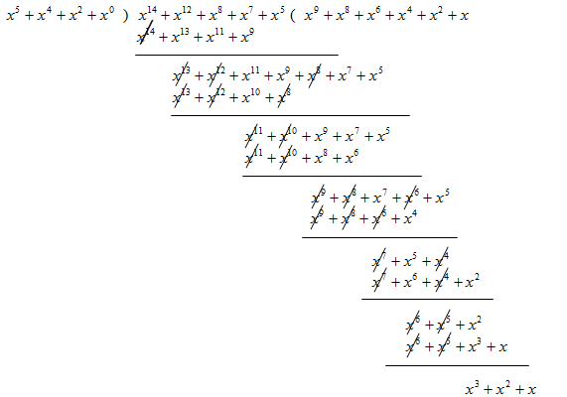
∴ R(x) = x³+ x ²+ x
∴T (x) = x ⁵ M (x) − R(x)
_{= x}14 _{+ x}12
+ x⁸ + x ⁷ + x⁵ + x ³ + x ² + x

Slide 11
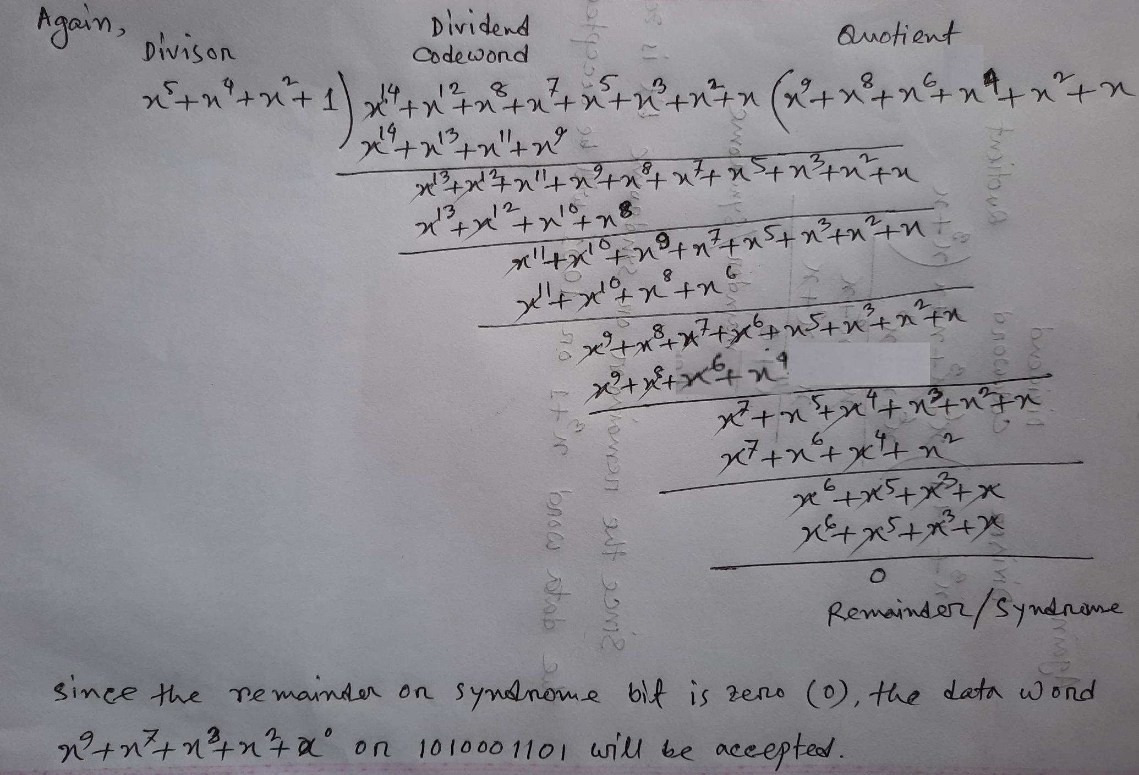
Example-2: Continued

Slide 12
Message string after appending 5 zeros, 1 0 1 0 0 0 1 1 0 1 0 0 0 0 0
1 1 0 1 0 1 ) 1 0 1 0 0 0 1 1 0 1 0 0 0 0 0 ( 1 1 0 1 0 1 0 1 1 0
1 1 0 1 0 1
1 1 1 0 1 1
1 1 0 1 0 1
1 0 1 0 0 0 1 1 0 1 0 0 0 0 0
+ 0 1 1 1 0
T = 1 0 1 0 0 0 1 1 0 1 0 1 1 1 0
1 1 1 0 1 0
1 1 0 1 0 1
1 1 1 1 1 0
1 1 0 1 0 1
1 0 1 1 0 0
1 1 0 1 0 1
1 1 0 0 1 0
1 1 0 1 0 1
0 1 1 1 0 (R)

Slide 13
Transmitted bit sequences and polynomial
T = 1 0 1 0 0 0 1 1 0 1 0 1 1 1 0
T (x) = x¹⁴ + x¹² + x⁸ + x⁷+ x⁵ + x³ + x² + x
G(x) = x⁵+ x ⁴+ x ²+ x⁰
^{T (x)} = Q(x) = x⁹ + x⁸ + x⁶ + x⁴ + x² + x
G(x)
The received polynomial
R(x) = T (x) + E(x)

Slide 14
Exercise/Home Task
Ex-1: Given the dataword 1010011110 and the divisor 10111,
a. Show the generation of the codeword at the sender site (using binary division).
h. Show the checking of the codeword at the receiver site (assume no error).
Ex-2: Given the dataword 1010011110 and the code generator 10111,
a. Show the generation of the codeword at the sender site (using polynomial division).
h. Show the checking of the codeword at the receiver site (assume no error).
Ex-3: Given the dataword 10110110 and the divisor/code generator 1101,
a. Show the generation of the codeword at the sender site (using polynomial division).
h. Show the checking of the codeword at the receiver site (assume no error).

