Slide 1

Red Hat Linux Admin I Linux For Security
Mohamed Gamal
SR. System Engineer
Redhat Certified Engineer

Slide 2
Course Overview
Get started with RedHat Enterprise Linux
Access the command line
Manage files from the command line
Get help in Red Hat Enterprise Linux
Create, view, and edit text files
Manage local users and groups
Control access to files
Monitor and manage Linux processes

Slide 3
Course Overview cont.
Control services and daemons
Configure and secure SSH
Analyze and store logs
Manage networking
Archive and transfer files
Install and update software
Access Linux files systems
Analyze servers and get support
Comprehensive review

Slide 4
Getting Started with RHEL
History
Why Linux
What Makes Linux Great
Linux Distributions

Slide 5
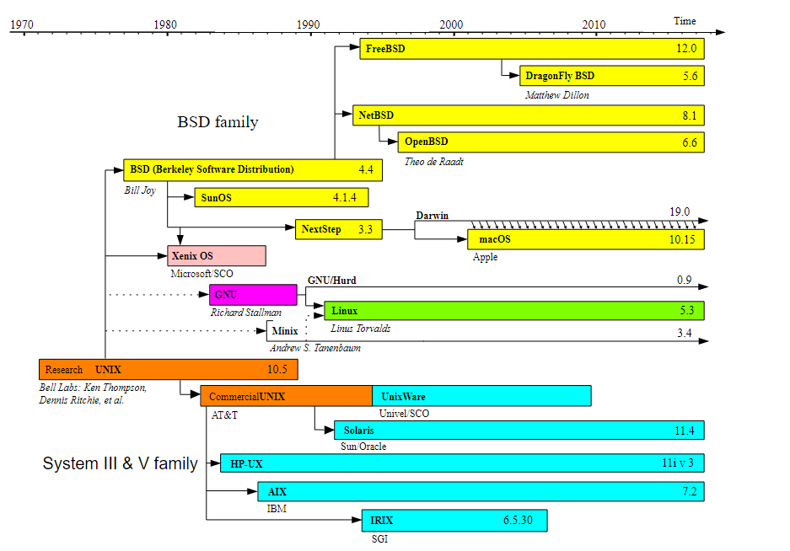
History

Slide 6
Why Linux
Open source software
Linux provides easy access via CLI
Easily replace or remove components

Slide 7
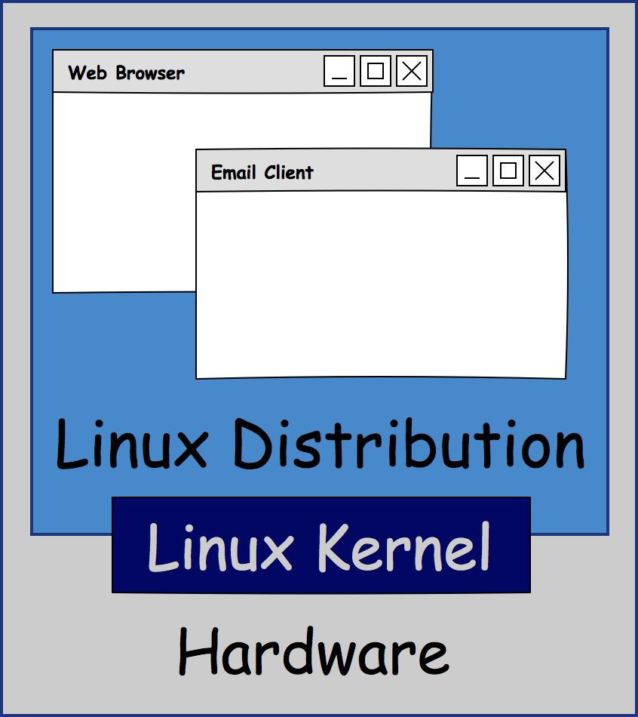
Linux Kernel
The kernel is the core of the OS
Linux Kernel + Apps = Distro
LinuxTrainingAcademy.com

Slide 8
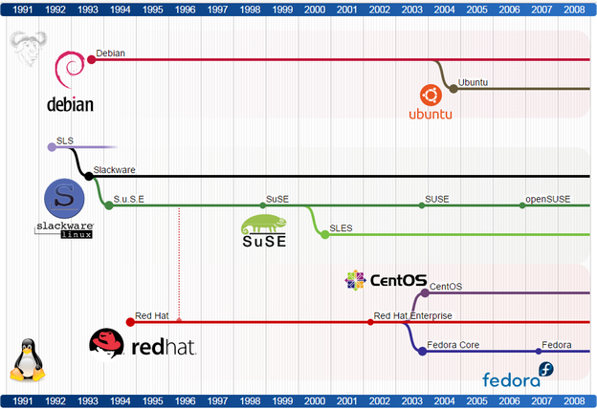
Linux Distribution
Debian:
Ubuntu
Slackware:
OpenSUSE
redhat:
RHEL
Fedora
Centos

Slide 9



Slide 10
Summary
From Unix to Linux
Linux Distro = Linux Kernel + Software
CentOS = RHEL - branding/logos

Slide 11
Environment Setup
Basic Virtualization concepts
Installing VMware WorkStation on Windows
Install CentOS on VM.

Slide 12
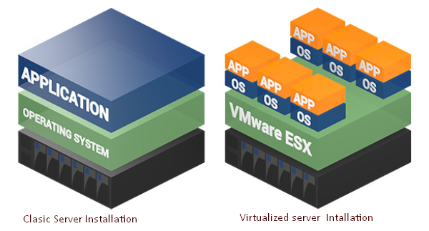
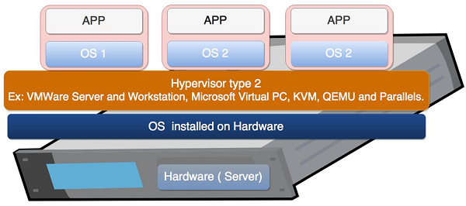
Virtualization Concept

Slide 13
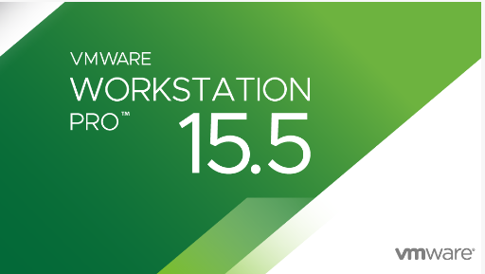
Installing VMware Workstation
Download it from here

Slide 14
Installing CentOS on VM
Download CentOS 7 Image from Official website
http://mirror.veridyen.com/centos/7.9.2009/isos/x86_64/
Install CentOS 7 via Interactive Method

Slide 15
Access the Command Line
The Shell
CLI vs a GUI
Basic Linux commands
Editing the CLI

Slide 16
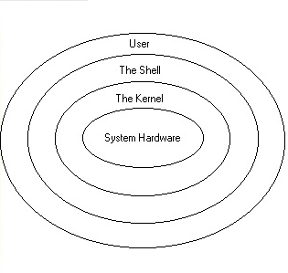
The Shell (BASH)
Terminal = tty = pts = text IO environment display
Console = physical terminal
Shell = command line interpreter
Commands entered at the shell prompt
The $ char is replaced by a # char
if the shell is running as the superuser.

Slide 17
CLI vs a GUI
The command line is more powerful.
There will always be a command line.
Server distributions do not include GUIs.
Desktop distributions have GUIs and CLIs.

Slide 18
Basic Linux Commands
date- display date and time
----------Viewing Files----------------
cat - Concatenates and displays files.
head - ?
tail - ?
---------------------------------------
passwd - changes a user's own password.
Tab completion
history

Slide 19
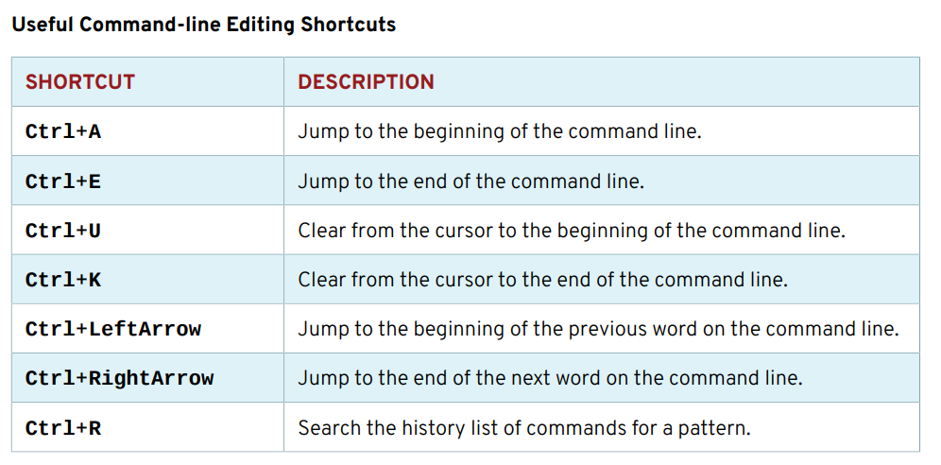
Editing the CLI

Slide 21
Manage files from the command line
Describing Linux file system Hierarchy
Specifying files by name
Managing files using CLI tools
Making Links
Matching File names with shell Expansions

Slide 22
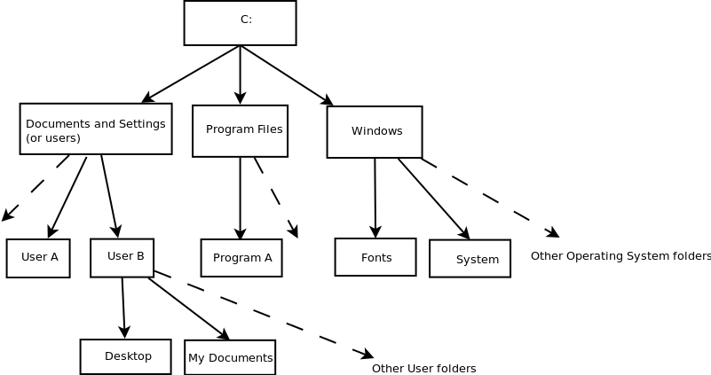
Windows File System Tree

Slide 23
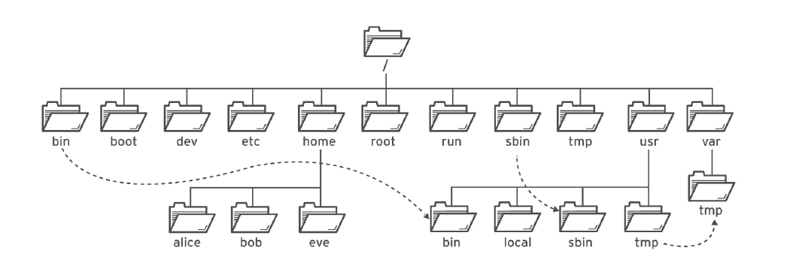
Linux File System Tree

Slide 24
Difference between ‘/’ and ‘/root’
‘/’ is called as a root.
It’s Root directory.
Root of the all file systems of Linux.
Every directory is “under” root ultimately.
/root
Root is the user with super powers over the system. !!!
It’s administrative(root) user’s home directory.
Notes:
Root The super user
Root access is typically restricted to system administrators.
Root access may be required to install, start, or stop an application.
Day to day activities will be performed using a normal account.

Slide 25
/boot
Contains the boot loader , Grub and Linux kernel
Contains everything required for the boot process except for configuration files not needed at boot time.
Stores data that is used before the kernel begins executing user-mode programs.
/boot is static and unsharable directory.
If /boot is lost , then we can’t boot OS .

Slide 26
/bin
Stands for binary
Need for system startup
Used by everyone in terminal
Shells like bash, csh
No subdirectories in /bin
Basic commands for
Navigating in file system
File management

Slide 27
/sbin
binary files usually for system administration.
Only root can access.
System configuration programs
Format hard disk
Manage hardware
are usually not executed by normal users.

Slide 28
/tmp
Contains file that are required temporarily
Directory is cleared out at boot or at shutdown.
/opt
“optional” software
/opt/Org_name/Software_name
/lib
All essential libraries which are needed for system startup
Also in this directory are kernel modules

Slide 29
/dev
Stands for devices.
Linux file system : everything is a file or a directory.
So device is treated as file. Usually It is the location of device files
It is equivalent to a mashup of the Device Manager
/dev/sda (SCSI Disk)
/dev/cdrom (CD ROM Drive)

Slide 30
/usr
Usually contains by far the largest share of data on a system.
One of the most important directories in the system as it contains all the user binaries, their documentation, libraries and header files.
/usr is shareable, read-only data.
Any information that is host-specific or varies with time is stored elsewhere.
Large software packages must not use a direct subdirectory under the /usr hierarchy

Slide 31
/etc
Contains all system related configuration files.
These files are generally text files and can be edited using any
text editor: VIM or VI on the command line.
/etc/rc.d: directory contains the system startup scripts.
Fstab : Static information about file systems.
Passwd : This is the password file, but it contains more: username, user password, userID, group ID, home directory, and shell. It can optionally contain the user's “real name”.

Slide 32
/proc
Pseudo file system residing in the virtual memory.
It is virtual file system maintained by the Linux kernel.
The files are readable and will give you a picture of how the kernel sees your computer.
Maintains highly dynamic data on the state of your operating system.
A new /proc file system is created every time your Linux machine reboots.

Slide 33
/usr/bin
Contains executable files for many Linux commands
These are commands that are not part of the core Linux operating system
Examples of commands in here:
Perl
Python
/usr/sbin
This directory contains any non-essential binaries used exclusively by the system administrator.

Slide 34
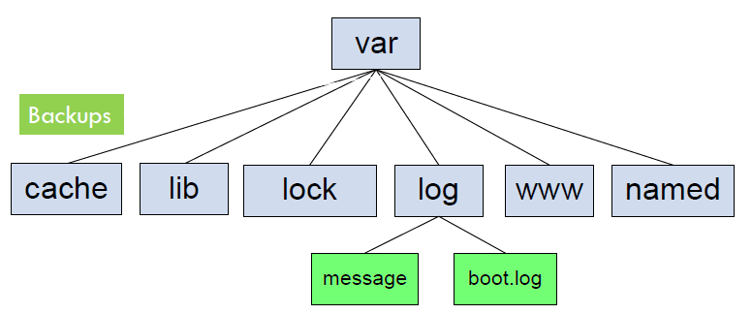
/var
Contain files that are expected to be updated and changed.
Administrative and Logging data
Temporary files
Websites
Mail directories
Print spool

Slide 35
/home
containing saved files, personal settings, etc.
Contains the user’s personal configuration files.
/mnt
points for removable devices that have been mounted manually.
/media
contain the mount points for removable media such as,
-USB drives,
-CD-ROMs, etc.
that are mounted automatically at insertion.

Slide 36
Specifying files by name
Navigating PATHS
pwd
ls
cd - , .. , ~ , .

Slide 37
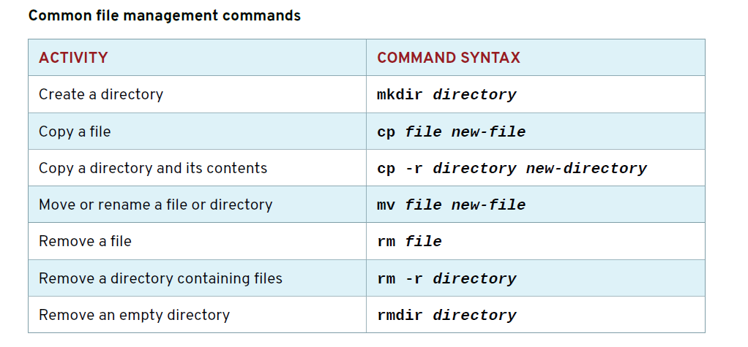
Managing Files using CLI Tools

Slide 38
Making Links between files
Hard link
The same inode value of original file
We cannot create hard link for a directory
If original file removed hard link works
ls -l <file> “show number of hard links”
ls -l <Dir> “show number of Dirs inside Dir + 2 “
Using ln command
Soft link
Different inode value of original file
ls –l <file> “show link type”
Link work across file systems
Contain only path of file
If original file removed , soft link dangled “corrupted ”
Using command ln -s <****FULL PATH **** of the file that will make a shortcut from it > <shortcut name>

Slide 39
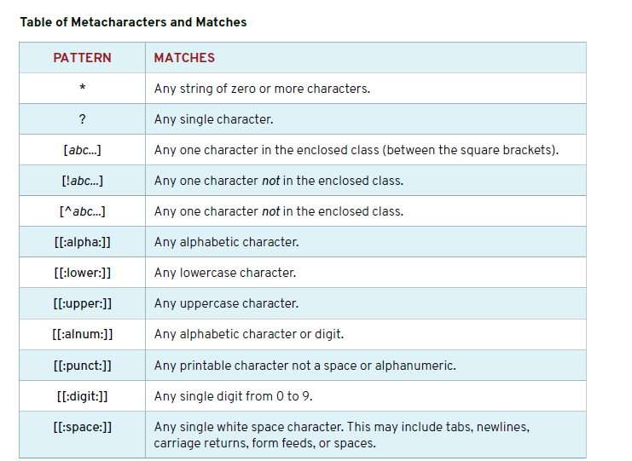
Matching file names (Shell expansions)

Slide 40
Matching file names (Shell expansions) cont.
Command substations
$()
Protecting Arguments from Expansion
The backslash \

Slide 41
Getting help in RHEL
Using man command
Using pinfo command
Reading Documentation in /usr/share/doc

Slide 42
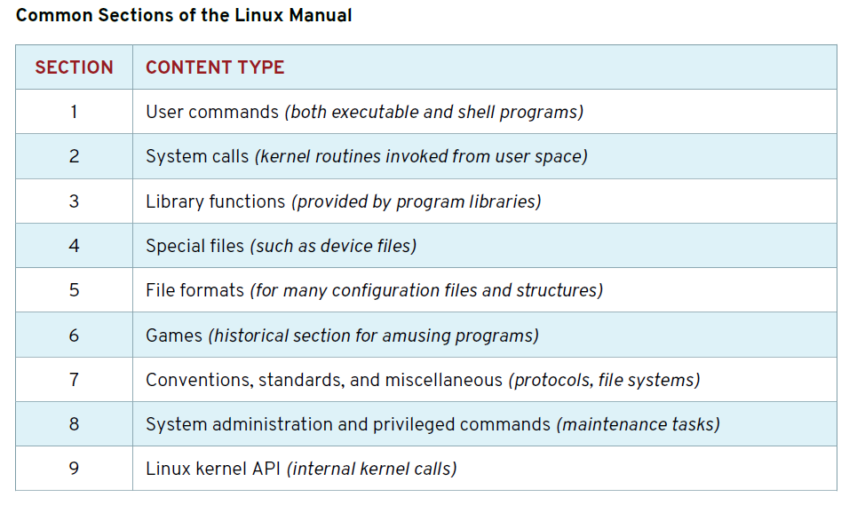
man command
Press ↓
Enter Move down one line.
Space Move down one page.
g Move to the top of the page.
G Move to the bottom of the page.
q Quit.

Slide 43
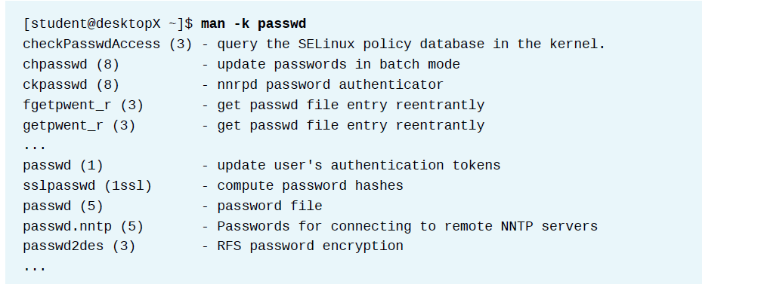
Search by Keyword
man –k <keyword>

Slide 44
Create, view, and edit text files
Redirection
Editing Text Files
Changing the Shell Environment

Slide 45
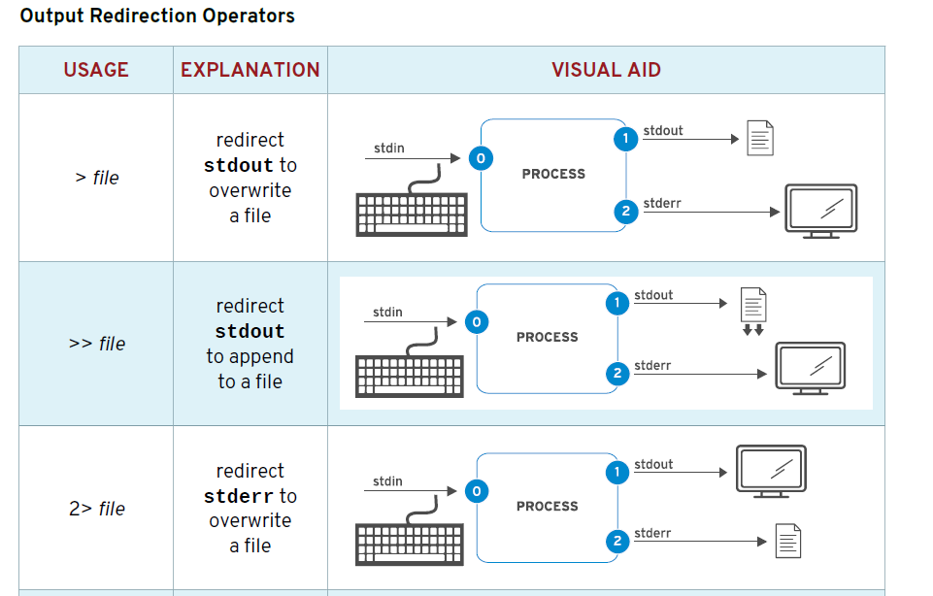
Redirection

Slide 46
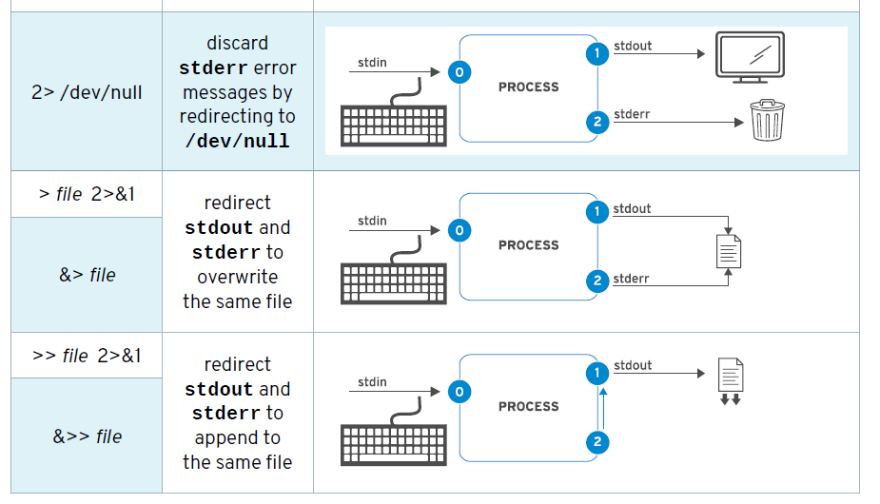
Redirection cont.

Slide 47
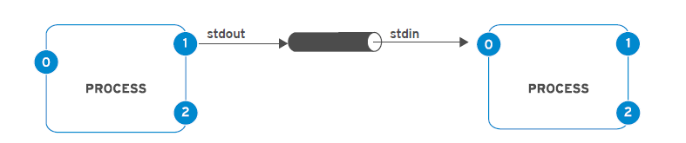
Redirection cont. Constructing PIPELINES
Using |
Using tee (then the final output of a command can be saved and output to the terminal at the same time.)

Slide 48
Editing Text Files
Using vim

Slide 49
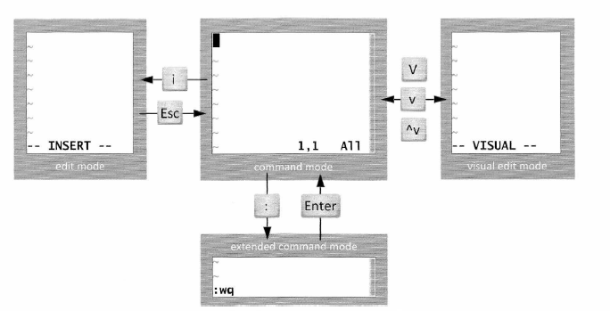
vi modes
Command (default) mode
Edit (insert) mode
Visual mode
Line mode

Slide 50
vi edit mode
i Insert at the cursor position.
I Insert at the beginning of the line.
a Append after the cursor position.
A Append at the end of the line.

Slide 51
vi line mode
:w Writes (saves) the file.
:w! Forces the file to be saved.
:q Quit.
:q! Quit without saving changes.
:wq! Write and quit.
:x Same as :wq.

Slide 52
vi undo/redo action
u
Ctrl-R
Undo Redo

Slide 53
Changing the Shell Environment
Assign Values to Variables
Retrieving Values from Variables
Shell Variables
Setting Variables Automatically
/etc/profile , /etc/bashrc and ~/.bash_profile
Unsetting Variables

