Slide 1

Predicting the Revenue for the movie DB
Presented by:
Morooj & Rawan

Slide 2
overview
BACK Story
We want to investigate whether we can predict the overall movie revenue given all the collected features.
For this, we scraped the data from themoviedb.org to get the information for the movies and other related info like the year and the rating.
Afterwards, we performed stringent data pre-processing to prepare the data for subsequent data analysis.
Notes:
Frist I would begin by talking about the business story
My goal is to help

Slide 3

Research Questions
Investigate the relationship between movie budget and revenue. What is the expected revenue for a movie given a specific user rating?
What are the most effective features that affect the predictability of movie revenue ?

Slide 4
The Data
Main Columns :
Title, id ,Release date , Duration ,Genre count ,Genre ,Rating ,Keywords, Language , Budget, Revenue.
Data-Frame Shape :
Original data: (3621,11)
After EDA: (1871, 11)
After the Feature engineering: (1871, 29)
28 features and one predictor
Tools and Libraries :
Selenium, Beautifulsoup4, Scikit-learn, stats models , pandas

Slide 5
OUR STRATEGY
Data scraping and cleaning
Data and feature engineering
Model validation and selection
Model prediction and evaluation

Slide 6
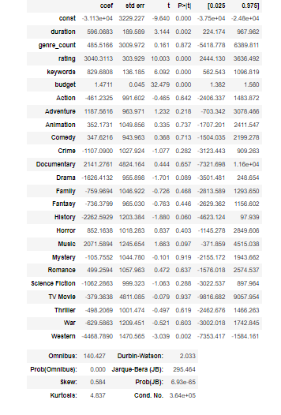
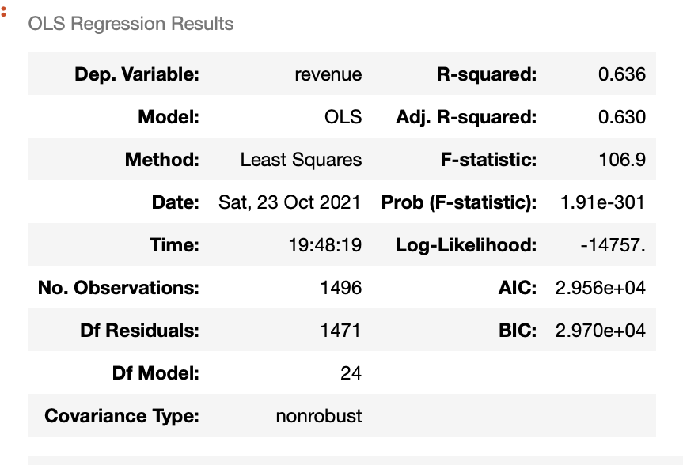
Stats model

Slide 7
Models Comparison
Model Type | Score (Training) | Score (validation)
Linear Regression | 0.65 | 0.547
Polynomial | 0.74 | 0.406
LASSO d=2 | 0.67 | 0.562
CROSS Validation for 5 parts of the data | Mean Score 0.63
Model Type | Score (Test)
Linear Regression | 0.598
LASSO | 0.598
Ridge | 0.599
Elastic Net | 0.599
Random Forrest | 0.500
Gradient Boosting | 0.572

Slide 8
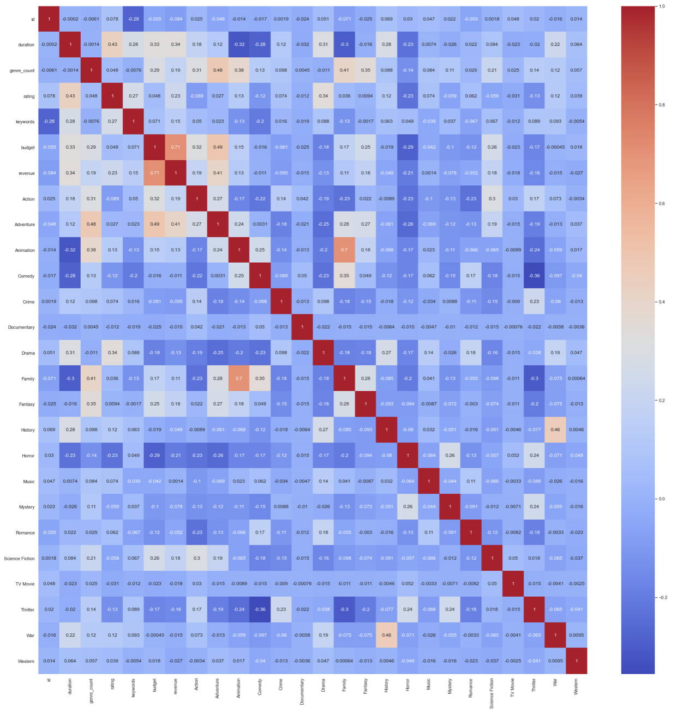
features Correlations

Slide 9
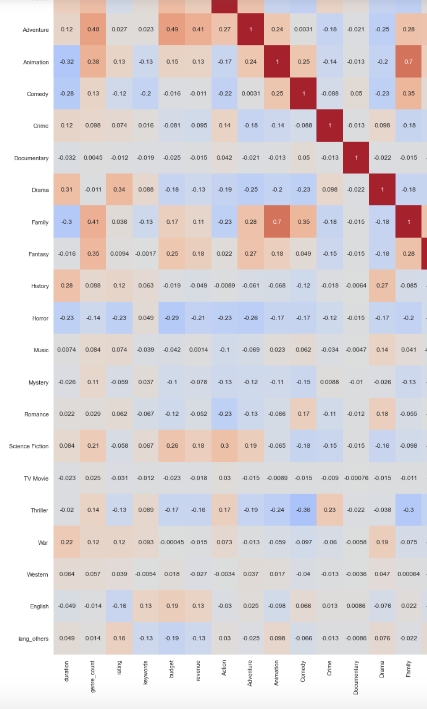
FEATURE ENGINEERING
We removed useless features which will not be used by our regression modelling step like id, release date.
We converted genre and language categorical features into numerical by converting them into dummy variates.
We transformed some numerical columns using square root to make all numerical variates closer to each others to normalization of the model.

Slide 10
FEATURE ENGINEERING
We added a new column by multiplying the two columns that had a high correlation between them.
We also created a new column that represents the difference between revenue and budget.
['FxA'] = ['Family'] * ['Animation']
['cost'] = ['revenue'] - ['budget']

Slide 11
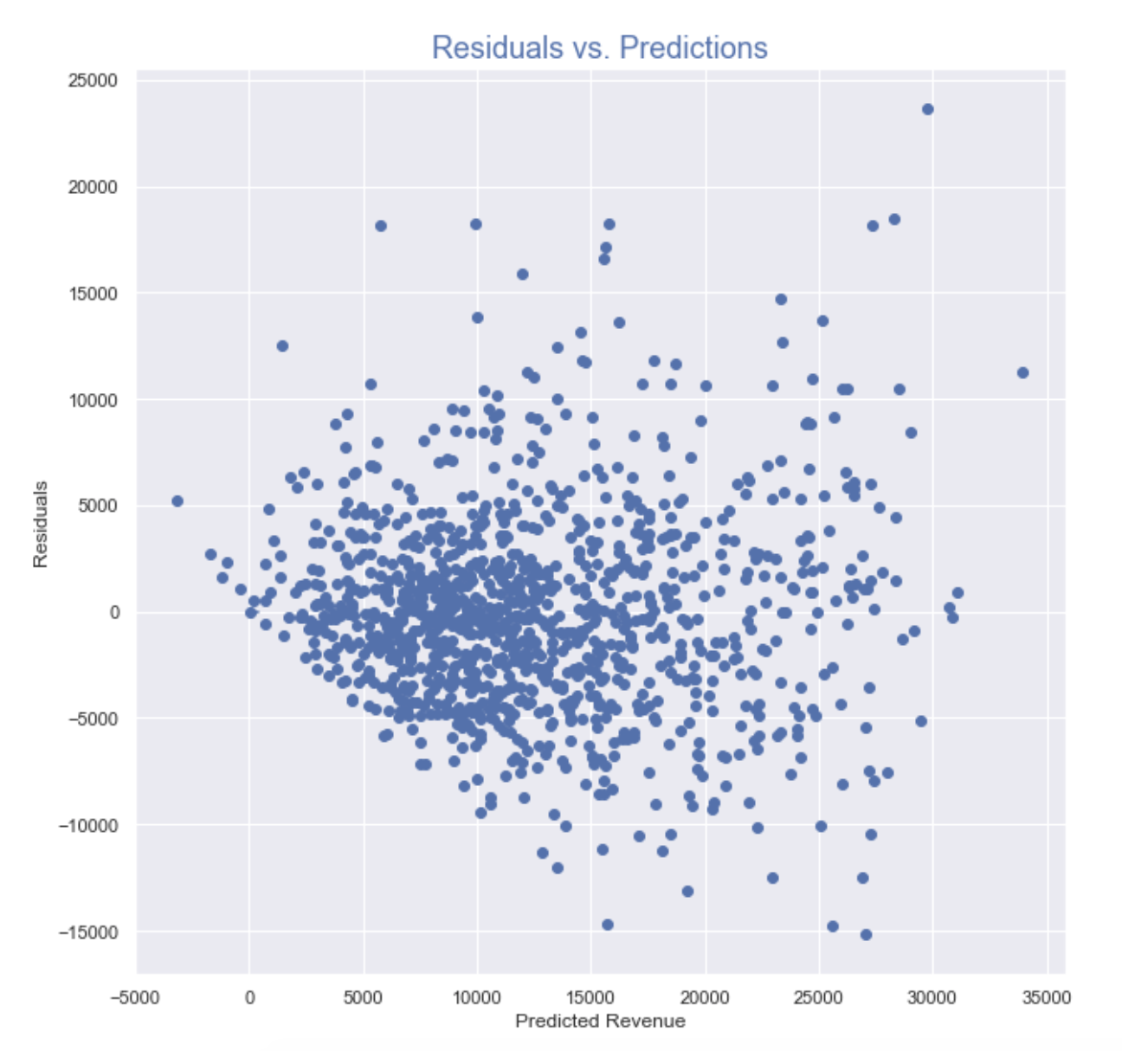
Residuals vs. Predictions
This chart shows the number of errors that occurred during
Predicted Revenue.

Slide 12
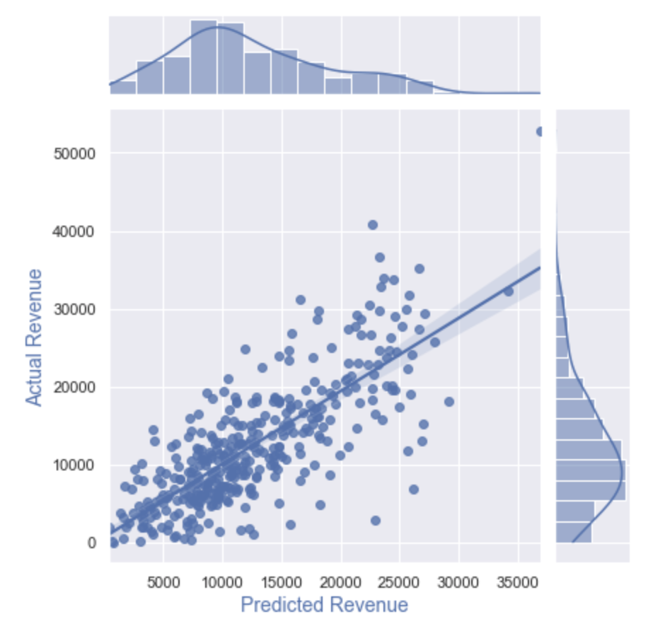
Model Prediction and Evaluation
This chart shows the Relationship between Actual revenue and Predicted Revenue.

Slide 13
FUTURE WORK
Using complex mods
Using complex mods
Using complex mods
Using complex mods
Using complex mods
Predicting the number of visitors to a website.
Used complex models like machine learning and Deep learning

Slide 14
Thanks for listening☺

