Slide 1
CIS 2202-System Analysis and Design Accident Assistance Service Project Lecturer: Dr. Abdullah Alshanqiti

Slide 2
Work team
Ali Habib
Abdulrahman Shahata
Mohammed Gamal
Ali Domlo

Slide 3
Outlines
Problem description
System description
System functionalities
Feasibility study
Time Plan
System process

Slide 4
Problem description
Some car manufacturers sell cars with a built-in Accident Assistance Service, this service is activated only for the high trim levels which have higher prices. Some drivers want to activate this service in their cars but they want not to pay for high trim level.

Slide 5
System description
Accident Assistance Service is a subscription-based service that makes drivers receive a call from an automated call center when they have accidents, this call aims to make sure the driver has not injured. If the driver was injured the call center will alert emergency services and provides them car location and information.

Slide 6
System functionalities(1/2)
Our proposed system provides these functionalities:
1. Send an automated message to the system.
The accident triggers the device to send a message to Accident Assistance Server. The message includes the car’s location (GPS) and identification number.
2. Place a call to the driver's phone.
Using an automated call center, the system will place a call to the driver’s phone.

Slide 7
System functionalities(2/2)
Our proposed system provides these functionalities:
3. Alert emergency services
If the driver doesn’t answer the call, the system will alert emergency services (police, ambulance), and provide them the accident’s details.
4. Store customer information
Store some information about customers e.g. phone numbers, also store some information about customers’ cars e.g. VIN number, plate number, model, color, etc.

Slide 8
Feasibility study
We studied the project feasibility in terms of four aspects:
Technical feasibility
Operational feasibility
Economical feasibility
Scheduling feasibility

Slide 9
Technical feasibility
Is the solution technically practical? The implementation of the main operation of the system does not require a lot of specifications.
Does our staff have the ability to build this system?
a- Familiarity with the application:
Some of the team members are familiar with this type of applications because they worked on some similar projects.
b- Familiarity with the technology:
Our team members have some experience with automated messages and call centers, and they fully trained to use database servers.
c- Project size:
The size of the system is suitable for the size of our team.

Slide 10
Operational feasibility
We discuss the operational feasibility int terms of two aspects:
The degree to which the system fulfills customer requirement:
The overall requirement of the system is to alert emergency services about car accidents, the system easily can fulfill this requirement.
Users' feelings about the system:
According to our questionnaire results, we found that many users see the system is important and provide a service that helps to save the drivers lives.

Slide 11
Economical feasibility
 | Year
 | 2019 | 2020 | 2021
Development costs
Development team salaries | 16,000 SR | - | -
Development team training | 3,000 SR | - | -
IaaS subscription | 4,000 SR | 4,000 SR | 4,000 SR
Call center | 4,000 SR | - | -
Operation costs
Communication charges | 2,000 SR | 2,000 SR | 2,000 SR
Call center maintenance | - | 2,000 SR | 2,000 SR
Total costs per year | 29.000 SR | 8,000 SR | 8,000 SR
Total | 45,000 SR
Economic feasibility is shown in the table below (All costs are estimated):

Slide 12
Scheduling feasibility
Based on our planning, our team can complete the project within the deadline (4th of July) as we show in the project plan in the next slide.

Slide 13
After studying the system and its requirements, we proposed potential methodology is the waterfall methodology .but the main drawback is it takes long time. To avoid this drawback
we use parallel methodology which divides the project into a series of subprojects that can be designed and implemented in parallel, then integrate them into final project.
The main advantage of parallel methodology is reducing the time required to deliver a system

Slide 14
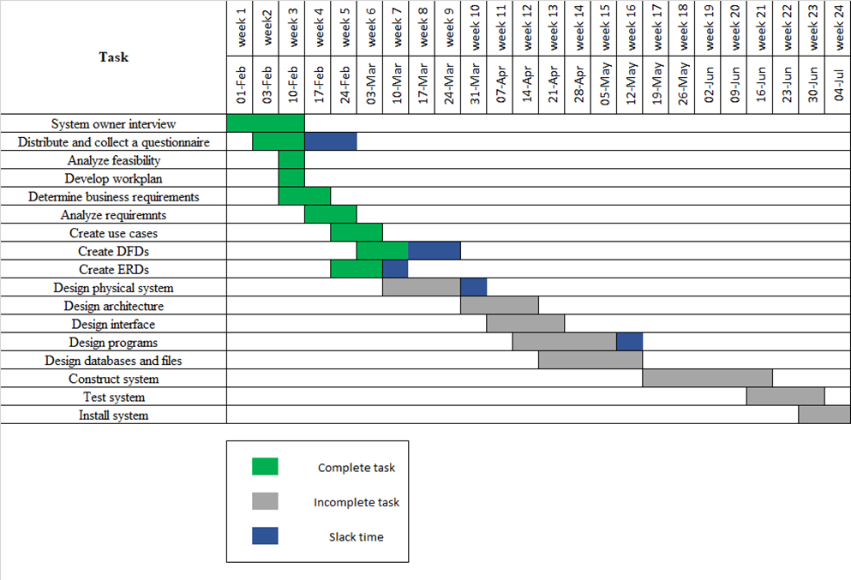
Time plan
There three tasks critical path:
1- System owner interview It’s the first task in the project because it determines whether the team continue the project or leave it, also it states the main aspects of the work plan.
2- Develop workplan
3- Determine business requirements
Because of the short available time, we used the reverse scheduling strategy, we established scheduling from the project deadline and then scheduled backward from that date. Project time plan is shown in the Gantt chart :

Slide 15
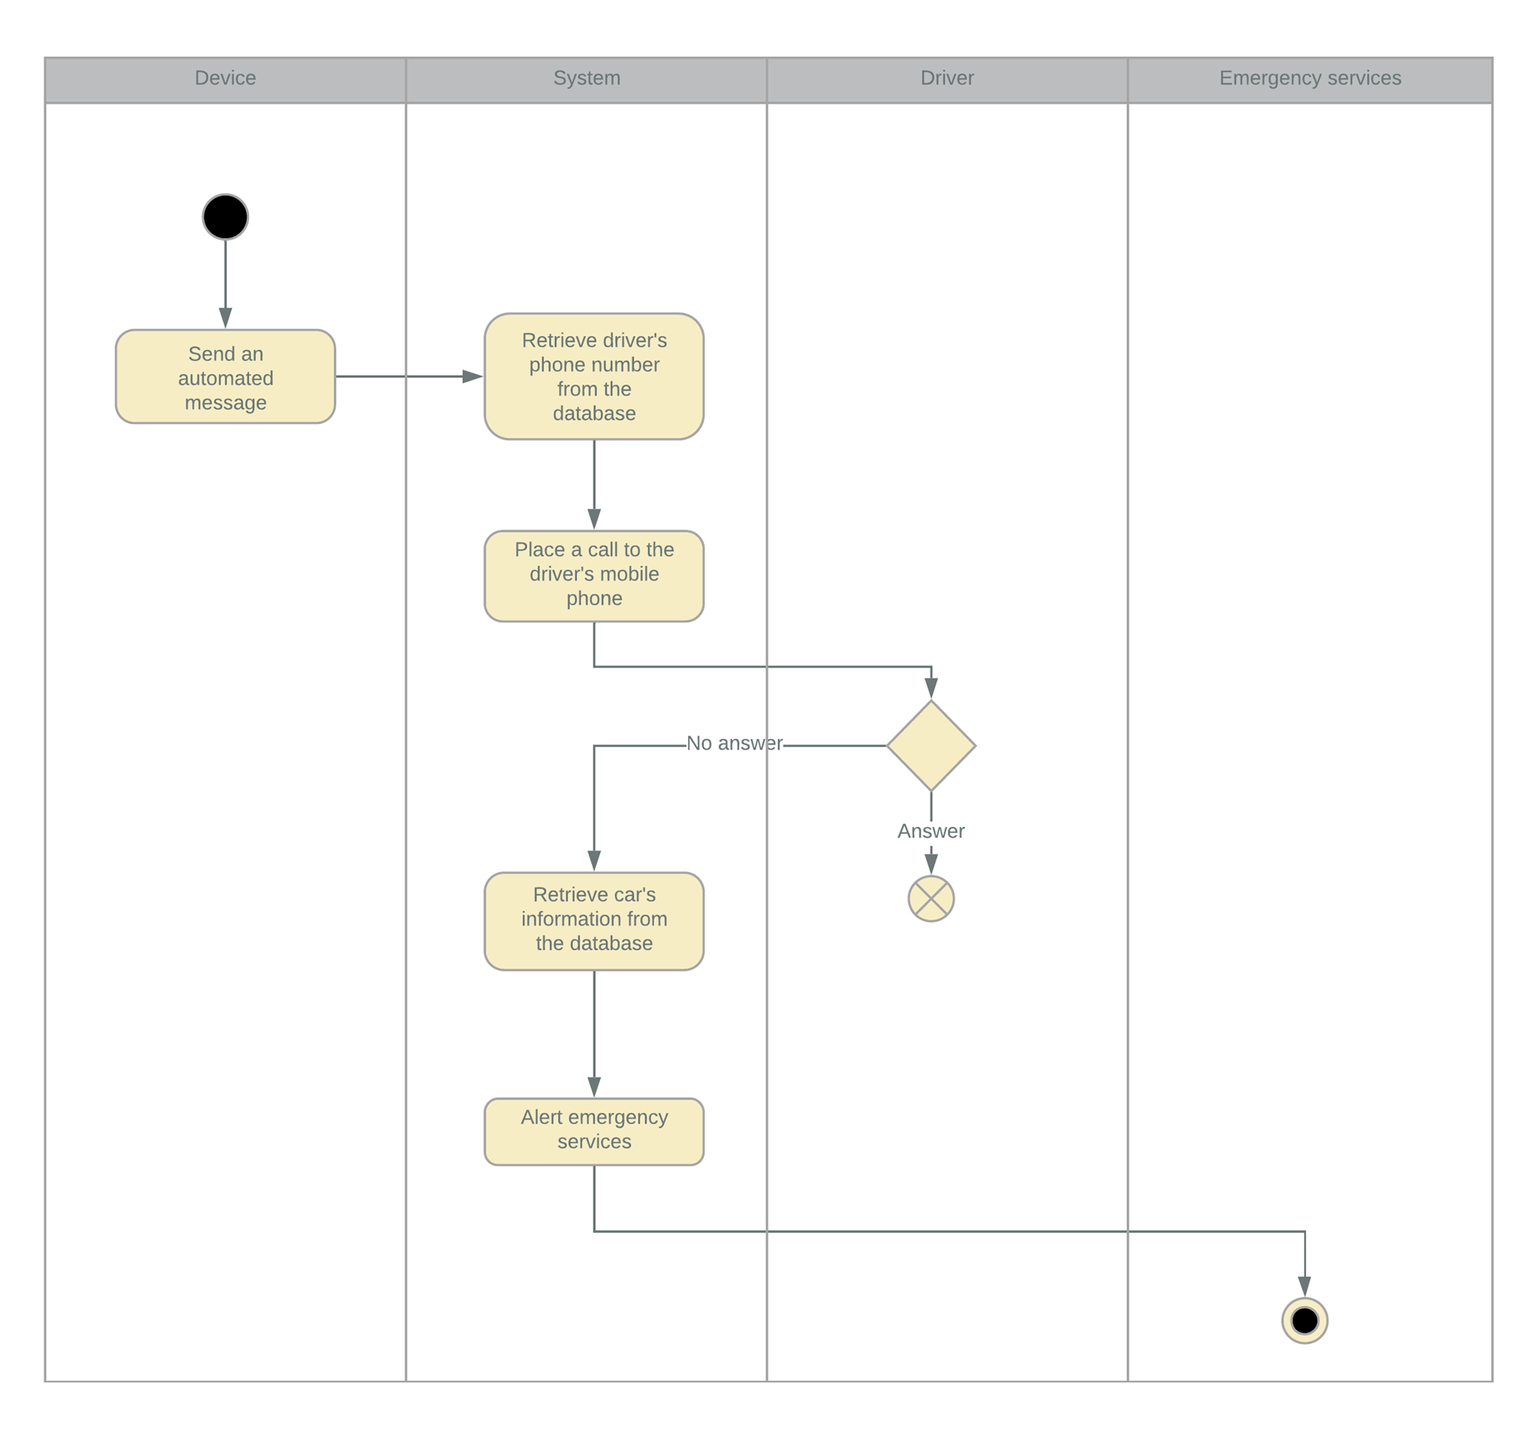
System process
How the system will work

Slide 16
Thank You

