Slide 1

Loan Default Prediction Using LendingClub Data
EDA & Machine Learning–Based Loan Default Risk Analysis
Memoona Mashood
Data Analysis – Cohort 23

Slide 2

Lending Club Business Overview
Median Loan Amount: ~$14,500
Loan Term: Mostly 36 months, some 60 months
Interest Rate Range: 7% – 36%
Typical Borrower Income: ~$73,945
Debt-to-Income Ratio (DTI): 10% – 20%
Home Ownership: Mostly Rent or Mortgage
Loan Purpose: Debt consolidation, credit card refinancing
Stats Link

Slide 3
Problem Statement
LendingClub issues thousands of loans annually.
Some borrowers default (Charged Off), causing financial risk
Traditional screening may miss behavioral patterns
Project Goal
Identify the key factors that drive loan default
Discover patterns that distinguish defaulters from fully-paid borrowers
Explore interactions between risk factors
Build ML models to predict default risk

Slide 4
Data Description
Source: Lending Club issued-loan dataset
Total Observations: ~850k Loans and 74 Features
Categories of Features Used:
Loan Characteristics
Borrower Financials
Demographics
Target Variable:
Loan Status: Fully Paid or Charged Off ~ Default

Slide 5
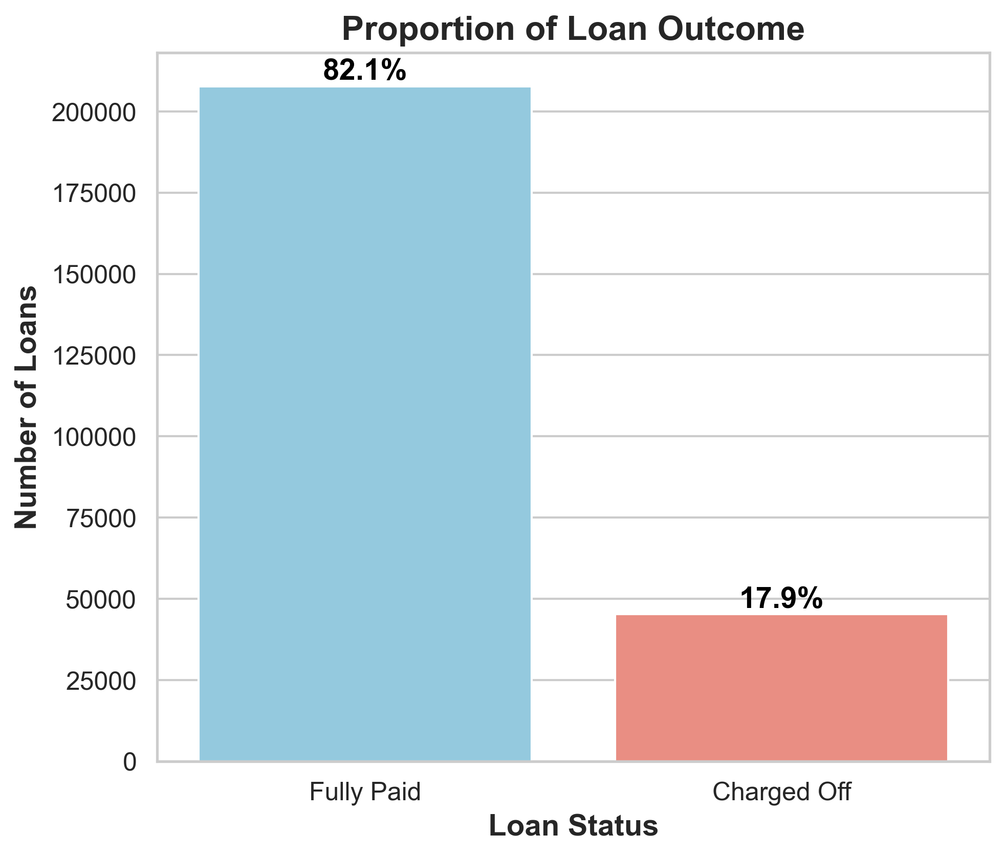
Loan Status
18% of borrowers defaulted; default is moderate in this dataset.
Imbalanced

Slide 6
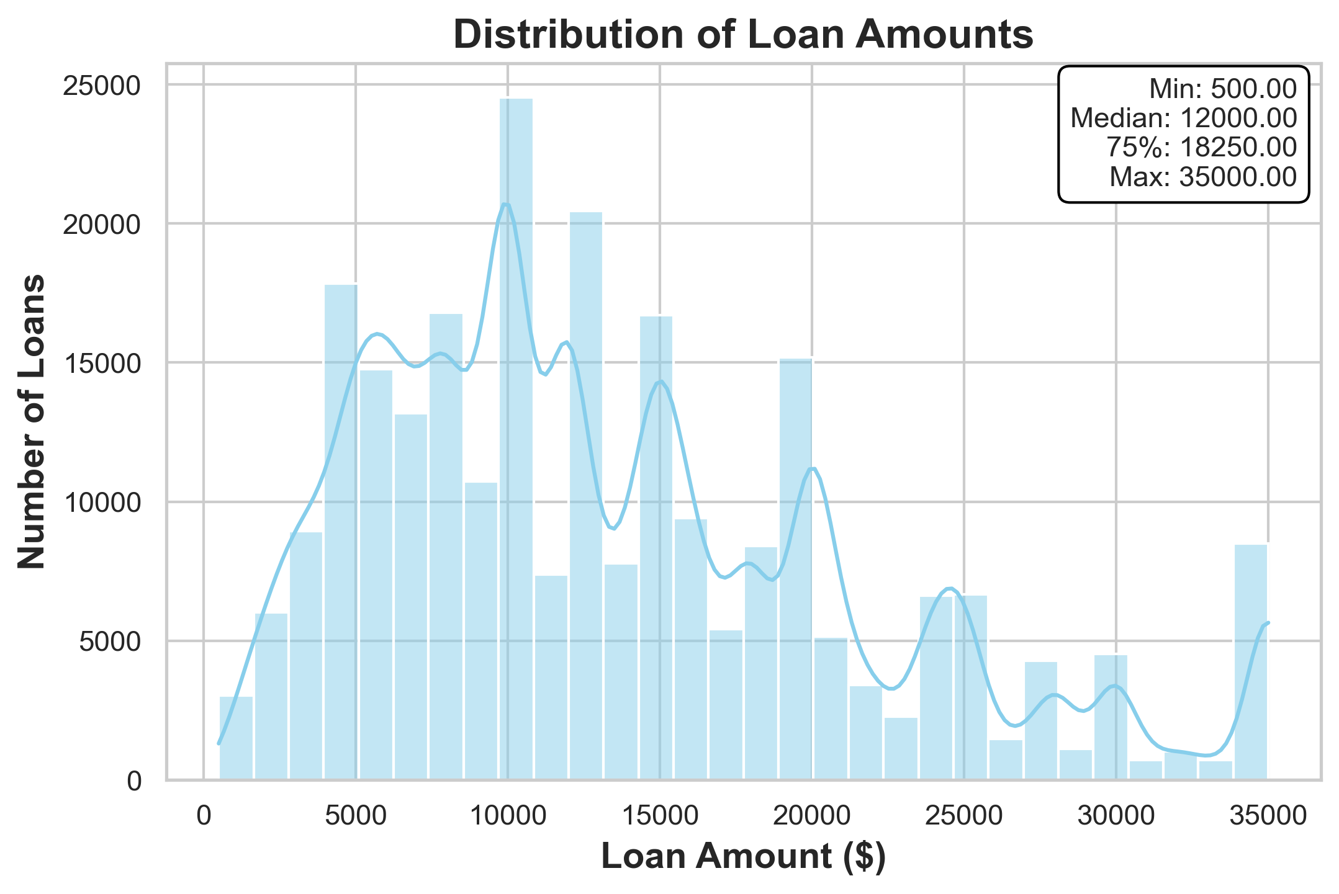
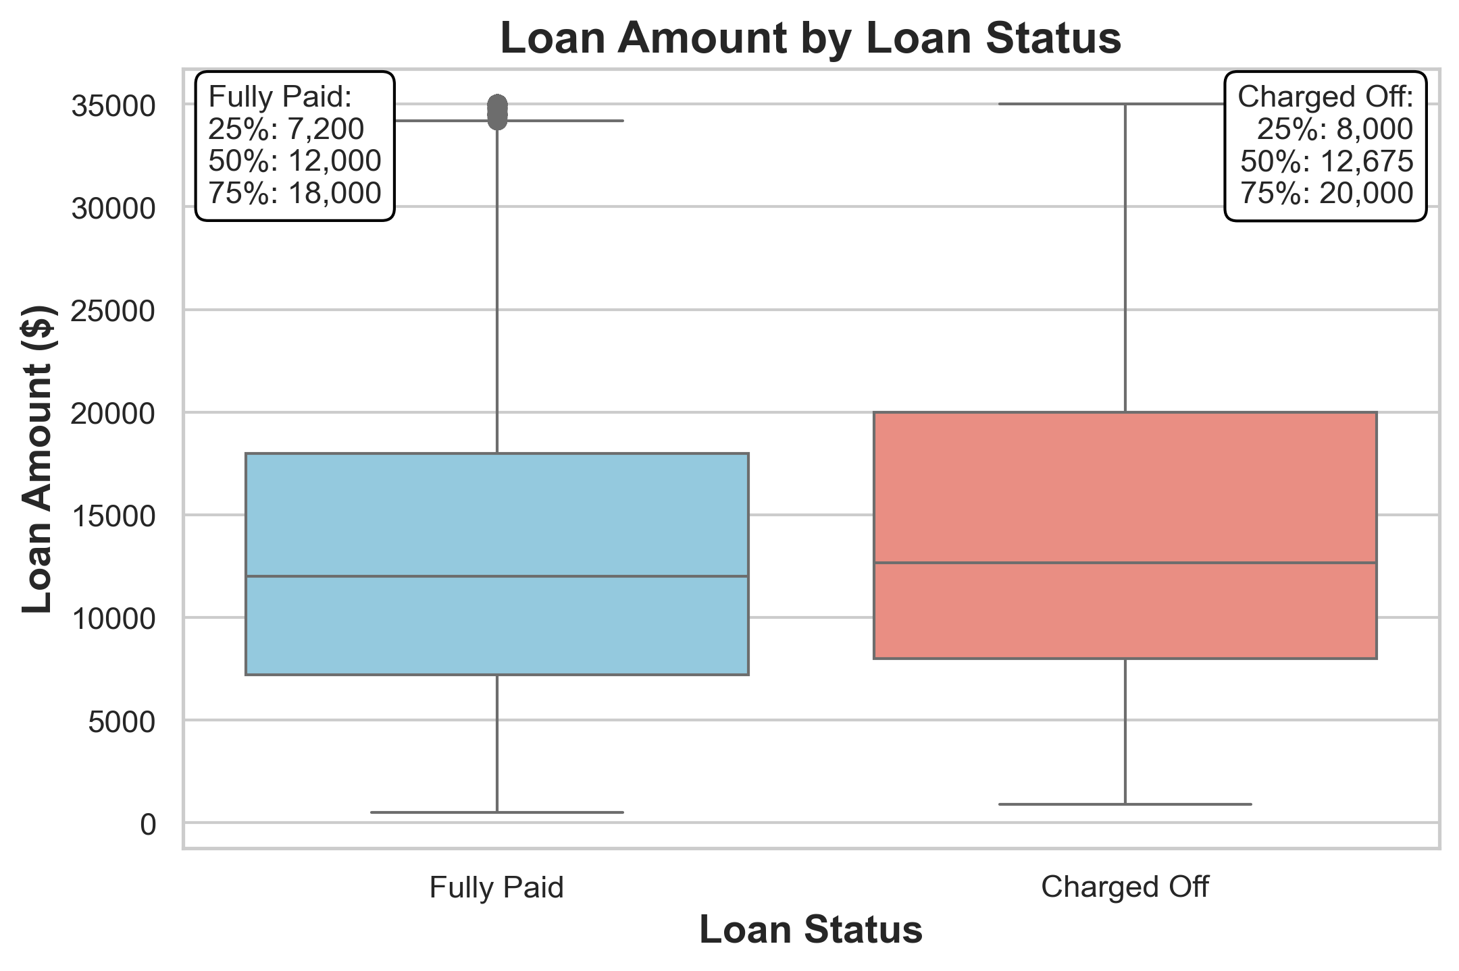
Loan Characteristics-Loan Amount

Slide 7
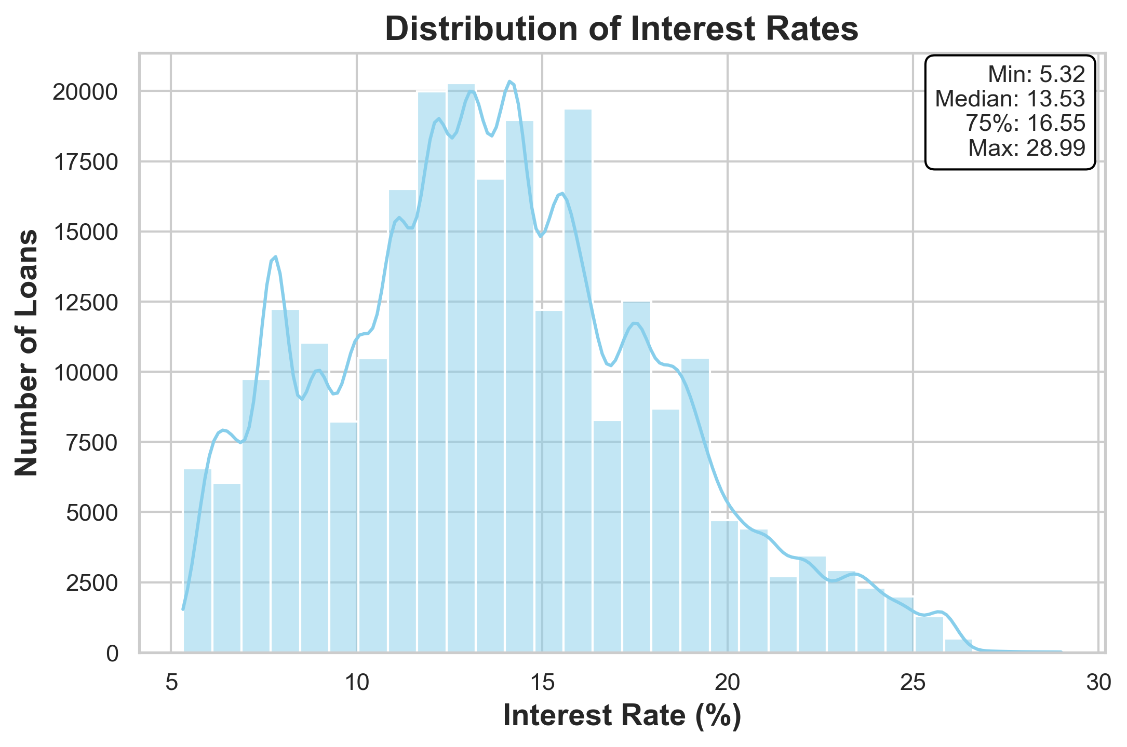
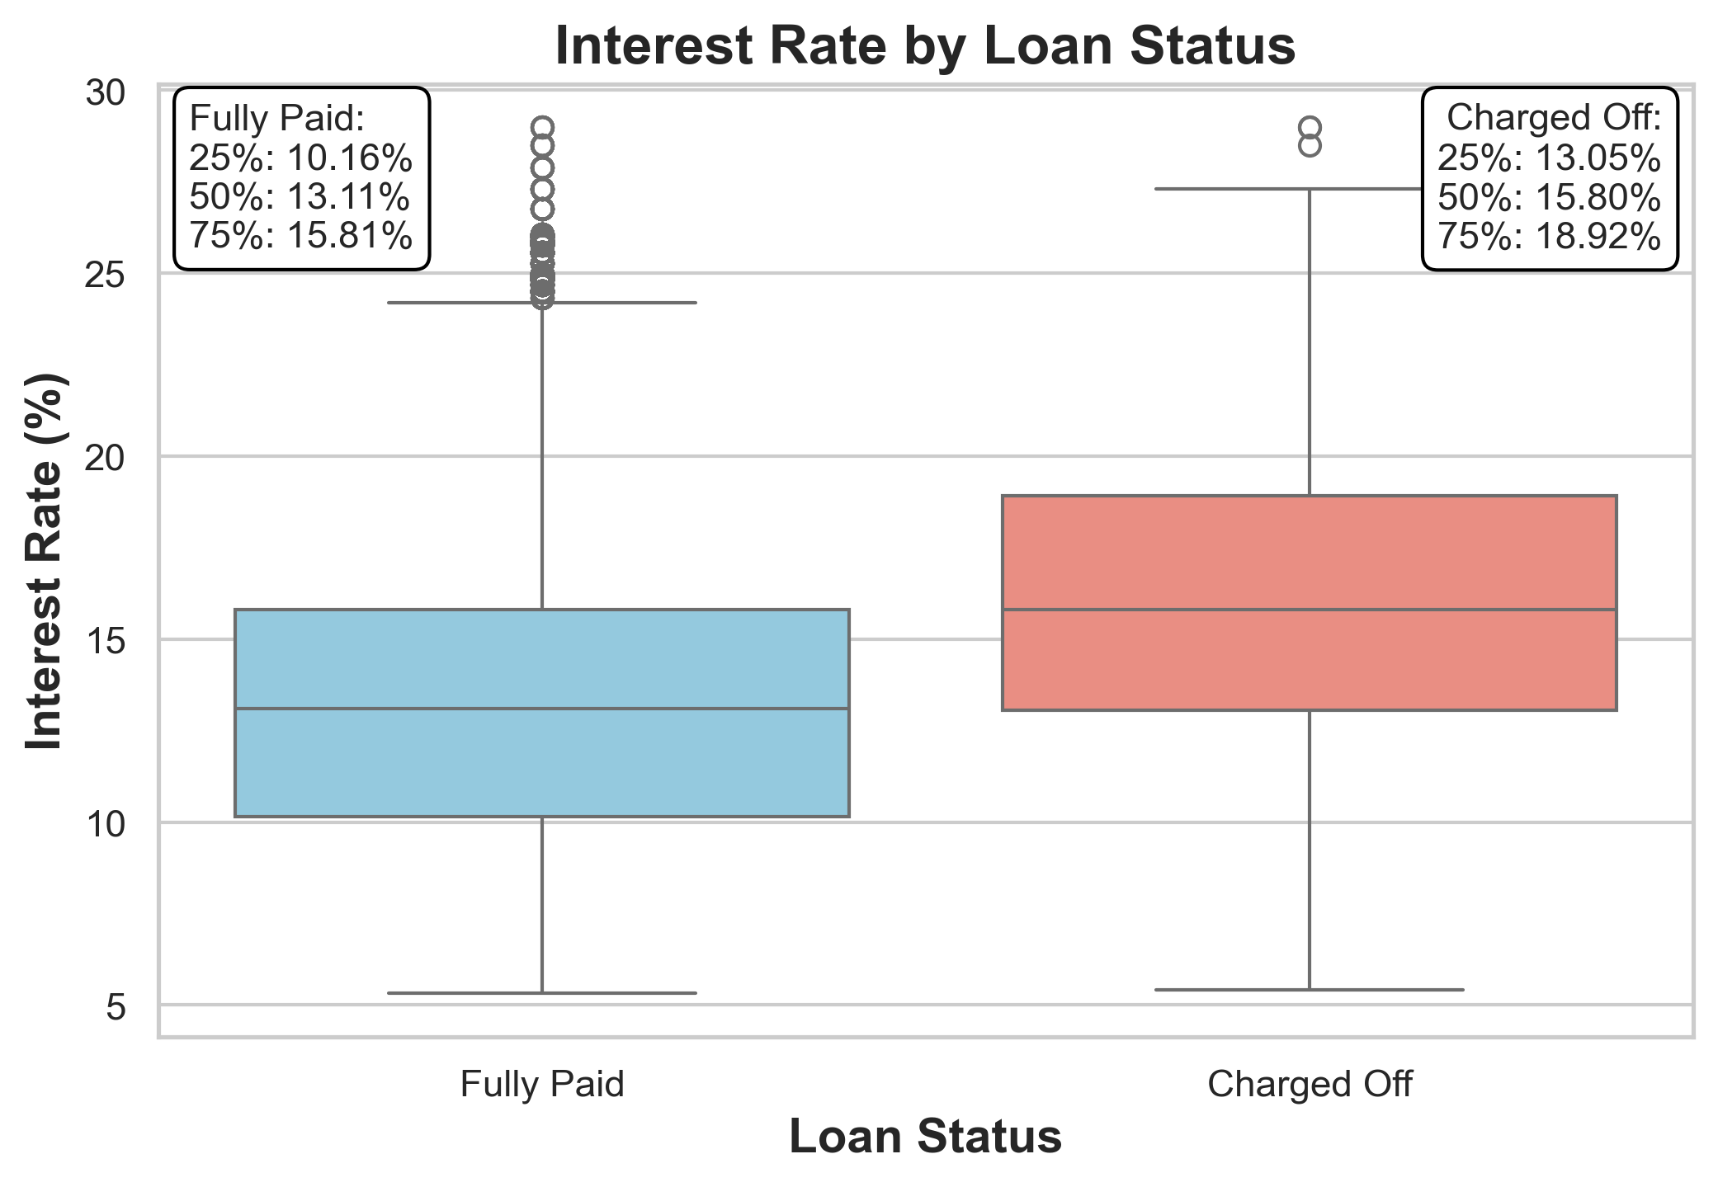
Interest Rate

Slide 8
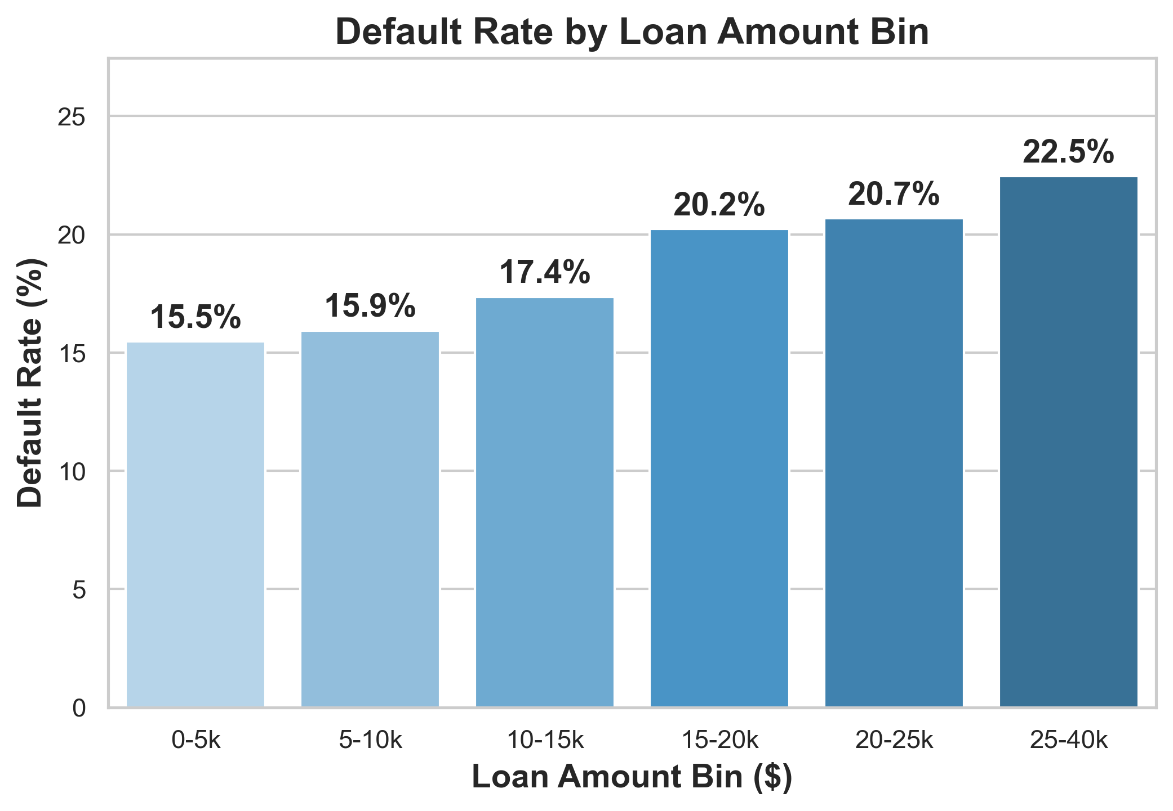
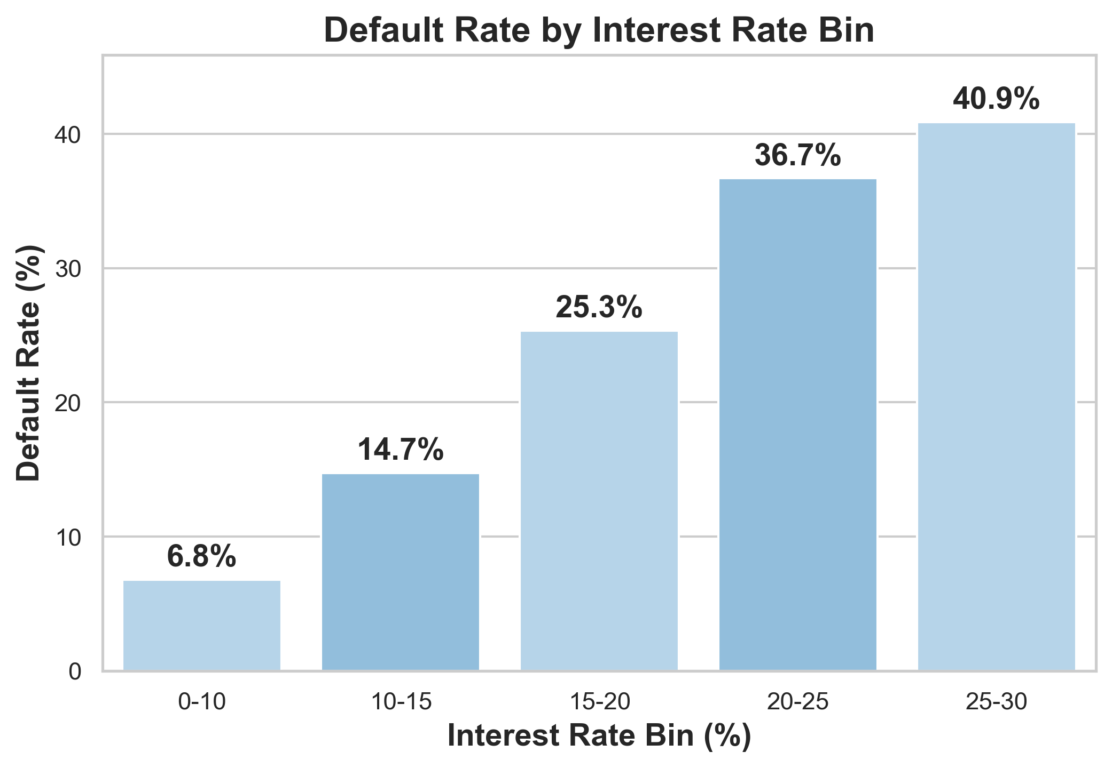
Default Rate Trends

Slide 9
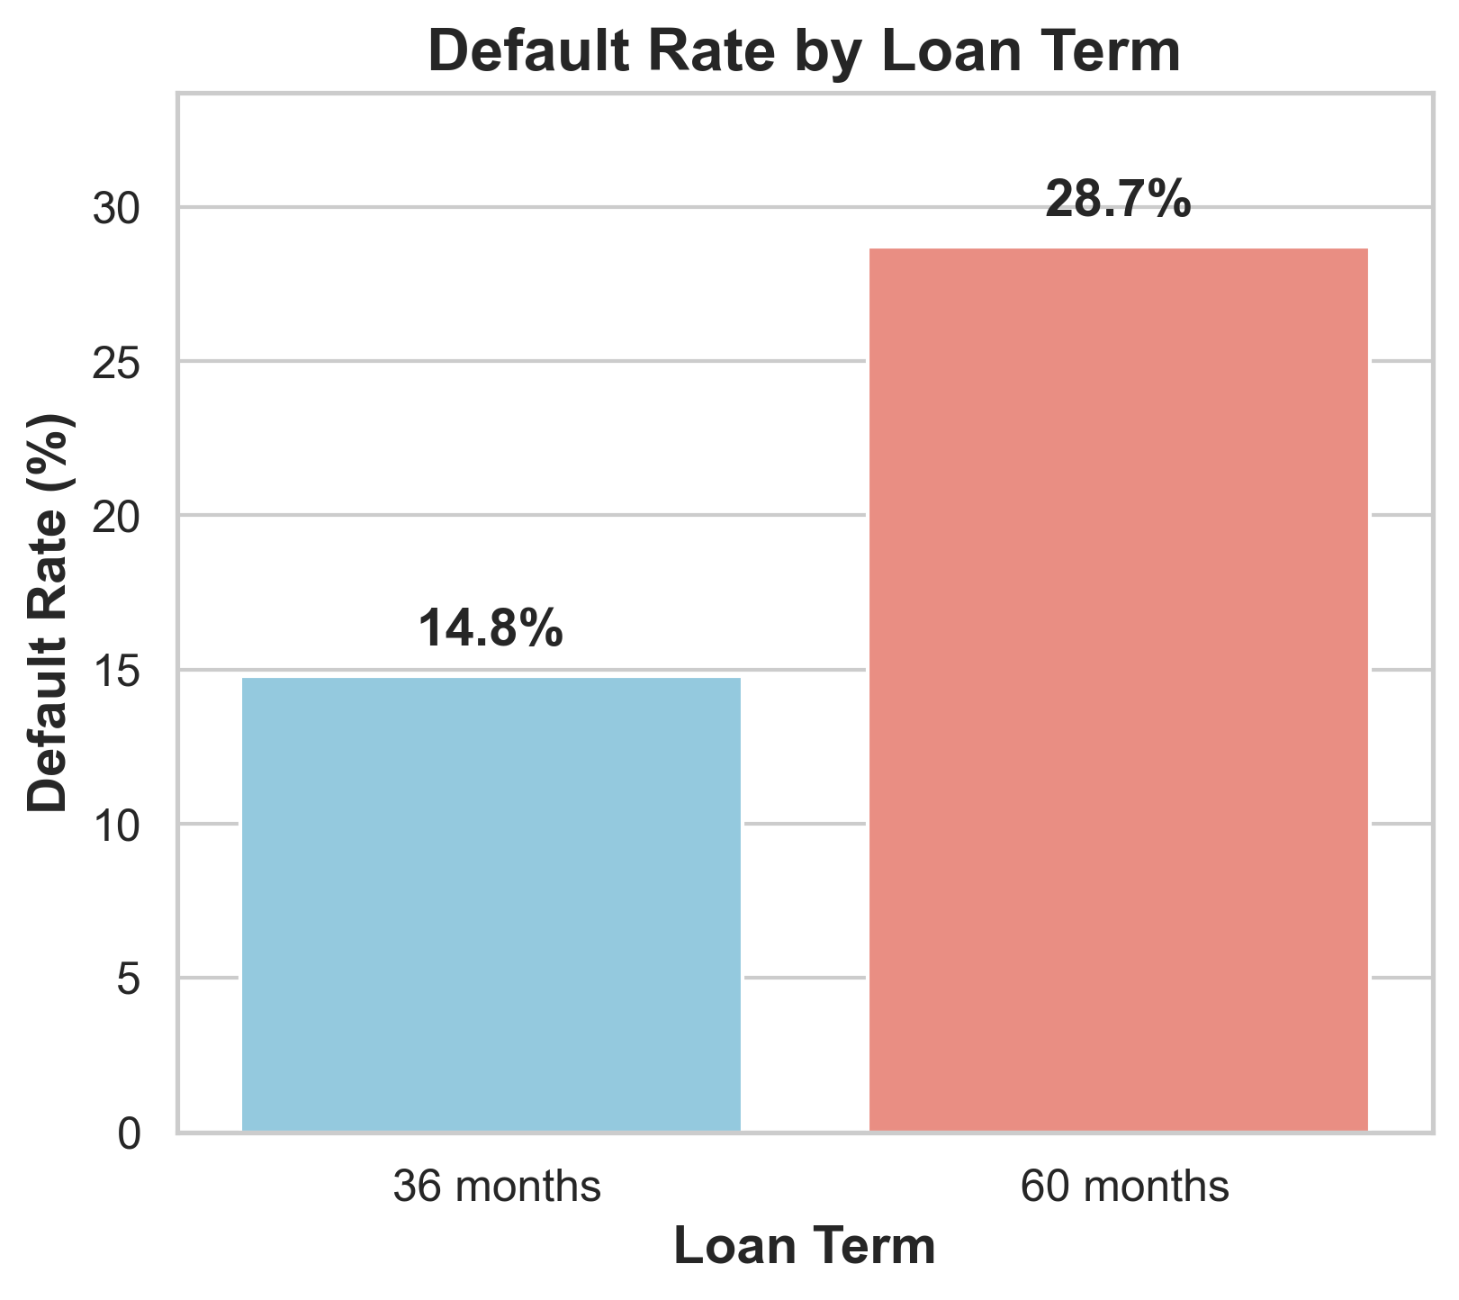
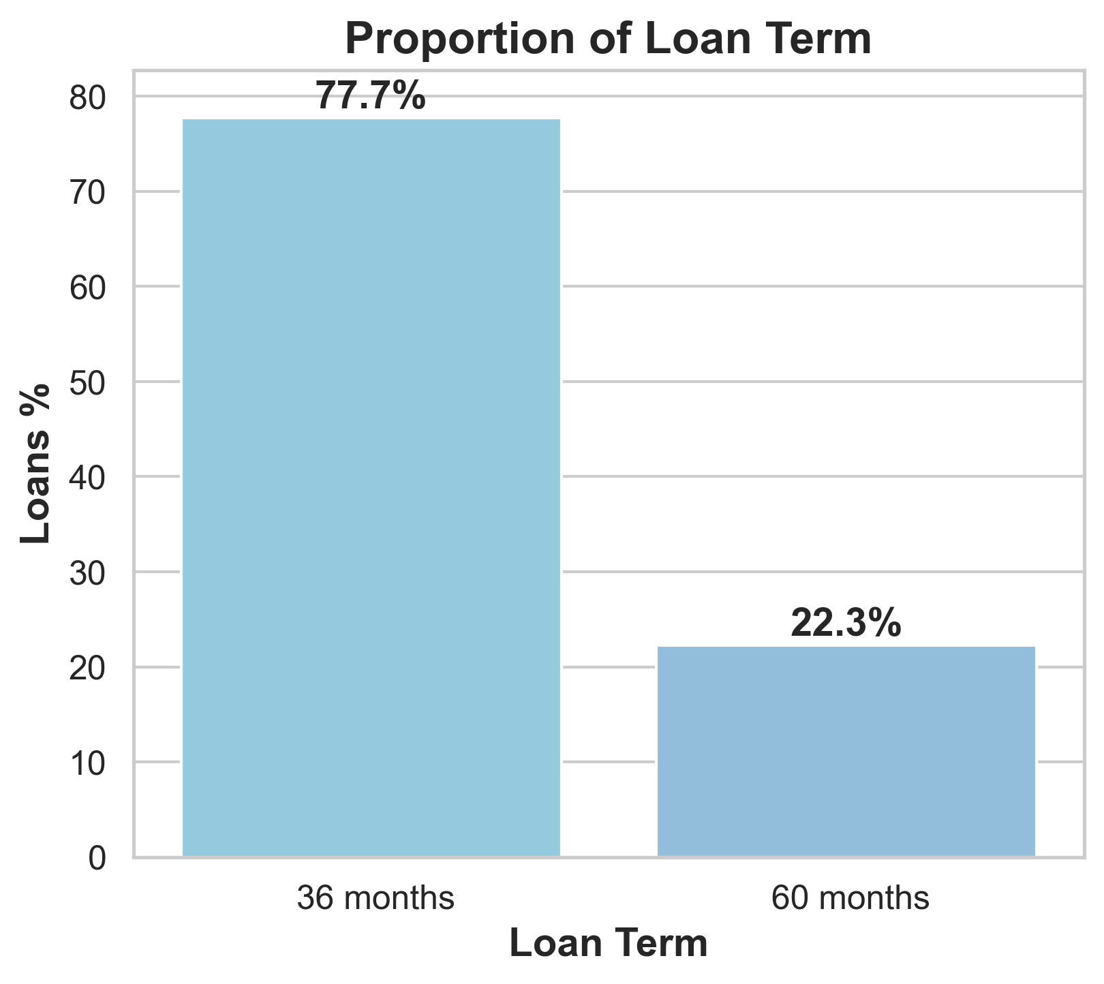
Loan Repaying Term

Slide 10
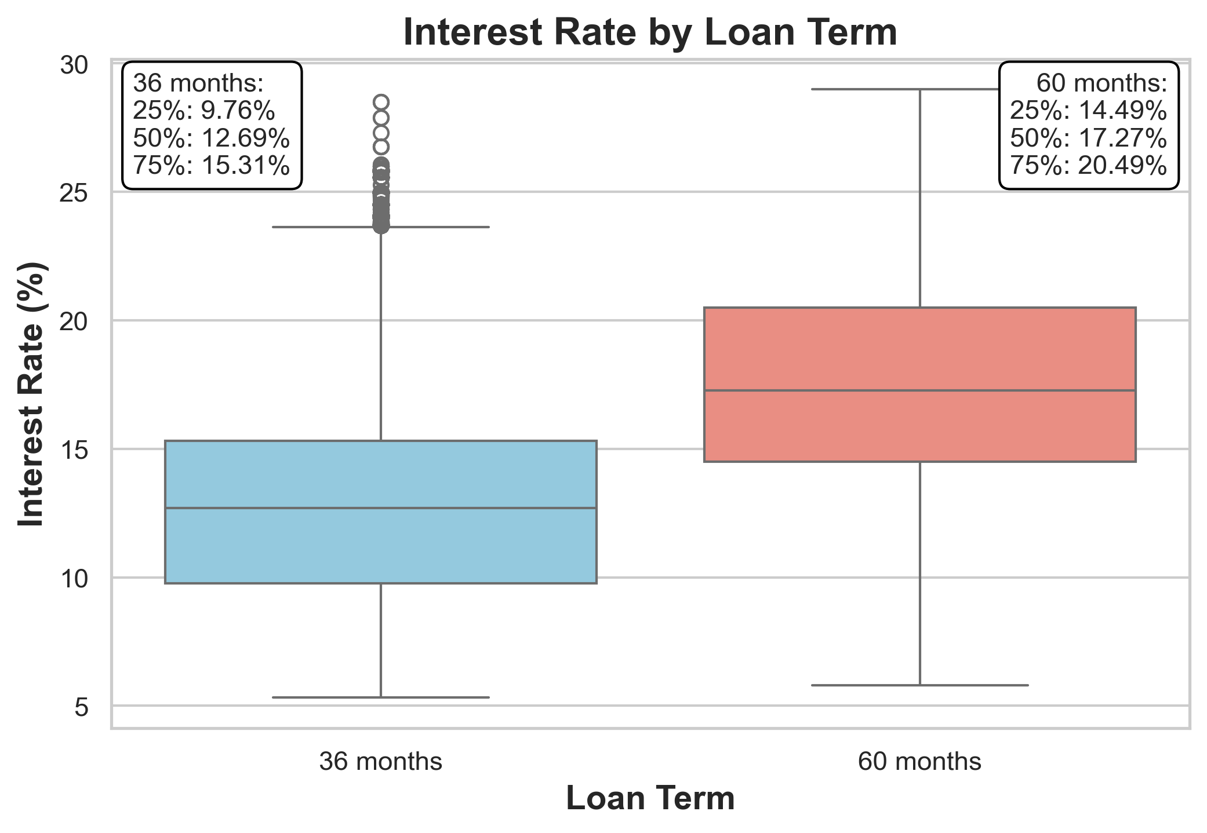
Relationship b/w Interest Rate and Term

Slide 11
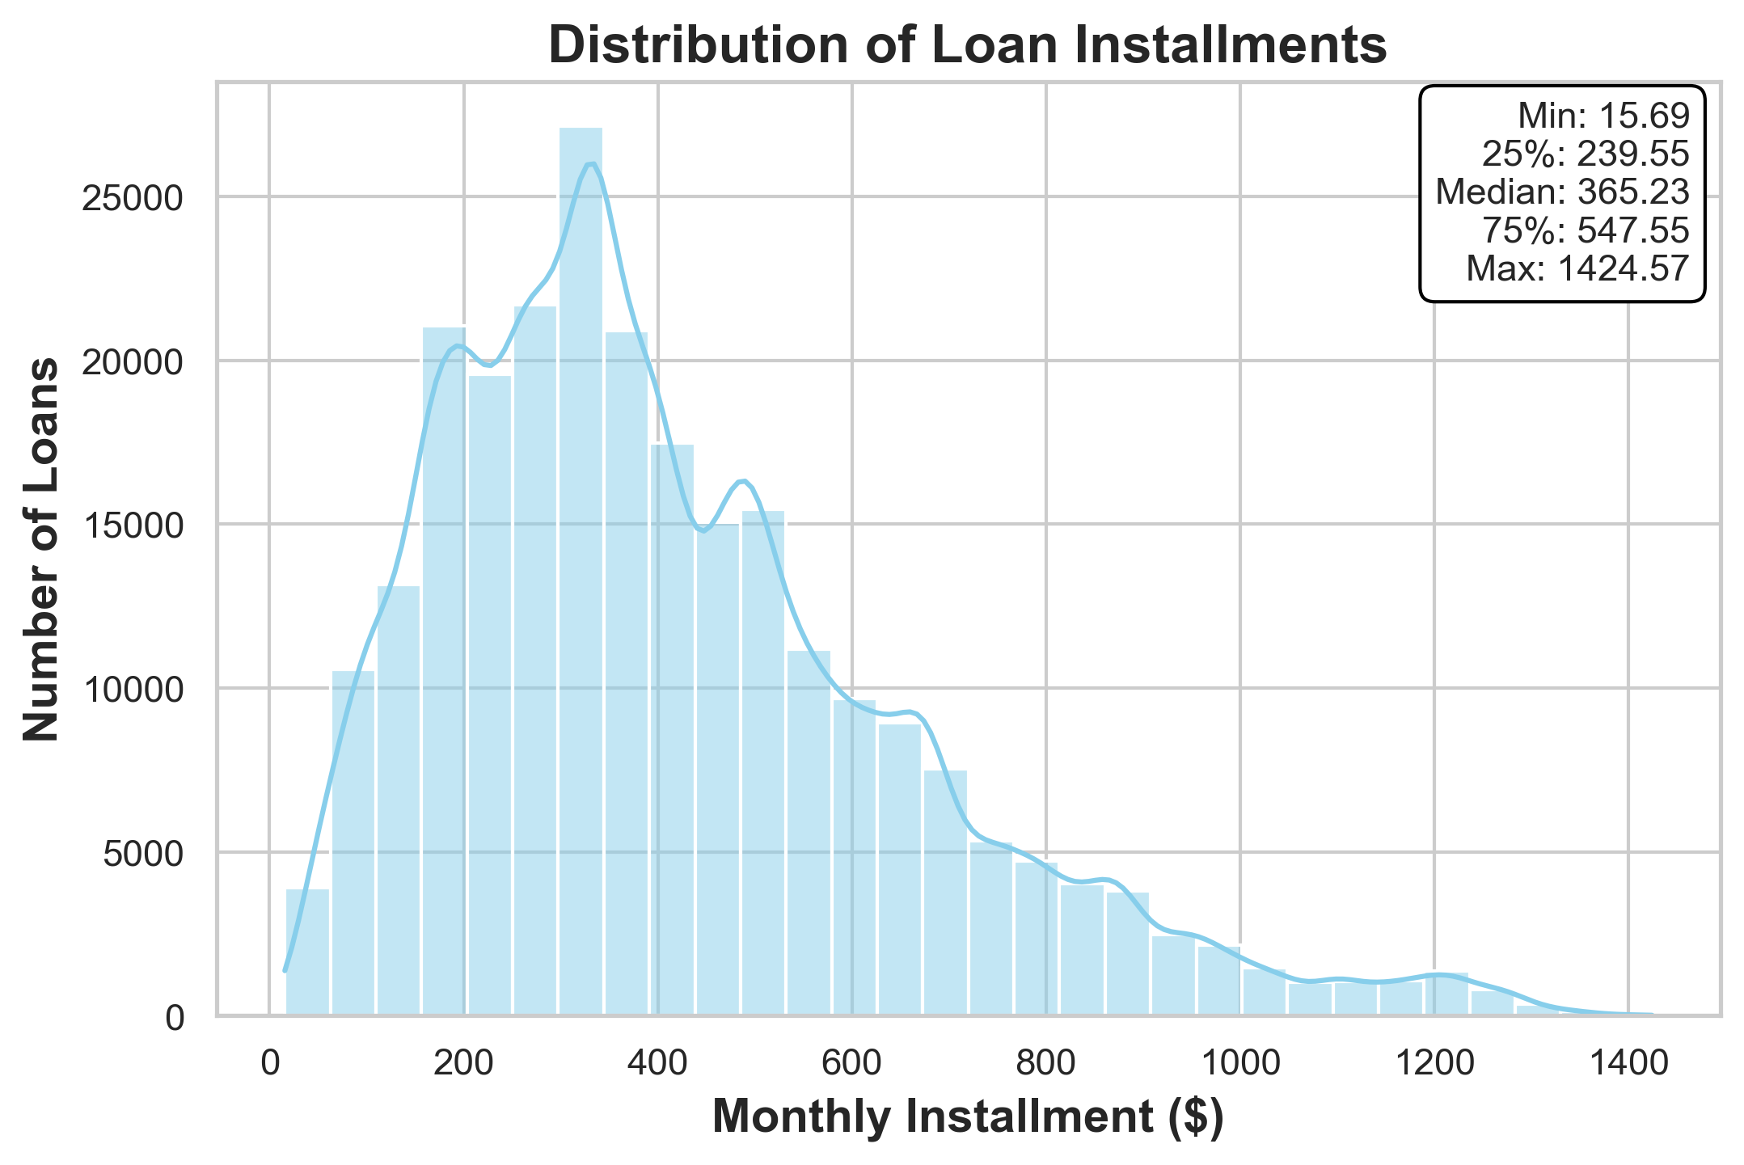
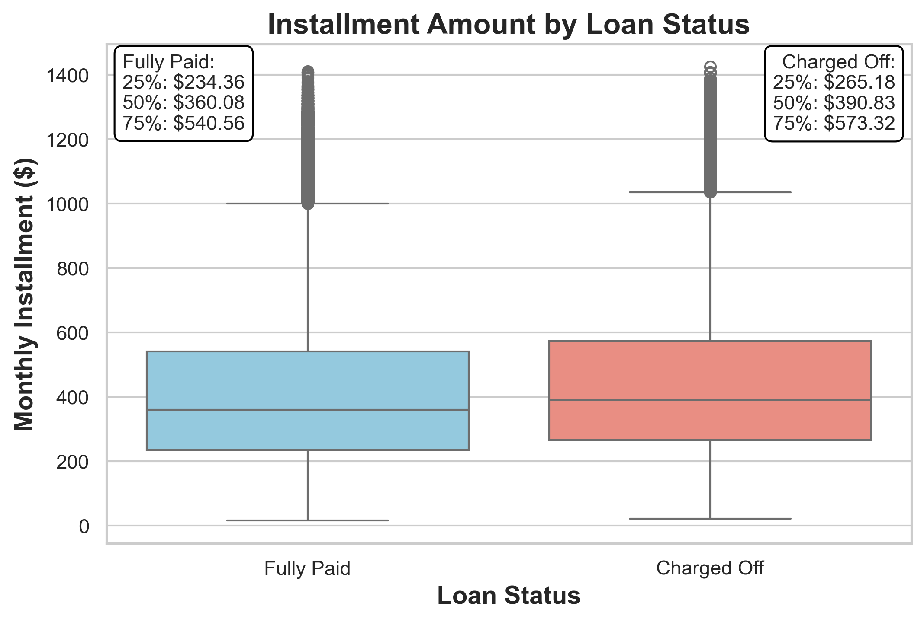
Installment

Slide 12
Insights
Higher loan amounts, longer terms, and higher interest rates significantly increase default risk.

Slide 13
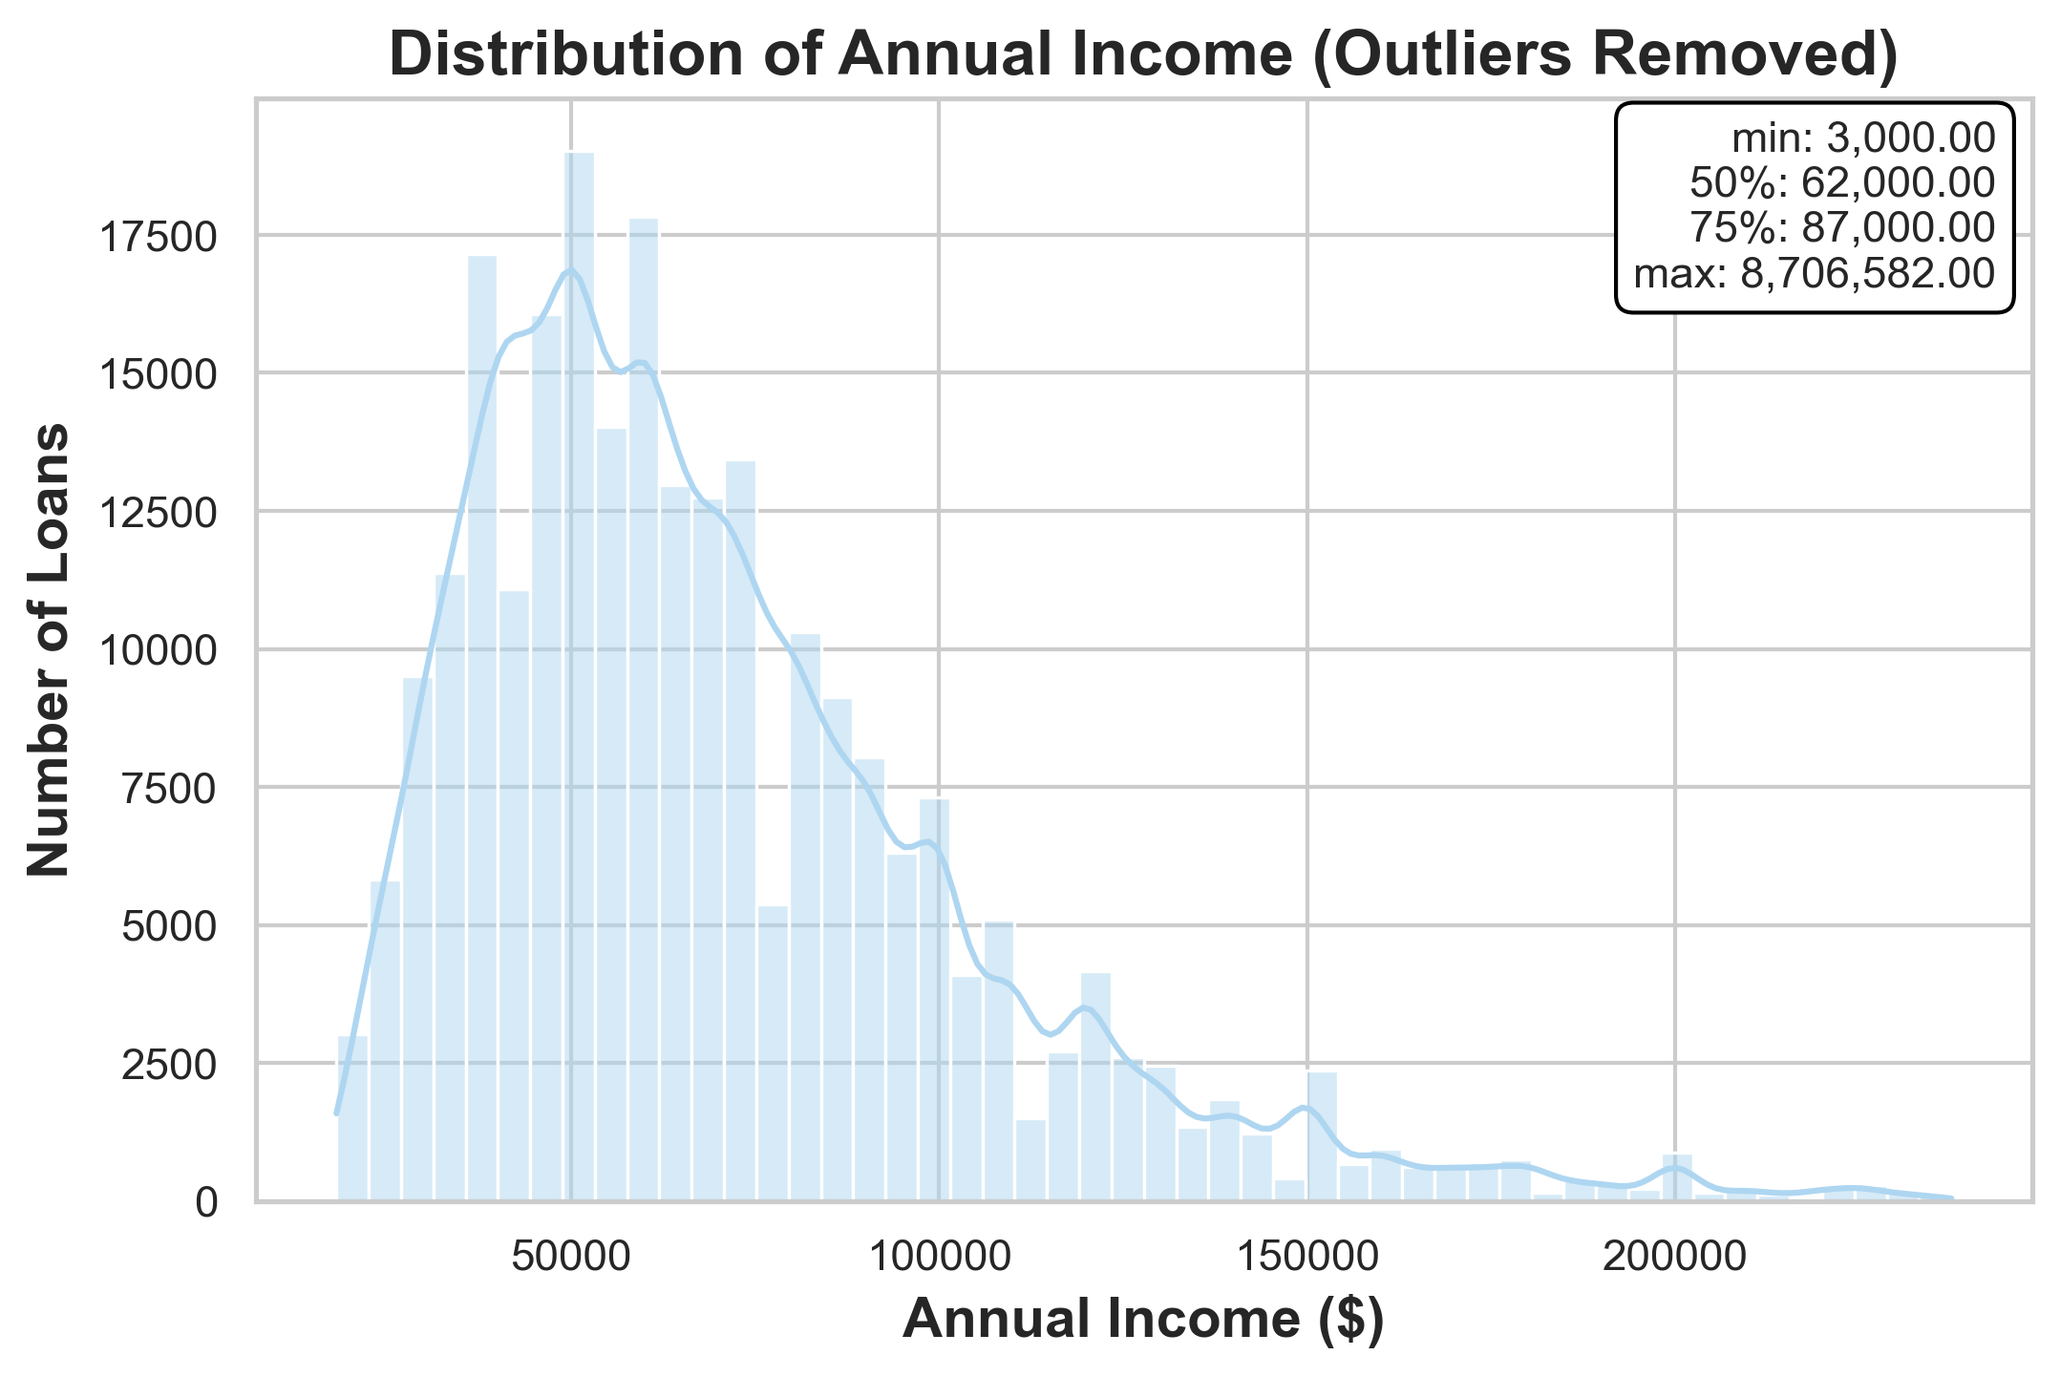
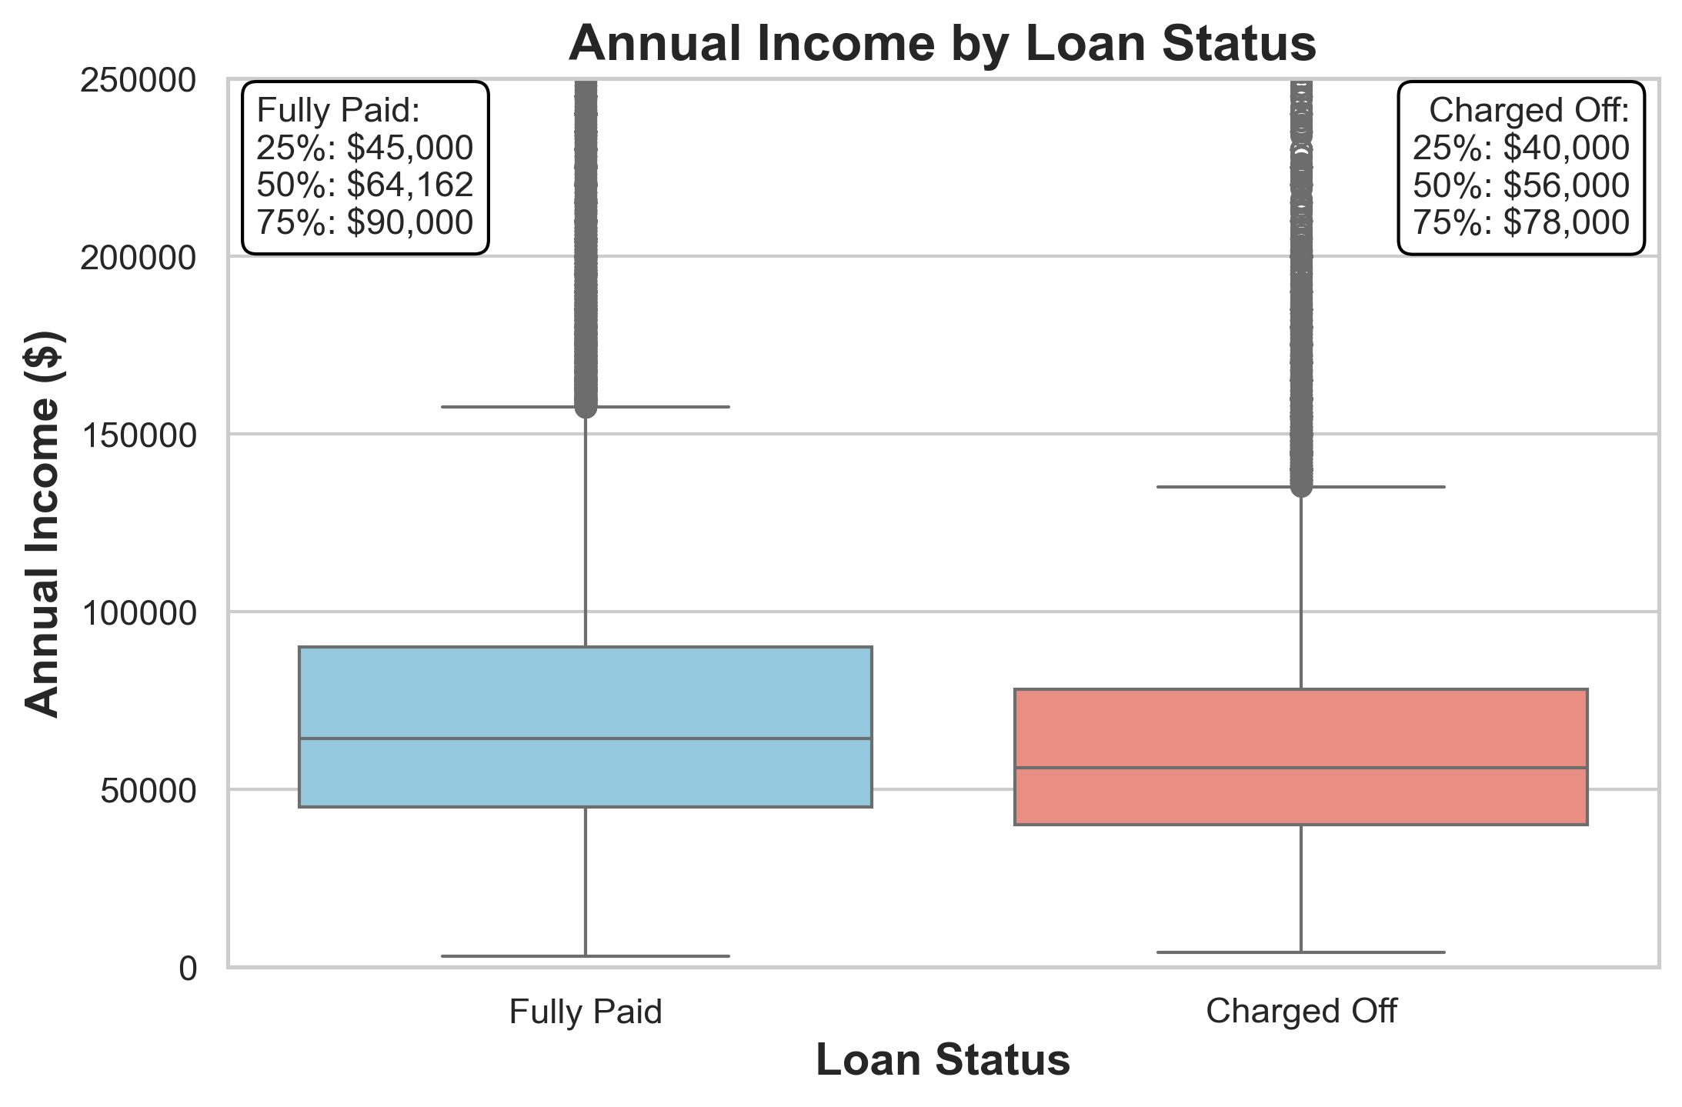
Borrower Financial Strength-
Annual Income

Slide 14
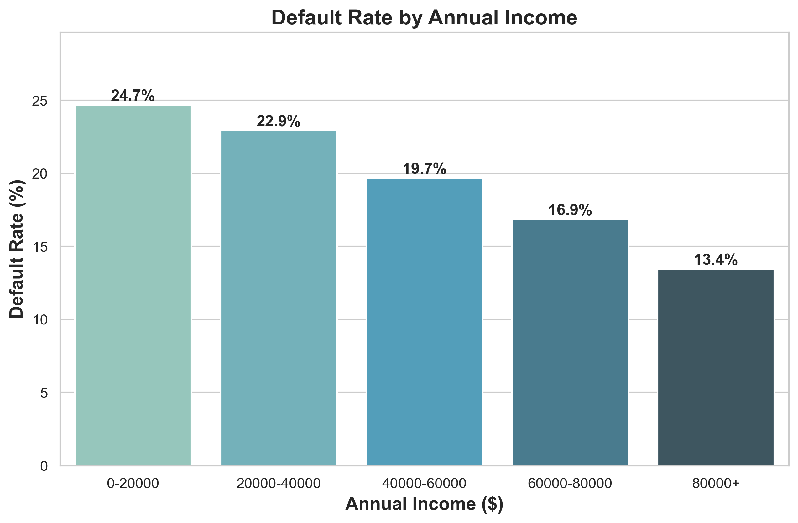
Default Rate

Slide 15
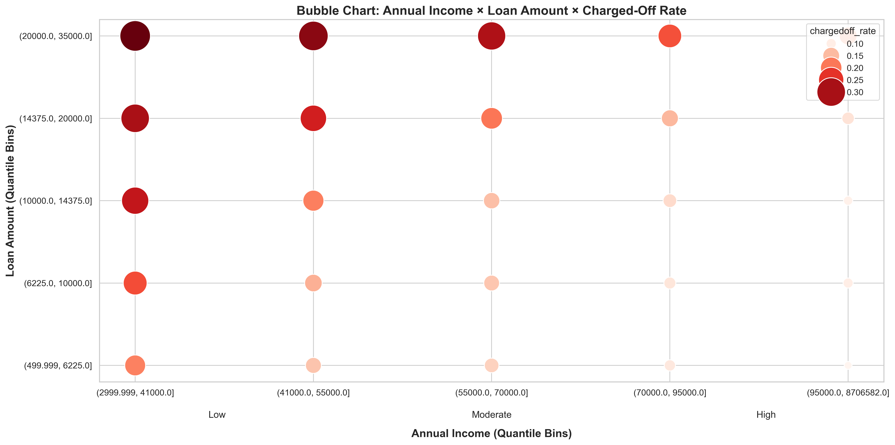

Slide 16
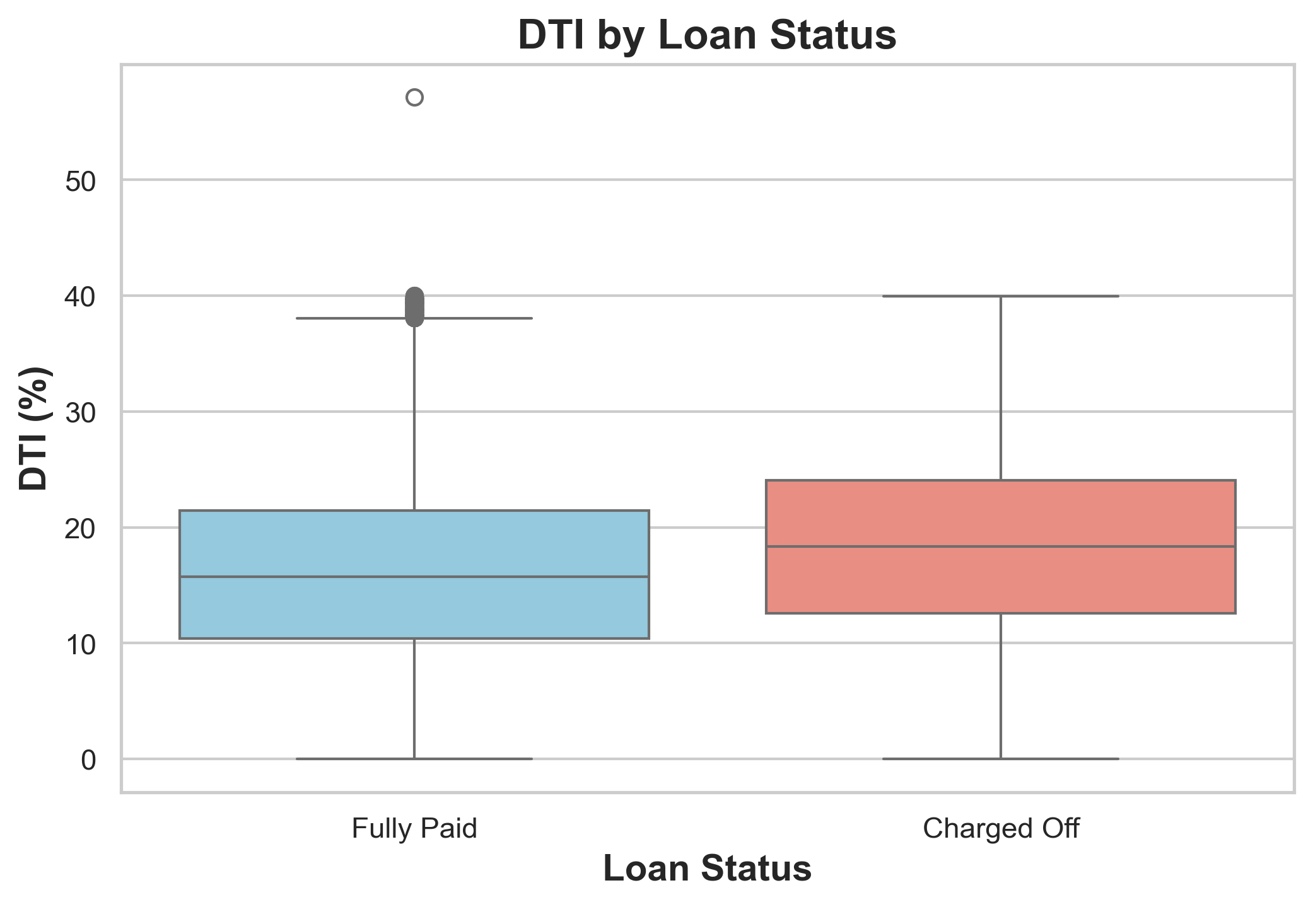
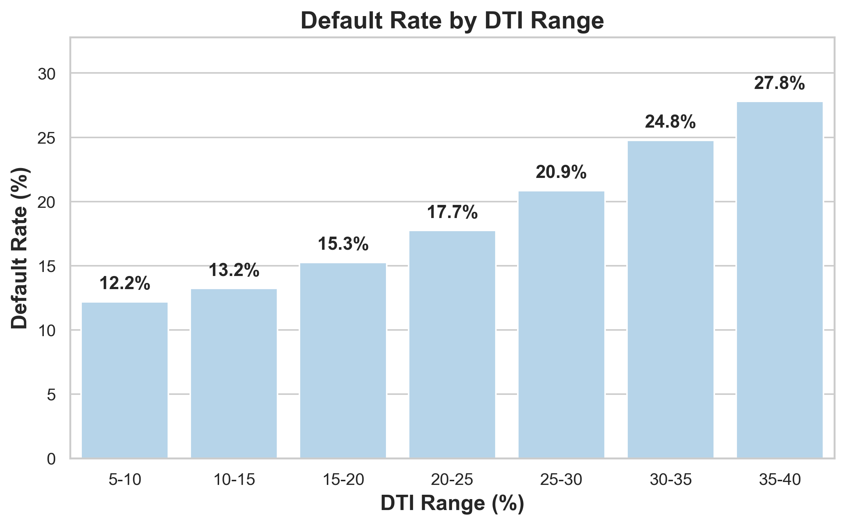
Debt Burden & Default Risk
DTI: the percentage of a borrower’s monthly income that goes toward paying existing debts

Slide 17
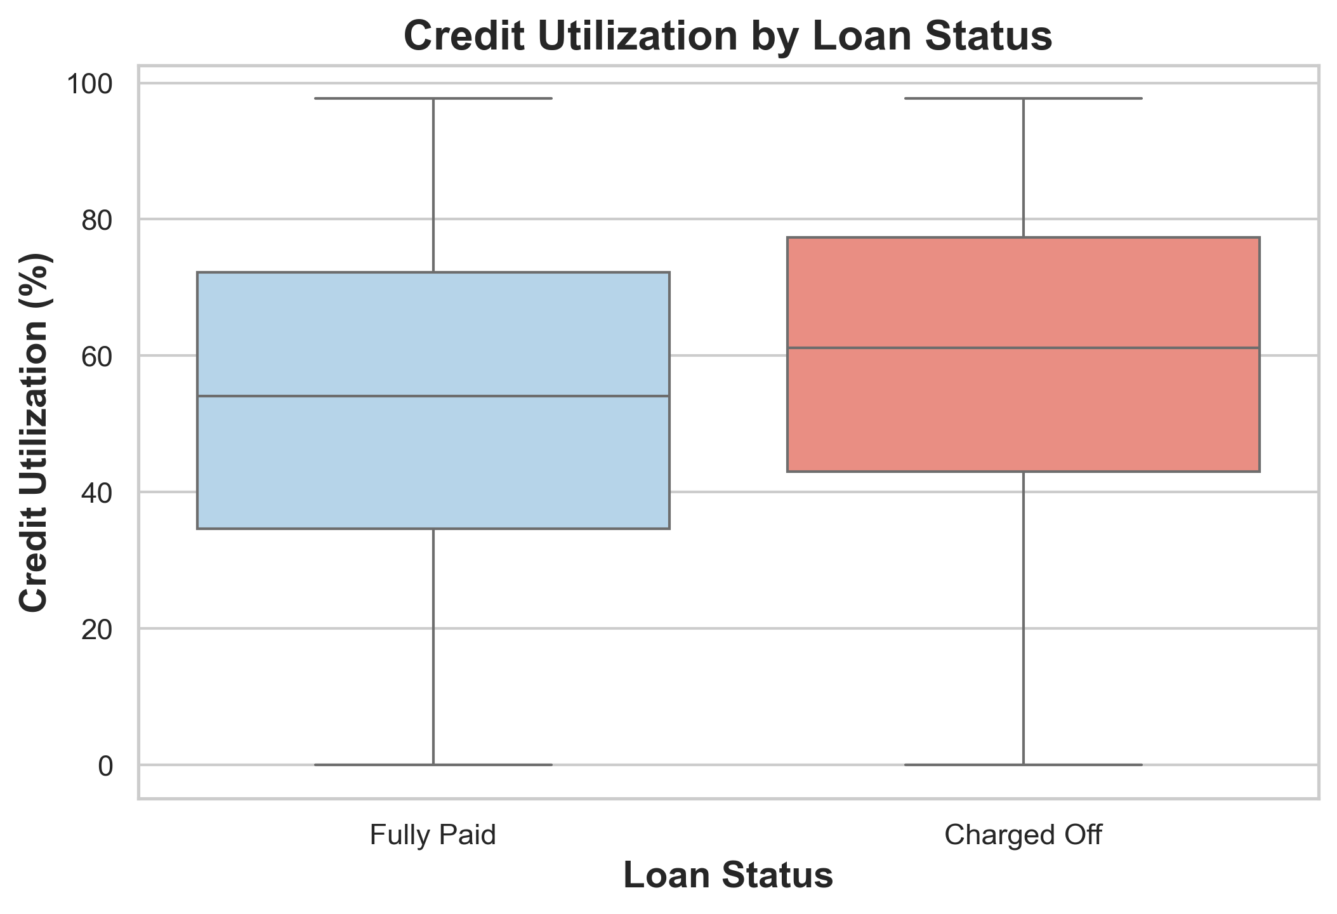
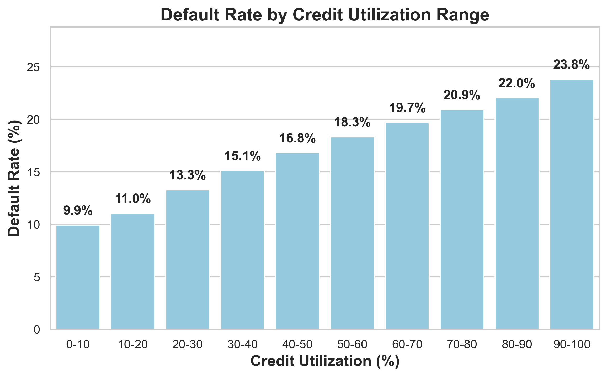
Revolve Utilization
Rev_util: credit utilization percentage on borrower’s credit cards/accounts.
Borrowers who heavily depend on credit lines are significantly more likely to default.

Slide 18
Insights
Higher loan amounts, longer terms, and higher interest rates significantly increase default risk.
Lower income, higher debt burden, and high credit utilization strongly increase default risk.

Slide 19
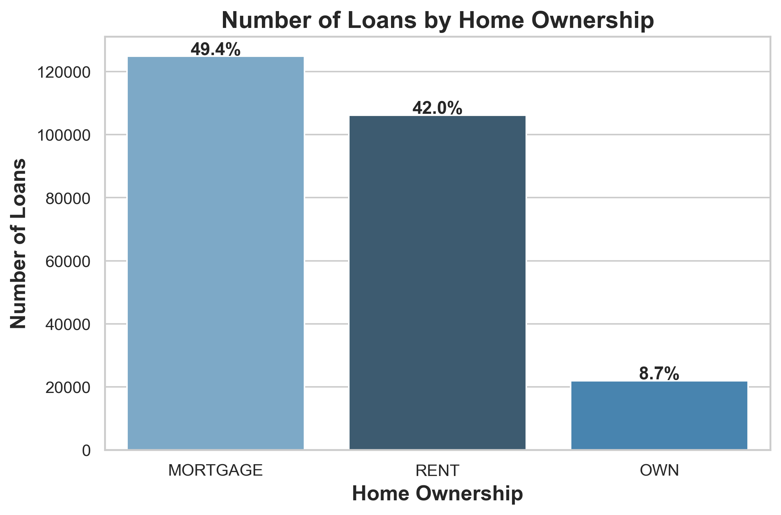
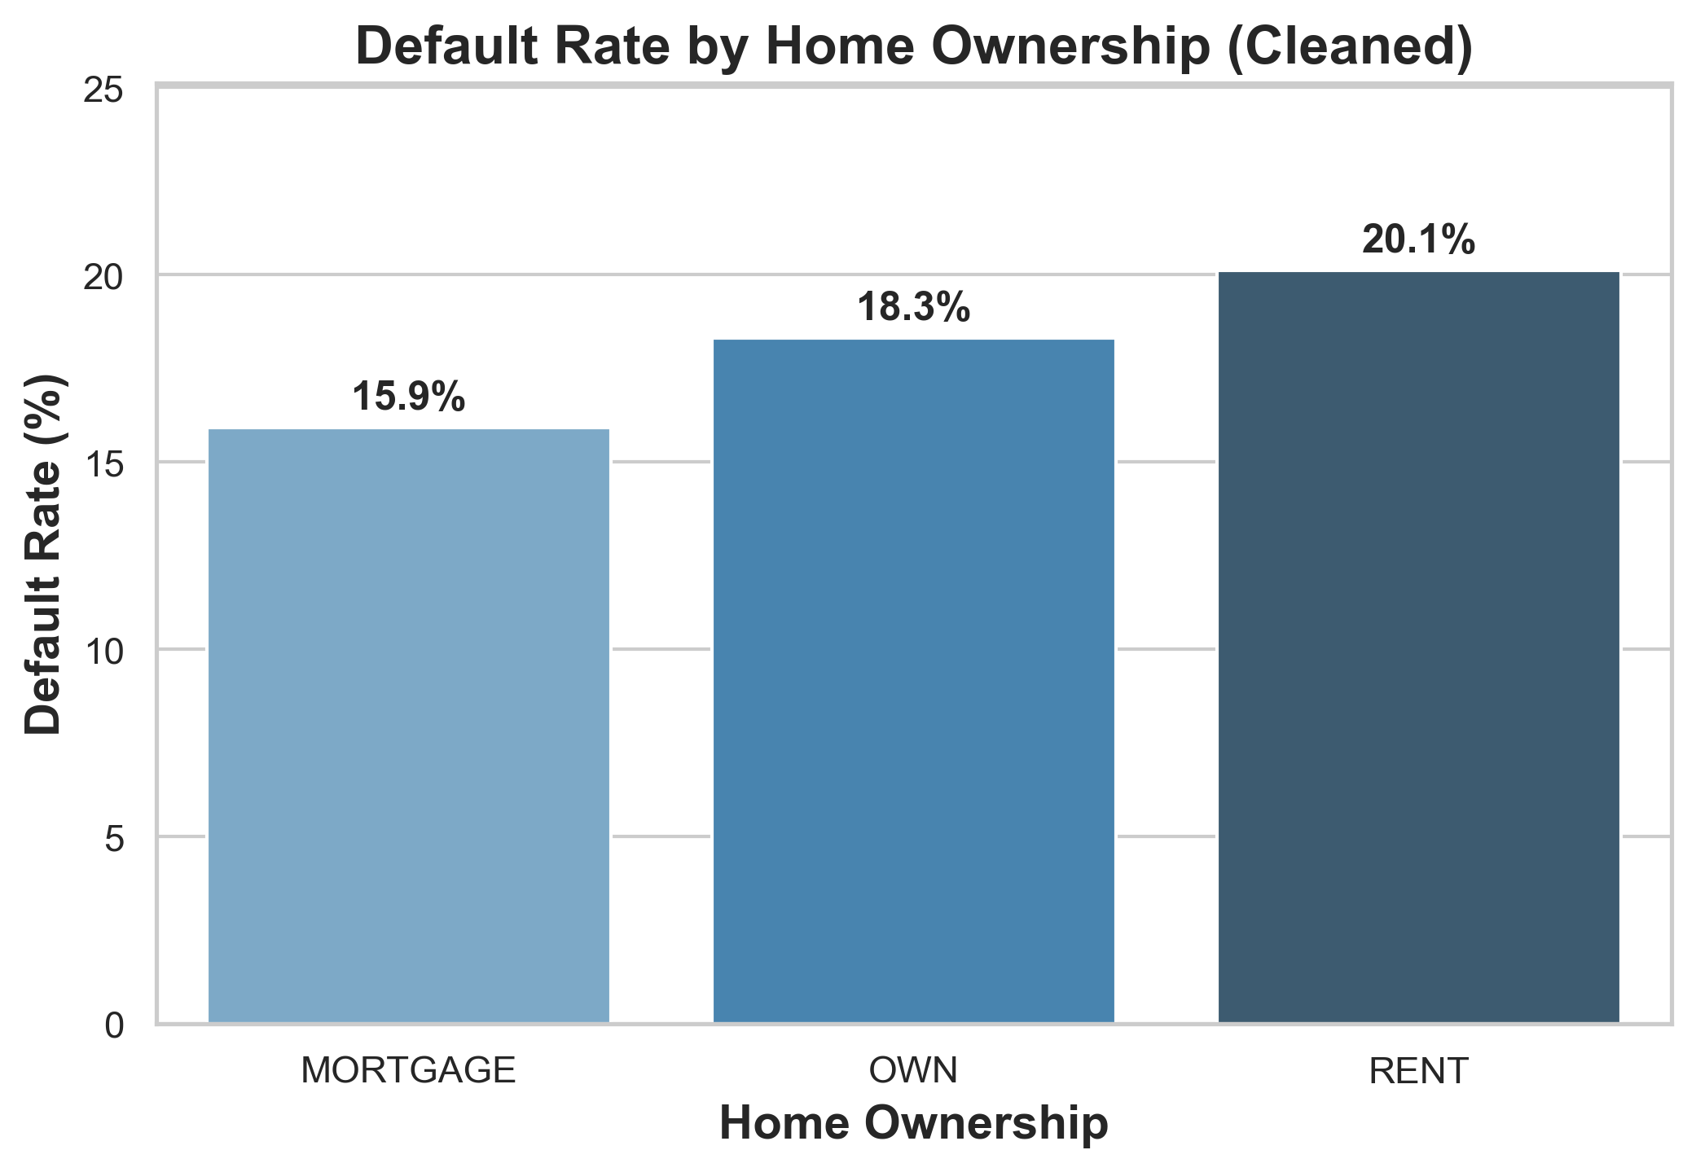
Demographics – Home Ownership

Slide 20
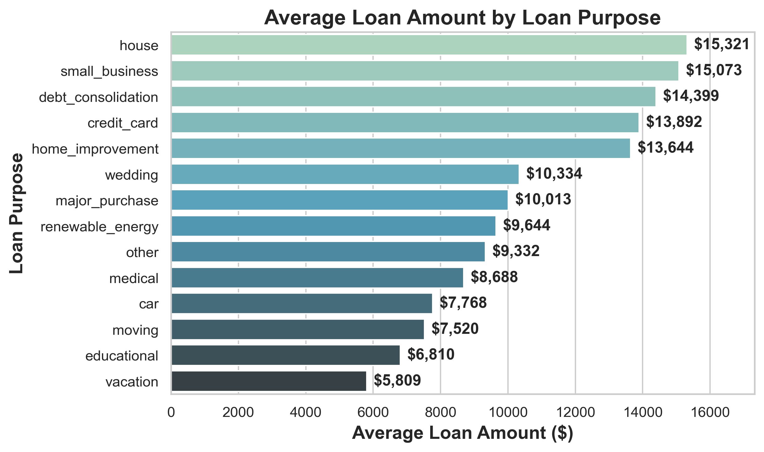
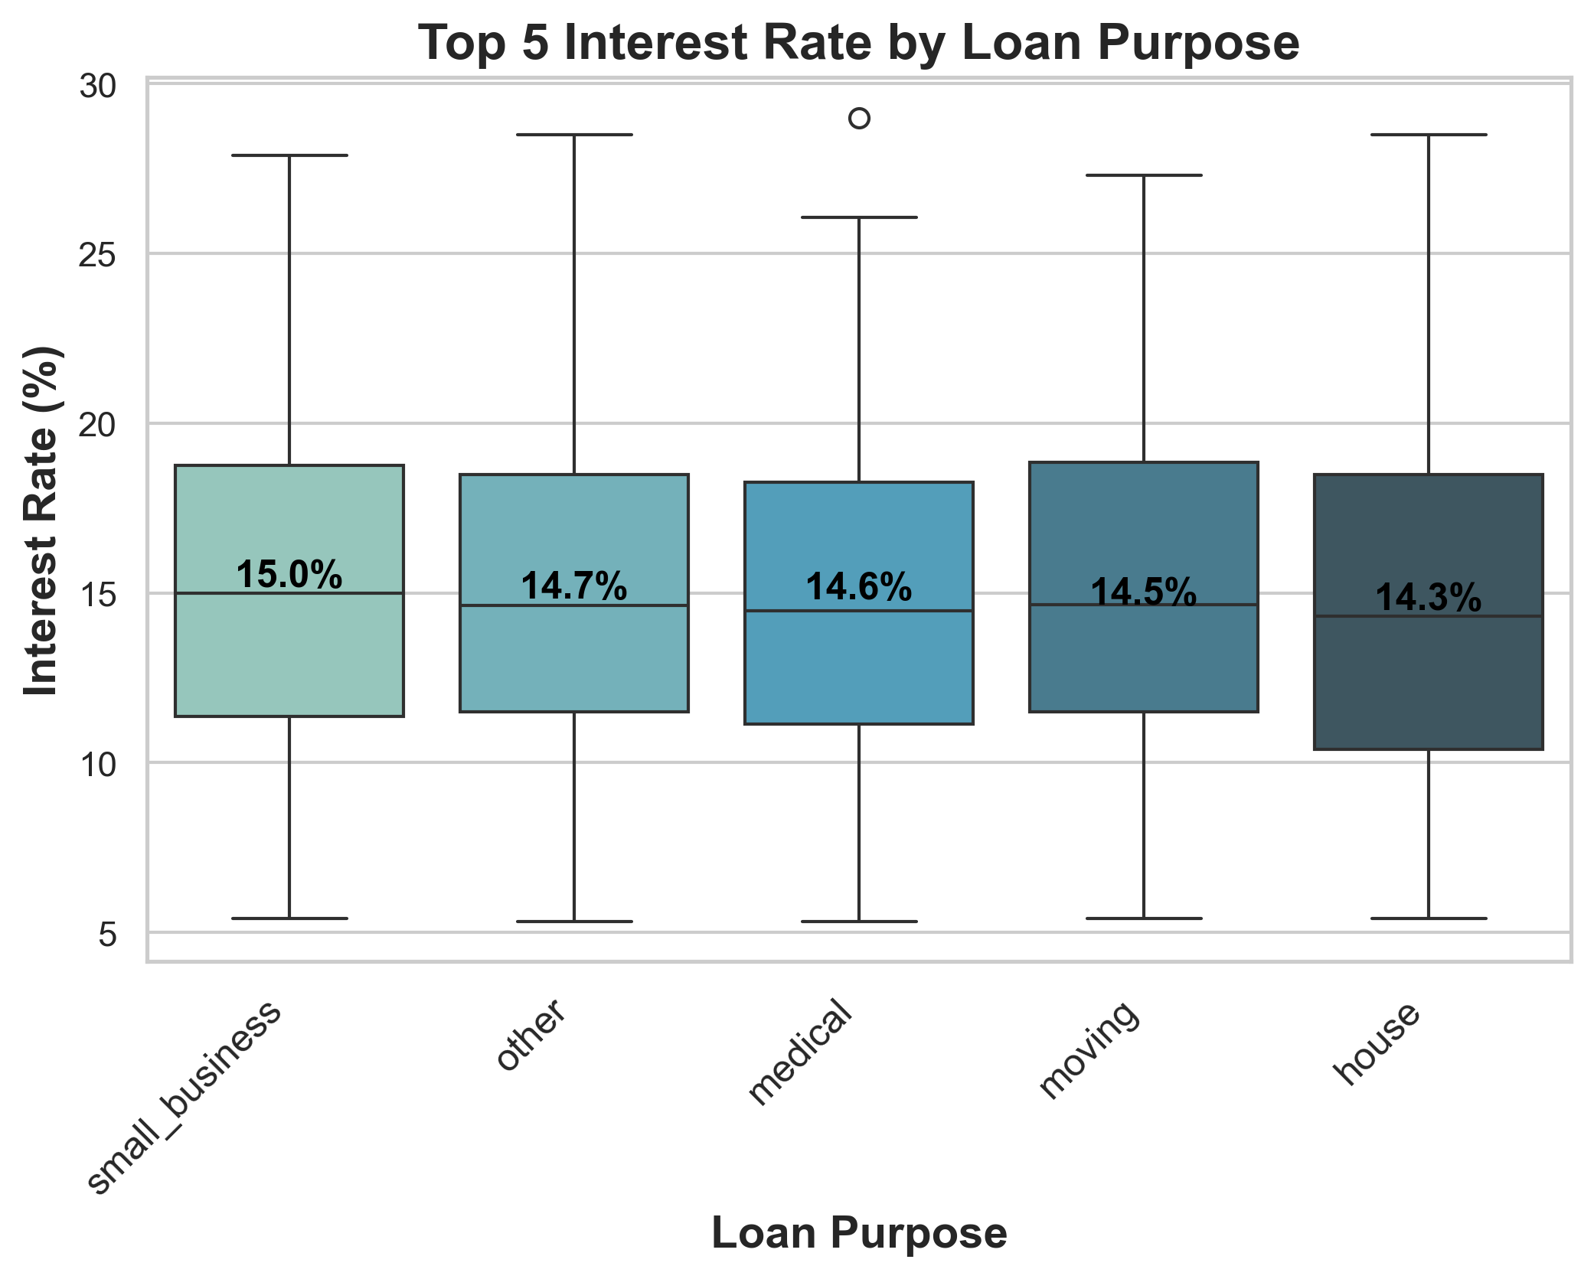
Purpose of Loan

Slide 21
Key Takeaways
Higher loan amounts, longer terms, and higher interest rates significantly increase default risk.
Lower income, higher debt burden, and high credit utilization strongly increase default risk.
Renters default more than homeowners.
Lending Club adjusts pricing (interest rates) based on loan purpose and associated risk.
Small business loans carry higher risk and interest rates.

Slide 22
Loan Prediction

Slide 23
Models Used
Two models used for classification:
Logistic Regression
Random Forest Classifier
Trained on:
Cleaned and Engineered Features
OneHot Encoding + Scaling
2 Different dataset (Training & Test)
Test dataset Observation (759,338 Loans)

Slide 24
Model Evaluation Matrix & Comparison
Accuracy: Overall Correct Prediction
Precision: Out of Predicted Defaulters, how many were correct?
Recall: Out of all actual Defaulters, How many were caught
F1-Score: Balance b/w Precision & Recall (Risk Control)
Metric | Logistic Regression | Random Forest
Accuracy | 0.95 | 0.97
Default Precision | 0.68 | 0.98
Default Recall | 0.62 | 0.67
F1-Score | 0.65 | 0.79

Slide 25
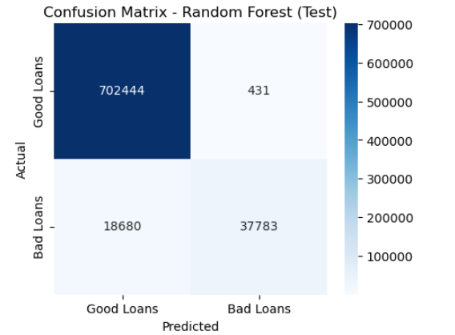
Confusion Matrix – Random Forest
Corrected Prediction: 740,227 cases
Incorrect Prediction: 19,111 Loans

Slide 26
Thank you!

