Slide 1

Top Product: CTE de Blaye Sales Analysis using Northwind Dataset
Key insights, trends, and growth opportunities
CTE de Blaye is our top-selling product. Let’s see where it performs, why, and how we can grow sales further.

Slide 2
Northwind Trading Company
Sample database for sales and business analysis, representing a fictitious trading company.
Northwind Traders buys specialty foods from suppliers and sells them in bulk to customers (other businesses)
Covers customers, suppliers, products, orders, order details, and employees.
Useful for analyzing sales trends, customer behavior, inventory, and supplier performance.

Slide 3
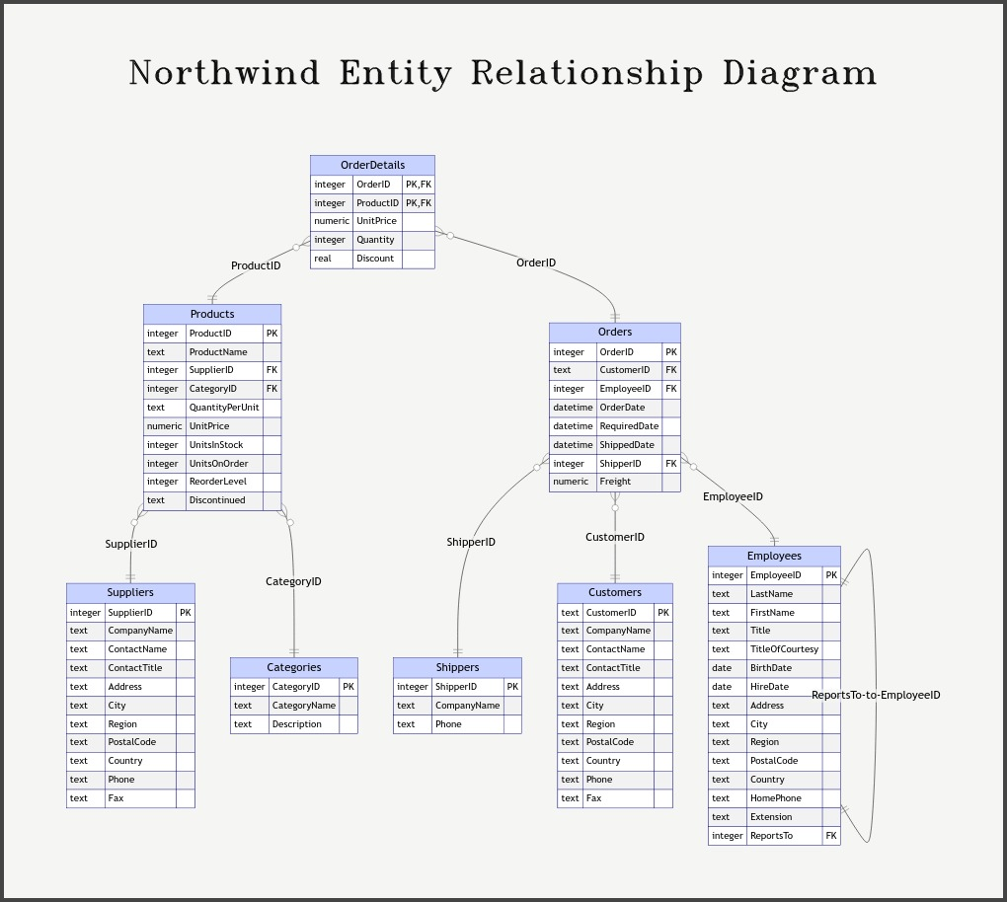

Slide 4
⚠️Problem Statement 🎯Project Goal
CTE de Blaye is a top-selling product, but there is limited visibility into its performance across countries, territories, and customer segments.
Lack of insights into seasonal sales trends, cross-selling opportunities, and employee contribution to revenue.
Without deeper understanding, growth opportunities may be missed, and resources may not be allocated efficiently.
Analyze sales performance of CTE de Blaye across products, countries, and territories.
Identify high-value customers, seasonal trends, and cross-selling opportunities to maximize revenue.
Evaluate employee performance and provide actionable recommendations for strategic decision-making.

Slide 5
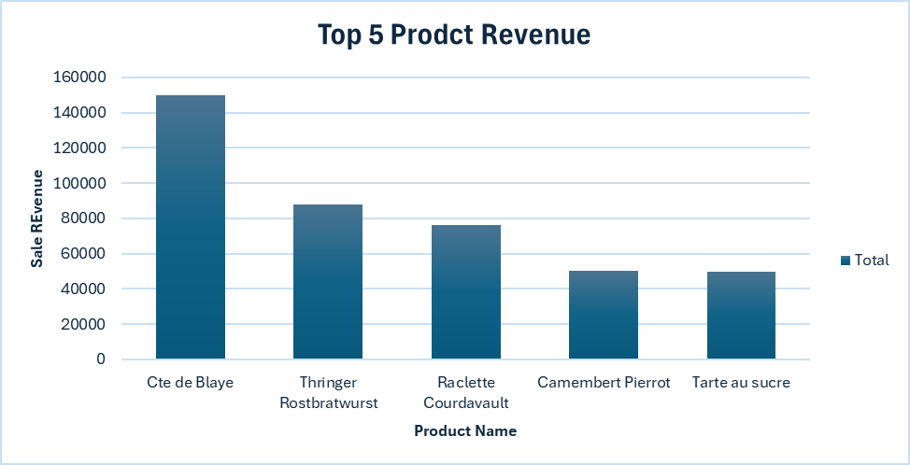
Top 5 Product Generating Revenue
Top 3 Categories:
Cte de Blaye
Thringer Rostbratwurst
Raclette Courdavult
CTE de Blaye contributing 11% of total revenue while 2nd product contributes 6.48%.

Slide 6
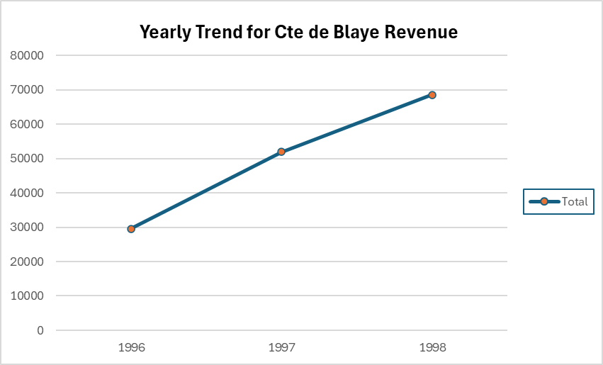
Sales show a steady upward trend year over year, reflecting growing demand
Temporal Sales Trend

Slide 7
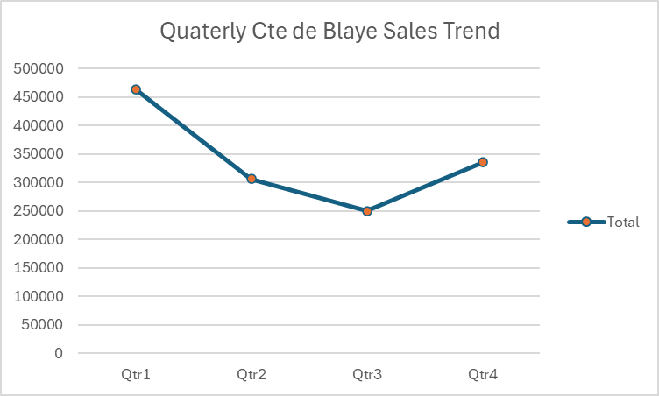
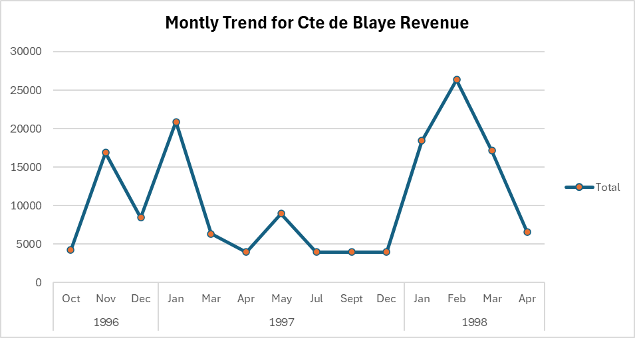
Quarter & Monthly Sales Trend – Cte de Blaye
Peaks (Q4–Q1): Boost campaigns during holidays & winter when demand is highest.
Mid-Year Dip: Introduce summer-friendly pairings / limited editions to smooth seasonality.
Optimize Distribution: Ensure high availability in peak months, manage leaner stock in off-season.

Slide 8
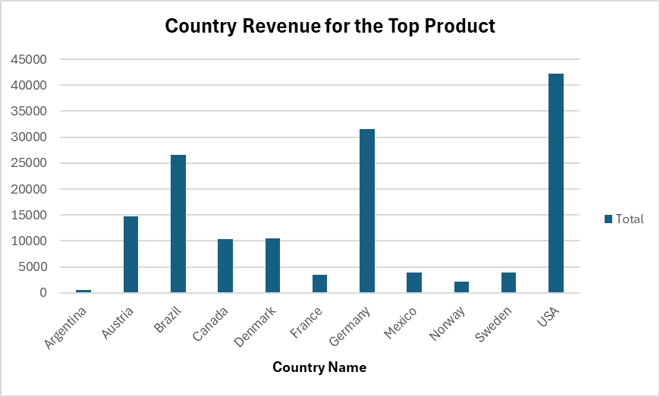
Geographic Performance
Revenue by Country for Cte de Blaye
Top Revenue Contributors:
USA
Germany
Brazil
Austria
Some countries with lower sales may represent untapped market potential.

Slide 9
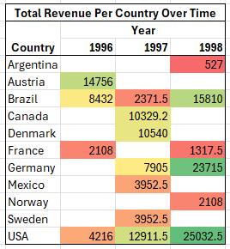
Country Behavior Over Time
Geographic Performance
Invest in growing markets, Reactivate one-off bulk markets, Reconsider weak/unprofitable markets.

Slide 10
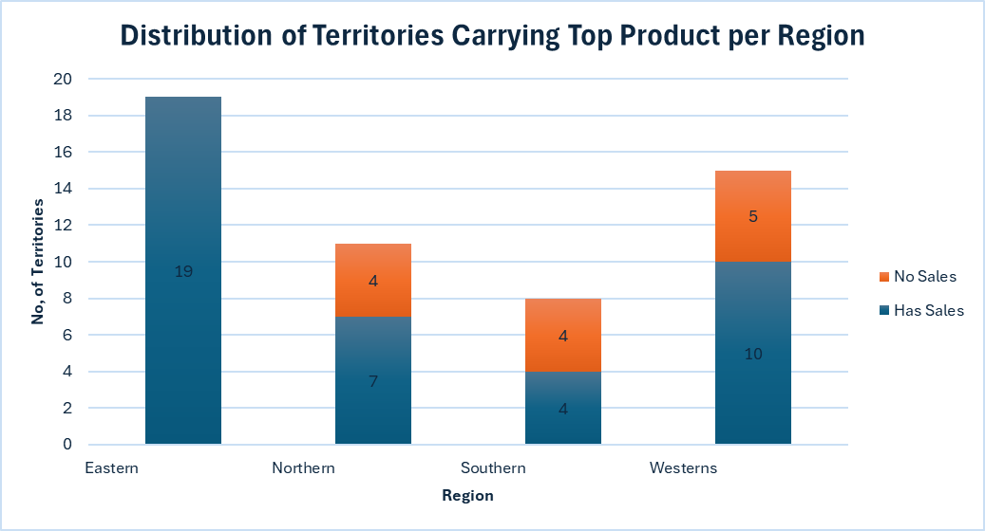
Territorial Analysis
Wide product adoption (75% of territories engaged).
Focus growth efforts on inactive northern, southern, and western territories.
Consider regional promotions to boost awareness and trial in underperforming territories.

Slide 11
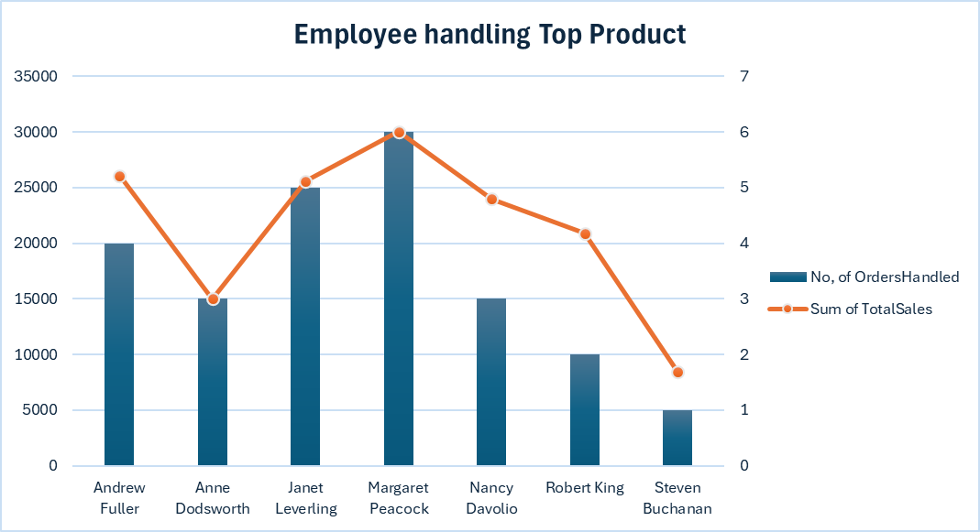
Employee Performance
Margaret generates the highest sales revenue, showing her ability to maximize order value.
Andrew places the most number of orders, highlighting strong customer engagement and activity.
Steven is consistently low in both orders and sales → needs coaching/support.

Slide 12

Territories vs Employee Performance
Eastern employees dominate sales (3 out of top 4 performers).
Robert underperforms with 10 territories in Western region.
Janet (Southern) shows strong efficiency and consistency.
Northern region contribution is lowest (Anne).
Strategy:
Expand Southern coverage, optimize Western & Northern.
Ensure allocation is based on market potential, not just equal headcount.
Train underperformers to raise baseline performance.
Janet

Slide 13
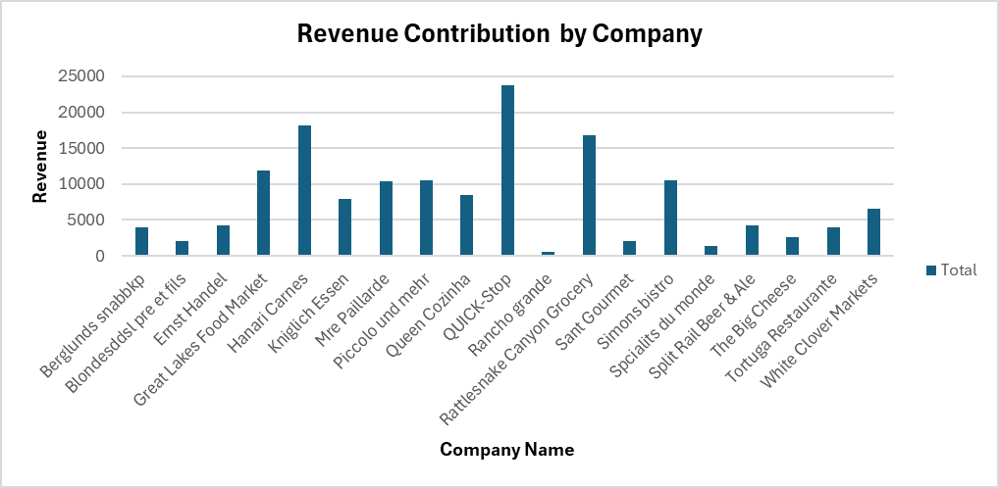
Customer Insights
Top Customers:
QUICK-Stop
Hanari Carnes
Rattlesnake Canyon Grocery
Strategy:
Focus personalized service for top accounts, while designing targeted promotions to activate and grow smaller customers.

Slide 14
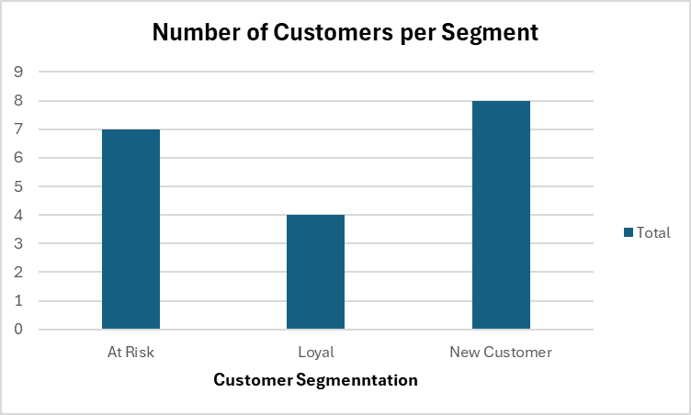
Customer Segmentation
Loyal customers buy frequently and generate highest revenue.
At-risk customers purchased previously but haven’t returned.
New customers entered in 1998, indicating healthy investment.
Strategy:
Loyal: Retain with rewards, exclusives, and early access.
At-Risk: Re-engage via discounts or direct outreach.
New: Onboard with support and tailored offers.

Slide 15
Cross-Selling Opportunities
Shows products that are bought frequently alongside Cte de Blaye
Flotemysost and Scottish Longbreads are most frequent products

Slide 16
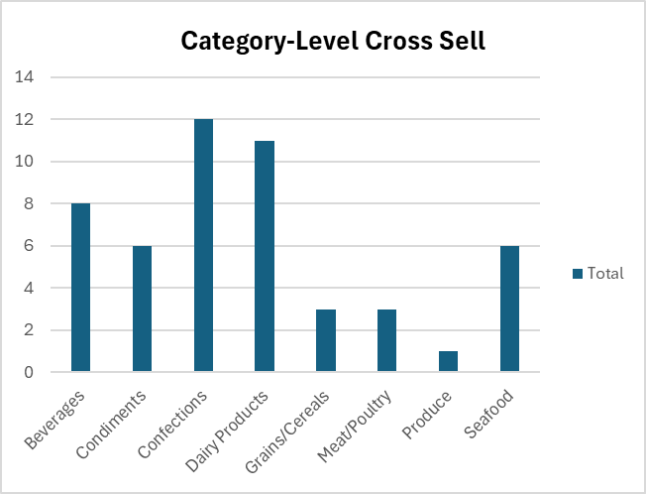
Cross Selling Opportunities
Côte de Blaye is frequently paired with Confections, Dairy, and Beverages — strong potential for bundle and cross-promotion strategies.

Slide 17

Conclusion
Cte de Blaye leads revenue, with growth in U.S., Germany, and Brazil; Austria and weaker markets need reassessment.
Sales are rising year-over-year, peaking in Q4–Q1, with mid-year dips.
Employee & territory performance is uneven.
Customers split into loyal, at-risk, new and top accounts (e.g., QUICK-Stop) need tailored engagement.
Cross-selling potential with Flotemysost, Scottish Longbreads, and categories like Confections, Dairy, and Beverages.

Slide 18

Recommendations
Focus on high-growth countries, optimize weak ones.
Maximize Q4–Q1 peaks, smooth seasonal dips with summer campaigns.
Train underperformers, expand strong Southern region, rebalance coverage.
Strengthen loyalty & re-engage at-risk customers.
Use bundling & category promotions to boost revenue.

Slide 19
Thank you

