Slide 1

Top Product: CTE de Blaye Sales Analysis using Northwind Dataset
Key insights, trends, and growth opportunities
CTE de Blaye is our top-selling product. Let’s see where it performs, when, and how we can grow sales further.

Slide 2
Northwind Trading Company
Sample database for sales and business analysis, representing a fictitious trading company.
Northwind Traders buys specialty foods from suppliers and sells them in bulk to customers (other businesses)
Covers customers, suppliers, products, orders, order details, and geographical information.
Useful for analyzing sales trends, customer behavior, inventory, and supplier performance.

Slide 3
🎯Project Goal
⚠️Problem Statement
How can we drive growth for CTE de Blaye by better understanding its sales performance?
The goal of this project is to analyze sales performance, uncover seasonal and cross-selling patterns, and provide actionable recommendations to support growth and strategic decision-making.

Slide 4
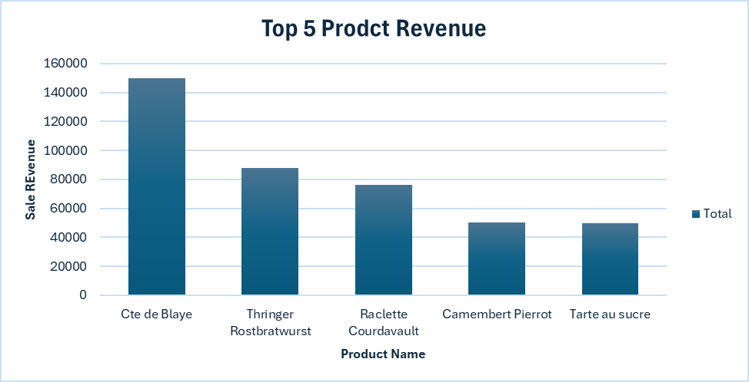
Top 5 Product Generating Revenue
Top 3 Categories:
Cte de Blaye
Thringer Rostbratwurst
Raclette Courdavult
CTE de Blaye contributing 11% of total revenue while 2nd product contributes 6.48%.

Slide 5
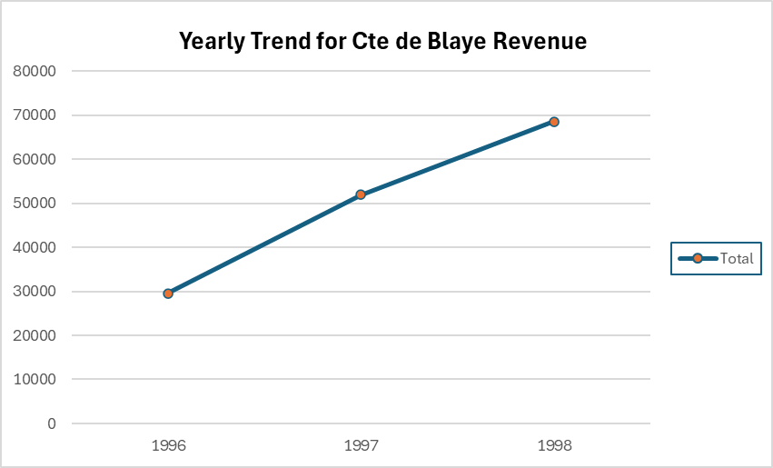
Sales show a steady upward trend year over year, reflecting growing demand
Temporal Sales Trend
32%
76%

Slide 6
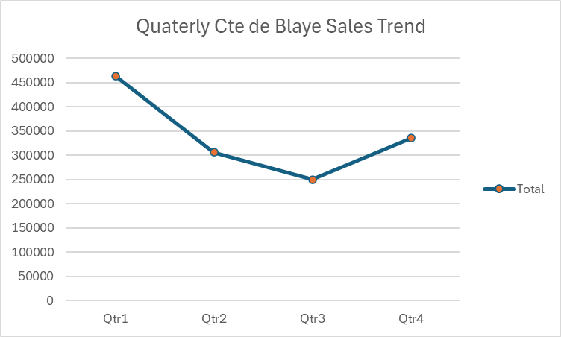
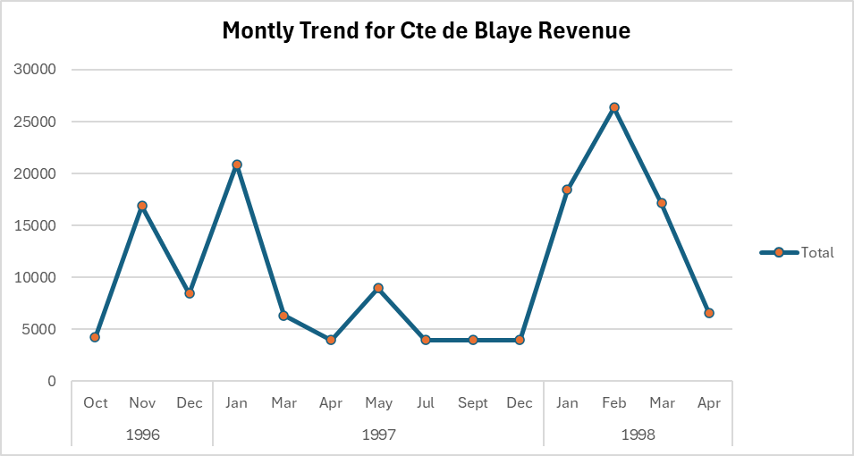
Quarter & Monthly Sales Trend – Cte de Blaye
Peaks (Q4–Q1): Boost campaigns during holidays & winter when demand is highest.
Mid-Year Dip: Introduce summer-friendly pairings / limited editions to smooth seasonality.
Optimize Distribution: Ensure high availability in peak months, manage leaner stock in off-season.

Slide 7
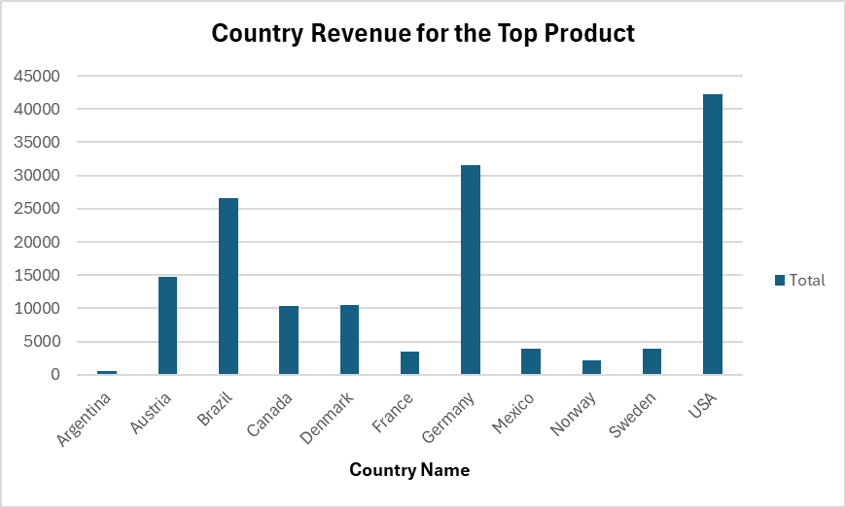
Geographic Performance
Revenue by Country for Cte de Blaye
Top Revenue Contributors:
USA
Germany
Brazil
Austria
Some countries with lower sales may represent untapped market potential.

Slide 8
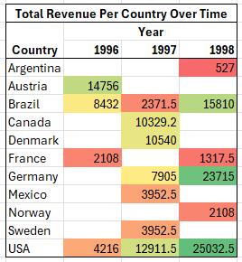
Country Behavior Over Time
Geographic Performance
Invest in growing markets, Reactivate one-off bulk markets, Reconsider weak/unprofitable markets.

Slide 9
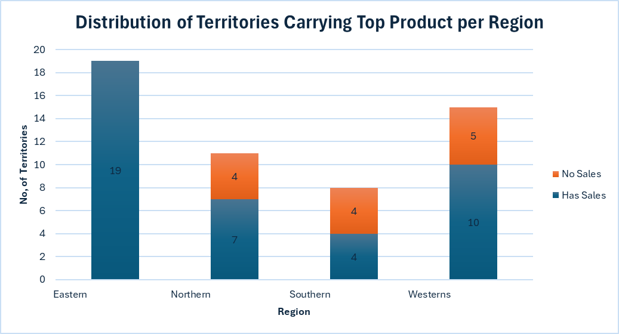
Territorial Analysis
Wide product adoption (75% of territories engaged).
Focus growth efforts on inactive northern, southern, and western territories.
Consider regional promotions to boost awareness and trial in underperforming territories.

Slide 10
Cross-Selling Opportunities
Shows products that are bought frequently alongside Cte de Blaye
Flotemysost and Scottish Longbreads are most frequent products

Slide 11
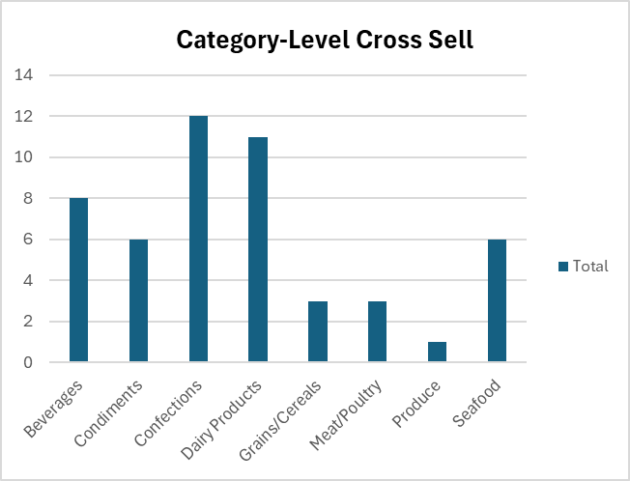
Cross Selling Opportunities
Côte de Blaye is frequently paired with Confections, Dairy, and Beverages — strong potential for bundle and cross-promotion strategies.

Slide 12

Conclusion
Cte de Blaye leads revenue, with growth in U.S., Germany, and Brazil; Austria and weaker markets need reassessment.
Sales are rising year-over-year, peaking in Q4–Q1, with mid-year dips.
Cross-selling potential with Flotemysost, Scottish Longbreads, and categories like Confections, Dairy, and Beverages.

Slide 13

Recommendations
Focus on high-growth countries, optimize weak ones.
Maximize Q4–Q1 peaks, smooth seasonal dips with summer campaigns.
Use bundling & category promotions to boost revenue.

Slide 14
Thank you

