Slide 1
instructions

Slide 2
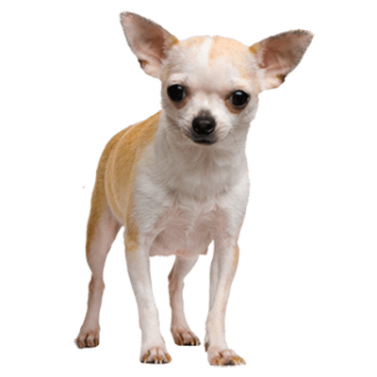
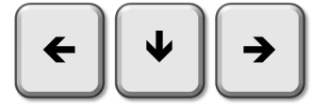
Visual
chihuahua
hummingbird
chihuahua
hummingbird
2 seconds

Slide 3
reminders

Slide 4
Two descriptions will appear on the screen, followed by an object.
Choose the correct description by pressing LEFT or RIGHT.
Please answer as fast as you can!
Press any key to start.

