Slide 1
instructions

Slide 2
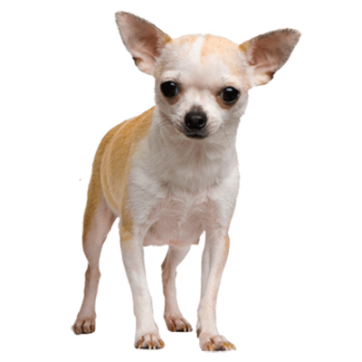
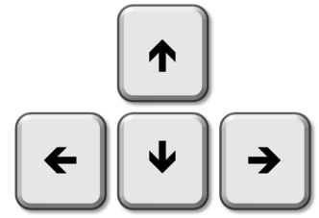
Familiarization
chihuahua
hummingbird
2 seconds

Slide 3
Encoding

Slide 4
Select the location of the next object. Press a key to continue…
remembered
select
forgotten
counter-
clockwise
clockwise

Slide 5
Number Task
73
odd
even

Slide 6
Retrieval
chihuahua
hummingbird
forgotten
remembered
forgotten

Slide 7
reminders

Slide 8
You will see an object on the screen, followed by two possible descriptions.
Please choose the correct description by pressing LEFT or RIGHT.
You will then see whether your answer was correct or incorrect.
Press any key to start.

Slide 9
One location around the circle will be highlighted, then an object is shown.
When you are ready to continue to the next object, press UP.
Every now and then, you are shown an object and asked to remember their location. If you remember the location, press UP, otherwise press DOWN.
You then choose the location. Use LEFT and RIGHT to move around the circle and UP to select a location.
You are shown whether your answer was correct or incorrect.
Press any key to start.
remembered
forgotten
select
counter-
clockwise
clockwise

Slide 10
Is the number displayed ODD or EVEN?
Try to answer for as many numbers as you can.
Use LEFT for ODD and RIGHT for EVEN.
Press any key to start.
odd
even

Slide 11
One location around the circle will be highlighted.
When you remember the corresponding object, press the UP arrow. If you have forgotten the object, press DOWN.
Then think about the object for 3 seconds. Try to remember the details.
Every now and then, you will be shown two possible descriptions of the object.
Choose the correct description by pressing LEFT or RIGHT.
If you have forgotten, press DOWN.
Press any key to start.
remembered
forgotten
forgotten

Slide 12
One location around the circle will be highlighted.
When you remember the corresponding object, press the UP arrow. If you have forgotten the object, press DOWN.
You will then be shown two possible descriptions of the object.
Choose the correct description by pressing LEFT or RIGHT.
If you have forgotten, press DOWN.
Press any key to start.
remembered
forgotten
forgotten

