Slide 1
instructions

Slide 2
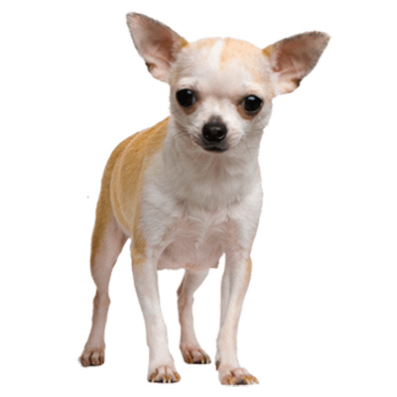
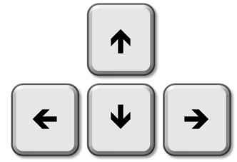
Familiarization
chihuahua
hummingbird
chihuahua
hummingbird
2 seconds

Slide 3
Encoding

Slide 4
Select the location of the next object. Press a key to continue…
remembered
select
forgotten
counter-
clockwise
clockwise

Slide 5
Number Task
73
odd
even

Slide 6
Retrieval
chihuahua
hummingbird
chihuahua
hummingbird
forgotten
forgotten
2 seconds

Slide 7
reminders

Slide 8
Two descriptions will appear on the screen, followed by an object.
Please choose the correct description by pressing LEFT or RIGHT.
You will then see whether your answer was correct or incorrect.
Press any key to start.

Slide 9
One location around the circle will be highlighted, then an object is shown.
When you are ready to continue to the next object, press UP.
Every now and then, you are shown an object and asked to remember their location. If you remember the location, press UP, otherwise press DOWN.
You then choose the location. Use LEFT and RIGHT to move around the circle and UP to select a location.
You are shown whether your answer was correct or incorrect.
Press any key to start.
remembered
forgotten
select
counter-
clockwise
clockwise

Slide 10
Is the number displayed ODD or EVEN?
Try to answer for as many numbers as you can.
Use LEFT for ODD and RIGHT for EVEN.
Press any key to start.
odd
even

Slide 11
You will be shown two possible descriptions. Please read these descriptions.
After 2 seconds, one location around the circle will be highlighted.
Try to remember the corresponding object.
Then, choose the description that matches the remembered object,
by pressing LEFT or RIGHT.
If you have forgotten, press DOWN.
Press any key to start.
forgotten

