Slide 1
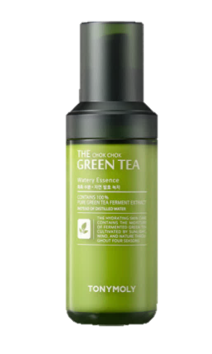

THE CHOK CHOK GREEN TEA_ WATERY ESSENCE
55ml
100% moist! Moister and milder antioxidant watery essence 100% pure naturally fermented green tea water
Watery essence containing 100% pure naturally fermented green tea water (Cheongtaejeon)
Mitigates irritation and maximizes moistness through 365-day natural fermentation
Intensive moisture care essence that quickly moisturizes the skin
Moist watery essence without stickiness
Safe ingredients that have obtained EWG Green rating
Dermatologically tested
Notes:
Seerumi, ei jätä tahmaiseksi

