Slide 1
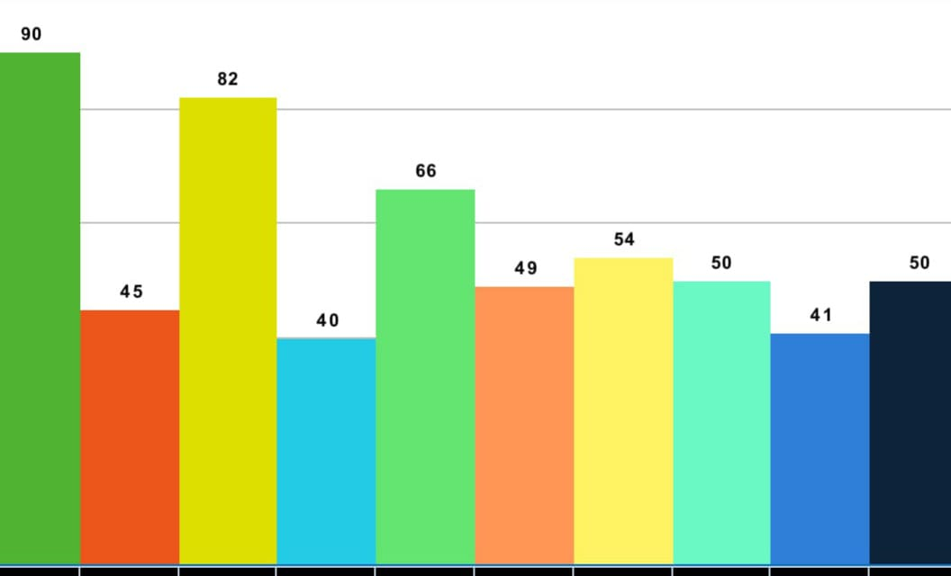
2
The answer to the first question
……
There is a relationship between age and income, as when a the age is greater the income increase

Slide 2
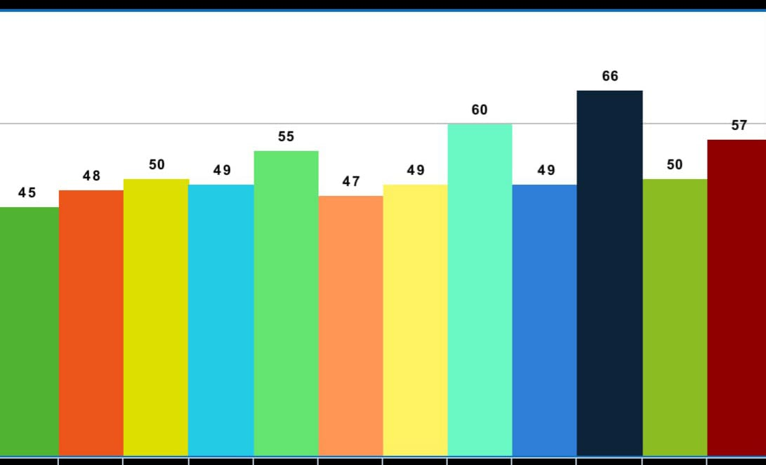
.... Answer q 2:
There is no equality between the income of women and men, as it is clear from the graph that men have a much higher national income than women.

Slide 3
q3
Among the factors that affect an individual's income from Ray:
There are psychological factors that hinder the owner from working if there are problems
A person’s way of thinking and his ability to innovate and innovate in his work and gain the trust of the customer.
Physical health too.

