Slide 1
MeridianAssist: Executive Decision
Option C: Continue with restrictions and explicit conditions
Restrict sensitive / PHI-related workflows pending investigation and control validation
Continue evidence preservation and investigation
Prioritize investment in Initiative 2: Comprehensive Privacy Monitoring and Reporting
Leadership retains authority to suspend use if decision-change triggers occur
Notes:
CIO (~30s): Recommend Option C: continue with restrictions and explicit conditions. Not saying the system is safe; not declaring a confirmed HIPAA breach. Controlled continuation while we reduce exposure, preserve evidence, strengthen controls and determine scope.

Slide 2
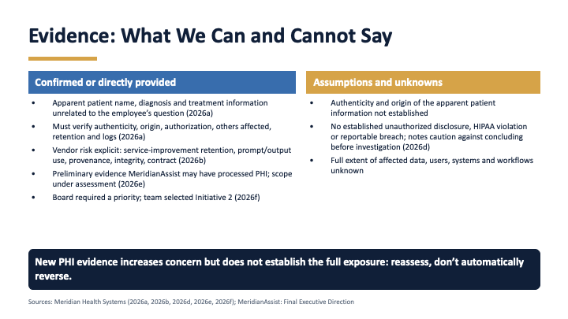

Slide 3
What Changed?
Possible sensitive-data exposure
Apparent patient information unrelated to the question
Vendor retention / service-improvement uncertainty
Possible
Apparent
Unknown
Unverified knowledge source
Possible PHI processing
Need for monitoring and reporting
Unverified
Possible
Needed
Nothing here is a confirmed breach finding: each item is indicated, apparent or unresolved.
Notes:
CIO / Privacy: Evidence raised risk substantially but does not yet establish full scope or a confirmed reportable breach.

Slide 4
Security and Privacy Risk
Security
Privacy
Possible data leakage
Prompt injection / manipulation
Authorization / access-control failure
Data integrity / provenance
Monitoring / logging
Third-party risk
PHI processing
Purpose and authorization
Data minimization
Retention
Vendor access / use
Disclosure
Security asks how information is protected. Privacy asks whether and under what conditions information should be collected, accessed, processed, shared, or retained.
Notes:
CISO: major security risks are leakage, prompt injection, unauthorized access, provenance, vendor risk, monitoring. Privacy: PHI may have been processed; privacy asks whether information should have been collected, accessed, processed, shared or retained at all.

Slide 5
What We Still Don’t Know
How much data was affected?
What information did the user actually receive?
Could the behavior be reproduced?
Which users / systems were affected?
?
?
?
?
Did the vendor receive or retain PHI?
What did the logs show?
What instructions or external content influenced the AI?
Was the questionable knowledge source validated?
?
?
?
?
Unknown does not mean malicious, and possible exposure does not automatically establish a reportable breach.
Notes:
Privacy: we need to determine what PHI was processed, why MeridianAssist had access, who could access it, whether disclosure occurred and whether the vendor received or retained it.

Slide 6
Required Controls
Data leakage
→
Retrieval boundaries and data segmentation
Unauthorized access
→
Least privilege, authentication, authorization
Prompt injection
→
Input controls, testing, human review
PHI / privacy risk
→
Privacy monitoring and reporting
Vendor risk
→
Contractual restrictions and audit evidence
Incident risk
→
Logging, evidence preservation, escalation triggers
Encryption and access controls remain essential, but they do not by themselves resolve retention, vendor-use, governance, monitoring, or broader privacy-accountability questions.
Notes:
CISO: encryption alone cannot solve unauthorized access or inappropriate data use. We need access controls, retrieval boundaries, logging, testing, evidence preservation and incident-response triggers.

Slide 7
Priority Investment: Comprehensive Privacy Monitoring and Reporting
Supports continuous monitoring
Improves visibility
Helps investigation
Provides management reporting
Supports privacy accountability
Helps determine whether controls are working
Tradeoff
Advanced encryption and access-control improvements remain important and required, but some investment is delayed.
Notes:
CFO/Operations (~30s): Initiative 2 gives continuous visibility into whether controls work. Tradeoff: some advanced encryption and access-control investment is delayed, but those controls remain required.

Slide 8
Accountability
CIO
CISO
Privacy
Technology and architecture
Security and investigation
PHI / privacy controls
Legal
CFO
Operations
Compliance and contracts
Investment and financial impact
Workflow implementation
Meridian cannot outsource accountability to the vendor.
Notes:
Legal (~30s): Meridian cannot transfer responsibility to the vendor. We need documentary evidence on retention, deletion, service improvement, training, subprocessors, access, data separation, incident notification and audit, plus the origin and validation history of the knowledge source. Do not label it malicious without evidence.

Slide 9
What Leadership Should Authorize Today
Authorize
Decision-change triggers
Restricted continuation of MeridianAssist
Initiative 2 investment
Evidence preservation and investigation
Vendor evidence requirements
Cross-functional governance
Recurring privacy / security reporting
Confirmed unauthorized PHI disclosure
Repeatable data leakage
Ineffective safeguards
Uncontrolled sensitive-data access
Vendor cannot provide required evidence
Continue under control. Monitor continuously. Investigate completely. Suspend when evidence requires it.
Notes:
Final action (~30s): Authorize restricted continuation, Initiative 2, evidence preservation, investigation, vendor evidence requirements and cross-functional oversight. Expand use only after scope is understood, controls validated, vendor handling documented and monitoring shows controls work.

