Slide 1


[Github Intro]

Slide 2

Some tips you must know…

Slide 3
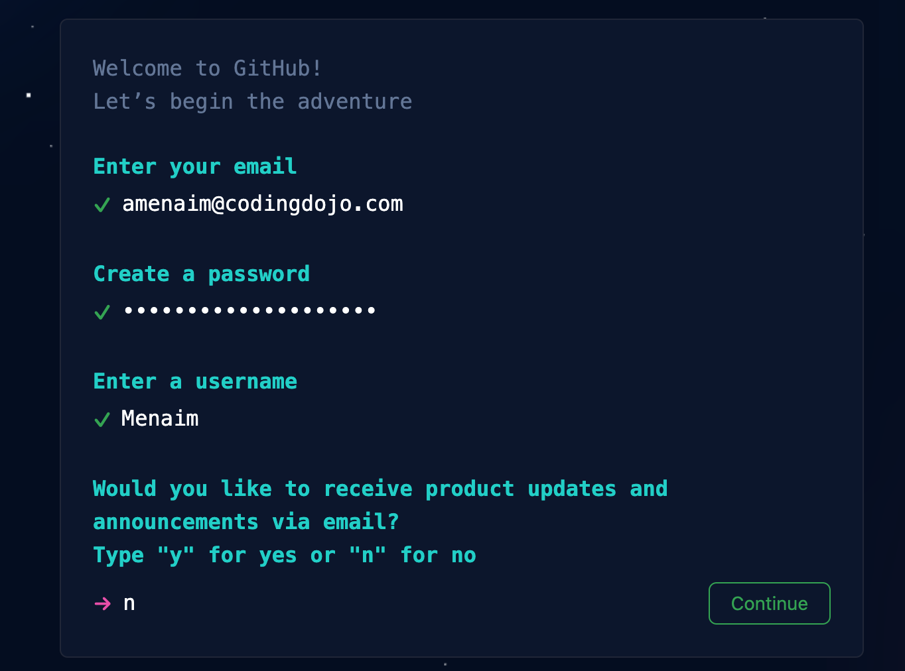
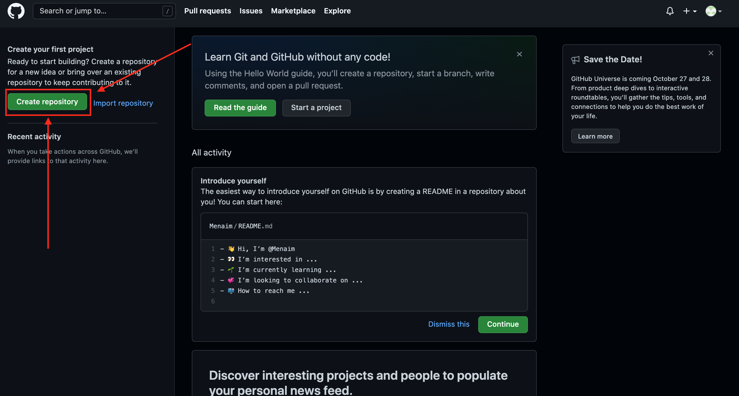
Signup & Login
1- Sign up from here
2- Fill your data
3- Yopy!! You are in the dashboard now
4- Click on create repository

Slide 4
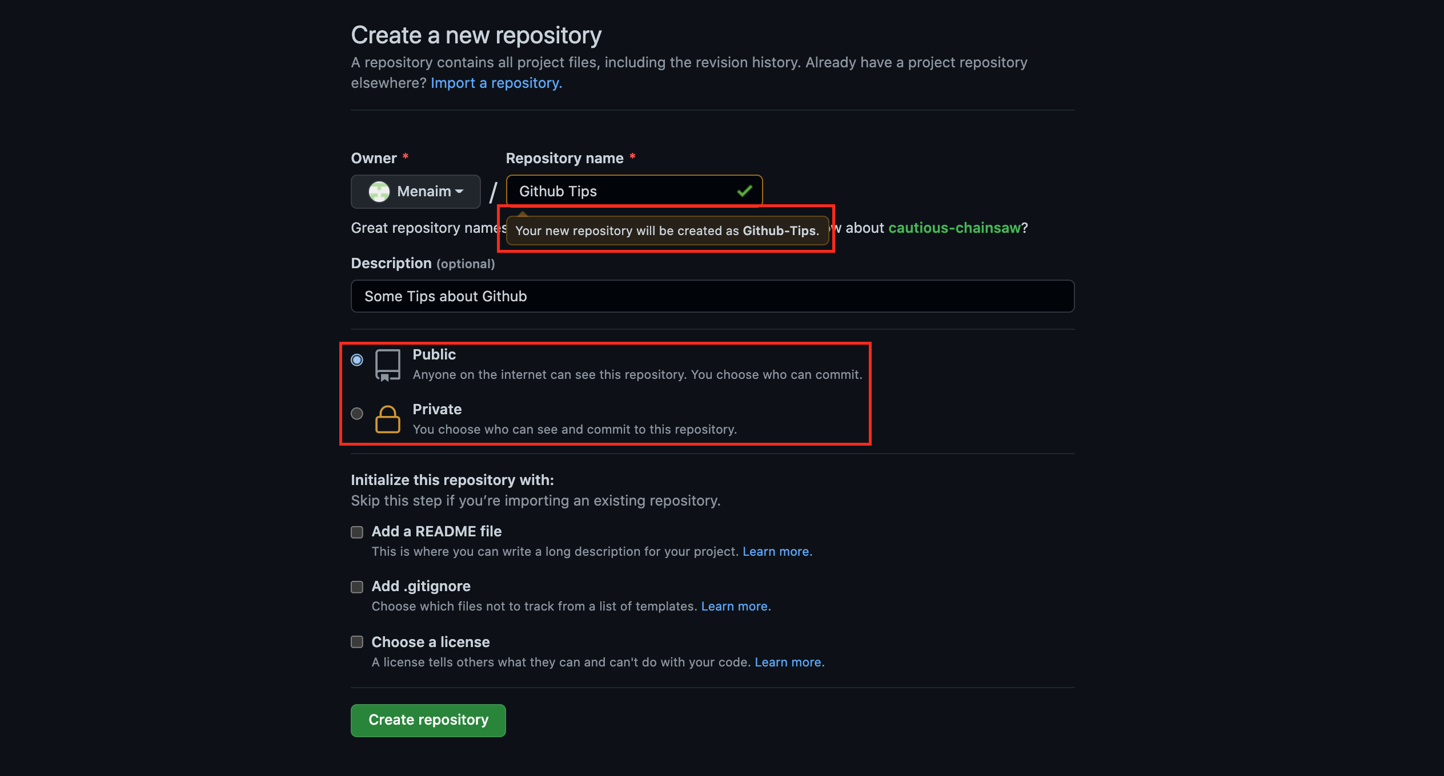
Creating Repo Tips
1- Repository name can’t have spaces
2- You can make it private and share it with your team only “Recommended for private work
3- You can make it public for anyone to see

Slide 5
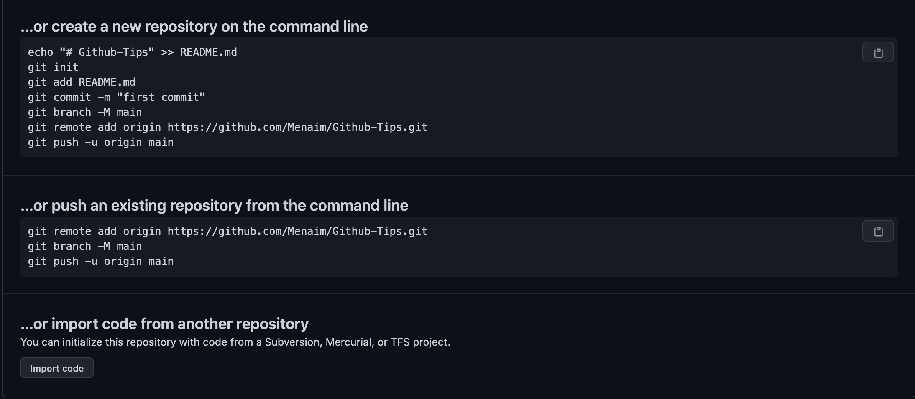
Creating Repo Tips Cont.
Don’t worry !! Every single line will be explained
1- Once you click on create you will see this screenshot…

Slide 6
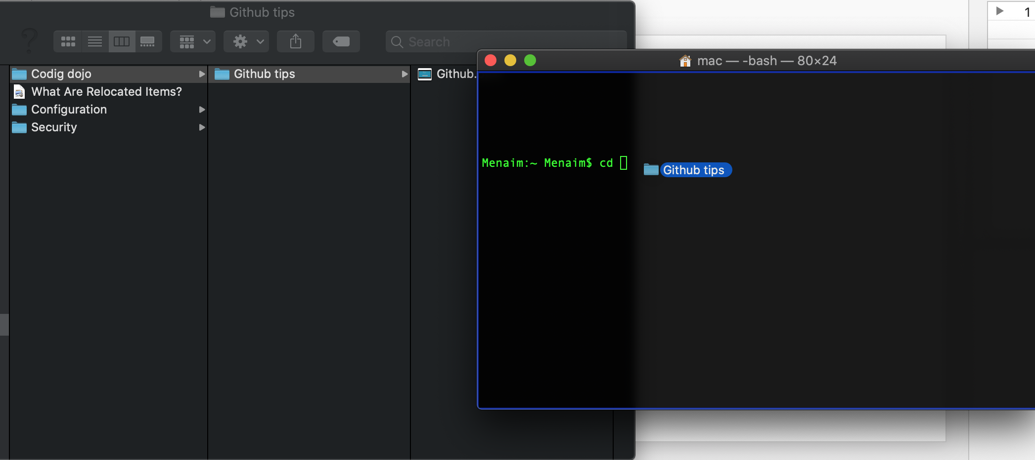
Creating Repo Tips Cont.
1- You need to access the file in your PC by doing this:
1.1 Open terminal
1.2 Type cd
1.3 Drag the folder

Slide 7
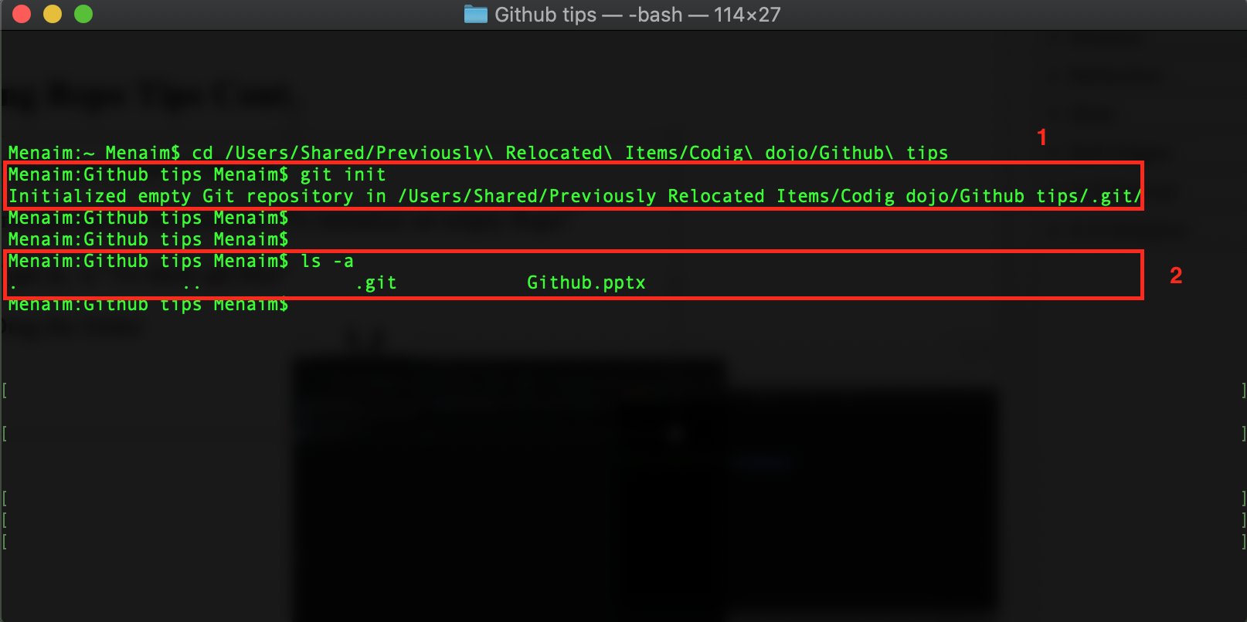
Creating Repo Tips Cont.
Now you have an access on the file:
1. Write git init on the terminal “To initialize an empty Repo”
2. Type ls –a “To show all files”

Slide 8
Creating Repo Tips Cont.
Now you have an access on the file:
1. Write git init on the terminal “To initialize an empty Repo”
2. Type ls –a “To show all files”

Slide 9
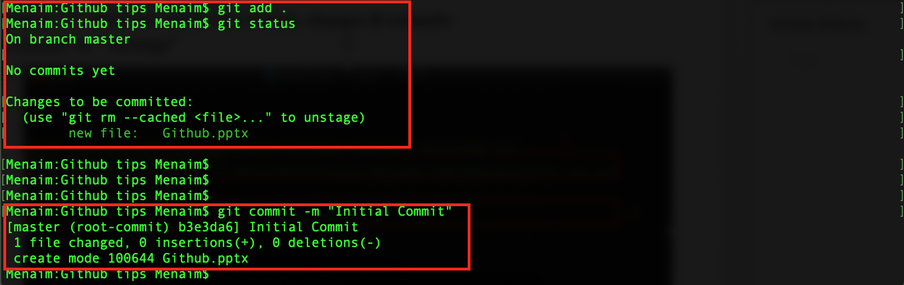
Commit to Repo
git add . “To add everything in your repo”
git status ”To check the details like branch, changes & commits
git commit -m “ message”

Slide 10
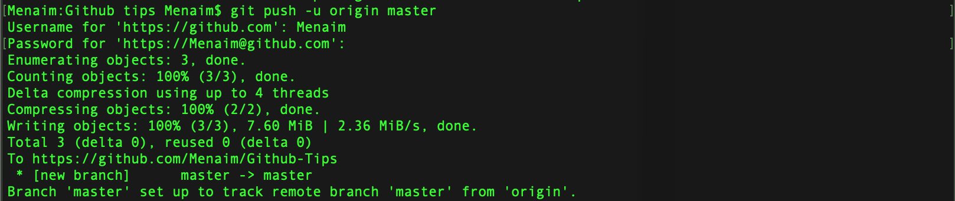
Commit to Repo Cont.
Go to github and copy the link for the repo you have created before
git remote add origin “The link”
git push -u origin master “It may require you to enter your username and password”

Slide 11
Commit to Repo Cont.
Now you can check your repo and you will find it updated !!
- Tips needed to be noted while committing:
1- Most of the time you are team player, so you need to create your own branch.
2- Never push to the master as I did in the previous slide.
3- Always be sure that you are pushing the specific branch you have created.

Slide 12
Create branch
1- To create a branch and auto switch to it use “git checkout -b branchName”
2- You can see your branches and the used one by using “git branch”
3- You can create only branch without switching to it “git branch branchName”
4- Switching to a branch after creating it “git checkout branchName”
5- Rename branch “git branch –m newName”
6- To delete a branch “git branch -d branchName” -d & -D Rule

Slide 13
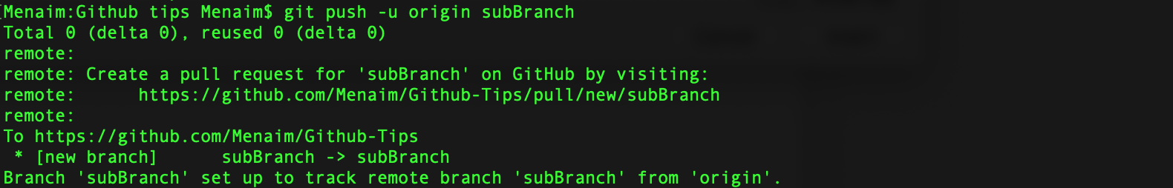
Create branch Cont.
1- To push changes onto a new branch on GitHub, you'll want to run git push origin yourbranchname. GitHub will automatically create the branch for you on the remote repository
2- Now you can check github, you will find two branches instead of one

Slide 14
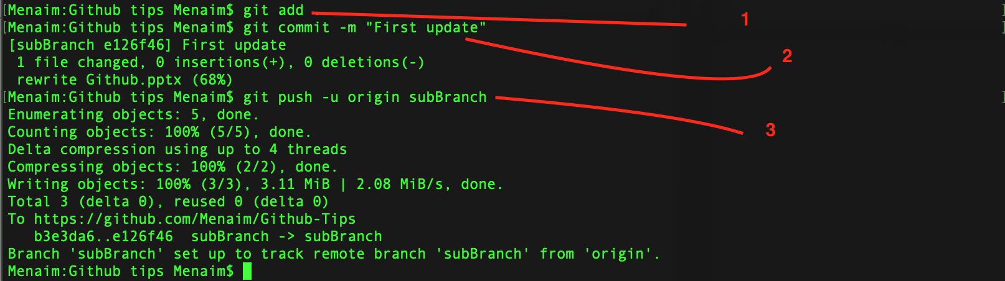
Commit to the new branch
- Of course your code or whatever is changed by the time so it needs to be updated by the time so I have retyped each command to be able to do this:

Slide 15
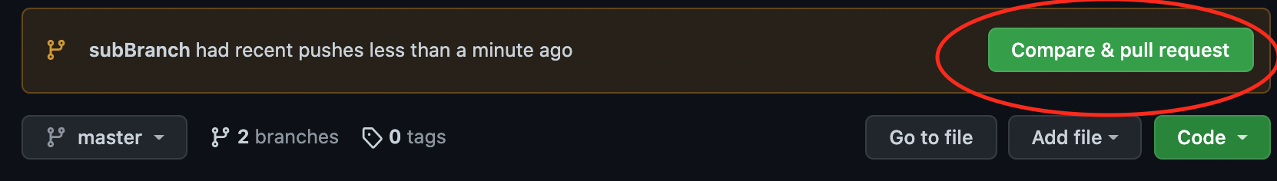
Pull Request
- Once pushing is done, Github will offer you to compare and make pull request

Slide 16
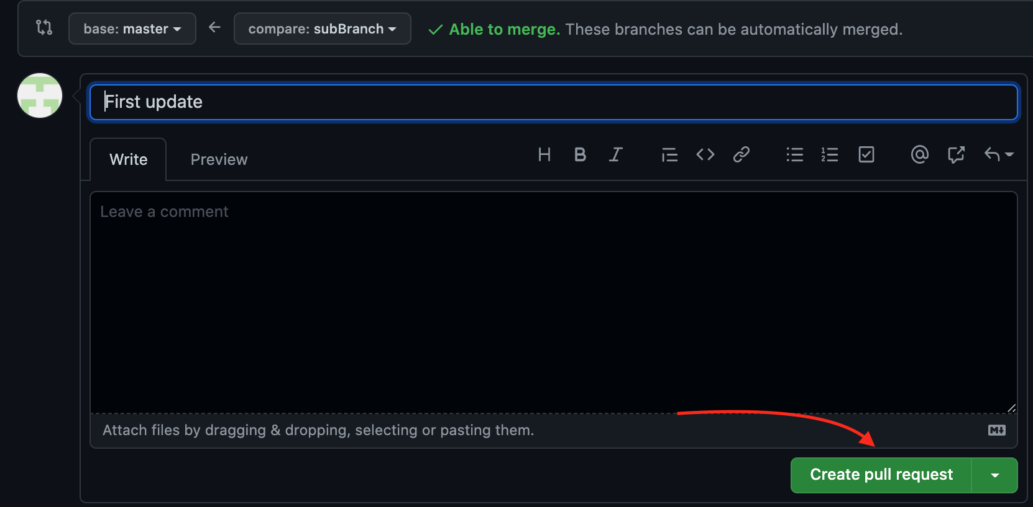
Pull Request Cont.
- Now you can create pull request to be able to merge files and get the new one:

Slide 17
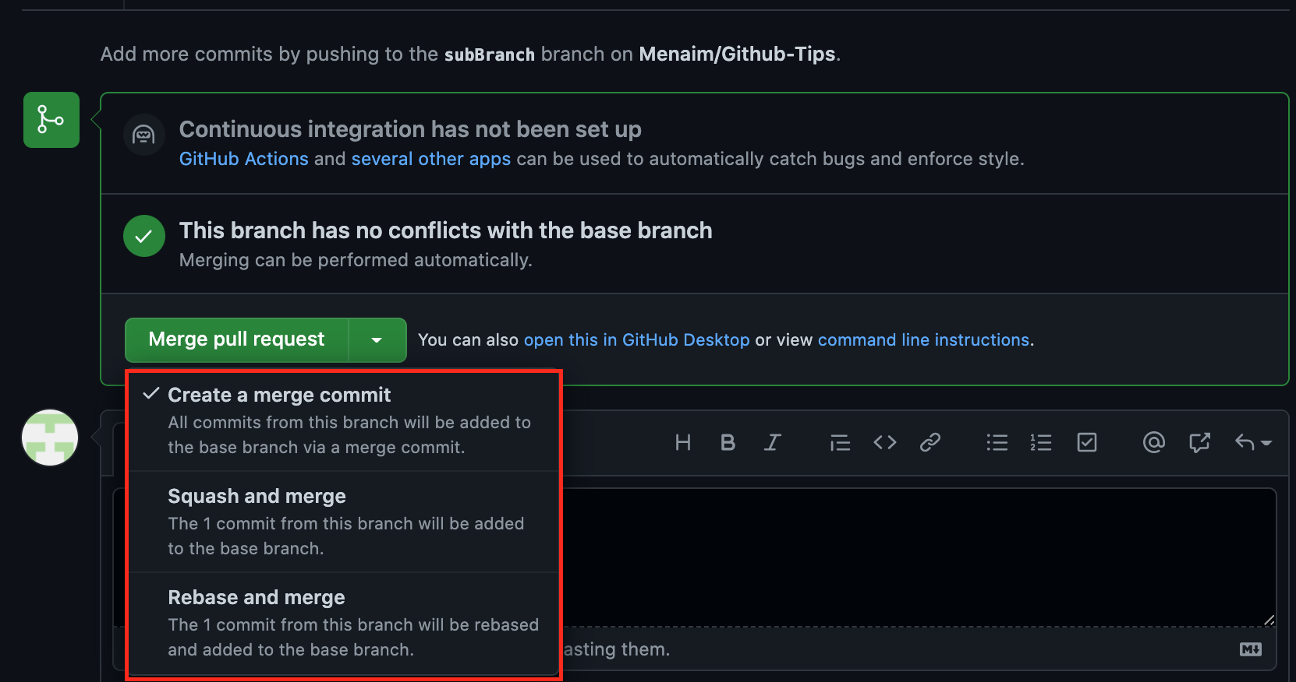
Pull Request Cont.
- All you need to do is to choose one depending on your project or to just click on “Merge pull request”

Slide 18
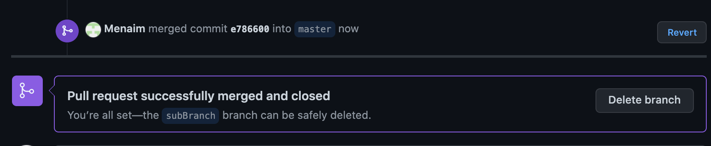
Pull Request Cont.
Now I have merged it and I can delete the unused branch…
Note that you can do it through terminal using this:
git checkout master
git merge subBranch
git branch -d subBranch

Slide 19

Errors you may face…

Slide 20
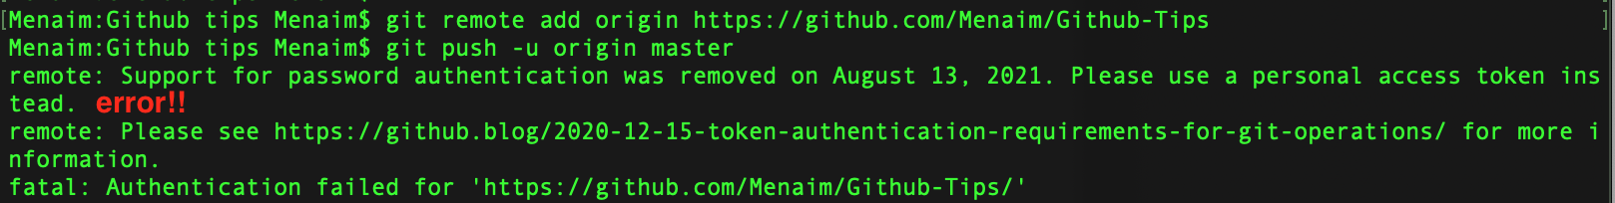
Commit to Repo
Go to github and copy the link for the repo you have created before
git remote add origin “The link”
git push -u origin master – I’ve face an error here:
Let’s solve it…

Slide 21
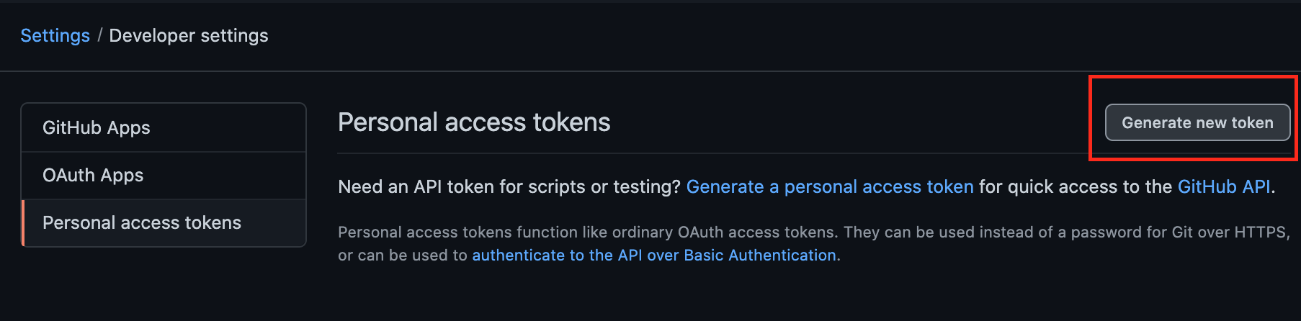
Solving Error For Mac users
Go to this link to generate a token here
Click on generate token like the image
Now search for an app in your Mac, named Keychain Access.
Search for github.com (if there are multiple GitHub logins then choose Kind: Internet password), double-click it.
Click on show password, then enter your Mac's password and hit Enter.
Password should be visible by now. Now, just paste the token you generated in step 2 and click Save changes

Slide 22
Solving Error For Windows users
Follow the same 1,2 steps in the previous slide
Search for an application in your Windows OS, named Credential Manager → then Windows Credentials.
Search for github.com and edit the password with the token you have generated on GitHub. Now enjoy!

Slide 23
Thank you

