Slide 1

RESUME BUILDER WEB APPLICATION
GUIDE:
Ms. D SANTHIYA (AP/CSE)
TEAM MEMBERS:
HARINI M 920222104011
LOGASHRI M 920222104028
SARMILA T 920222104049
Resume Builder Web Application
Page 1
Notes:
1

Slide 2
OBJECTIVE
Objective:
Streamline Resume Creation: Provide users with an easy-to-use platform to design professional resumes using
customizable templates.
Enhance User Experience: Offer real-time editing, writing tips,
and formatting options to ensure accuracy and
personalization.
Increase Job Search Success: Integrate with job platforms and export options (PDF, DOCX) to help users effectively showcase their qualifications to potential employers.
Scope:
The project offers customizable templates, content suggestions, export options, and job portal integration for users.
Resume Builder Web Application
Page 2
Notes:
2

Slide 3
ABSTRACT
. Offers professionally designed templates to match
personal style and industry standards.
Supports PDF and DOCX export for employer
compatibility
Provides live updates for real-time resume editing and
accuracy.
Includes writing tips and job platform integration to
boost job search success.
Ensures resumes are optimized for Applicant Tracking Systems, increasing job application success.
Ensures compatibility and ease of use across mobile, tablet, and desktop devices.
Enables sharing with mentors or peers for feedback and suggestions before finalizing the resume.
Resume Builder Web Application
Page 3
Notes:
3

Slide 4
EXISTING SYSTEM
Existing Systems:
Online Resume Builders (e.g., Canva, (link unavailable))
Offline Resume Builders (e.g., Microsoft Word, Google Docs)
Hybrid Resume Builders (e.g., LinkedIn Resume Builder)
Common Disadvantages:
Lack of personalization
Limited job-specific templates
Insufficient guidance on resume writing
Difficulty tracking application history
No integrated interview preparation tools
Resume Builder Web Application
Page 4
Notes:
4

Slide 5
PROPOSED SYSTEM
Easy Customization:
Drag-and-drop interface for effortless resume creation.
ATS Compatibility:
Ensures resumes pass Applicant Tracking Systems.
AI Suggestions:
Real-time recommendations for keywords and phrasing.
Flexible Templates:
Industry-specific, customizable resume designs.
Secure Storage:
Cloud-based, encrypted access to resumes anytime, anywhere.
Version Control:
The ability to save multiple versions of a resume for different job applications.
User-Friendly Design:
Intuitive drag-and-drop interface for easy customization of resume sections, layout, and styling.
Resume Builder Web Application
Page 5
Notes:
5

Slide 6
MODULES
Admin module
User Interface module
3. Template customization module
4. Data Storage and Security Module
Admin:
In this application administrator can login with his login details, after successful login he can view all available users as well as their resumes.
User:
User can easily build his own resume and he can view the resume & he can logout from the system. User can build the resume by entering his personal and educational & experience details. And the resume will be generated automatically By our application .and parallely he can view the generated resume.
Resume Builder Web Application
Page 5
Notes:
6

Slide 7
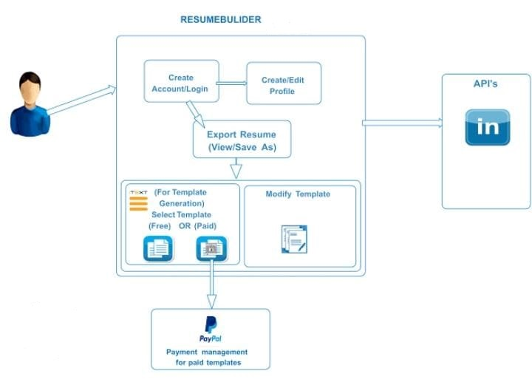
FlOW CHART
Resume Builder Web application
Page 16
Notes:
7

Slide 8
SOFTWARE REQUIREMENTS
Software Requirements:
Language : Java (Servlets & Jsp)
Frontend : Html
Client side Scripting : javaScript
Backend : Mysql 6.0
Operating System : windows XP/7/8
Hardware Requirements:
Processor : Pentium IV
Hard Disk : 80GB
RAM : 1GB
Resume Builder Web Application
Page 18
Notes:
8

Slide 9
CONCLUSION
The resume builder web application is designed to streamline the process of creating professional resumes for users of all experience levels. With its user-friendly interface, customizable templates, and real-time preview feature, the application offers a seamless experience for job seekers aiming to create standout resumes. Key functionalities include:
Customizable Templates: Users can choose from a variety of professional designs.
Intuitive User Interface: Simplified steps guide users through the resume creation process.
Download and Sharing Options: Resumes can be downloaded in multiple formats (PDF, Word) and shared via email or social platforms.
Profile Management: Users can save multiple versions of their resume and edit them anytime.
Data Security: User data is stored securely with encryption and can be accessed only with proper authentication.
AI Accessibility Empowerment
Page 19
32
Notes:
9

Slide 10
THANK YOU
Notes:
10

