Slide 1
IBM University Engagement Project Submission
“AI-Powered Technical Interview Trainer”

Slide 2

Project Tile – [AI-Powered Technical Interview Trainer]
Domain of Project – [Education / Career Development / Information Technology ]
Student Name | Recent Passport Photo | Email ID | Mobile number [WhatsApp]
MENAKA |  | menakasarvanan30@gmail.com | 9025391806
Recommended font style and size: Font Style: Arial Font Size (Heading): 28
Font Size (Content): 20

Slide 3
Problem Statement -
Problem Statement : AI Interview Trainer
The Challenge Preparing for technical interviews can be stressful, and candidates often struggle with lack of realistic practice, unstructured feedback, and managing multi-turn interview interactions. Information about technical questions and standard answers is scattered across unreliable sources. Without personalized, real-time guidance and realistic simulation, many fail to build confidence or clear technical rounds.
The Objective
Build an AI-Powered Technical Interview Trainer that delivers personalized and interactive interview simulations for students, job seekers, and professionals. The solution should:
Role-Based Customization – Tailor interview questions based on specific job roles (e.g., Software Engineer, Data Scientist) and skill levels.
Contextual RAG & Prompting – Enforce strict system instructions and prompt engineering to keep the AI acting as a professional interviewer.
Multi-Turn Interaction – Allow users to answer questions step-by-step, receiving follow-up queries dynamically just like a real interview.
Backend-Frontend Integration – Establish seamless JSON communication between a responsive web UI and enterprise-grade AI foundation models.
IBM Watsonx.ai Integration – Leverage advanced LLMs (like Mistral-small) via cloud SDKs for fast, intelligent, and accurate responses.
Performance Tracking & Feedback – Provide interactive chat logs and immediate conversational feedback to improve candidate readiness.

Slide 4
Proposed Solution -
Proposed Solution: AI-Powered Technical Interview Trainer
The proposed solution is an AI-powered Technical Interview Trainer built using Python (Flask), JavaScript, and IBM watsonx.ai to provide personalized, real-time mock interview sessions. The system addresses challenges in technical preparation, skill assessment, and realistic interview simulation through an intelligent, modular architecture.
At its core, the solution uses system prompt engineering and role-based instruction tuning to maintain a professional, step-by-step interviewer persona. This ensures the model dynamically adapts to user responses rather than acting as a generic text generator.
The system consists of four key components:
Interview Controller Agent manages the conversational state and dictates multi-turn interview flow.
Role Customization Module generates targeted technical questions based on specific job roles and user inputs.
Evaluation & Feedback Handler processes user answers and delivers contextual, real-time follow-up queries.
JSON Communication Bridge handles seamless data exchange between the backend routing logic and the frontend user interface.
The solution includes a user-friendly dashboard (built with HTML, CSS, and JavaScript) that renders chat interactions, manages dynamic loading states, and provides a smooth conversational experience.
IBM watsonx.ai is used to ensure scalable model deployment, robust prompt execution, and AI governance, while Mistral models power conversational reasoning and response generation.
Overall, this solution delivers an end-to-end intelligent interview assistant that promotes candidate readiness through realistic practice, structured role-based queries, and dynamic interaction.

Slide 5
Technology Used
Python & Flask Framework – For building robust backend routing logic, managing API endpoints, and handling server-side requests.
IBM Watsonx.ai – For model deployment, foundation model inference, prompt execution, and AI governance.
Mistral Model (mistral-small-3-1-24b-instruct-2503) – For natural language understanding, conversational reasoning, and role-based persona execution.
IBM Cloud – It provides the infrastructure to build, deploy, and scale the application efficiently, ensuring a reliable, secure, and scalable environment.
RAG-based Prompt Engineering – To fetch contextual instructions first, then generate intelligent and structured interviewer responses, making the training session more trustworthy and effective.
HTML5, CSS3, & JavaScript (Fetch API) – For designing a clean, responsive frontend user interface and handling asynchronous client-server communication seamlessly.

Slide 6
Langflow component Used -
Chat Input – Interface where candidates enter their job role preferences and answers during the mock interview session.
2) IBM watsonx.ai Agent – Processes user input using Mistral/Foundation models with strict system prompt instructions to maintain a professional interviewer persona.
3) Name of IBM Model – mistralai/mistral-small-3-1-24b-instruct-2503 → Fast, efficient, and context-aware for real-time technical interview dialogues.
4) Chat Output – Displays AI-generated responses such as follow-up technical questions, evaluations, and interactive feedback.
5) Flask Backend & JSON Router – Manages server-side routing logic and secures asynchronous JSON data communication between the UI and AI layer.
6) Frontend UI Interface – HTML, CSS, and JavaScript-based chat window that handles user interaction, loading states, and dynamic message rendering.

Slide 7
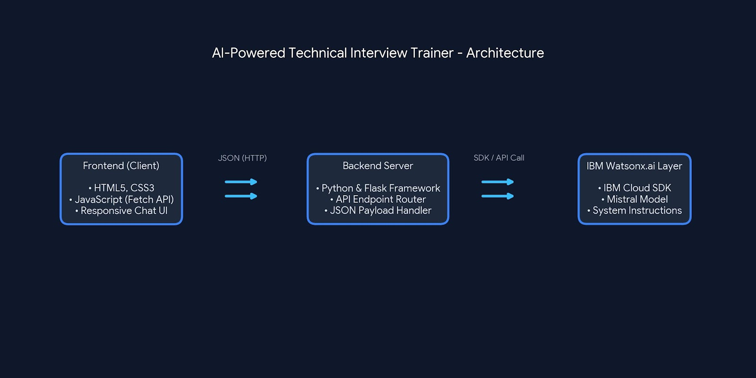
Langflow workflow -

Slide 8
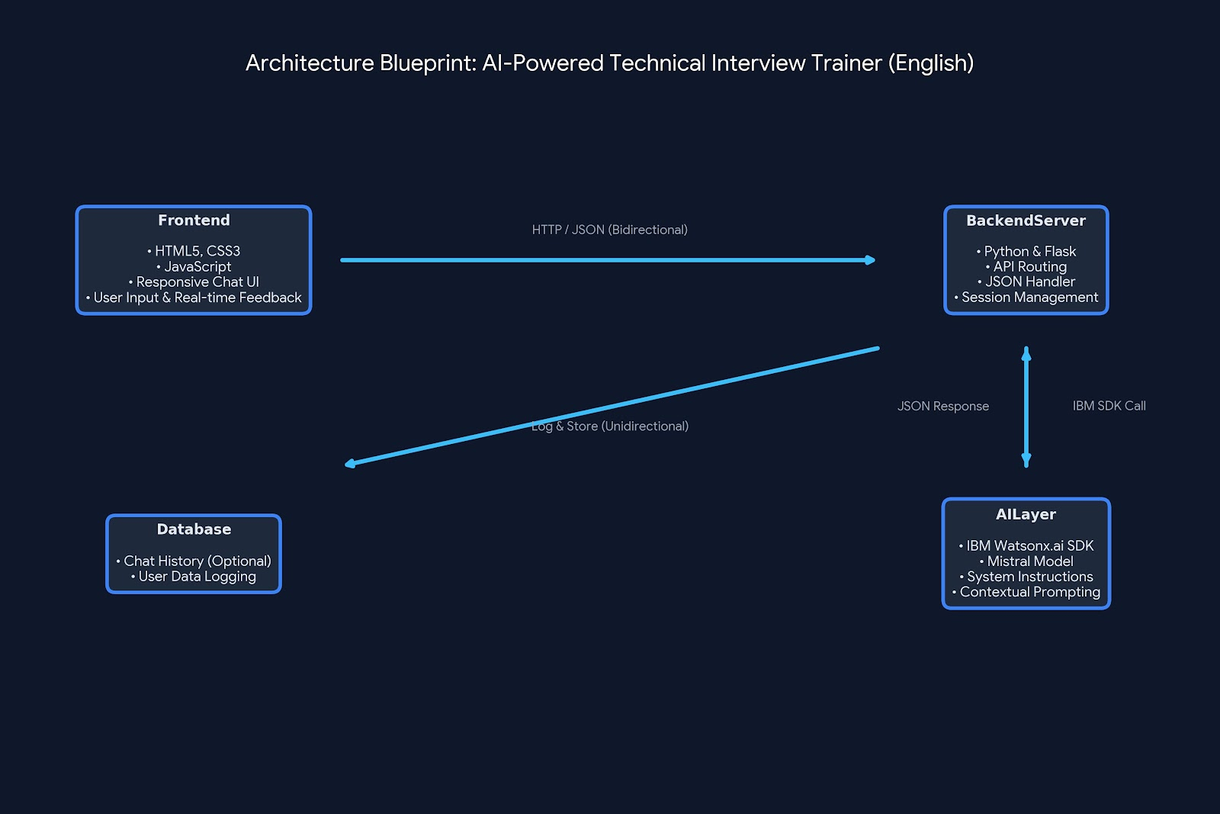
Architecture blueprint

Slide 9

Role of Agentic AI in the solution
Role of Agentic AI in Technical Interview Trainer
Agentic AI enables the Interview Trainer to function as an intelligent, autonomous system rather than a simple static chatbot. Using IBM watsonx.ai and Mistral models, it coordinates multiple specialized tasks to deliver personalized interview simulation and evaluation.
Each component performs a specific role—such as managing interview state, generating targeted technical questions, evaluating candidate responses, and delivering actionable feedback—while working collaboratively. This systematic approach ensures efficient workflow execution and precise assessment results.
Agentic AI also brings context awareness, understanding user details like target job roles, skill levels, and previous answers to generate tailored follow-up queries. It supports real-time adaptation, continuously adjusting question complexity based on user performance. Additionally, the system maintains conversational continuity, enabling better candidate profiling and improved interview readiness.
Overall, Agentic AI makes the system proactive, personalized, and goal-driven, acting like a smart digital technical interviewer that helps candidates build confidence and master technical interviews.

Slide 10


Token Usage
11,761 token are used
Before Prompt
After the Prompt
·
·
·

Slide 11
Novelty and Uniqueness
The proposed Technical Interview Trainer stands out by combining Agentic AI, structured prompt engineering, and real-time adaptability into a single intelligent system.
Multi-Turn Role Adaptation – Instead of a single static chatbot, it dynamically adjusts its questioning strategy based on the candidate's performance and target job roles.
Prompt-Driven Accuracy – Integrates strict system instructions with foundation model generation, reducing generalized responses and ensuring focused technical assessments.
Hyper-Personalization – Tailors mock interview sessions based on specific programming languages, frameworks, and candidate experience levels.
Real-Time Feedback Loop – Continuously analyzes candidate answers to provide targeted explanations, follow-up questions, and performance evaluations.
Interactive UI Interface – Supports a clean, responsive chat experience designed for seamless technical engagement.
Career Readiness Focus – Goes beyond standard Q&A platforms to simulate real-world technical screening and build candidate confidence
.
Scalable & Enterprise-Ready – Built on IBM watsonx.ai with Mistral models, ensuring reliability, security, and enterprise AI governance.
This makes the solution a smart, adaptive, and proactive technical interviewer, not just a static question bank tool.

Slide 12
Git Hub Link
Please create public github repository (Enable Add README button while creating repository) with format –
Please test and Paste the working Github URL –https://github.com/MenakaSaravanan/IntelliMock-AI-Powered-Technical-Interview-Train
Make sure you have Uploaded following three files into your github repository 1) app.json file , 2) yourproblemstatement.pdf file 3) your projectpresntation.pptx file 4)any other files\
·
·
·

Slide 13
Future Scope
1. Advanced Code Execution & Real-Time IDE Integration – The system can be integrated with online code compilers and integrated development environments (IDEs) to allow candidates to write, execute, and test code live during technical mock interviews. This will enable the AI Interview Trainer to provide instant syntax analysis, code optimization tips, and logical evaluations based on actual code performance.
2. Voice-Enabled Assistant & Multi-Language Support – Enhancing the system with a voice-enabled conversational assistant and support for multiple languages will improve accessibility. Candidates can practice verbal communication and interact naturally in their preferred language, making the platform more inclusive and effective for global tech aspirants with varied linguistic backgrounds.
·
·
·

Slide 14
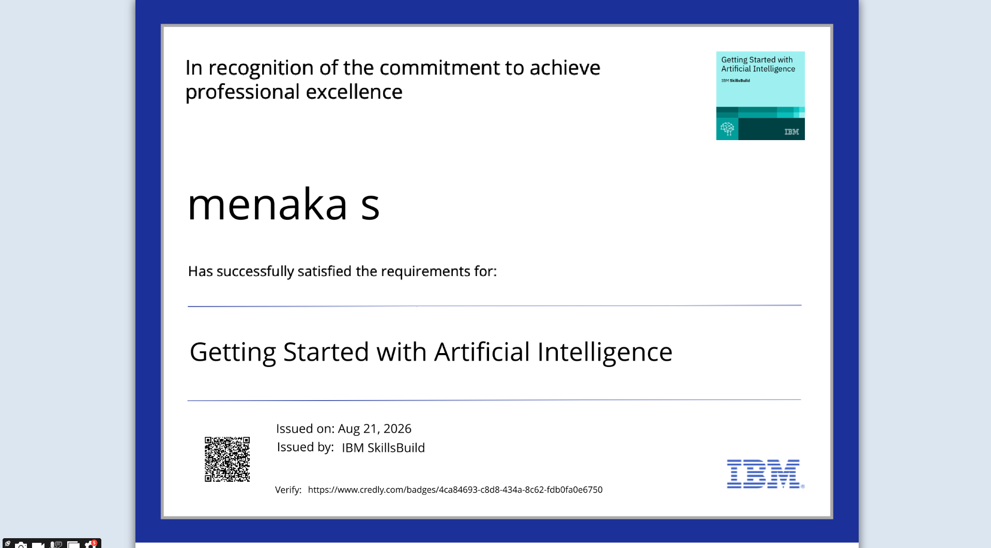
Certificates Earned:
Please add your credly certificate

Slide 15
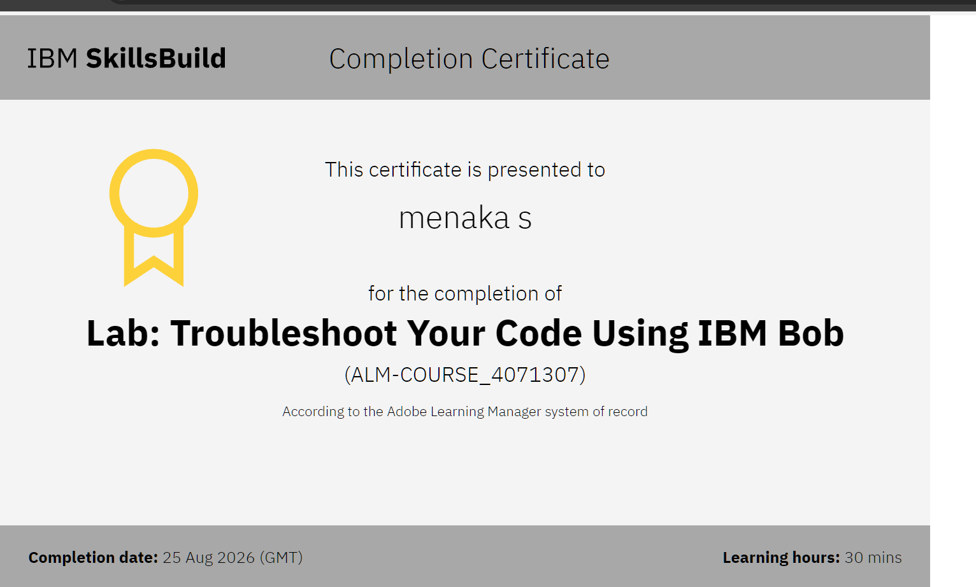
Certificates Earned:​
Add your IBM BOB Certificate

Slide 16


