Slide 1



Android Application
Development with Java
UPenn CS4HS 2011
Chris Murphy
cdmurphy@cis.upenn.edu

Slide 2
Overview
What is Android?
Why teach Android?
What do you need in order to teach Android?
Hello, Android
Basic Android graphics
Lunch
Part 2: More Android!

Slide 3
What is Android?

Slide 4
What is Android?
An open source Linux-based operating system intended for mobile computing platforms
Includes a Java API for developing applications
It is not a device or product

Slide 5
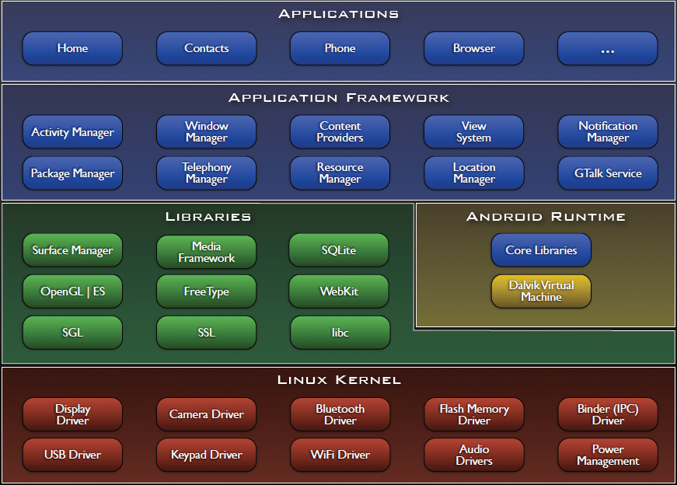

Slide 6
Why teach Android?

Slide 7

NYC High School Girls Build Android Apps
http://www.pcworld.com/article/223409/move_over_dr_soong_girls_can_build_android_apps_too.html

Slide 8
Engaging Students with Android
Android has a lot of “buzz” now
  Newness
  Coolness
  Googleness
UI and graphics made simple(r)
Advanced Java skills

Slide 9
What Skills Will Students Learn?
Reinforce the basics: OOP, decomposition, etc.
Separation of UI design and functionality
XML and resource files
Events and Listeners
Callback methods
Threads

Slide 10

Android vs. iPhone
Java vs. Objective-C
Direct install vs. Marketplace vs. App Store
Open source?

Slide 11
What do you need in order to teach Android?

Slide 12
What Should Students Already Know?
Java!
  inheritance, method overriding
  interfaces, casting
  exceptions
  debugging
  reading API documentation
Eclipse
  easy to pick up quickly, though

Slide 13
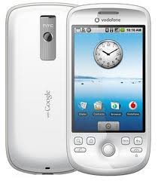
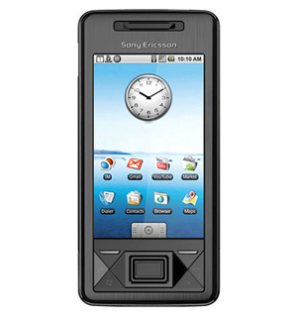
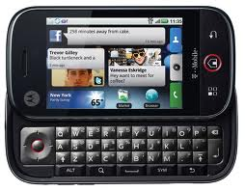
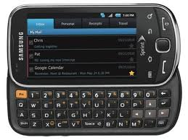
Do I Need Phones?
The emulator that is part of the Android toolset for Eclipse is quite good (though a bit slow)
You may be able to get free “developer phones” from Google

Slide 14
Online Resources
developer.android.com
code.google.com/p/apps-for-android/
stackoverflow.com
videos from Google I/O conferences

Slide 15

“Hello, Android”

Slide 16
Creating Your First(?) Android App
Set up your development environment
Create a new Android project in Eclipse
Run it in the emulator
Hilarity ensues

Slide 17
1. Set Up Your Android Environment
http://developer.android.com/sdk
Install Eclipse
Install Android SDK (Android libraries)
Install ADT plugin (Android development tools)
Create AVD (Android virtual device)
We’ve already done this for you!!

Slide 18
2. Create an Android Project in Eclipse
File → New → Project
Select “Android Project”
Fill in Project details...

Slide 19
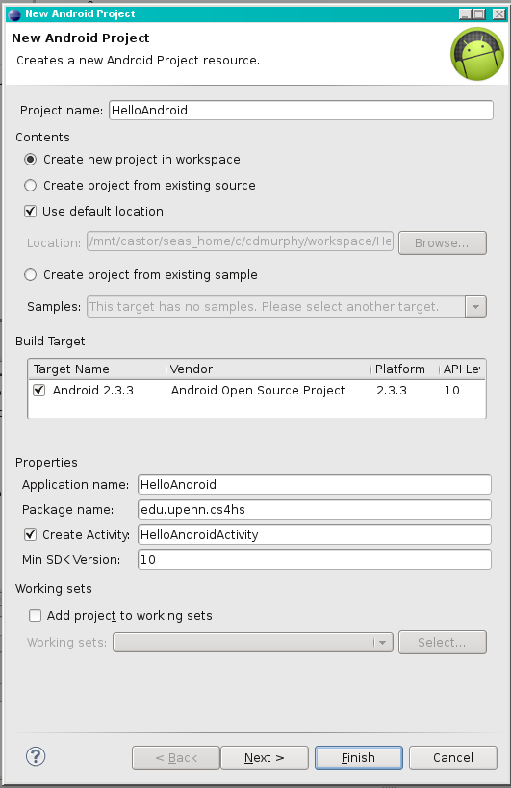
Directory
name
Android
version
Java package
Name that appears
on device
Class to
automatically
create

Slide 20
3. Run the Android Application
Run → Run (or click the “Run” button)
Select “Android Application”
The emulator may take a few minutes to start, so be patient!
You don't need to restart the emulator when you have a new version of your application

Slide 21
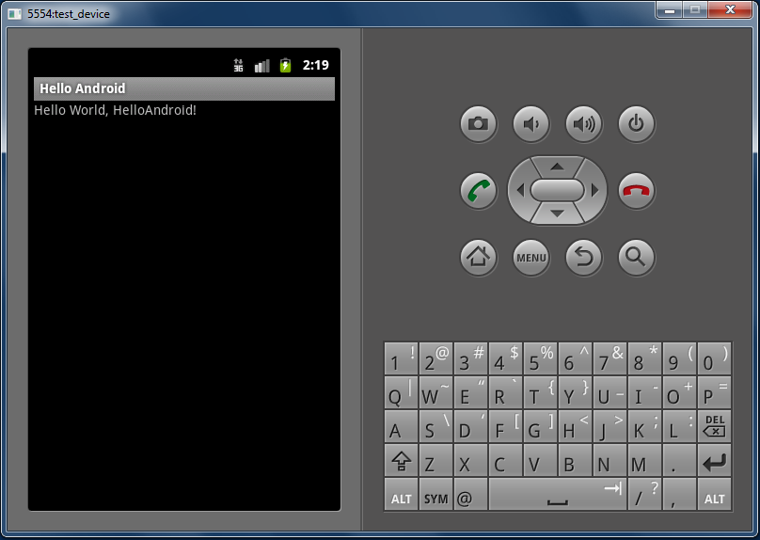

Slide 22
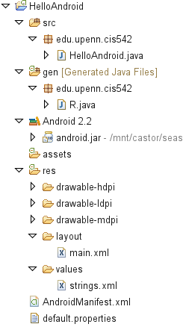
Source
code
Auto-generated
code
String
constants
UI
layout
Configuration

Slide 23
HelloAndroid.java
1 public class HelloAndroid extends Activity {
2 /** Called when the activity is first created. */
3 @Override
4 public void onCreate(Bundle savedInstanceState)
5 {
6 super.onCreate(savedInstanceState);
7 setContentView(R.layout.main);
8 }
9 }

Slide 24
main.xml
1 <?xml version="1.0" encoding="utf-8"?>
2 <LinearLayout
3 xmlns:android="http://schemas.android.com/apk/res/android"
4 android:orientation="vertical"
5 android:layout_width="fill_parent"
6 android:layout_height="fill_parent"
7 >
8 <TextView
9 android:layout_width="fill_parent"
10 android:layout_height="wrap_content"
11 android:text="@string/hello "
12 />
13 </LinearLayout>

Slide 25
strings.xml
1 <?xml version="1.0" encoding="utf-8"?>
2 <resources>
3 <string name="hello">Hello World, HelloAndroid!
4 </string>
5 <string name="app_name">Hello, Android</string>
6 </resources>

Slide 26
AndroidManifest.xml
1 <?xml version="1.0" encoding="utf-8"?>
2 <manifest
3 xmlns:android="http://schemas.android.com/apk/res/android"
4 package="edu.upenn.cis542"
5 android:versionCode="1"
6 android:versionName="1.0">
7 <application android:icon="@drawable/icon"
8 android:label="@string/app_name">
9 <activity android:name=".HelloAndroid"
10 android:label="@string/app_name">
11 <intent-filter>
12 <action
13 android:name="android.intent.action.MAIN" />
14 <category
15 android:name="android.intent.category.LAUNCHER"/>
16 </intent-filter>
17 </activity>
18 </application>
19 </manifest>

