Slide 1
Chapter 10
Decision Support Systems

Slide 2
Decision Support Systems
Decision support systems (DSS)
  Offer potential to assist in solving both semi-structured and unstructured problems

Slide 3
Decision Making as a Component of Problem Solving
Intelligence
Decision
making
Design
Choice
Problem
solving
Implementation
Monitoring

Slide 4
Solution Types
Optimization model
  Finding the best solution
Satisficing model
  Finding a good -- but not necessarily the best -- solution to a problem
Heuristics
  Commonly accepted guidelines or procedures that usually find a good solution

Slide 5
Problem Solving Factors
Multiple decision objectives
Increased alternatives
Increased competition
The need for creativity
Social and political actions
International aspects
Technology
Time compression

Slide 6
Characteristics of a DSS (1)
Handles large amounts of data from different sources
Provides report and presentation flexibility
Offers both textual and graphical orientation

Slide 7
Characteristics of a DSS (2)
Supports drill down analysis
Performs complex, sophisticated analysis and comparisons using advanced software packages
Supports optimization, satisficing, and heuristic approaches

Slide 8
Characteristics of a DSS (3)
Performs different types of analyses
  “What-if” analysis
    Makes hypothetical changes to problem and observes impact on the results
  Simulation
    Duplicates features of a real system
  Goal-seeking analysis
    Determines problem data required for a given result

Slide 9
Goal Seeking Example
You know the desired result
You want to know the required input(s)
Example:
  Microsoft Excel’s “Goal Seek” and “Solver” functions

Slide 10
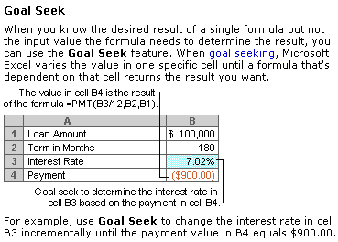
Excel
demo

Slide 11

Capabilities of a DSS (1)
Supports
  Problem solving phases
  Different decision frequencies
Merge with
another company?
How many widgets
should I order?
low
high
Frequency

Slide 12
Capabilities of a DSS (2)
Highly structured problems
  Straightforward problems, requiring known facts and relationships.
Semi-structured or unstructured problems
  Complex problems wherein relationships among data are not always clear, the data may be in a variety of formats, and are often difficult to manipulate or obtain

Slide 13
Decision Making Levels
Strategic
Tactical
Operational
Operational-level
managers involved with
daily decisions
Strategic-level managers
involved with long-term
decisions
High
Low
Decision Frequency

Slide 14
Integration of
TPS, MIS, and DSS
In many organizations they are integrated through a common database
Separation of DSS transactions in the database from TPS and MIS transactions may be important for performance reasons

Slide 15
Web-Based
Decision Support Systems
Web-based decision support systems
  Decision support system software provides business intelligence through web browser clients that access databases either through the Internet or a corporate intranet

Slide 16
Components of a DSS
Model management software (MMS)
  Coordinates the use of models in the DSS
Model base
  Provides decision makers with access to a variety of models
Dialogue manager
  Allows decision makers to easily access and manipulate the DSS

Slide 17
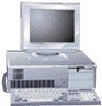

Database
Model base
DBMS
MMS
External
databases
Access to the
internet, networks,
and other computer
systems
External database
access
Dialogue manager

Slide 18
Model Base
Model Base
  Provides decision makers with access to a variety of models and assists them in decision making
Models
  Financial models
  Statistical analysis models
  Graphical models
  Project management models

Slide 19
Advantages and Disadvantages of Modeling
  Advantages
    Less expensive than custom approaches or real systems.
    Faster to construct than real systems
    Less risky than real systems
    Provides learning experience (trial and error)
    Future projections are possible
    Can test assumptions
  Disadvantages
    Assumptions about reality may be incorrect
    Accuracy of predications often unreliable
    Requires abstract thinking

Slide 20
Group Decision Support System
Group Decision Support System (GDSS)
  Contains most of the elements of DSS plus software to provide effective support in group decision-making settings

Slide 21

Databases
Model base
GDSS processor
GDSS software
External
databases
Access to the internet
and corporate intranet,
networks, and other
computer system
Dialogue
manager
External database
access
Users

Slide 22
Characteristics of a GDSS (1)
Special design
Ease of use
Flexibility
Decision-making support
  Delphi approach (decision makers are geographically dispersed)
  Brainstorming
  Group consensus
  Nominal group technique

Slide 23
Characteristics of a GDSS (2)
Anonymous input
Reduction of negative group behaviour
Parallel communication
Automated record keeping
Cost, control, complexity factors

Slide 24
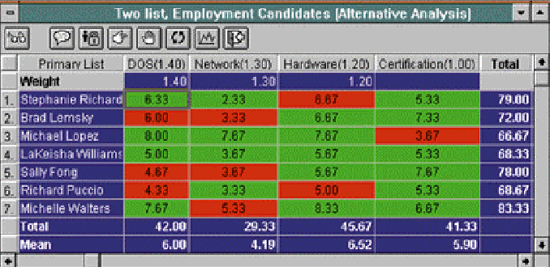
Group Results Matrix

Slide 25
Components of a GDSS and GDSS Software
Database
Model base
Dialogue manager
Communication capability
Special software (also called GroupWare)
E.g., Lotus Notes
  people located around the world work on the same project, documents, and files, efficiently and at the same time

Slide 26
GDSS Alternatives
high
Local area
decision network
Wide area
decision network
Decision frequency
Decision
room
Teleconferencing
low
close
distant
Location of group members

Slide 27
Decision Room
Decision Room
  For decision makers located in the same geographic area or building
  Use of computing devices, special software, networking capabilities, display equipment, and a session leader
  Collect, coordinate, and feed back organized information to help a group make a decision
  Combines face-to-face verbal interaction with technology-aided formalization

Slide 28
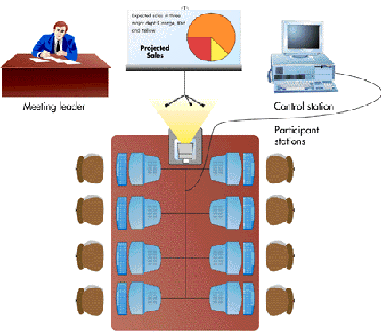

Slide 29
Wide Area Decision Network
Characteristics
  Location of group members is distant
  Decision frequency is high
  Virtual workgroups
    Groups of workers located around the world working on common problems via a GDSS

Slide 30
Executive Support System
Characteristics
  A specialized DSS that includes all the hardware, software, data, procedures, and people used to assist senior-level executives within the organization
Board of directors
President
Function area
vice presidents
Function area
managers

Slide 31
Characteristics of ESSs
Tailored to individual executives
Easy to use
Drill down capabilities
Support the need for external data
Help with situations with high degree of uncertainty
Futures orientation (predictions, forecasting)
Linked with value-added business processes

Slide 32
Capabilities of an ESS
Support for
  defining overall vision
  strategic planning
  strategic organizing and staffing
  strategic control
  crisis management

Slide 33
End of Chapter 10
Chapter 11

