Slide 1
Course Introduction
Xin Zhao

Slide 2
Goal
Implement a tiny search engine that is able to crawl, store, analyze, index, and retrieve documents
Collection: webpages from RUC INFO
Factoid queries
Advanced: returning answers instead of documents
Optional: Web API interface

Slide 3
Course Schedule
July 13-July 20
half-day lecture, half-day programming
Tencent meeting
Final Evaluation
Attendance
Project
Accuracy & time
Report
LaTex
Presentation (optional)

Slide 4
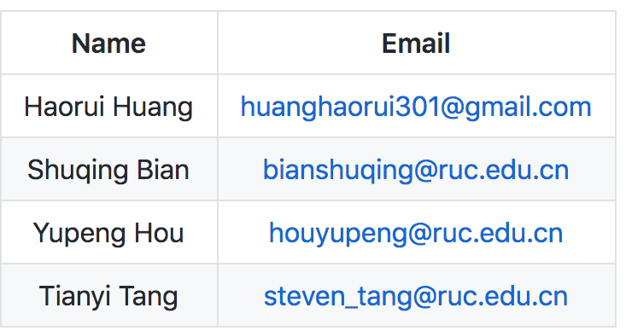
TA and TA groups
Four TAs
TA group
Run in small groups
Daytime on
Can ask TA anything about the course

Slide 5
Requisites
Basic knowledge about Linux or cygwin
Mac shell is also OK
C++, JAVA or Python
STL (set, string, map)
Basic algorithms (BFS, DFS)

Slide 6
Day 1
Crawl all the webpages with the domain of info.ruc.edu.cn

Slide 7
Day 2
Extract the content from the crawled webpages, and perform basic natural language processing on them

Slide 8
Day 3
Implement a tiny search engine with the inverted index and supports query retrieval

Slide 9
Day 4
NULL

Slide 10
Day 5
Optional
Try word2vec or BERT, and enhance the previous search engine

Slide 11
Day 6
Construct the server-client API and wrap the function with basic web UI

Slide 12
Day 7
(Required) Learn to use LaTex write the course project report

Slide 13
Day 8
NULL

