Slide 1
CS276
Information Retrieval and Web Search
Chris Manning and Pandu Nayak
Crawling and Duplicates

Slide 2
Today’s lecture
Web Crawling
(Near) duplicate detection

Slide 3
Basic crawler operation
Sec. 20.2
Begin with known “seed” URLs
Fetch and parse them
  Extract URLs they point to
  Place the extracted URLs on a queue
Fetch each URL on the queue and repeat

Slide 4

Crawling picture
Sec. 20.2
URLs crawled
and parsed
Unseen Web
Seed
pages
URLs frontier
Web

Slide 5
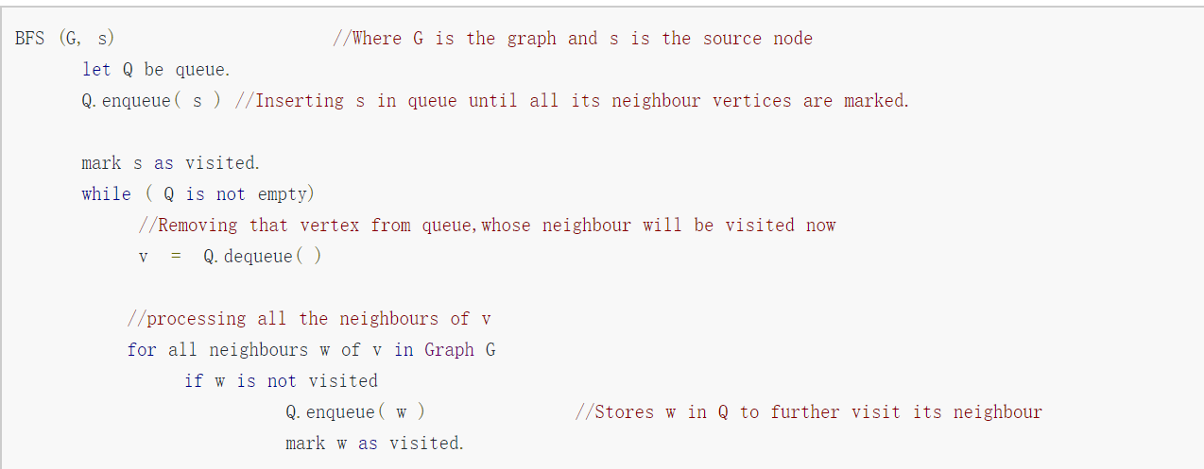
Breadth-first search (BFS)

Slide 6
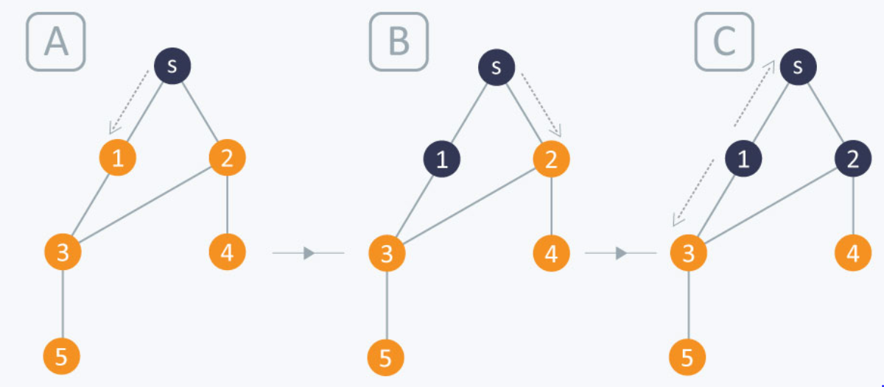
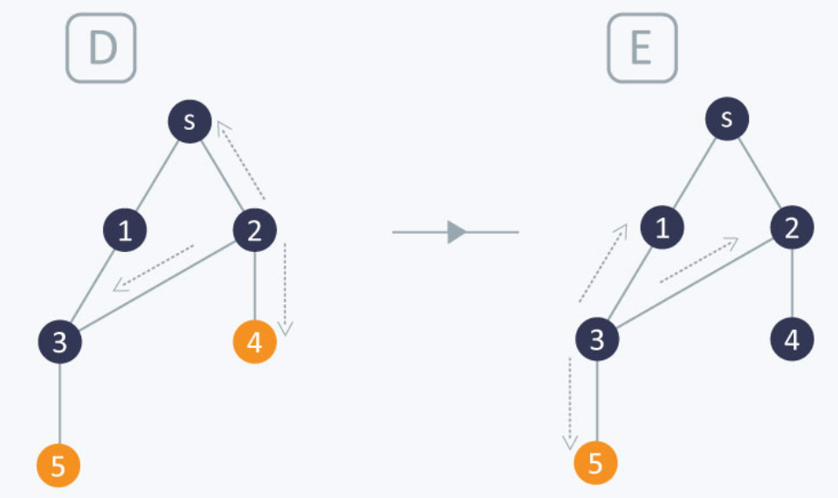
Breadth-first search (BFS)

Slide 7
Simple picture – complications
Sec. 20.1.1
Web crawling isn’t feasible with one machine
  All of the above steps distributed
Malicious pages
  Spam pages
  Spider traps – dynamically generated
Even non-malicious pages pose challenges
  Latency/bandwidth to remote servers vary
  Webmasters’ stipulations
    How “deep” should you crawl a site’s URL hierarchy?
  Site mirrors and duplicate pages
Politeness – don’t hit a server too often

Slide 8
What any crawler must do
Sec. 20.1.1
Be Robust: Be immune to spider traps and other malicious behavior from web servers
Be Polite: Respect implicit and explicit politeness considerations

Slide 9
Explicit and implicit politeness
Sec. 20.2
Explicit politeness: specifications from webmasters on what portions of site can be crawled
  robots.txt
Implicit politeness: even with no specification, avoid hitting any site too often

Slide 10
Robots.txt
Sec. 20.2.1
Protocol for giving spiders (“robots”) limited access to a website, originally from 1994
  www.robotstxt.org/robotstxt.html
Website announces its request on what can(not) be crawled
  For a server, create a file /robots.txt
  This file specifies access restrictions

Slide 11
Robots.txt example
Sec. 20.2.1
No robot should visit any URL starting with
"/yoursite/temp/", except the robot called “searchengine":
User-agent: *
Disallow: /yoursite/temp/
User-agent: searchengine
Disallow:

Slide 12
What any crawler should do
Sec. 20.1.1
Be capable of distributed operation: designed to run on multiple distributed machines
Be scalable: designed to increase the crawl rate by adding more machines
Performance/efficiency: permit full use of available processing and network resources

Slide 13
What any crawler should do
Sec. 20.1.1
Fetch pages of “higher quality” first
Continuous operation: Continue fetching fresh copies of a previously fetched page
Extensible: Adapt to new data formats, protocols

Slide 14
Updated crawling picture
Sec. 20.1.1
URLs crawled
and parsed
Unseen Web
Seed
Pages
URL frontier
Crawling thread

Slide 15
URL frontier
Sec. 20.2
Can include multiple pages from the same host
Must avoid trying to fetch them all at the same time
Must try to keep all crawling threads busy

Slide 16
Processing steps in crawling
Sec. 20.2.1
Pick a URL from the frontier
Fetch the document at the URL
Parse the URL
  Extract links from it to other docs (URLs)
Check if URL has content already seen
  If not, add to indexes
For each extracted URL
  Ensure it passes certain URL filter tests
  Check if it is already in the frontier (duplicate URL elimination)
Which one?
E.g., only crawl .edu, obey robots.txt, etc.

Slide 17
Basic crawl architecture
Sec. 20.2.1
WWW
DNS
Doc
FP’s
robots
filters
URL
set
Parse
Fetch
Content
seen?
URL
filter
Dup
URL
elim
URL Frontier

Slide 18
DNS (Domain Name Server)
Sec. 20.2.2
A lookup service on the internet
  Given a URL, retrieve its IP address
  Service provided by a distributed set of servers – thus, lookup latencies can be high (even seconds)
Common OS implementations of DNS lookup are blocking: only one outstanding request at a time
Solutions
  DNS caching
  Batch DNS resolver – collects requests and sends them out together

Slide 19
Parsing: URL normalization
Sec. 20.2.1
When a fetched document is parsed, some of the extracted links are relative URLs
E.g., http://en.wikipedia.org/wiki/Main_Page has a relative link to /wiki/Wikipedia:General_disclaimer which is the same as the absolute URL http://en.wikipedia.org/wiki/Wikipedia:General_disclaimer
During parsing, must normalize (expand) such relative URLs

Slide 20
Content seen?
Sec. 20.2.1
Duplication is widespread on the web
If the page just fetched is already in the index, do not further process it
This is verified using document fingerprints or shingles
  Second part of this lecture

Slide 21
Filters and robots.txt
Sec. 20.2.1
Filters – regular expressions for URLs to be crawled/not
Once a robots.txt file is fetched from a site, need not fetch it repeatedly
  Doing so burns bandwidth, hits web server
Cache robots.txt files

Slide 22
Duplicate URL elimination
Sec. 20.2.1
For a non-continuous (one-shot) crawl, test to see if an extracted+filtered URL has already been passed to the frontier
For a continuous crawl – see details of frontier implementation

Slide 23
Distributing the crawler
Sec. 20.2.1
Run multiple crawl threads, under different processes – potentially at different nodes
  Geographically distributed nodes
Partition hosts being crawled into nodes
  Hash used for partition
How do these nodes communicate and share URLs?

Slide 24
Communication between nodes
Sec. 20.2.1
Output of the URL filter at each node is sent to the Dup URL Eliminator of the appropriate node
WWW
DNS
To
other
nodes
URL
set
Parse
Doc
FP’s
robots
filters
Fetch
Content
seen?
URL
filter
Host
splitter
Dup
URL
elim
From
other
nodes
URL Frontier

Slide 25
URL frontier: two main considerations
Sec. 20.2.3
Politeness: do not hit a web server too frequently
Freshness: crawl some pages more often than others
  E.g., pages (such as News sites) whose content changes often
These goals may conflict with each other.
(E.g., simple priority queue fails – many links out of a page go to its own site, creating a burst of accesses to that site.)

Slide 26
Politeness – challenges
Sec. 20.2.3
Even if we restrict only one thread to fetch from a host, can hit it repeatedly
Common heuristic: insert time gap between successive requests to a host that is >> time for most recent fetch from that host

Slide 27
URL frontier: Mercator scheme
Sec. 20.2.3
URLs
Prioritizer
K front queues
Biased front queue selector
Back queue router
B back queues
Single host on each
Back queue selector
Crawl thread requesting URL

Slide 28
Mercator URL frontier
Sec. 20.2.3
URLs flow in from the top into the frontier
Front queues manage prioritization
Back queues enforce politeness
Each queue is FIFO

Slide 29
Front queues
Sec. 20.2.3
Prioritizer
1
K
Biased front queue selector
Back queue router

Slide 30
Front queues
Sec. 20.2.3
Prioritizer assigns to URL an integer priority between 1 and K
  Appends URL to corresponding queue
Heuristics for assigning priority
  Refresh rate sampled from previous crawls
  Application-specific (e.g., “crawl news sites more often”)

Slide 31
Biased front queue selector
Sec. 20.2.3
When a back queue requests a URL (in a sequence to be described): picks a front queue from which to pull a URL
This choice can be round robin biased to queues of higher priority, or some more sophisticated variant
  Can be randomized

Slide 32
Back queues
Sec. 20.2.3
Biased front queue selector
Back queue router
1
B
Heap
Back queue selector

Slide 33
Back queue invariants
Sec. 20.2.3
Each back queue is kept non-empty while the crawl is in progress
Each back queue only contains URLs from a single host
  Maintain a table from hosts to back queues
Host name | Back queue
… | 3
 | 1
 | B

Slide 34
Back queue heap
Sec. 20.2.3
One entry for each back queue
The entry is the earliest time t_{e} at which the host corresponding to the back queue can be hit again
This earliest time is determined from
  Last access to that host
  Any time buffer heuristic we choose

Slide 35
Back queue processing
Sec. 20.2.3
A crawler thread seeking a URL to crawl:
Extracts the root of the heap
Fetches URL at head of corresponding back queue q (look up from table)
Checks if queue q is now empty – if so, pulls a URL v from front queues
  If there’s already a back queue for v’s host, append v to it and pull another URL from front queues, repeat
  Else add v to q
When q is non-empty, create heap entry for it

Slide 36
Number of back queues B
Sec. 20.2.3
Keep all threads busy while respecting politeness
Mercator recommendation: three times as many back queues as crawler threads

Slide 37
Near duplicate document detection

Slide 38
Duplicate documents
Sec. 19.6
The web is full of duplicated content
Strict duplicate detection = exact match
  Not as common
But many, many cases of near duplicates
  E.g., Last modified date the only difference between two copies of a page

Slide 39
Duplicate/Near-Duplicate Detection
Sec. 19.6
Duplication: Exact match can be detected with fingerprints
Near-Duplication: Approximate match
  Overview
    Compute syntactic similarity with an edit-distance measure
    Use similarity threshold to detect near-duplicates
      E.g., Similarity > 80% => Documents are “near duplicates”
      Not transitive though sometimes used transitively

Slide 40
Computing Similarity
Sec. 19.6
Features:
  Segments of a document (natural or artificial breakpoints)
  Shingles (Word N-Grams)
  a rose is a rose is a rose → 4-grams are
  a_rose_is_a
  rose_is_a_rose
  is_a_rose_is
  a_rose_is_a
Similarity Measure between two docs (= sets of shingles)
  Jaccard cooefficient: (Size_of_Intersection / Size_of_Union)

Slide 41
Shingles + Set Intersection
Sec. 19.6
Computing exact set intersection of shingles between all pairs of documents is expensive
Approximate using a cleverly chosen subset of shingles from each (a sketch)
Estimate (size_of_intersection / size_of_union) based on a short sketch
Doc A
Shingle set A
Sketch A
Jaccard
Doc B
Shingle set B
Sketch B

Slide 42
Sketch of a document
Sec. 19.6
Create a “sketch vector” (of size ~200) for each document
  Documents that share ≥ t (say 80%) corresponding vector elements are deemed near duplicates
  For doc D, sketch_{D}[ i ] is as follows:
    Let f map all shingles in the universe to 1..2^{m} (e.g., f = fingerprinting)
    Let π_{i} be a random permutation on 1..2^{m}
    Pick MIN {π_{i}(f(s))} over all shingles s in D

Slide 43
Computing Sketch[i] for Doc1
Sec. 19.6
Document 1
2⁶⁴
Start with 64-bit f(shingles)
Permute on the number line
with π_{i}
Pick the min value
2⁶⁴
2⁶⁴
2⁶⁴

Slide 44
Test if Doc1.Sketch[i] = Doc2.Sketch[i]
Sec. 19.6
Document 1
Document 2
2⁶⁴
2⁶⁴
2⁶⁴
2⁶⁴
2⁶⁴
2⁶⁴
A
2⁶⁴
B
2⁶⁴
Are these equal?
Test for 200 random permutations: π₁, π₂,… π₂₀₀

Slide 45
However…
Sec. 19.6
Document 1
Document 2
2⁶⁴
2⁶⁴
2⁶⁴
2⁶⁴
A
2⁶⁴
B
2⁶⁴
2⁶⁴
2⁶⁴
A = B iff the shingle with the MIN value in the union of Doc1 and Doc2 is common to both (i.e., lies in the intersection)
Claim: This happens with probability
Size_of_intersection / Size_of_union
Why?

Slide 46

Set Similarity of sets C_{i} , C_{j}
Sec. 19.6
View sets as columns of a matrix A; one row for each element in the universe. a_{ij} = 1 indicates presence of item i in set j
Example
C₁ C₂
0 1
1 0
1 1 Jaccard(C₁,C₂) = 2/5 = 0.4
0 0
1 1
0 1

Slide 47

Key Observation
Sec. 19.6
For columns C_{i}, C_{j}, four types of rows
  C_{i} C_{j}
  A 1 1
  B 1 0
  C 0 1
  D 0 0
Overload notation: A = # of rows of type A
Claim

Slide 48

“Min” Hashing
Sec. 19.6
Randomly permute rows
Hash h(C_{i}) = index of first row with 1 in column C_{i}
Surprising Property
Why?
  Both are A/(A+B+C)
  Look down columns C_{i}, C_{j} until first non-Type-D row
  h(C_{i}) = h(C_{j}) ←→ type A row

Slide 49
Random permutations
Random permutations are expensive to compute
Linear permutations work well in practice
  For a large prime p, consider permutations over {0, …, p – 1} drawn from the set:
  F_{p} = {π_{a,b} : 1≤ a ≤ p – 1, 0 ≤ b ≤ p – 1} where
  π_{a,b}(x) = ax + b mod p

Slide 50
Final notes
Shingling is a randomized algorithm
  Our analysis did not presume any probability model on the inputs
  It will give us the right (wrong) answer with some probability on any input
We’ve described how to detect near duplication in a pair of documents
In “real life” we’ll have to concurrently look at many pairs
  See text book for details

