Slide 1











100BaseT Hub
PC
Laptop
Workgroup Switch
Cloud/Network
Line
Routers
Access Point
Cisco ASA 5500
Route/Switch Processor
Cisco IOS Firewall
PIX Firewall
Si

Slide 2




















核心层
核心层
VS 1
VS 1
纵向 虚拟化
VS 2
VS 2
汇聚层
汇聚层
VS 1
VS 2
VS 1
VS 2
横向 虚拟化

Slide 3
















Internet
WAN
三层BGP/
OSPF/VRRP等
Internet
WAN
VS 1
VS 1
VS 2
VS 2
二层VLAN/ LACP等
Internet
WAN
Internet
WAN
VS 1
VS 1
三层业务
VS 2
VS 2
Trill业务

Slide 4










公有云
租户 A
租户 A
核心层
VS 1
VS 2
VS 1
VS 2
租户映射到
VS
汇聚层
租户映射到 VLAN

Slide 5









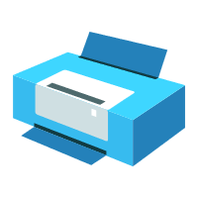




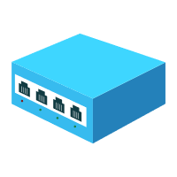




Slide 6















Slide 7














Slide 8



















