Slide 1
Contract Monthly Claim System - Part 3
Your Name: Mendes Sithole
Student Number: 10332172
Course/Project: Programming 2B
Date: 11/22/2024

Slide 2
Project Overview
The Contract Monthly Claim System is a web-based platform designed to automate the submission, approval, and management of claims for lecturers, program coordinators, and HR personnel.
The system provides a user-friendly interface for lecturers to submit claims, allows program coordinators to approve or reject claims, and enables HR to generate reports.
Technologies Used:
- ASP.NET MVC: Framework used for building the application.
- Entity Framework: ORM for interacting with the database.
- jQuery: For client-side interactivity and validation.
- HTML/CSS: For the front-end design.

Slide 3
Features
Lecturer Dashboard:
- Submit claims with Hours Worked and Hourly Rate.
- View Monthly Claims and track their status.
- Upload supporting documents for each claim.
Program Coordinator:
- Review and approve or reject submitted claims.
- View claim details and update the status to 'Approved' or 'Rejected'.
HR Generated Report:
- Generate detailed reports on claims and payments processed.
- Display claims' status and other relevant data for HR personnel.

Slide 4
System Architecture
Lecturer submits claims -> Program Coordinator approves/rejects -> HR generates reports.
The flow between users is as follows:
Lecturer -> Program Coordinator -> HR.
The database stores claims and user data.

Slide 5
Database Design
Data Storage:
- Claims are stored in an in-memory collection (or database for production).
- Lecturer information and claim data such as Hours Worked, Hourly Rate, and Amount are stored in the MonthlyClaimModel.
Tables/Models:
- Lecturer (LecturerName, Surname, etc.)
- Claim (ClaimId, Description, Amount, Date, Status)
- Program Coordinator and HR interact with the claim data.

Slide 6
User Interfaces
Screenshots:
- Lecturer Dashboard: Show the buttons for submitting claims, viewing monthly claims.
- Program Coordinator Page: Show a table with options to approve or reject claims.
- HR Report Page: Show the report generation interface or display.

Slide 7


System Workflow
Lecturer:
- Submits claims with Hours Worked and Hourly Rate. The Amount is auto-calculated.
- Uploads supporting documents.
Program Coordinator:
- Views submitted claims, approves or rejects them.
- Approves or rejects based on predefined criteria.
HR:
- Generates detailed reports of claims.

Slide 8
Challenges and Solutions
Challenge 1: Handling auto-calculation of claim amounts.
Solution: Implemented jQuery on the client-side to auto-calculate the amount based on Hours Worked and Hourly Rate.
Challenge 2: Ensuring correct data validation for claim submission.
Solution: Used ModelState and data annotations to validate the claim data before submitting.
Challenge 3: Managing claims approval workflows.
Solution: Used simple status fields to manage the approval/rejection process for claims.

Slide 9
How the System looks like

Slide 10
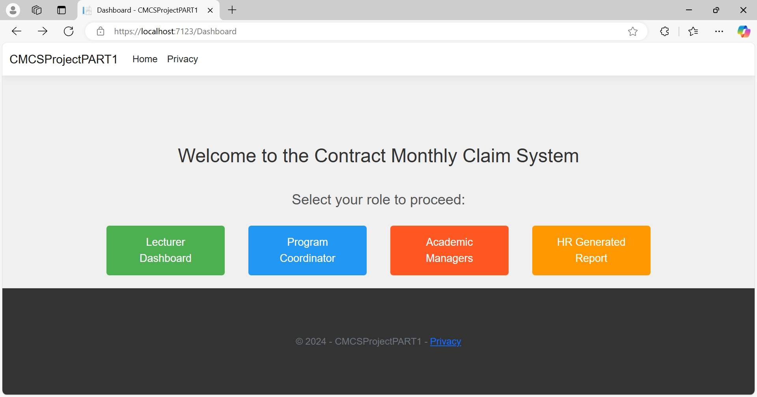

Slide 11
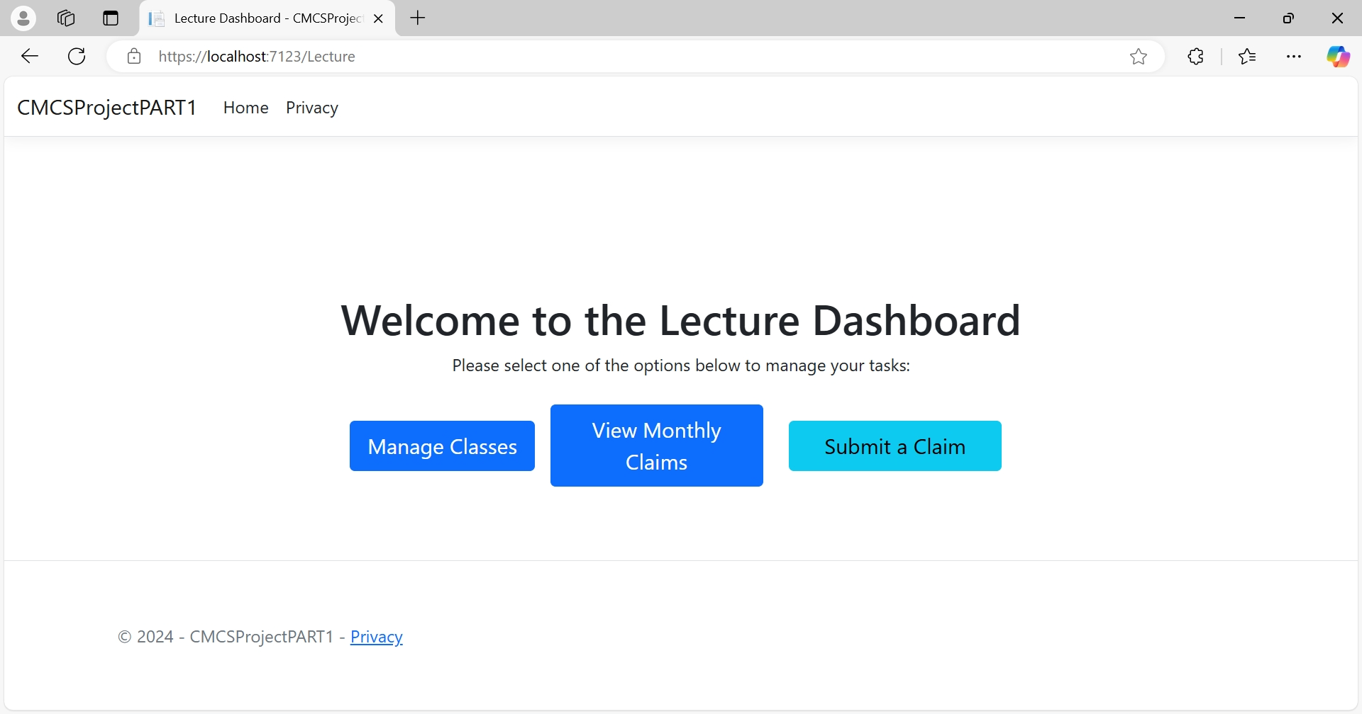

Slide 12
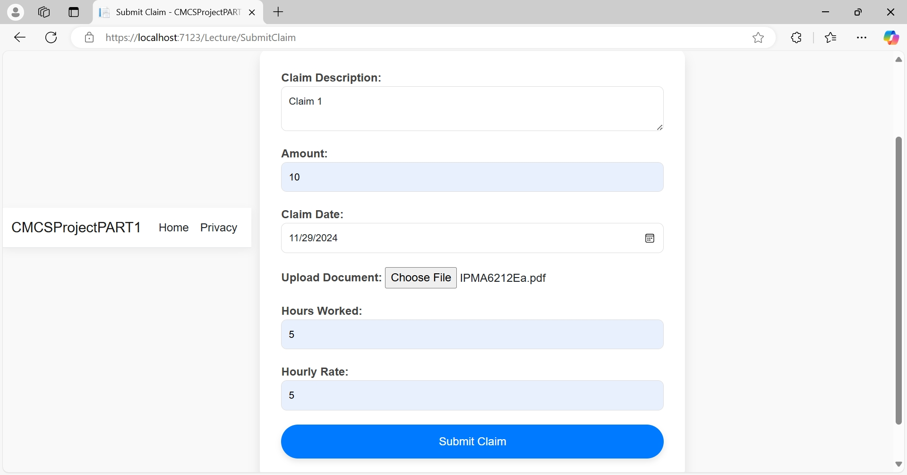
Submit Claims

Slide 13
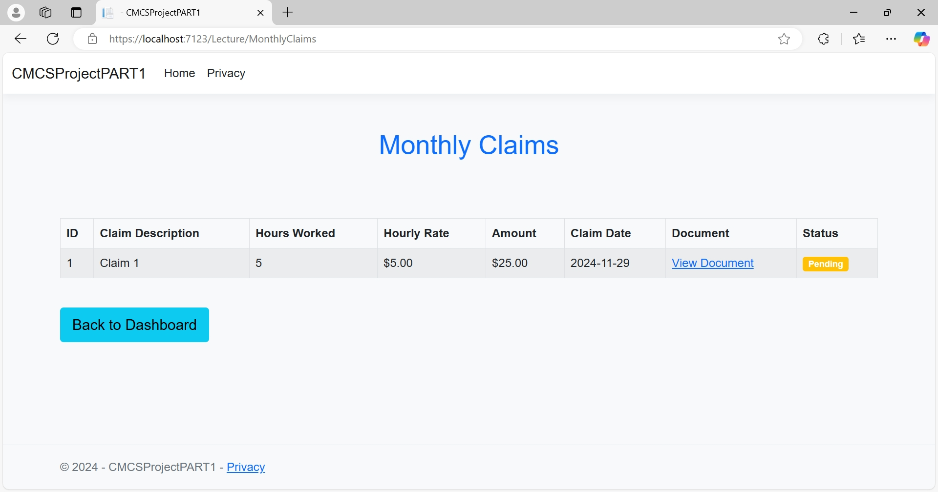
Monthly Claims

Slide 14
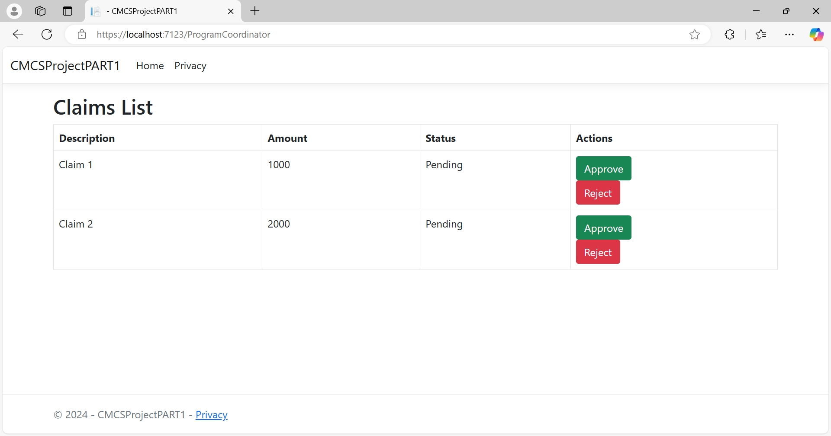
Program Coordinator

Slide 15
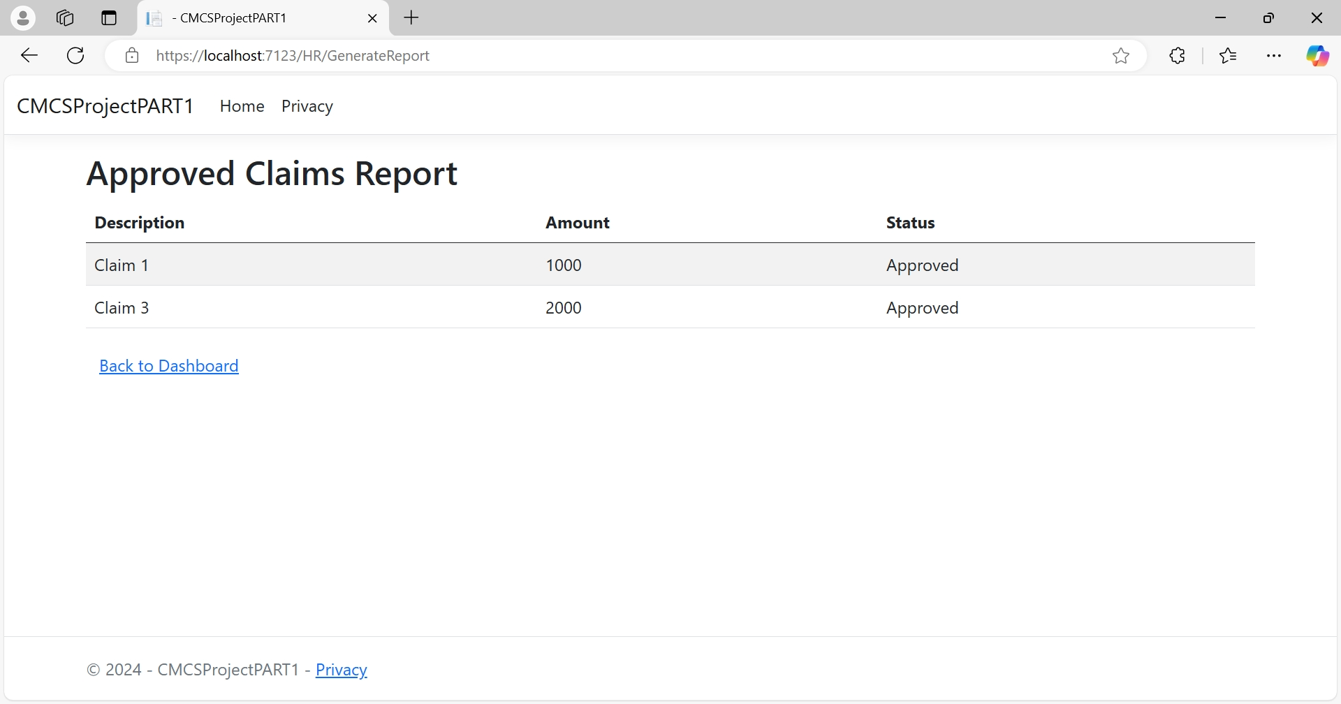
HR Generate Report

Slide 16
Theres a lot done in this Project
That was just tip of an iceberg

Slide 17
Conclusion
Summary:
The Contract Monthly Claim System streamlines the submission, approval, and reporting of claims. It enhances the efficiency of handling claims by automating processes and improving user interaction.
Results:
- Reduced manual effort in claim processing and reporting.
- Simplified the approval process for Program Coordinators.
- Enabled HR to generate reports automatically.

