Slide 1
COS Website Vibe Guide

Slide 2
Project overview
The website will be the main landing page for people referred to the study.
It should act as a clear and welcoming introduction to learn about the project, motivate people to participate (e.g., testimonials/videos), and provide access to the study (It will be hosted externally).
The overall goal is to be a clear welcoming introduction to the study rather than feeling too academic or complicated.

Slide 3
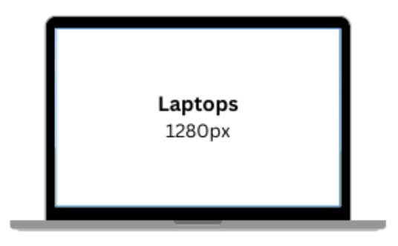
Landing page
Logo/banner
Short clear introduction (~X words).
Simple explanation of the project (~X words).
Minor content from other pages.
Prominent call-to-action (to participate/learn more)
TITLE BANNER
LOGO
PAGE NAVIGATION BAR
TAKE THE SURVEY!
TEXT ABOUT THE STUDY
PROMOTIONAL UPDATE LIKE 4000 PEOPLE HAVE PARTICIPATED SO FAR – WOW!
TESTIMONIALS / PROMOTIONAL IMAGES & SLOGANS
The layout can also look different – I just made an attempt ☺

Slide 4
Other pages
I was going to make an example then realised I had no idea how it would look (lol)
About the project
Study information
FAQs
Depression Dictionary
Testimonials/Community
Publications
Media promotion/Webinars
Take the survey!
Most pages will have a single page of content.
If more, then continuous scroll would be nice (if possible?)
It would be nice to have the logo/navigation bar set across all pages (for consistency)
Any videos/survey link will be external – is it possible to embed videos (from youtube probably) on the pages of the site?

Slide 5
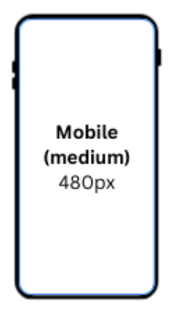
Mobile accessibility
It would also be super cool to have it accessible on mobile (not sure if this is possible).
We’re targeting a lot of younger people (18-35) so it would be handy for them to access this site on their phone.
Would a mobile version be easier with only a few pages?

Slide 6
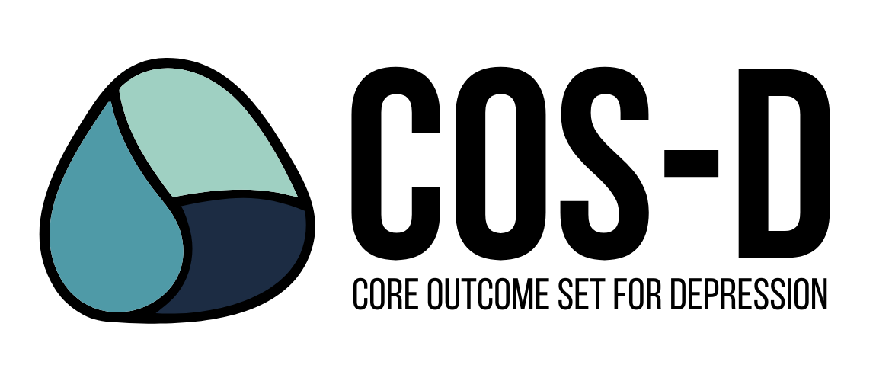
Visual style
Main logo colours: #4f9aa7, #9fd0c2, #1c2c43
Prefer to keep to this palette + black text , rather than super coloured/intense
More understated, professional, minimal, but not too cold.
This logo is meant to represent tears from the three target groups (people with depression, healthcare professionals, and informal caregivers) coming together in a single tear. I’m not sure if that’s relevant for the website…?

Slide 7
Technical design preferences
Continuous scroll/swipeyness where possible for mobile users.
Limited animation → I don’t want to gamify it/keep it a bit serious.
No pop-ups → I wanna seem legit.

Slide 8
Some other website examples
For information/image combination ratio:
https://wellcome.org/our-priorities/mental-health
https://www.mqmentalhealth.org/
For vibe/style:
I couldn’t find anything but maybe we can speak together.

