Slide 1

Graph Neural Network for Optimal Energy Prediction
Menelaos and Chiara
Supervisors: John Kouroudis & Poonam
Garching, 20th December
Computational Material Design
TUM School of Computation, Information and Technology

Slide 2

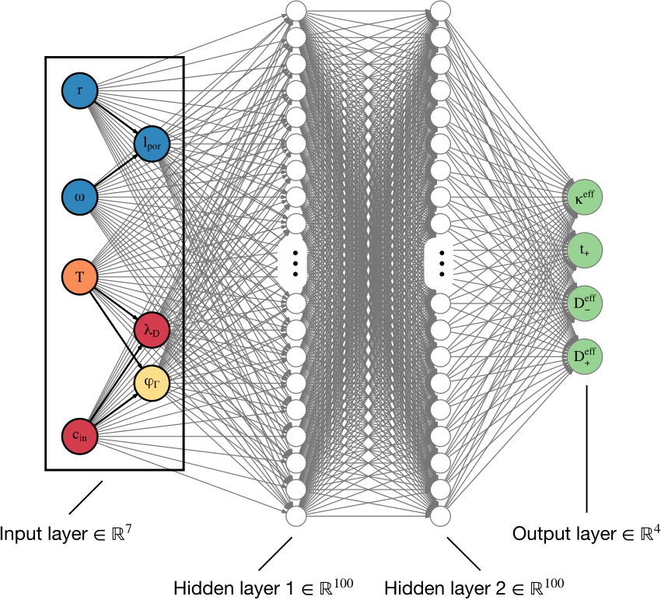
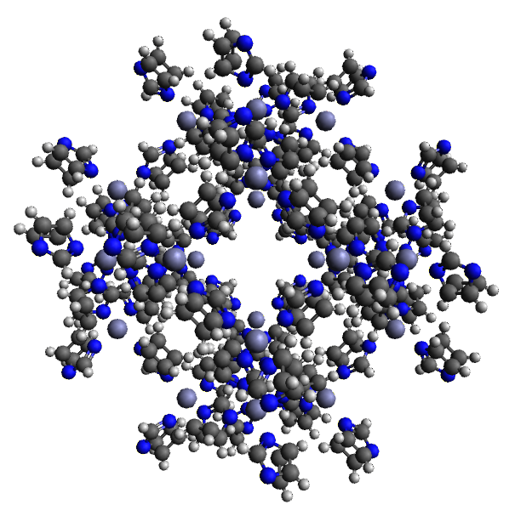
Introduction to our project
1. DFT calculations
2. Graph Neural Network
3. Energy Prediction without DFT

Slide 3
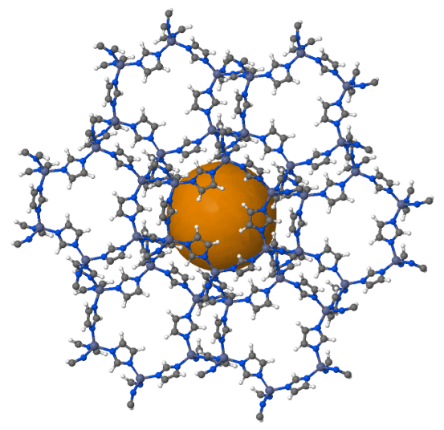
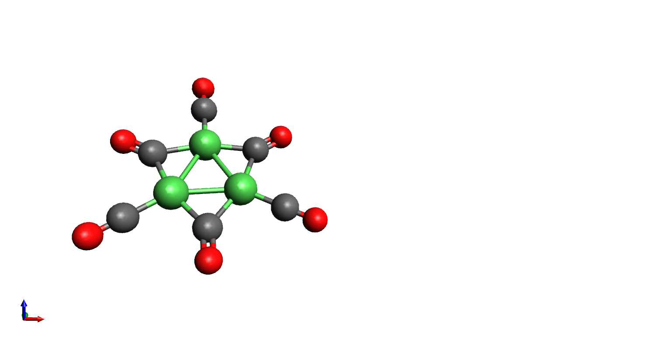
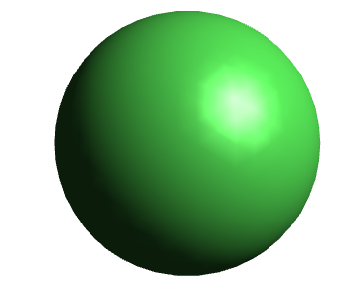
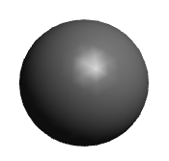
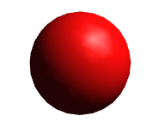
Ni nanoclusters (NCs) and metal-organic frameworks (MOFs)
encapsulation in a MOF
Ni
Tendency of nanoclusters to agglomerate
C
o
Notes:
ZIF-8 MOF: Zn and four imidazolate rings

Slide 4
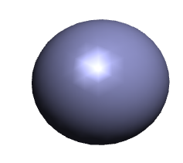
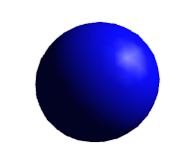
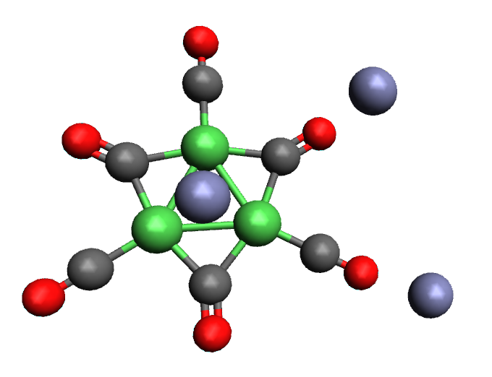
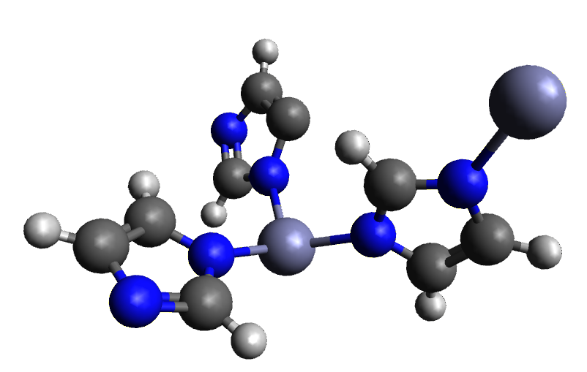
How does the MOF build around the nanocluster?
Ni
Zn
C
N
o
2
starts with the adsorption of Zn²⁺
1
3
MOF used: ZIF-8
Zn²⁺ and imidazolate rings
Notes:
The MOF builds around the nanocluster, starting with Zn2+

Slide 5
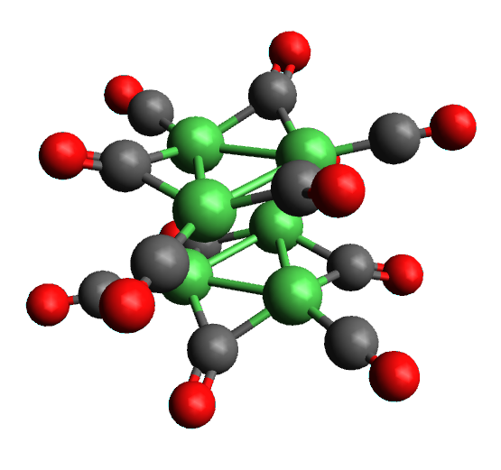
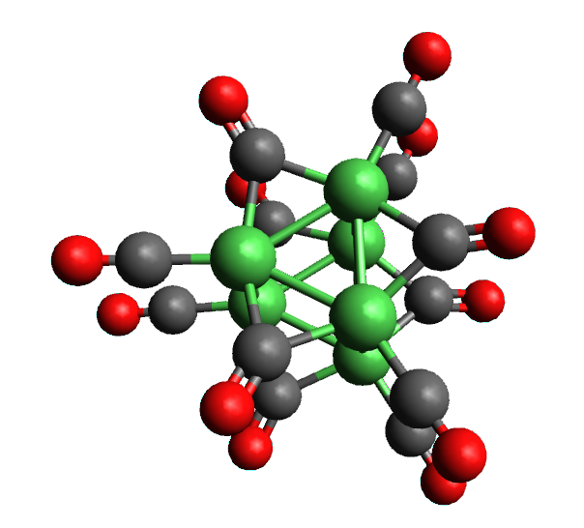
DFT Simulations on the nanoclusters
Ni
C
O
1. Geometrical optimization of the NCs without Zn, benchmark of the multiplicity
2. Geometrical optimization of the NCs with Zn in the adsorption sites
Zn

Slide 6
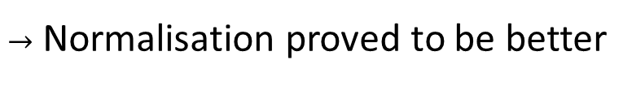
Data preprocessing
Use create_data.ipynb to extract the coordinates and energies from the .xyz files
Number of Graphs/Energies, controlled by the parameter index
= 3
Afterwards the data was either standardised or normalised
$→$ Normalisation proved to be better
At the end the data was stored in .pt files

Slide 7
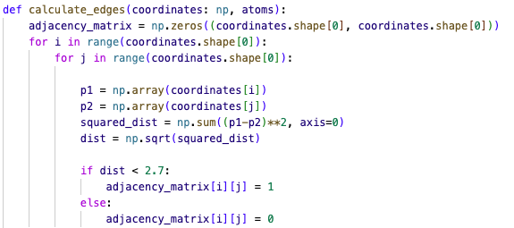
Adjacency matrix

Slide 8
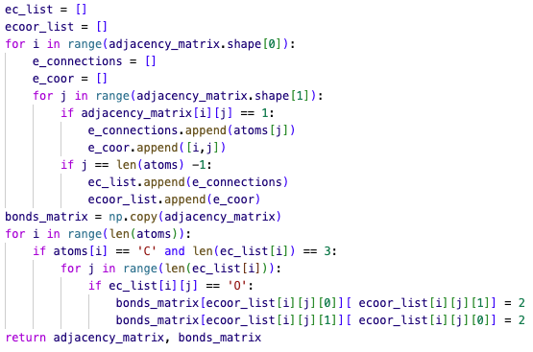
Double Bonds

Slide 9

Graph Initialisation
Edges of the the GNN were set as the adjacency matrix
Edges attributes: multiplication of the coulomb matrix and the pairwise distances with the adjacency matrix to establish only the relevant connections
The node attributes (electronegativity, atomic radius and atomic number) for new atom Nickel were also added
The edge attributes and edges were flattened and then in combination with the node attributes were added to the graph

Slide 10

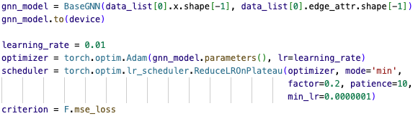
Casual Training & Testing setup

Slide 11
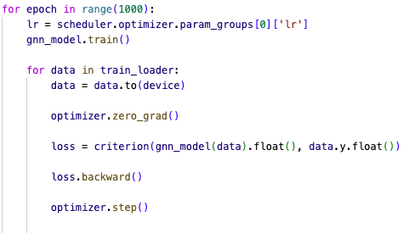
Training

Slide 12
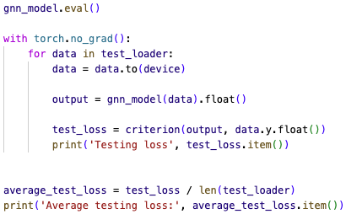
Testing

Slide 13
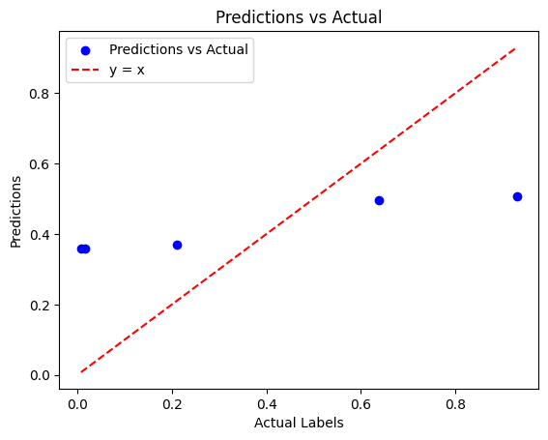
Results

Slide 14

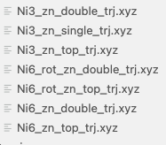





Cross Validation
$$⋮$$
$$⋮$$
$$⋮$$
$$⋮$$
$$⋮$$

Slide 15
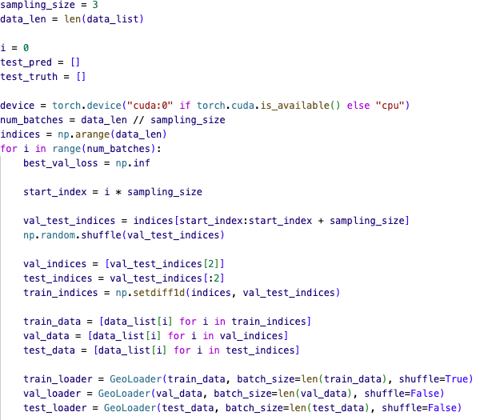
Cross validation

Slide 16
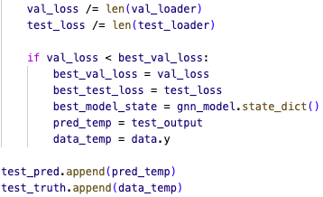
Training, Validation, Test
Training, testing and model parameters are exactly the same as in the causal setup
GNN is initialised for each batch iteration, namely 7 times

Slide 17
GNN Parameters
Initial Learning Rate: 0.01, with scheduler
2 Convolutional Layers
Add and mean Pooling
Epochs: 1000
Conv Layers: Gaussian Mixture Models (GMM), TransformersConv, NNConv
Loss: MSE Loss
Optimiser: Adam
Predictor: Single layer NN with ELU
Generally activation functions: ReLU

Slide 18
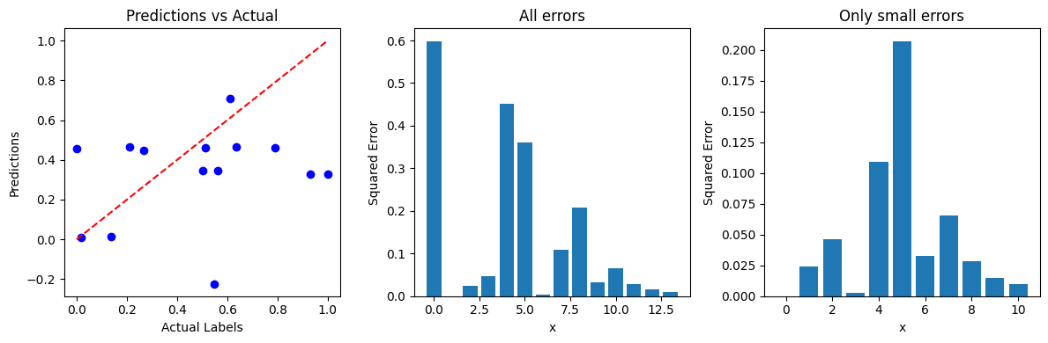
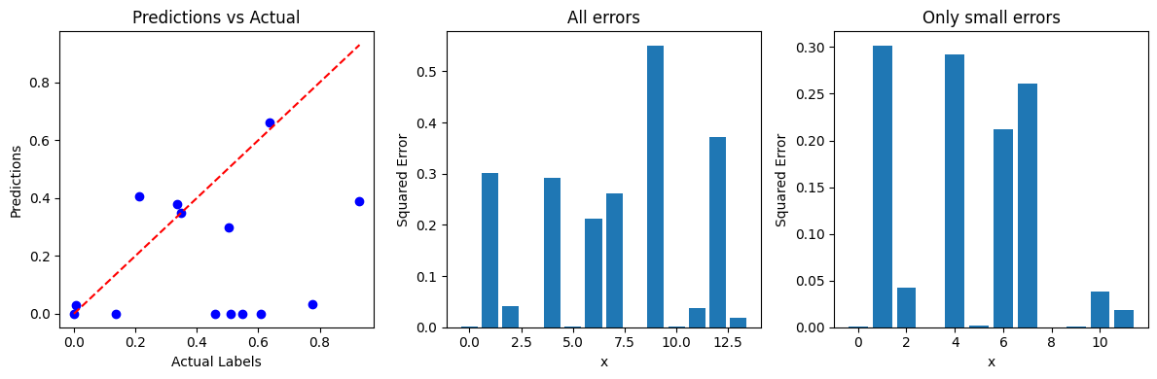
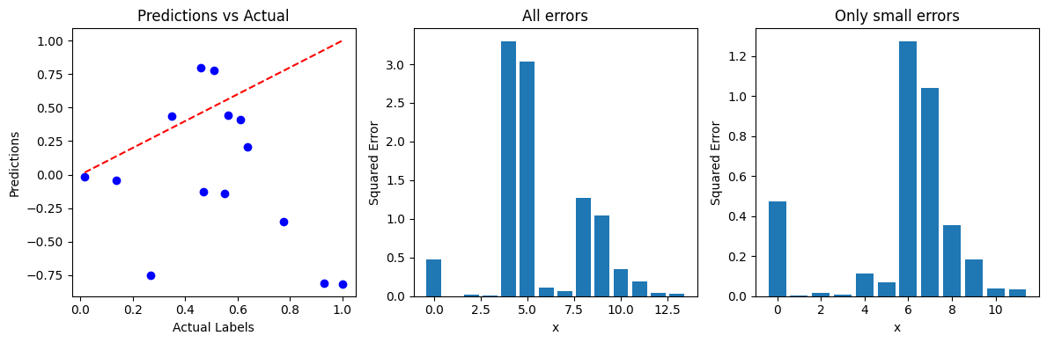
Results GMM
Both Layers GMM: MSE: 0.157, SE.std: 0.175
GMM & NNConv: MSE: 0.7098, SE.std: 1.074
GMM & NNConv: MSE: 0.14, SE.std: 0.17

Slide 19
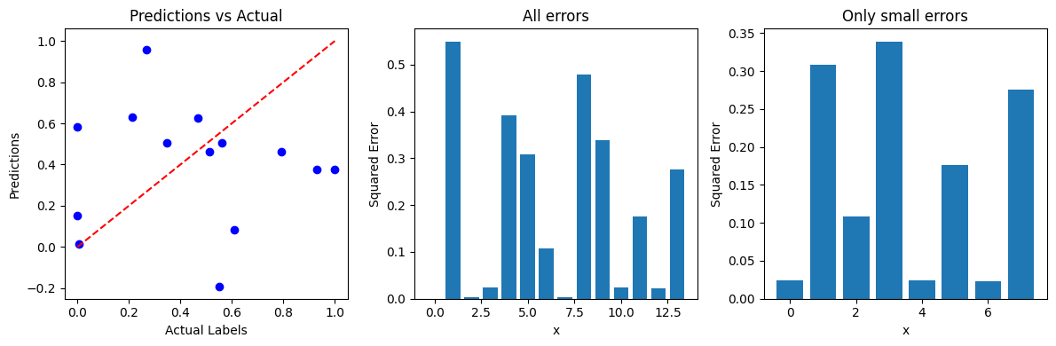
Results GMM
GMM & TransformerConv: MSE: 0.193, SE.std: 0.1875
GMM & TransformerConv: MSE: 0.39, SE.std: 0.575

Slide 20
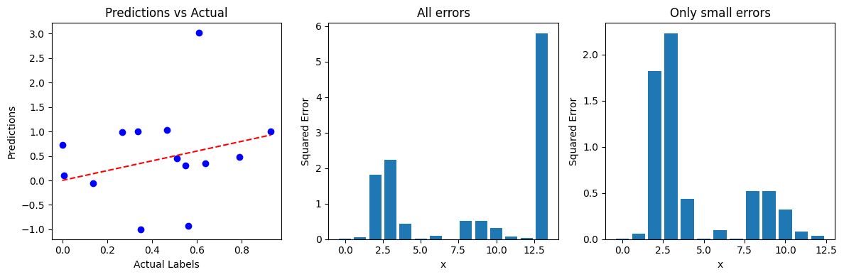
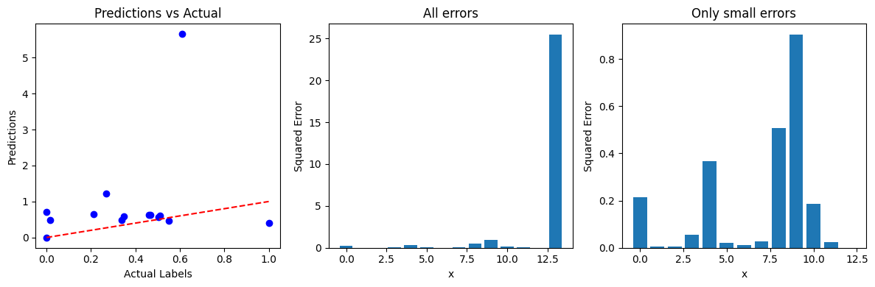
Results NNConv
Both Layers NNConv: MSE: 0.85 SE.std: 1.524
NNConv & GMM: MSE: 1.98 SE.std 6.5

Slide 21
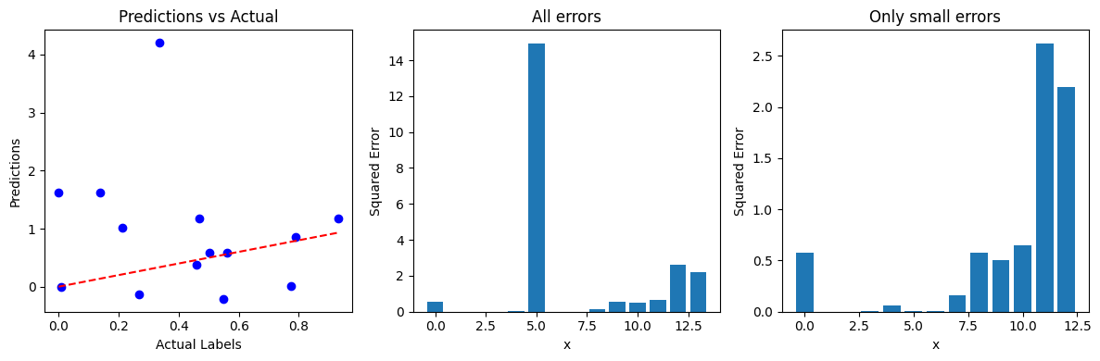
Results NNConv
NNConv & TransformerConv: MSE: 1.58 SE.std 3.78

Slide 22
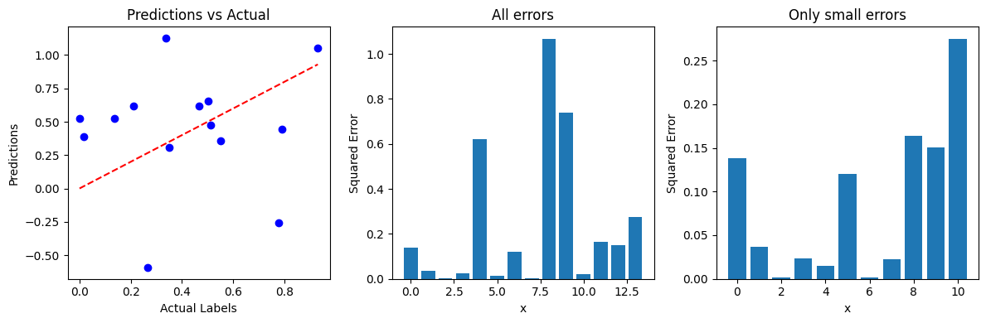
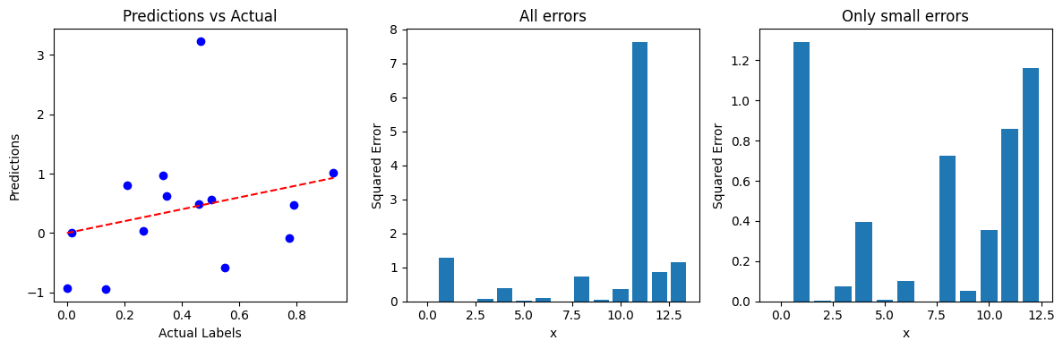
Results TransformerConv
Both Layers TransformerConv: MSE: 0.24 SE.std: 0.31
Both Layers & NNConv: MSE: 0.90 SE.std 1.94

Slide 23
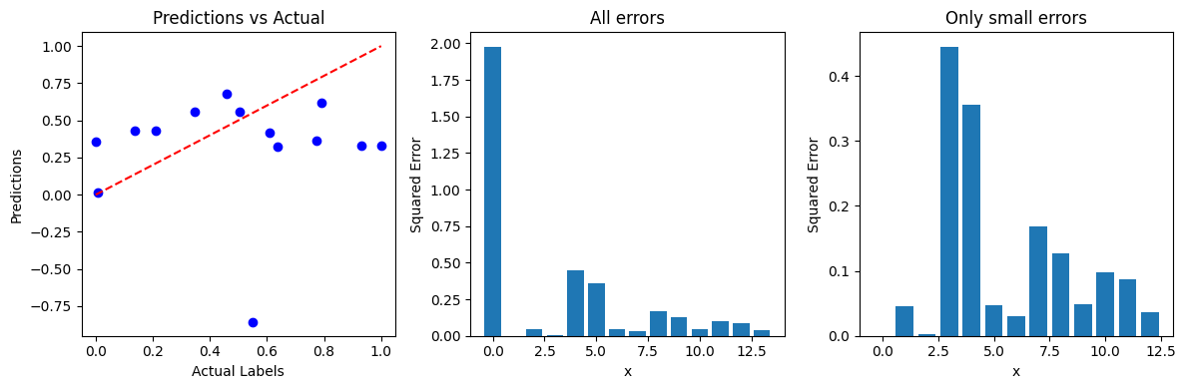
Results TransformerConv
TransformerConv & GMM: MSE: 0.24 SE.std: 0.49

Slide 24
Discussion
More data
Adjacency matrix and coulomb interaction
Bonds representation
Read the documentation of the functions further
See if the error comes from specific data

Slide 25
Thank you! Questions?

