Slide 1

Project Laboratory
The Integration of galvanic skin response (GSR) sensors into wearable wireless devices
By: Kormoua Khongmeng – I3MLPQ

Slide 2
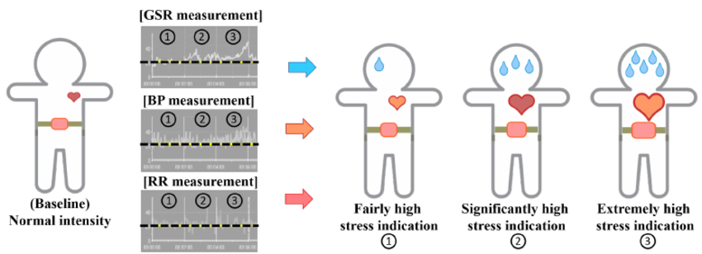
1. What is GSR?
GSR (Galvanic Skin Response) :
How to skin react electrically based on his/her activity and emotional state, etc.
Resistance / Conductance
Sweat
Tan, C. S. S., Schöning, J., Luyten, K., & Coninx, K. (2014).
Investigating the effects of using biofeedback as visual stress indicator
during video-mediated collaboration.

Slide 3
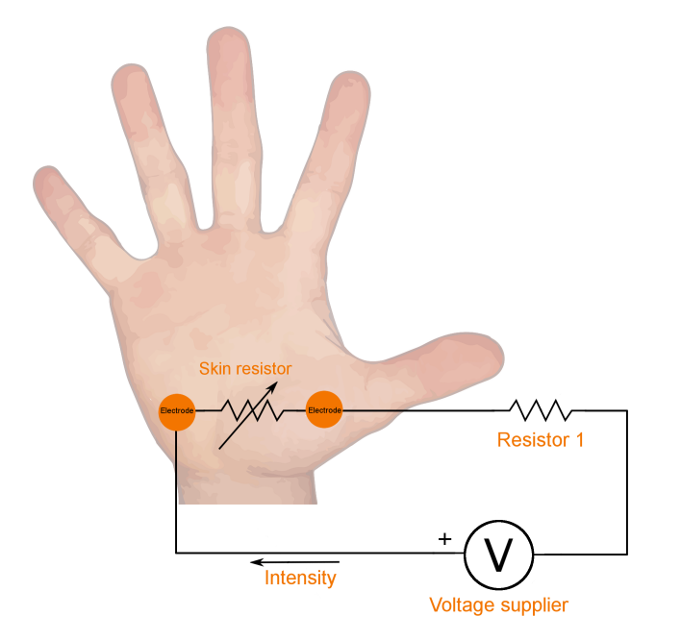
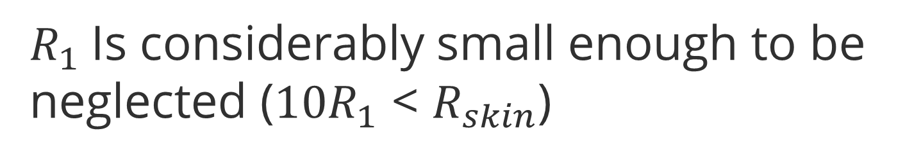
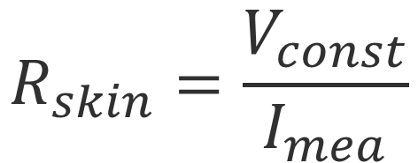
2. How do we measure GSR?
Ohm’s Law
$$R_{skin}=\frac{V_{const}}{I_{mea}}$$
$R_{1}$Is considerably small enough to be neglected ($10R_{1}$ < $R_{skin}$)
Boucsein, W. (2012). Electrodermal activity. Springer Science & Business Media.

Slide 4
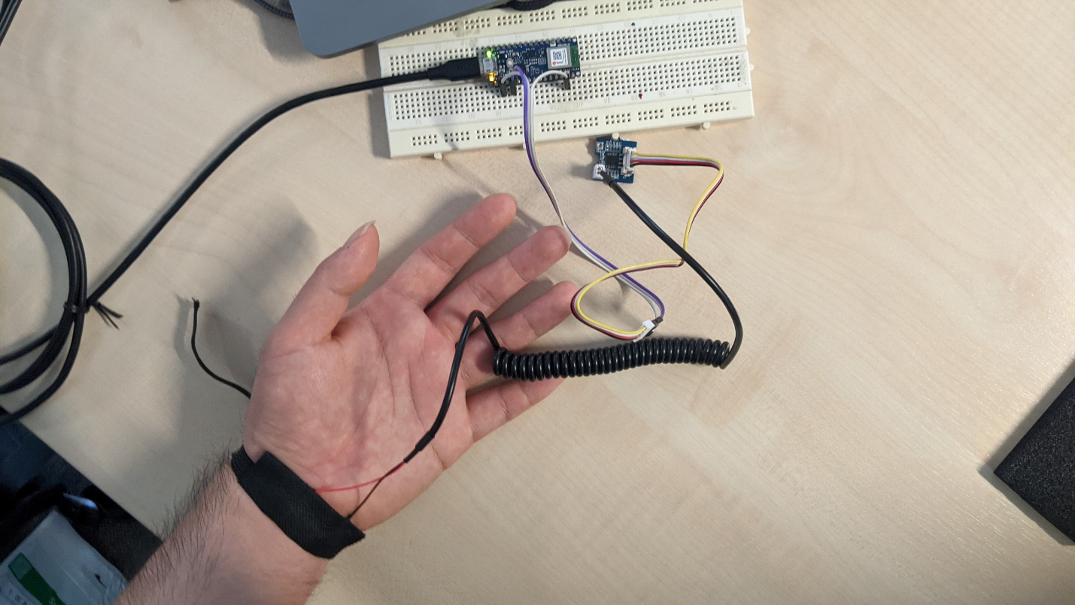



3. How do we implement it for wireless wearable device
Module:
Bluetooth module
Arduino nano BLE 33
Grove - GSR_Sensor
A pair of electrodes
GSR sensor
Electrodes

Slide 5
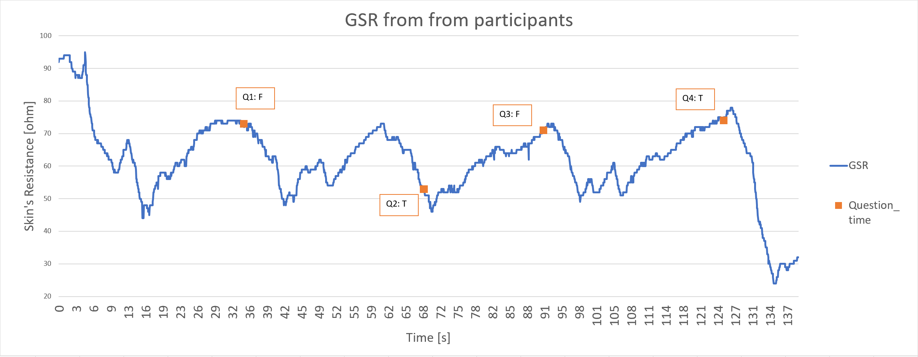
3. How do we implement it for wireless wearable device

Slide 6
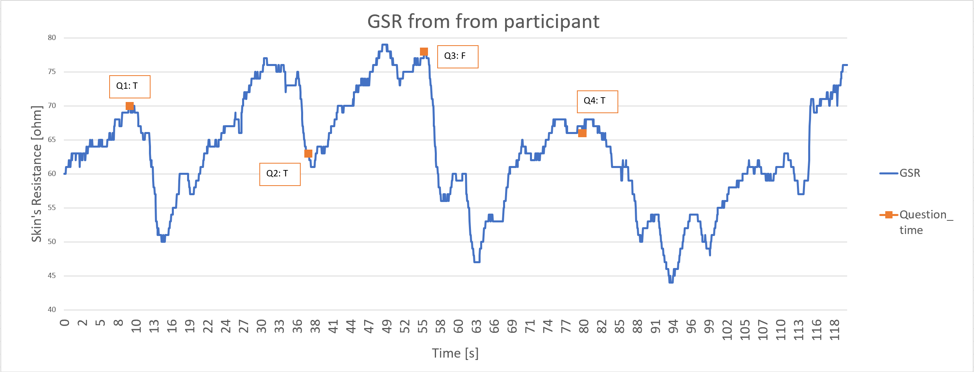
3. How do we implement it for wireless wearable device

Slide 7
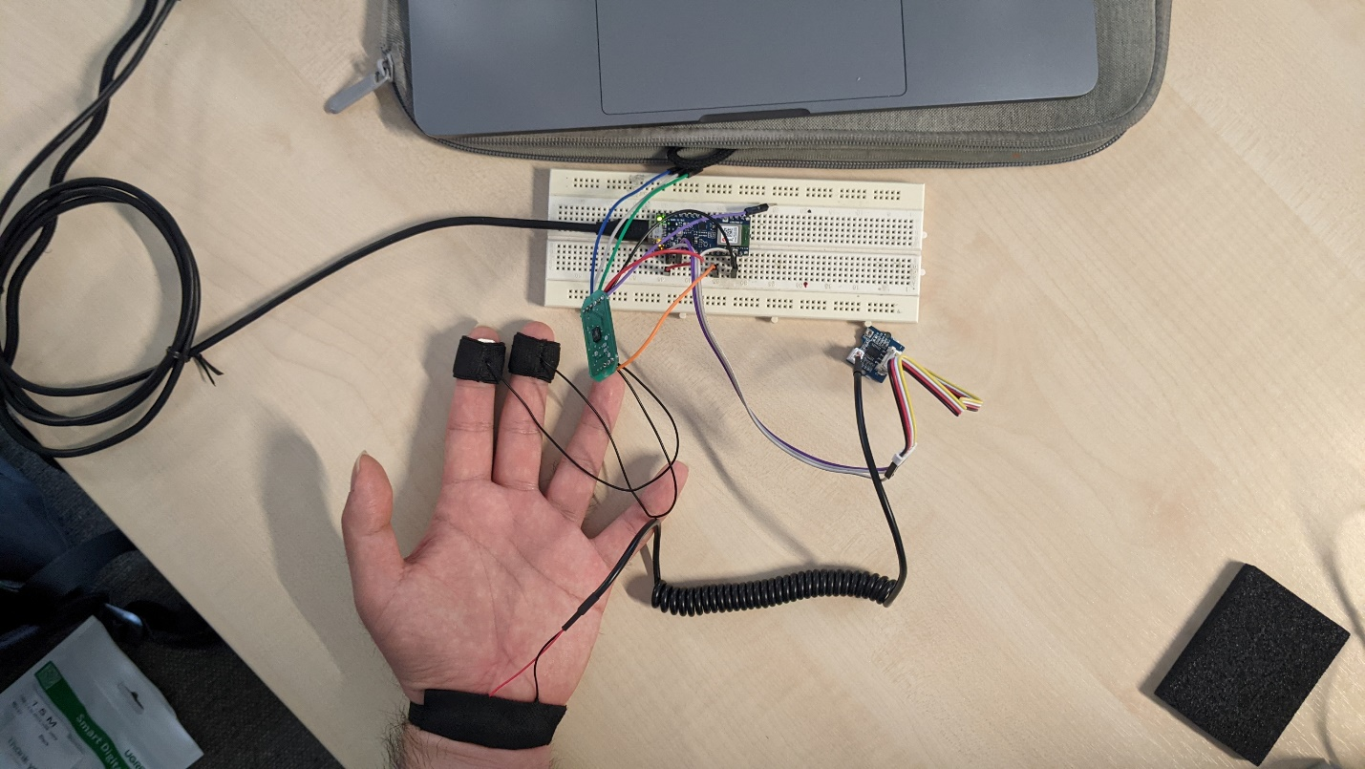
4. Validation of GSR measurement on wearable device
Module:
Arduino nano BLE 33
Grove - GSR_Sensor
A pair of electrodes
Bluetooth module
Go to the wrist
GSR sensor 2
Electrodes pair 2
GSR sensor 2
GSR sensor 1
A pair of electrodes
Go to the fingers
Electrodes pair 1

Slide 8
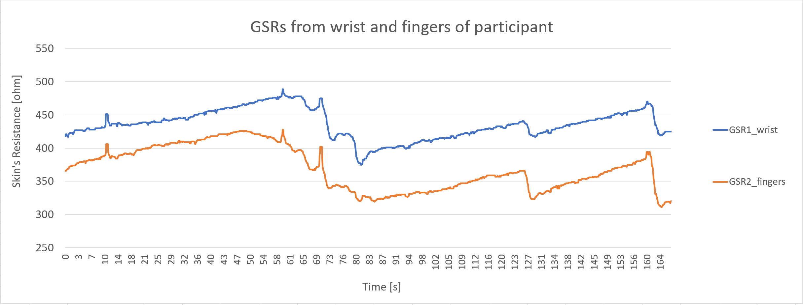
4. Validation of GSR measurement on wearable device
Jump scare scene
Building tension scene

Slide 9
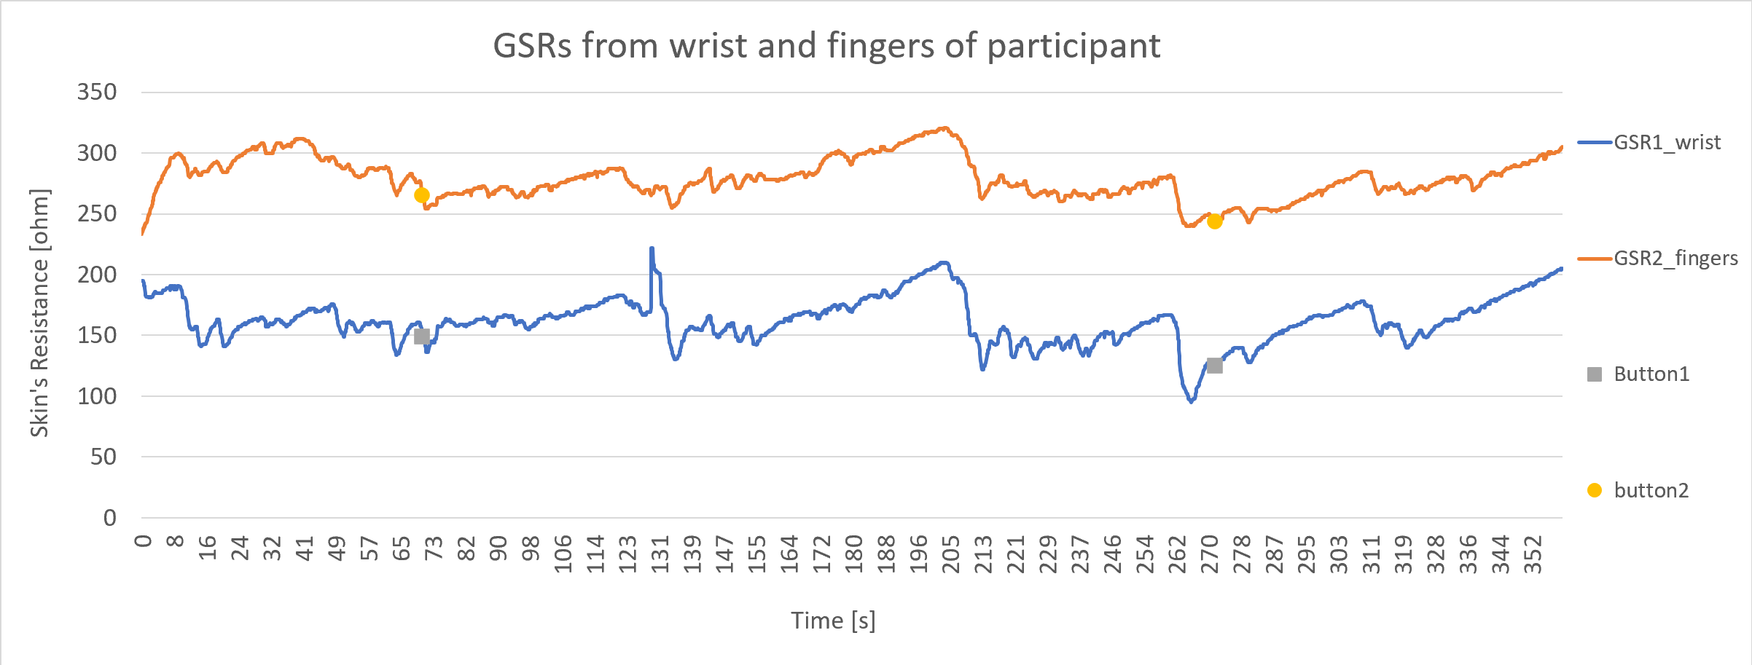
4. Validation of GSR measurement on wearable device

Slide 10
Ending
Special thanks to:
My supervisor: Dr. Márton Gergely
Guided me through out the work to achieve the goal
My advisor: János Csipor
Gave technical advises through out the whole work
Dr. Ferenc Ender
Helped me out regarding administration work

Slide 11
1. Title should not be at bottom (on each slide)
2. Fix the graph, add label on axis, delete time,
3. Change title color to black
4. Delete table of context
5. Add reference to each picture that is not our work
6. Delete a reference at the end and add to each picture
7. Spend more time to explain the graph and how to understand the result
8. Change the schematic to our modules

Slide 12
Montagu, J. D.; Coles, E. M. (1966). Mechanism and measurement of the galvanic skin response.. Psychological Bulletin, 65(5), 261–279.
Rickles, William Jr H (1964). Engineering Considerations in GSR Research, AD0610222
Mahima Sharma; Sudhanshu Kacker; Mohit Sharma (2016). A brief Introduction and Review on Galvanic Skin Response.. International Journal of Medical Research Professionals, P-ISSN: 2454-6356; E-ISSN: 2454-6364.
Milstein, Nir; Gordon, Ilanit (2020). Validating Measures of Electrodermal Activity and Heart Rate Variability Derived From the Empatica E4 Utilized in Research Settings That Involve Interactive Dyadic States. Frontiers in Behavioral Neuroscience, 14(), 148–.
Nicole S. Chudy, Daniel S. McConnell, Janan A. Smither (2016). The Performance of Microsoft Band 2 and Basis Peak: A Validity and Reliable Test.
Villarejo, María Viqueira; Zapirain, Begoña García; Zorrilla, Amaia Méndez (2012). A Stress Sensor Based on Galvanic Skin Response (GSR) Controlled by ZigBee. Sensors, 12(12), 6075–6101.
https://www.amazon.com/gp/customer-reviews/RMJKQU5RMDTKZ/ref=cm_cr_arp_d_viewpnt?ie=UTF8&ASIN=B01IPSUIZ0#RMJKQU5RMDTKZ
https://www.pocket-lint.com/fitness-trackers/reviews/microsoft/136205-microsoft-band-2-review-function-over-form
The Best Wearable Device for Research on Emotion and Affect? - AffecTech
Toomin, M. K., & Toomin, H. (1975). GSR biofeedback in psychotherapy: Some clinical observations. Psychotherapy: Theory, Research & Practice, 12(1), 33–38. doi:10.1037/h0086402
Nagai, Y., Jones, C. I., & Sen, A. (2019). Galvanic Skin Response (GSR)/Electrodermal/Skin Conductance Biofeedback on Epilepsy: A Systematic Review and Meta-Analysis. Frontiers in Neurology, 10. doi:10.3389/fneur.2019.00377
5. Reference

Slide 13
TABLET OF CONTENT
1
What is GSR?
Theoretical explanation about GSR
2
How do we measure GSR?
A physic and idea behind the engineering of GSR sensor
3
How do we implement it for wireless wearable device?
What I used and what I did to construct a virtual wireless wearable device that measure GSR
4
Validation of GSR measurement on wearable device
Test the sensor and data that is read
5
Reference
Resource of my information.

Slide 14
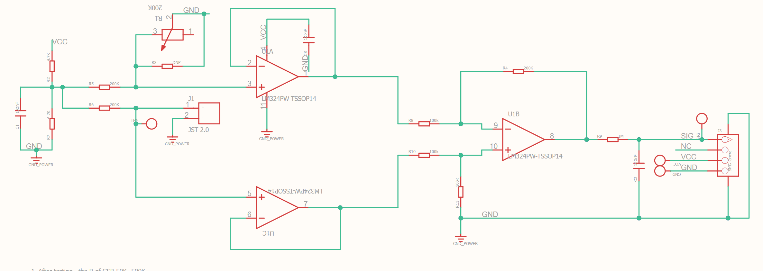
2. How do we measure GSR?

Slide 15
