Slide 1
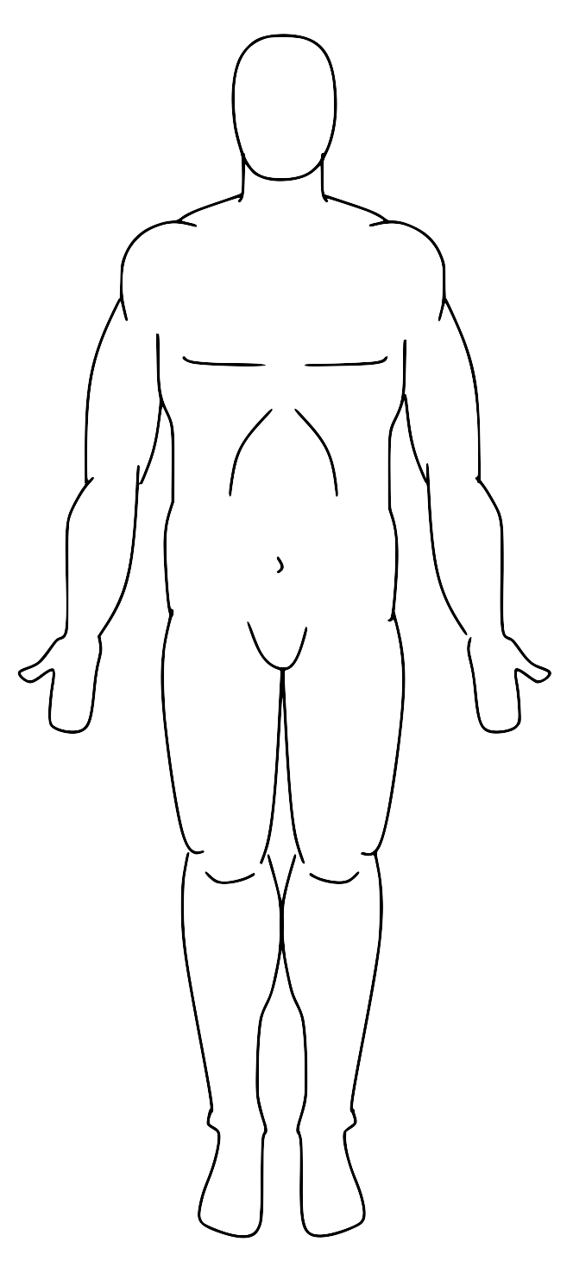
H
P
R
L
[Slice, row, column]
0
A
0: head;
max: foot
0: posterior;
max: anterior
0: right;
max: left
A
R
L
P
0
F

