Slide 1

Texture Memory on GPUs
ZHAONAN MENG

Slide 2
Contents
What is the texture memory?
Architecture
Features
(How to use textures in CUDA?)
Some demos

Slide 3
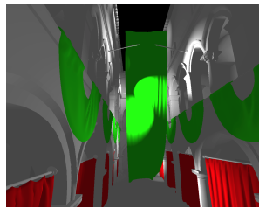
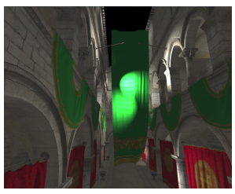
What is the texture memory?
In computer graphics...
The texture cache is an essential component of modern GPUs and plays an important role in achieving real-time performance when generating realistic images. The texture cache is a read-only cache that stores image data that is used for putting images onto triangles, a process called texture mapping.
without texture mapping with texture mapping

Slide 4
What is the texture memory?
In computer graphics...
The texture cache has a high hit rate since there is heavy reuse between neighboring pixels and is usually located close to the shader processor so texture data is available with high throughput and at low read latencies.
without texture mapping with texture mapping

Slide 5
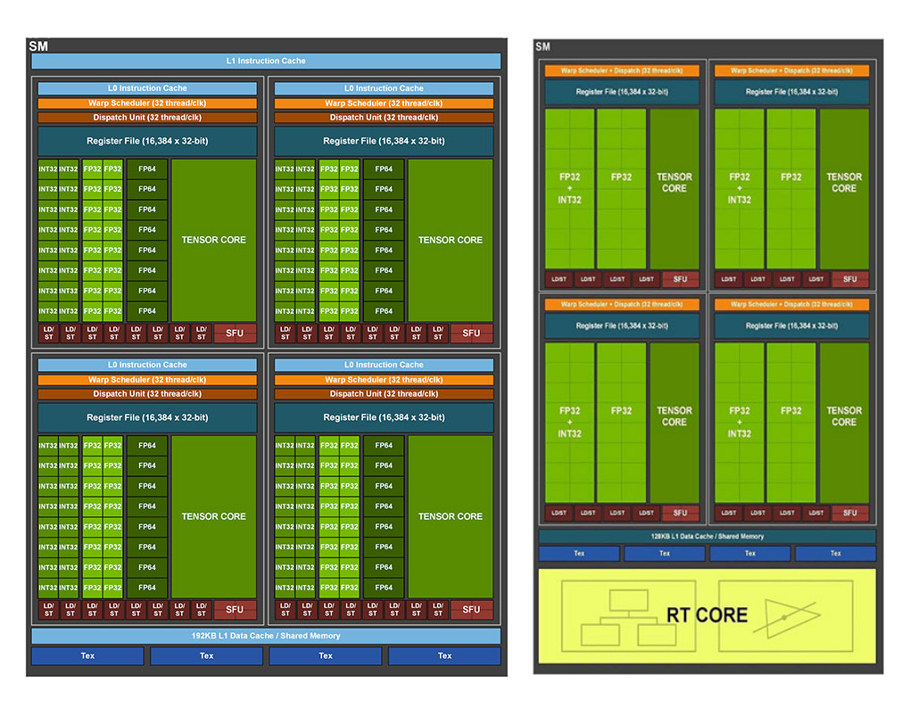
Architecture
Notice that the term “texture cache” is used instead of “texture memory”...
Analogous to the constant memory, the texture memory is cached on a chip, and thus provides higher effective bandwidth.
NVIDIA Ampere Streaming Multiprocessor

Slide 6
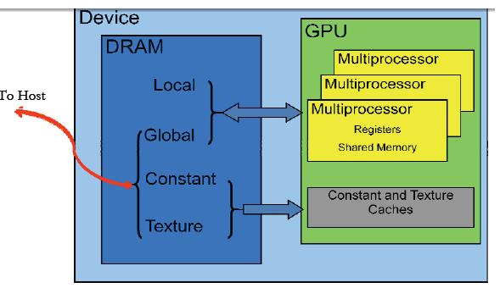
Architecture
Notice that the term “texture cache” is used instead of “texture memory”...
Analogous to the constant memory, the texture memory is cached on a chip, and thus provides higher effective bandwidth.
The various memory spaces on a CUDA device

Slide 7
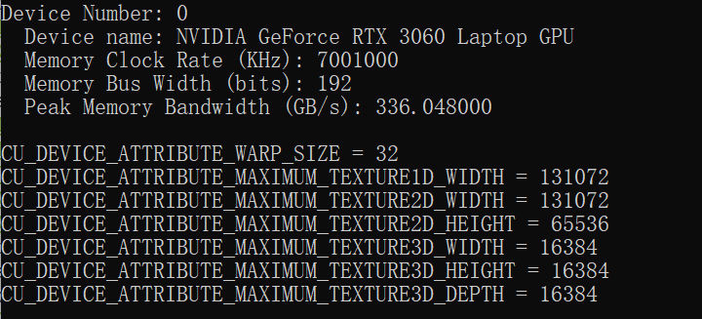
Features
Using CUDA driver API to query the attributes of the texture cache:
CUresult cuDeviceGetAttribute ( int* pi, CUdevice_attribute attrib, CUdevice dev )
CU_DEVICE_ATTRIBUTE_MAXIMUM_TEXTURE1D_WIDTH,
CU_DEVICE_ATTRIBUTE_MAXIMUM_TEXTURE2D_WIDTH,...
1D width: 128KB
2D width: 128KB
2D height: 64KB
3D width: 16KB
3D height: 16KB
3D depth: 16KB

Slide 8
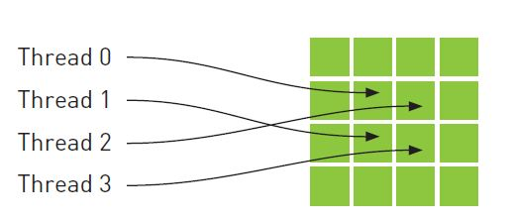
Features
Can cache non consecutive memory locations unlike CPU caching schemes.
Designed to accelerate access patterns.
WHY USE TEXTURES?
Recall what we introduced about computer graphics...

Slide 9
Features
Can cache non consecutive memory locations unlike CPU caching schemes.
Designed to accelerate access patterns.
Utilization of textures can help improve performance of application where memory access patterns exhibit great deal of spatial locality.
WHY USE TEXTURES?
Recall what we introduced about computer graphics...

Slide 10
Features
WHY USE TEXTURES?
Recall what we introduced about computer graphics...
An idea
It would be beneficial to use textures when..
you’re accesing elements frequently from adjacent columns of a matrix stored by row major.
Convolution Filtering
Physical Simulation
...
(Some specific domains in medical image reconstruction)

Slide 11
How to use textures in CUDA?

Slide 12
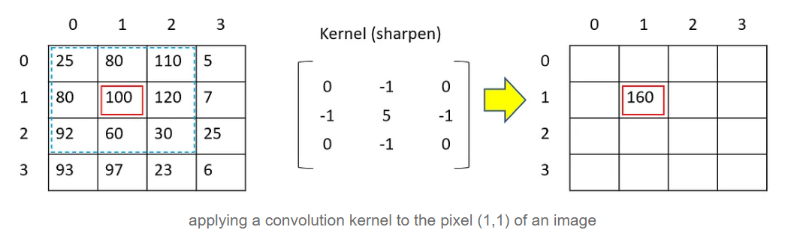
Some demos
Heat simulation example - book “CUDA by Example”
Convolution filtering

