Slide 1

SCHOOL OF COMPUTER SCIENCES
UNIVERSITI SAINS MALAYSIA
SEMESTER I, ACADEMIC SESSION 2013/2014
CAT400: Undergraduate Major Project
RFID-enabled Attendance Management System
Competitor : Zhi Meng
Supervisor : Dr. Manmeet Mahinderjit Singh

Slide 2
The Aim of This Project
Increase the accuracy and efficiency for student signing attendance
Make it convenient for lecturers and students checking students attendance

Slide 3
Contribution
Combine the attendance system with mobile device (Smartphone & Tablet)
Decrease the probability of duplication reading and miss reading

Slide 4
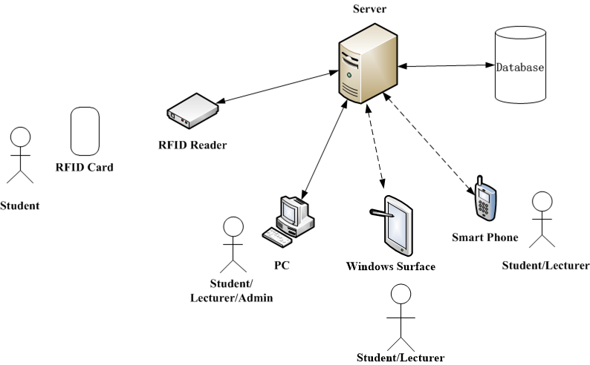
Project Structure Diagram

Slide 5
RFID Part
Student:
Student Sign Attendance and Access Control
Check Duplication Reading
Check Miss Reading

Slide 6
Webpage Part (ASP.Net)
Administrator :
Enroll Staff
Enroll Student
Set Class Time
Monte Carlo Simulation
Changing Password
Lecturer:
Check Student Attendance and Movement
Changing Password
Student:
Check Attendance and Movement
Changing Password

Slide 7
Smartphone Part (Windows Phone 8)
Lecturer:
Check Student Attendance and Movement
Changing Password
Student:
Check Attendance and Movement
Changing Password

Slide 8
Tablet Part (Surface, Windows 8)
Lecturer:
Check Student Attendance and Movement
Changing Password
Student:
Check Attendance and Movement
Changing Password

Slide 9
Project Challenge
Transmission problem of TTL convert to USB cable
When the project sending email, it cannot read the card

Slide 10
Future Work
Combine with NFC technology
Use wireless network for data transmission

Slide 11
Thank You

