Slide 1
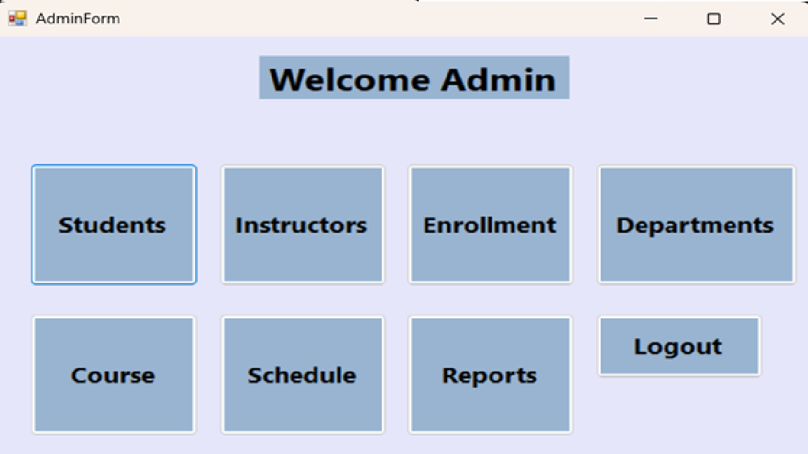
University Management System
A SQL-Integrated Desktop Application for Academic Administration
C# · Windows Forms · SQL Server · .NET Framework 4.7.2
This system was developed to digitize and streamline the administrative operations of a university — replacing manual record-keeping with a centralized, database-driven desktop application accessible by Admins, Students, and Instructors.
Notes:
Good [morning/afternoon] everyone. Today we'll be presenting the University Management System — a desktop application built with C# and Windows Forms, connected to a Microsoft SQL Server database.
This system was designed to replace manual, paper-based or spreadsheet-based university administration with a single, unified application. Whether you're managing student records, assigning instructors to courses, handling enrollments, or generating academic reports — everything happens here, in one place.
The system supports three types of users: Administrators, Students, and Instructors. Each role gets their own tailored interface after logging in. Let's walk through what this system does and how it works.

Slide 2
Project Overview
What this system is, who it serves, and what problem it solves
What It Is
Who It's For
What Problem It Solves
A fully offline, desktop-based University Management System. Built entirely in C# using the Windows Forms framework on .NET 4.7.2. All data is stored and retrieved from a Microsoft SQL Server Express database named "University". No internet connection is required — it runs entirely on a local machine or campus network.
Three user roles are supported. Administrators have full access to all modules — they can add, edit, and delete any record. Students can view their own enrollment and grade information. Instructors can view assigned courses and student lists. Each role is authenticated at login and directed to their specific dashboard.
Universities often manage student records, instructor data, course catalogs, and enrollments in separate spreadsheets or paper files — leading to errors and data duplication. This system centralizes everything into one relational database, enforcing data integrity through foreign keys and providing a clean UI for non-technical staff.
Notes:
Let's start with a high-level overview of the project.
WHAT IT IS: This is a local desktop application — meaning it doesn't require a web browser or internet connection. It's installed on a computer, connects to a SQL Server database, and provides a graphical interface for managing university data. We built it using C# and Windows Forms, which is a Microsoft framework for building desktop apps.
WHO IT'S FOR: There are three types of users. First, the Admin — this is usually a registrar or department staff member who has full control over all records. Second, Students — they can log in to check their enrolled courses and grades. Third, Instructors — they can see their course assignments and student lists. The system automatically shows the right interface depending on who logs in.
WHAT PROBLEM IT SOLVES: Before a system like this, university staff might manage student lists in Excel, instructor assignments in a different file, and enrollments on paper. This creates duplication and errors. Our system puts everything in one relational database — so when a student's department changes, it updates everywhere automatically.

Slide 3
System Architecture
How the three layers of the application communicate with each other
① Presentation Layer
② Business Logic Layer
③ Data Layer
Windows Forms (.NET 4.7.2) This is what the user sees and interacts with. It contains all the Forms: LoginForm, AdminForm, StudentForm, InstructorForm, CourseForm, DepartmentForm, EnrollmentForm, ScheduleForm, and ReportForm. Each form has buttons, text fields, dropdowns (ComboBox), and data tables (DataGridView) that display live database records.
C# Event Handlers & ADO.NET When a user clicks a button, a C# event handler fires. It builds a SQL command using SqlCommand or SqlDataAdapter, attaches parameter values, and sends the query to SQL Server. All queries use @parameters (parameterized queries) — meaning user input is passed as data, never as raw SQL text. This prevents SQL injection attacks.
Microsoft SQL Server Express Database name: University This layer stores all persistent data. Key tables include: student, instructor, department, course, section, takes (enrollments), user (login credentials), and time_slot. The database enforces referential integrity — for example, a course cannot reference a department that does not exist.
→
→
Notes:
Now let's look at how the system is structured internally. We follow what's called a 3-tier architecture — which means the system is divided into three separate layers, each with a specific responsibility.
LAYER 1 — PRESENTATION: This is the visual interface. Every screen the user sees is a Windows Form. We have forms for login, for the admin dashboard, for managing students, instructors, departments, courses, enrollments, the schedule, and reports. These forms contain buttons that trigger actions, text fields where users type data, and DataGridViews — which are essentially tables that display records from the database in real time.
LAYER 2 — BUSINESS LOGIC: This is the C# code behind each button. When you click 'Add Student', for example, C# reads what you typed in the text fields, builds an INSERT SQL statement, attaches your input as parameters, and sends it to the database. We use parameterized queries throughout — this is a security best practice that prevents SQL injection, where a malicious user might try to type SQL commands into a text field to manipulate the database.
LAYER 3 — DATA: This is the SQL Server database called 'University'. It stores all the actual records. The database also enforces rules — for instance, you can't enroll a student in a course that doesn't exist, because the enrollment table has a foreign key relationship with the course table.
Think of it this way: the Presentation Layer is the face, the Business Logic Layer is the brain, and the Data Layer is the memory.

Slide 4
Login & Authentication
The entry point of the system — verifies identity and assigns the correct role
How Authentication Works
Step 1 — Input
The user types their Username and Password, then selects their Role (Admin, Student, or Instructor) from a dropdown menu.
Step 2 — Query
The system runs a SELECT against the [user] table using all three values as parameterized inputs. If a matching row is found, login succeeds.
Step 3 — Routing
Based on the role, the system opens the correct form: AdminForm for admins, and the respective form for students and instructors. The login screen closes.
Step 4 — Failure
If no match is found, an error message appears — "Invalid credentials" — without revealing which field was wrong, protecting security.
SQL Query:
SELECT * FROM [user] WHERE username = @username AND password = @password AND role = @role
Notes:
The first screen every user sees is the Login Form. Let me walk you through exactly what happens when someone logs in.
STEP 1 — INPUT: The user types their username and password into text fields, and selects their role — Admin, Student, or Instructor — from a dropdown. The role selection is important because two users could share the same username but have different roles.
STEP 2 — QUERY: When the Login button is clicked, the system fires a SQL SELECT query against the [user] table. Notice the query uses @username, @password, and @role — these are parameterized placeholders. The actual values are passed separately, which means even if a user types something like ' OR 1=1 -- into the username field, it won't manipulate the query. This is called SQL injection protection.
STEP 3 — ROUTING: If the query returns a record, the login is successful. The system then checks the role value and opens the appropriate form. An admin sees the Admin Dashboard with all modules. A student sees their personal academic portal. An instructor sees their course management view.
STEP 4 — FAILURE: If no matching record is found, the user sees a generic error message. We intentionally don't say 'wrong password' or 'user not found' — because revealing that information could help someone trying to break into the system.
This is a simple but effective authentication system — straightforward for users, and secure by design.

Slide 5
Admin Dashboard
The central hub — every module of the system is accessible from here
👩‍🎓 Students
👨‍🏫 Instructors
Add, edit, delete, and view all student records including department and credits.
Manage instructor profiles, department assignments, and salary data.
🏛 Departments
📚 Courses
Create and maintain department records with building and budget info.
Build the course catalog — set course IDs, titles, departments, and credit hours.
📋 Enrollment
🗓 Schedule
After a successful admin login, this dashboard appears. It presents eight large buttons, each opening a dedicated management module. The admin is the only role with access to all eight modules — giving them full control over every record in the system.
Assign students to course sections and record or update their grades.
Define and view when and where each course section is held.
📊 Reports
🚪 Logout
Generate analytics reports on students, courses, and enrollments.
Ends the session and returns to the login screen securely.
Notes:
Once an administrator logs in successfully, they land on the Admin Dashboard — the command center of the entire system.
As you can see on the screen, the dashboard is clean and simple: eight large buttons, each clearly labeled. The design is intentional — even a non-technical staff member can immediately understand what each button does.
Let me briefly describe each module:
STUDENTS — This is where you manage all student records. You can add a new student, update their information, or remove them from the system.
INSTRUCTORS — Similar to students, but for teaching staff. You can track which department they belong to and their salary.
DEPARTMENTS — This is the foundational module. Departments must be created here first before they can be assigned to students, instructors, or courses — because of the foreign key relationships in the database.
COURSES — This is the academic catalog. Every course offered by the university is listed here with its ID, title, department, and credit hours.
ENROLLMENT — This is where students get assigned to specific course sections. You can also enter or update grades from here.
SCHEDULE — Shows when and where each course section meets — the building, room, semester, and year.
REPORTS — Generates visual analytics on student performance, course enrollment numbers, and more.
LOGOUT — Simply ends the session and returns to the login screen.
Every module we just listed will be explained in detail in the following slides.

Slide 6
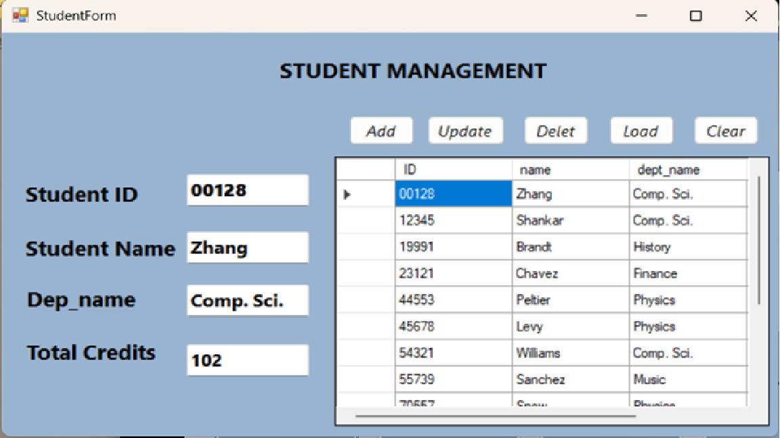
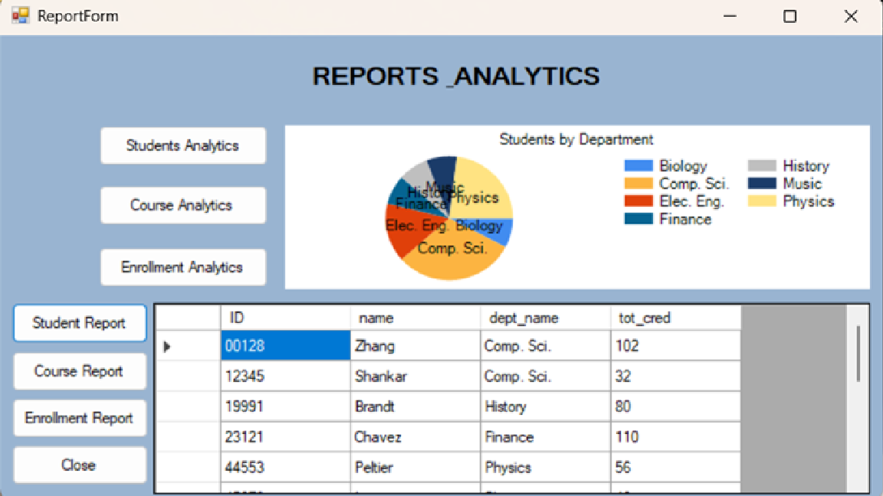
Student Management
A complete record system for every enrolled student in the university
What Gets Stored
Each student record contains four key pieces of information: • Student ID — a unique numeric identifier that serves as the primary key. It links the student to their enrollment records and grade history. • Name — the student's full name for display and reporting. • Department (dept_name) — the department the student belongs to. This is a foreign key referencing the department table, so only valid departments can be entered. • Total Credits (tot_cred) — the cumulative number of credit hours the student has earned across all completed courses.
How CRUD Works
Load — fetches all students (SELECT *). Add — inserts a new row with all four fields validated first. Update — modifies the selected student's data by ID. Delete — removes the record and immediately refreshes the table. Clicking any row auto-fills the input fields for quick editing.
Notes:
The Student Management module is one of the most frequently used parts of the system. Let's look at what it does in detail.
WHAT YOU SEE: On the left side of the screen is the StudentForm — a Windows Form with labeled input fields on the left (Student ID, Student Name, Department, Total Credits) and a DataGridView table on the right that shows all student records pulled live from the database.
Below that is the Student Analytics report — a visual breakdown of students grouped by department, shown as a pie chart. This helps administrators quickly see which departments have the most students.
THE FOUR FIELDS:
Student ID is the unique identifier. When a new student enrolls, they're assigned an ID that becomes their permanent reference across the entire system — their enrollment records, grade history, and reports all link back to this ID.
Name is straightforward — the student's full name.
Department is a foreign key — meaning it must match an existing department in the database. This prevents orphaned records where a student is assigned to a department that doesn't exist.
Total Credits tracks how many credit hours the student has accumulated. This updates as they complete courses.
THE CRUD OPERATIONS:
To add a new student, you fill in all four fields and click Add. The system runs an INSERT INTO query.
To update a student — click their row in the table. All their details auto-fill in the input fields. Make your changes, then click Update.
To delete a student — select their row and click Delete. The system removes the record and automatically refreshes the table.
Load refreshes the table at any time by re-running SELECT * FROM student.
This module is designed to be fast — the auto-fill behavior means you never have to retype information you already see on screen.

Slide 7
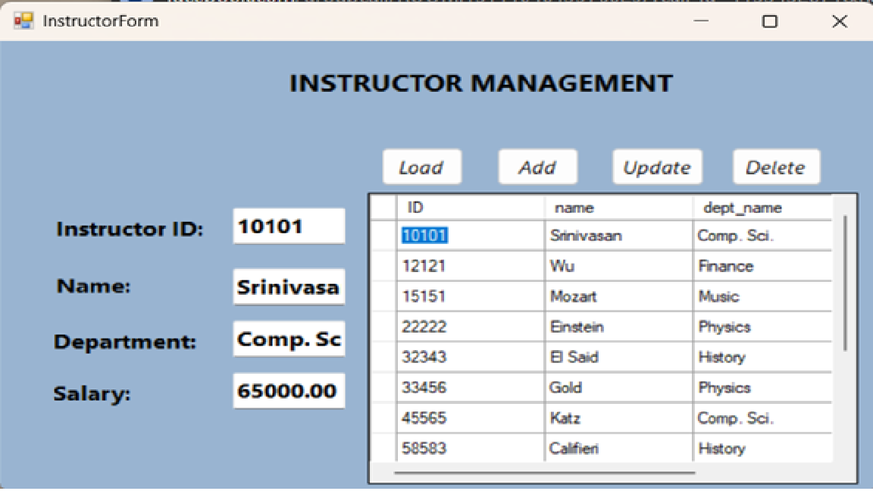
Instructor Management
Track every teaching staff member — their department and compensation
What Gets Stored
ID
Unique instructor identifier — Primary Key. Just like students, this ID links the instructor to their course assignments in the teaches table.
Name
The instructor's full name as it appears in course listings and reports.
dept_name
The department this instructor belongs to — a Foreign Key to the department table. An instructor can only be assigned to an existing department.
Salary
The instructor's annual salary, stored as a decimal. This is used in budget reporting and financial oversight.
Smart UI Behavior
Clicking any row in the DataGridView instantly populates all text fields with that instructor's data — no retyping required. This makes updates fast and error-free. After every Add, Update, or Delete, the grid refreshes automatically.
Notes:
The Instructor Management module follows the same CRUD structure as Student Management, but focuses on teaching staff.
WHAT YOU SEE: The InstructorForm shows input fields on the left for Instructor ID, Name, Department, and Salary — and a DataGridView on the right displaying all instructors currently in the system.
THE FOUR FIELDS:
ID — same concept as Student ID. Each instructor has a unique numeric ID. This ID is what connects them to the courses they teach in other parts of the database.
Name — the instructor's full name.
Department — this is a foreign key to the department table. You cannot assign an instructor to a department that doesn't exist in the system. This enforces data consistency — if a department is restructured, the system keeps the relationship accurate.
Salary — stored as a decimal value. This data is important for HR and financial reporting. The Reports module can use salary data to calculate departmental payroll costs.
SMART UI DESIGN:
One design decision worth highlighting is the row-click behavior. When an admin clicks on any instructor row in the table, all four input fields instantly fill with that instructor's data. This means to update someone's salary, you don't need to remember or retype their ID — just click the row, change the salary, and hit Update.
This pattern — click to edit — is used consistently across all management modules in the system. It significantly reduces data entry errors and speeds up the admin's workflow.

Slide 8
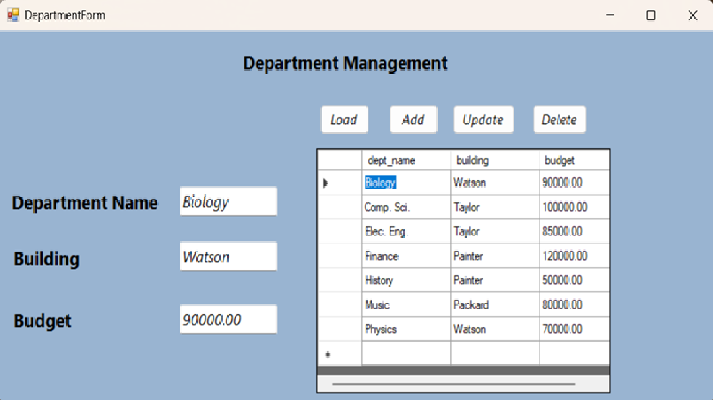
Department Management
The foundation of the system — all other records reference departments
Why Departments Come First
The department table is the backbone of the entire database. Students, instructors, and courses all have a dept_name foreign key that points back to this table. This means: before you can add a student to "Computer Science", the "Computer Science" department must already exist in the system. Departments must be set up first.
Data Fields
dept_name
The department name — acts as both the Primary Key and the value referenced by foreign keys in student, instructor, and course tables. Example: "Comp. Sci.", "Biology", "Finance".
building
The campus building where the department office is physically located. Example: "Watson", "Taylor". Used in scheduling and campus logistics.
budget
The annual budget allocated to this department, stored as a numeric value. Visible in the Reports module for financial comparison across departments.
Notes:
The Department Management module might seem simple, but it's actually the most structurally important module in the entire system.
Here's why: in a relational database, tables are linked to each other through foreign keys. The department table is referenced by three other major tables — student, instructor, and course. Every student belongs to a department. Every instructor belongs to a department. Every course is offered by a department.
This means if you want to add a student majoring in 'Computer Science', the 'Computer Science' department must already exist in the department table. If it doesn't exist, the system will reject the entry — because it would create what's called an orphaned record, a record pointing to something that doesn't exist. The database enforces this automatically through referential integrity.
PRACTICAL IMPLICATION: When setting up this system for the first time, departments must be created before anything else. This is the recommended setup order: Departments → Instructors/Courses → Students → Enrollments.
THE THREE FIELDS:
dept_name serves as the unique identifier — the primary key. Unlike student IDs which are numbers, department names are text-based. 'Comp. Sci.', 'Biology', 'Physics', 'Finance' — these names are exactly what gets stored and referenced.
building tells you where on campus the department is physically located. This connects to the scheduling module when assigning classrooms.
budget is the annual financial allocation to this department. Administrators can compare budgets across departments in the Reports module.
CRUD operations work the same way as other modules — click a row to auto-fill, then add, update, or delete as needed.

Slide 9
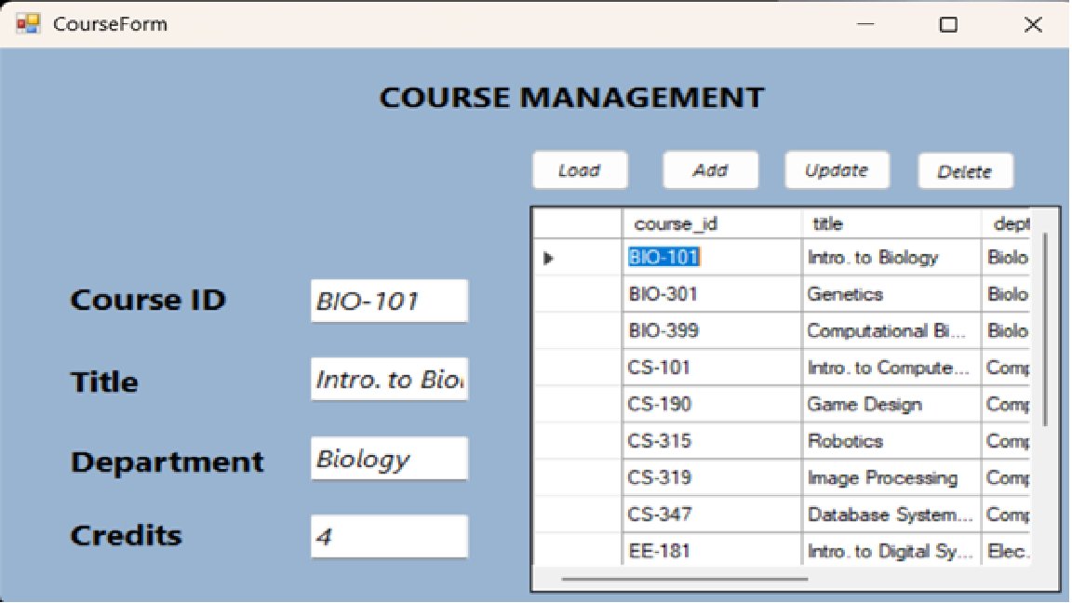
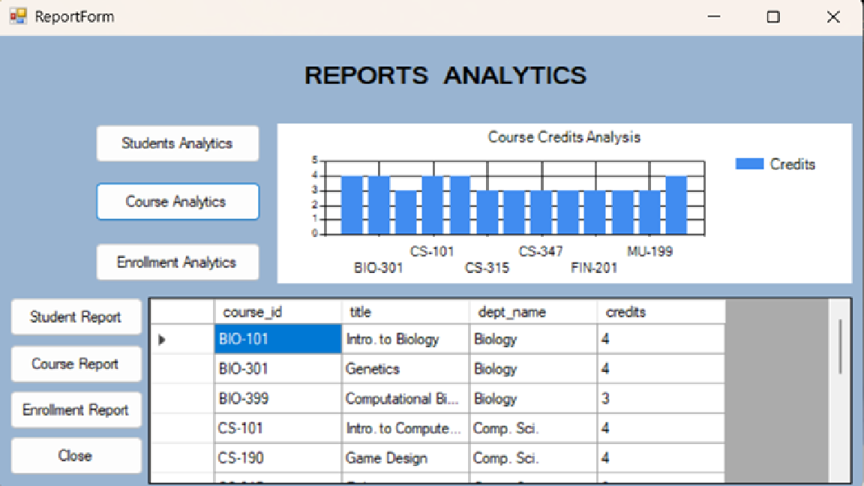
Course Management
Building and maintaining the university's academic course catalog
What Gets Stored
course_id
VARCHAR — Primary Key. A short alphanumeric code like "CS-101" or "BIO-301". This ID is used everywhere courses are referenced — in enrollment records, section assignments, and grade reports.
title
VARCHAR — The full human-readable course name, such as "Introduction to Computer Science" or "Genetics". This is what appears on transcripts and reports.
dept_name
VARCHAR — Foreign Key to the department table. Every course must belong to a department. You cannot create a course for a department that doesn't exist in the system.
credits
NUMERIC — The number of credit hours this course is worth. When a student completes this course, this number is added to their tot_cred (total credits) field.
Notes:
The Course Management module is where the academic catalog lives — every course the university offers is defined here.
WHAT YOU SEE: On the right is the CourseForm — input fields for Course ID, Title, Department, and Credits, plus a DataGridView listing all courses. Below that is the Course Analytics chart, which shows credit hour distribution across courses — a bar chart that helps administrators quickly see workload distribution.
THE FOUR FIELDS:
course_id is the course's unique code — like 'CS-101' or 'BIO-399'. This is the primary key. It's short, recognizable, and used as a reference everywhere in the system. When students enroll, they enroll in a course_id. When grades are recorded, they're linked to a course_id.
title is the full course name that appears in student-facing reports and transcripts. For example, 'Intro. to Biology' or 'Database Systems'.
dept_name is again a foreign key to the department table. You cannot create a Physics course if Physics isn't already a department. This enforces logical consistency — a course must belong to a real organizational unit.
credits determines how much a course contributes to a student's total credits. Most courses are worth 3 or 4 credits. This field directly feeds into the student's tot_cred field when they complete the course.
IMPORTANT DESIGN NOTE: The system auto-refreshes the DataGridView after every operation, so the admin always sees the latest state of the course catalog without needing to manually reload.
Courses created here become available for selection in the Enrollment and Schedule modules through ComboBox dropdowns — populated live from this table.

Slide 10
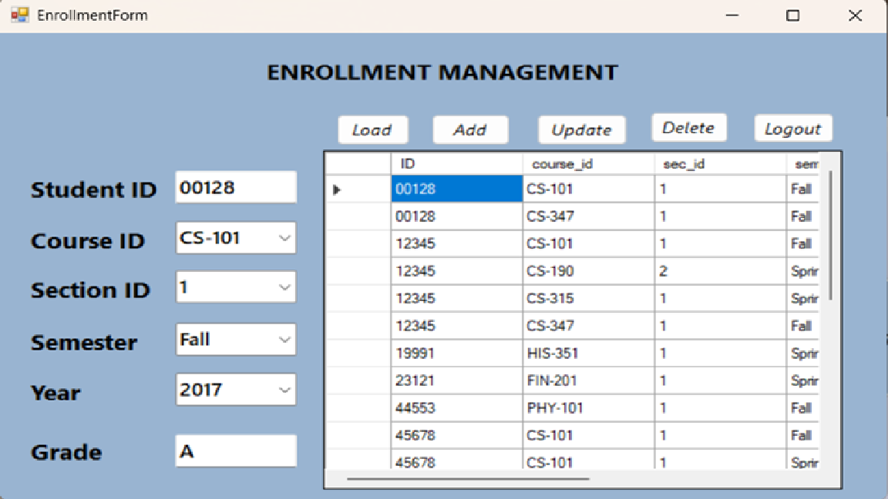
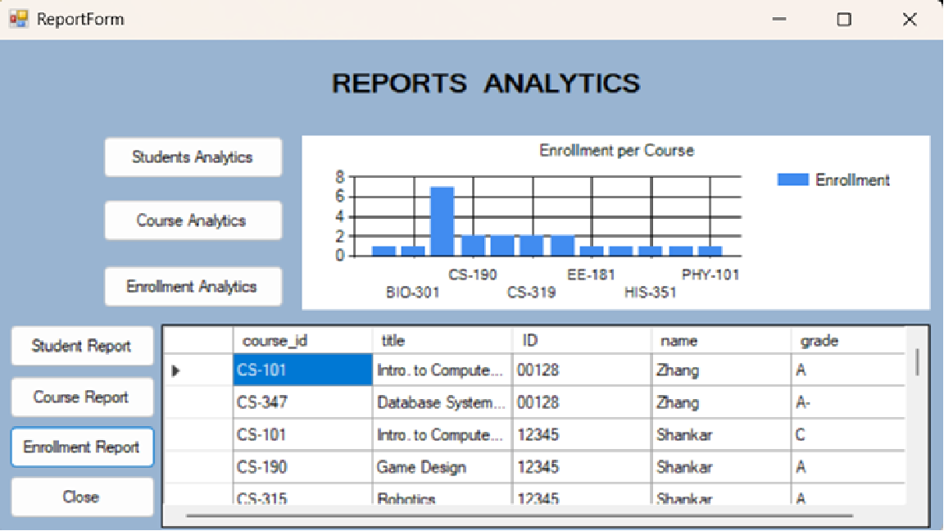
Enrollment Management
Connecting students to course sections — and tracking their grades
The "takes" Table — Enrollment Record
Each row in the takes table represents one student enrolled in one course section. This is a junction/bridge table — it links the student table and the section table together. A student can appear many times (once per course), and a course can appear many times (once per student).
ID
Student ID — FK to student. Identifies who is enrolled.
course_id
FK to course table. Populated via a ComboBox loaded from DB.
sec_id
Section number — dynamically loaded based on course selected.
semester
Semester of enrollment — Fall, Spring, or Summer.
year
Academic year — e.g. 2017, 2018. Loaded from the section table.
grade
Letter grade assigned by instructor. Can be empty (NULL) initially.
Smart Dropdowns
All dropdowns (course, section, semester, year) load live data from the database — preventing invalid entries and ensuring referential integrity at the UI level.
Notes:
Enrollment Management is where the relationship between students and courses is formally recorded. This is one of the most data-sensitive modules in the system.
WHAT YOU SEE: The top screenshot is the EnrollmentForm. The bottom is the Enrollment Analytics chart — showing enrollment counts per course, displayed as a bar graph.
THE 'takes' TABLE: In database design, when two entities have a many-to-many relationship — meaning one student can take many courses, and one course can have many students — you need what's called a junction table. The 'takes' table is that junction. Each row in this table is one enrollment record.
Let's go through each field:
ID — the Student ID. This is a foreign key pointing to the student table. You must enter a valid, existing student ID.
course_id — which course the student is enrolling in. This field is populated via a ComboBox dropdown that loads all available courses directly from the database. The admin doesn't type this — they select it from a list, preventing typos.
sec_id — the section number. Universities often run multiple sections of the same course. This field also uses a dropdown, and it updates dynamically based on which course was selected.
semester and year — when the enrollment is happening. Again, these are dropdowns loaded from the existing section records in the database.
grade — this is initially empty (NULL) when a student first enrolls. It gets filled in later when the instructor submits grades. The system has a dedicated 'Update Grade' function that lets admins or instructors find an enrollment record and update just the grade field.
WHY SMART DROPDOWNS MATTER: Because all dropdown values come directly from the database, it's impossible to enroll a student in a course that doesn't exist, or in a semester that has no scheduled sections. The UI enforces the same rules as the database — double protection against bad data.

Slide 11
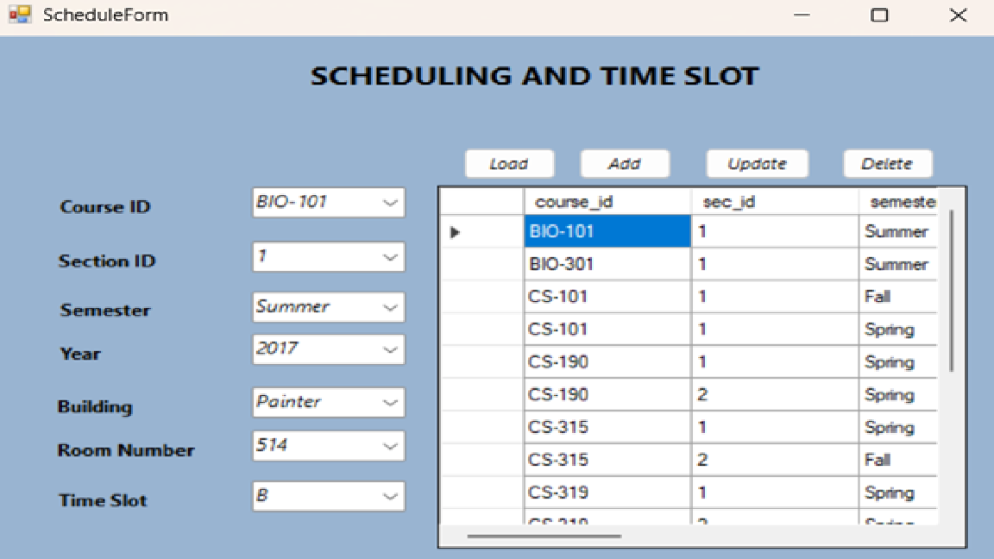
Schedule Module
Defining when, where, and how often each course section meets
What the Schedule Tracks
The ScheduleForm reads from the section table — the table that defines every scheduled offering of a course. A single course like "CS-101" can have multiple sections: Section 1 on Monday mornings, Section 2 on Wednesday evenings, taught in different rooms.
Section Table Fields
course_id
Which course this section belongs to — FK to course.
sec_id
Section number (e.g. 1, 2, 3) — differentiates parallel offerings.
semester
Academic semester: Fall, Spring, or Summer.
Sections created here become selectable in the Enrollment module — students are enrolled into specific sections, not just courses.
year
The academic year this section is scheduled for.
building
Campus building where classes are held.
room_number
Specific room within the building.
time_slot_id
Links to the time_slot table — defines day and class hours.
Notes:
The Schedule Module handles one of the most complex aspects of university administration — figuring out when each course is offered, where it meets, and for how long.
WHAT YOU SEE: The ScheduleForm displays a DataGridView populated from the section table. Each row represents one scheduled offering of a course — a section. You can see course IDs, section numbers, semesters, years, buildings, rooms, and time slot references.
WHY SECTIONS MATTER: Think of a course like 'Introduction to Biology' — BIO-101. The university might offer this course twice in the same semester: once for morning students and once for evening students. These are two separate sections — BIO-101 Section 1 and BIO-101 Section 2. They may be in different rooms, with different time slots, even with different instructors.
The section table captures all of this. Each section has:
- A course_id — what course it belongs to
- A sec_id — its section number
- A semester and year — when it's offered
- A building and room_number — where it meets
- A time_slot_id — which references the time_slot table for the specific day and hours
THE CONNECTION TO ENROLLMENT: This is critical to understand. When a student enrolls in the Enrollment module, they're not just enrolling in 'BIO-101' — they're enrolling in a specific section of BIO-101. The takes table (enrollment records) includes sec_id, semester, and year precisely because of this.
So the Schedule Module must be set up before enrollment can happen — you need sections to exist before students can sign up for them.
This module is typically managed by the registrar or scheduling office, who plans the academic calendar at the start of each semester.

Slide 12
Reports & Analytics
Visual insights generated directly from live database queries
Student Analytics
Course Analytics
Enrollment Analytics
Student Analytics
Course Analytics
A pie chart showing the distribution of students across departments. Pulls data from the student table grouped by dept_name. Helps administrators identify which departments have high or low enrollment.
A bar chart displaying credit hours per course. Queries the course table and visualizes the credits column. Useful for academic planning and workload balancing across departments.
Enrollment Analytics
Student/Course/Enrollment Reports
A bar chart showing how many students are enrolled in each course. Queries the takes table grouped by course_id. Used for capacity planning and identifying high-demand courses.
The ReportForm also includes tabular views — Student Report, Course Report, and Enrollment Report — which display raw database records in a grid for detailed review and verification.
Notes:
The Reports and Analytics module transforms raw database records into visual summaries that help administrators and decision-makers understand the state of the university at a glance.
WHAT YOU SEE: Three side-by-side screenshots of the ReportForm, each showing a different analytics view.
STUDENT ANALYTICS — the leftmost screenshot shows a pie chart. Each slice represents a department, and the size of the slice corresponds to the number of students in that department. This chart is generated by running a GROUP BY query on the student table: SELECT dept_name, COUNT(*) FROM student GROUP BY dept_name. The system then feeds this data into a chart control for visualization. An admin can instantly see, for example, that Computer Science has the most students, while Music has the fewest.
COURSE ANALYTICS — the middle screenshot shows a bar chart of credit hours per course. Each bar represents one course, and its height shows the credit value. This helps academic planners see the workload distribution — are most courses 3-credit or 4-credit? Are any departments offering unusually heavy or light courses?
ENROLLMENT ANALYTICS — the rightmost screenshot shows a bar chart of enrollment numbers per course. This is perhaps the most operationally useful report. It answers the question: which courses are oversubscribed? Which have low enrollment and might be candidates for cancellation? This data comes from the takes table.
TABULAR REPORTS — in addition to charts, the ReportForm also offers three tabular reports: Student Report lists all students with their details, Course Report lists all courses, and Enrollment Report lists all enrollment records. These grids allow admins to export or review raw data.
All reports pull live data every time the report is opened — so they always reflect the current state of the database, not a cached snapshot.

Slide 13
Security & Best Practices
How the system protects data integrity and prevents common vulnerabilities
🔒 Parameterized Queries
🔑 Role-Based Access Control
⚙️ Centralized Configuration
Every SQL statement uses @parameter placeholders instead of string concatenation. User input is passed as a typed value, never interpreted as SQL. This fully eliminates SQL injection — the most common database attack vector.
The login system checks the role column in the [user] table and directs each user to their specific form. Admins, students, and instructors cannot access each other's modules — access is enforced at the application level.
The database connection string is stored in App.config, not hardcoded in any form. Changing the server name or database only requires updating this one file — no source code changes needed. This is the industry-standard approach for .NET apps.
🔄 Auto-Refresh Pattern
🛡️ Try-Catch Error Handling
🗑️ Safe Deletion Pattern
After every Insert, Update, or Delete, the DataGridView is automatically refreshed by re-calling the Load function. This ensures what the user sees always matches what's in the database — preventing stale data issues and double submissions.
Critical database operations — especially enrollment inserts and updates — are wrapped in try-catch blocks. If a database error occurs (e.g. duplicate key, constraint violation), the system shows a clear, user-friendly message instead of crashing or displaying a raw SQL error.
When a record is deleted, the system immediately calls btnLoad_Click() to refresh the UI. This prevents the user from attempting to interact with a row that no longer exists in the database — avoiding ghost-record errors.
Notes:
Security and code quality are often overlooked in academic projects, but this system was built with several important best practices that make it production-worthy. Let me go through each one.
PARAMETERIZED QUERIES — This is the most important security feature. When the system builds a SQL query, it never does something like: 'SELECT * FROM user WHERE username = ' + userInput. That approach allows SQL injection — where a malicious user types SQL code into a text field to manipulate the database. Instead, every query uses placeholders like @username, and the actual value is passed separately as a typed parameter. The database treats it as data, not as code. SQL injection is impossible.
ROLE-BASED ACCESS CONTROL — After login, the system knows who you are and what role you have. The application routing logic ensures that a student can never open the Admin dashboard, and an instructor can never access enrollment editing. This is enforced in code — it's not just a visual difference, it's a programmatic restriction.
CENTRALIZED CONFIGURATION — The database connection string — including the server name, database name, and authentication details — lives in a single App.config file. If the system is deployed on a different server, only this one file needs to be updated. This is the standard .NET configuration approach.
AUTO-REFRESH — Every CRUD operation ends with a refresh. This prevents a common bug where a user deletes a record but it still appears in the UI, causing confusion or errors on subsequent actions.
TRY-CATCH ERROR HANDLING — Database operations can fail for many reasons: network issues, constraint violations, duplicate keys. Without error handling, the app would crash and show a raw system error. With try-catch blocks, the user sees a readable message like 'Enrollment already exists' instead.
SAFE DELETION — Immediately refreshing after a delete prevents the user from clicking on a row that was just removed from the database, which would cause a silent data inconsistency.
Together, these practices make the system robust, secure, and maintainable.

Slide 14
Database Schema Summary
All tables in the University SQL Server database — and how they connect
student
instructor
ID (PK), name, dept_name (FK→department), tot_cred
ID (PK), name, dept_name (FK→department), salary
Stores every student. dept_name links to the department table, ensuring students only belong to real departments.
Mirrors the student table structure for teaching staff. Salary enables financial reporting per department.
department
course
dept_name (PK), building, budget
course_id (PK), title, dept_name (FK→department), credits
The root table — referenced by student, instructor, and course. Must be populated first.
The course catalog. Credits feed into student total credit calculations upon completion.
section
takes
course_id (FK), sec_id, semester, year, building, room_no, time_slot_id
ID (FK→student), course_id (FK→section), sec_id, semester, year, grade
A scheduled offering of a course. Links course to a time/place. Multiple sections per course possible.
The enrollment junction table. Each row = one student in one course section. Grade starts NULL.
[user]
time_slot
username, password, role
time_slot_id (PK), day, start_time, end_time
Login credentials. Role determines which form opens after authentication.
Defines class meeting times. Referenced by section to avoid duplicating time data.
Notes:
This slide gives you a complete map of the University database — all eight tables and how they relate to each other.
Let me walk through each table and explain its role:
STUDENT — stores each student's ID, name, department, and total credits earned. The dept_name field is a foreign key — it must match an existing department name. This prevents a student from being assigned to a department that doesn't exist.
INSTRUCTOR — almost identical structure to student, but for teaching staff. The salary field enables HR and budget reporting by department.
DEPARTMENT — the root of the hierarchy. It has no foreign keys — everything else references it. That's why it must be set up first. It records the department name, which campus building it's in, and its annual budget.
COURSE — the academic catalog. Each course has a unique ID, a title, belongs to a department (FK), and has a credit value. The credits field is important — it's what gets added to a student's total when they complete the course.
SECTION — this is where courses become scheduled events. A section takes a course and assigns it to a specific semester, year, building, room, and time slot. One course can have many sections.
TAKES — this is the most relationship-heavy table. It's the enrollment record — one row per student per section. It contains foreign keys to both the student and the section. The grade field starts as NULL and is filled in when the instructor submits results.
USER — the authentication table. Stores usernames, passwords, and roles. The role value (Admin, Student, Instructor) is what determines which form opens after login.
TIME_SLOT — stores reusable time blocks like 'Monday 9:00AM–10:15AM'. By storing time slots as a separate table and referencing them by ID, we avoid duplicating time information for every section.
Together, these eight tables form a complete, normalized relational database — designed to eliminate redundancy and maintain consistency across all university records.

Slide 15
Summary & Conclusion
What We Built — And Why It Matters
The University Management System is a complete, end-to-end desktop solution for academic administration. From a single application, authorized users can manage every entity in the university — students, instructors, departments, courses, enrollments, and schedules — all backed by a live SQL Server database with enforced data integrity, role-based access, and real-time analytics.
8
3
7+
4
Modules
User Roles
DB Tables
CRUD Operations
Key Takeaways
✅ Centralized
All university data in one system — no more scattered spreadsheets or paper records.
✅ Secure
Parameterized SQL queries and role-based access protect against injection attacks and unauthorized access.
✅ Maintainable
Clean 3-tier architecture and centralized config make the system easy to update and deploy.
✅ Insightful
Built-in analytics provide immediate visual summaries of student, course, and enrollment data.
Notes:
Let me close with a summary of what we've built and why it matters.
The University Management System is not just a student project — it's a functional piece of administrative software. It solves a real problem: the fragmented, error-prone way universities often track academic data.
In just one application, an administrator can:
- Onboard a new student and assign them to a department
- Set up a new course and schedule its sections
- Enroll that student in a course section
- Record their grade at the end of the semester
- View reports on how enrollment is distributed across departments
All of this happens in real time, with data that's immediately consistent and validated.
Let me highlight the four key strengths:
CENTRALIZED — Before this system, you'd need a student spreadsheet, a separate instructor list, a course catalog document, and enrollment records in yet another file. Here, everything is in one relational database. Change a department name? It updates across all related records automatically.
SECURE — We didn't just build something that works — we built something that's secure. Parameterized queries prevent SQL injection. Role-based routing prevents unauthorized access. Error handling prevents crashes.
MAINTAINABLE — Because we followed a 3-tier architecture and stored configuration externally, this system can be deployed on a different server or database with minimal changes. A developer inheriting this project can understand the structure quickly.
INSIGHTFUL — The Reports module turns data into decisions. Who's overenrolled? Which courses are most popular? Which departments have the highest budgets? These questions are answered visually, without needing to write SQL queries manually.
Thank you for your time. We're happy to take any questions about the system's design, implementation, or how specific features work.

