Slide 1
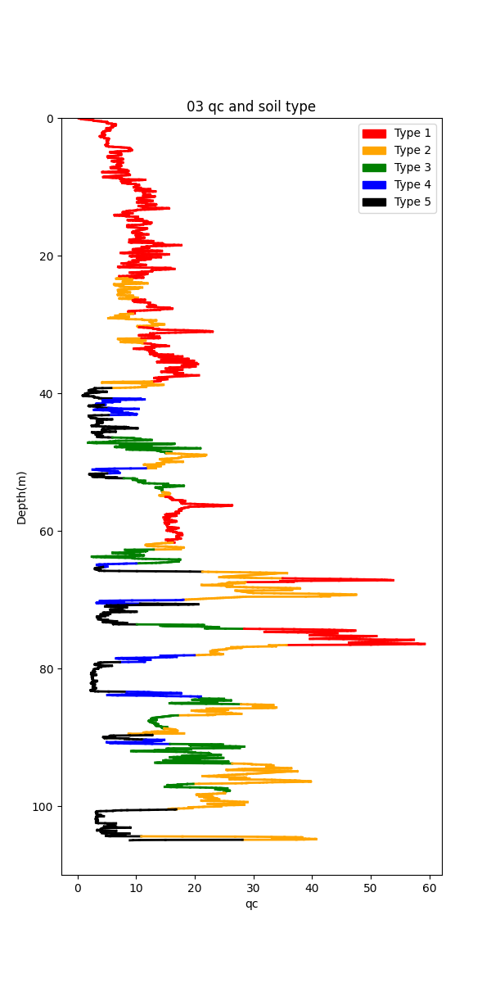
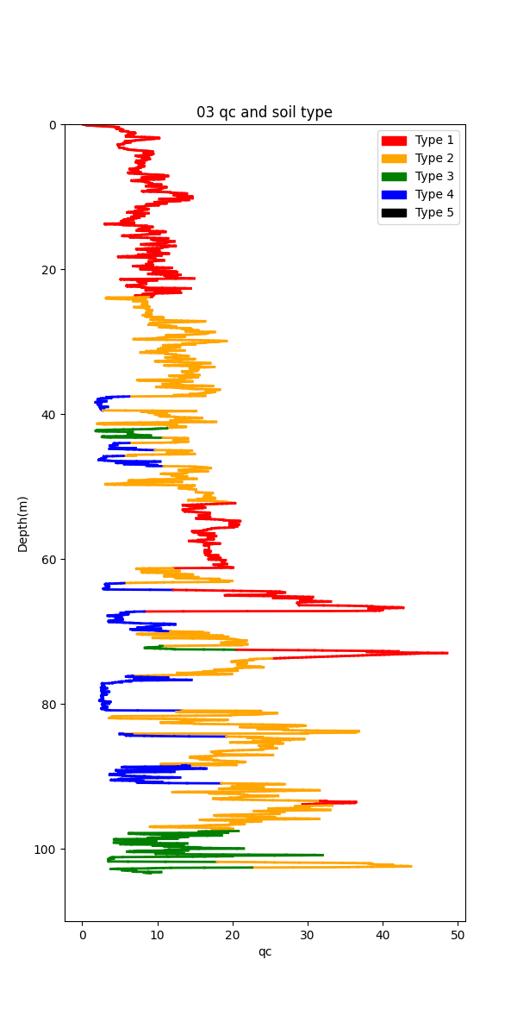
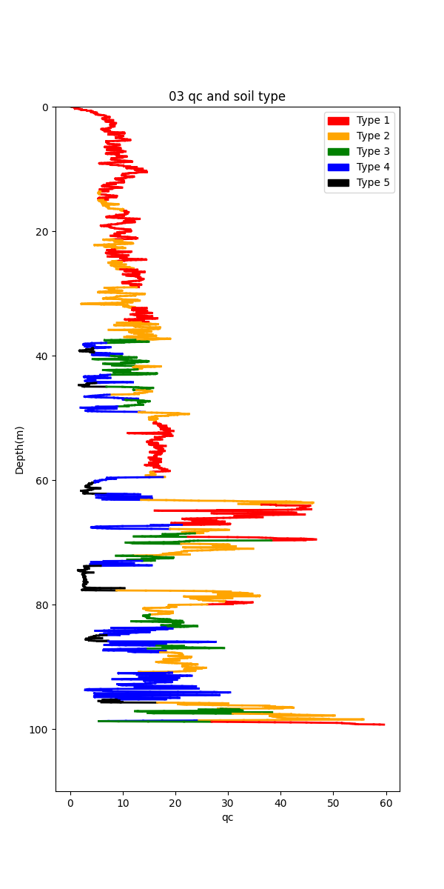
Borehole 02
qc
Borehole 03
qc
Borehole 04
qc

Slide 2
Borehole 03
Simple Kriging qc

