Slide 1
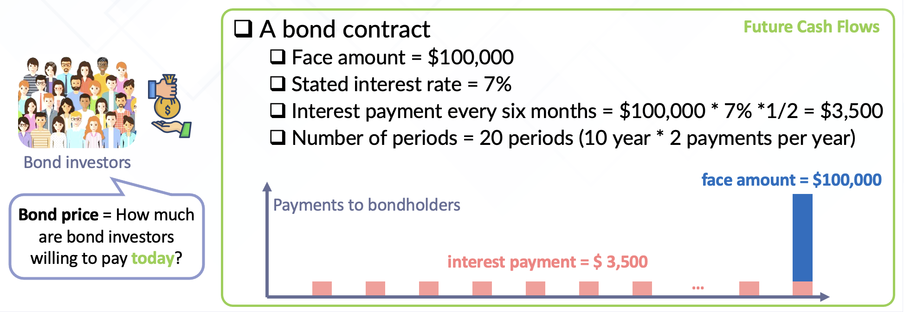
Notes:
The stated interest rate: Specified in the bond contract
Used to compute interest payments
The market interest rate: not specified in the bond contract.
Investors’ demand a higher market rate for bonds that have a higher default risk
Used to compute price of bond

Slide 2
Bonds
Issued at par (stated rate = market rate)
Stated rate meets bond investors’ expectation
Issued at discount (stated rate < market rate)
Stated rate is less attractive to bond investors, so need to sell it at discount
Issued at premium (stated rate > market rate)
Stated rate is more attractive to bond investors, so need to sell it at premium

Slide 3
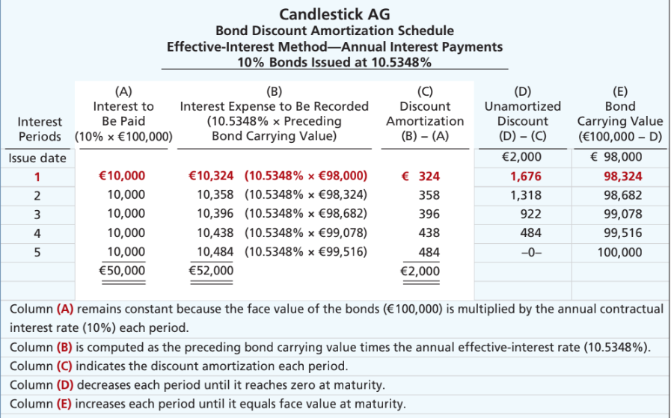
Bond Discount Amortization Schedule
Illustration 11A.2: Bond discount amortization schedule
L O 5
Notes:
Bond carrying value: On issue date, company sell at issue price of 98,000. This is how much we owe to bondholders (carrying value).
Total unamortized discount = 2000 (difference between face value and carrying value)
Interest payment (Col A): 5 payments of 10,000 in interest to bondholder.
Interest Exp (Col B): Apply market rate to the carrying amount of the bond at beginning of year. Reflects the cost of borrowing based on market conditions when bond was issued. In short, how much does company owe to bondholders.
Amortization of Discount (Col C): Since mkt rate is higher than coupon rate, int expense is more than the payment. The difference is the discount being amortized for the year. We are not paying enough. We owe more money to bondholders. We owe more, so carrying value is increased.
Carrying value (Col E): Increases by the amortized discount each year. By end of term, carrying amount equals face value.
Carrying value of bonds at beginning:
Carrying value is initially reported at issuance price (98,000)… liability as Bond Payable. Over time, it is adjusted for amortization, in this case, portion of discount is recognized as expense. Thus, carrying value increases. Think of bond discount as a deferred cost … we are spreading out the discount over the life of the bond. When we recognize the deferred cost each year, the carrying value (i.e., liability) increases until it matches the amount that will be paid in maturity.
Difference between interest to be paid (10,000 per year) and interest expense, we get discount.

Slide 4
Amortizing Bond Discount - Journal
Illustration: Candlestick AG records the accrual of interest and amortization of bond discount on Dec. 31, as follows:
Year 1 Dec. 31
Interest Expense 10,324
Bonds Payable 324
Interest Payable 10,000
Step 1. Interest Expense = carrying value at the beg period (98,000) * effective market interest rate (10.5348%)=10324
Step 2. Interest paid: face value * contractual rate =10,000
Step 3. Amortization: 324
L O 5
Notes:
At end of first period, we record accrual of interest, which is int exp.
Int Exp = 10324.
Int Pay = 10,000 … periodic int pmt (haven’t paid yet, because pay tomorrow)
B/P = 324 … Discount amortization over the period. The amount to be paid is less than what bondholers demand (i.e., interest expense incurred), which increases our liability (i.e., owe more money).

Slide 5
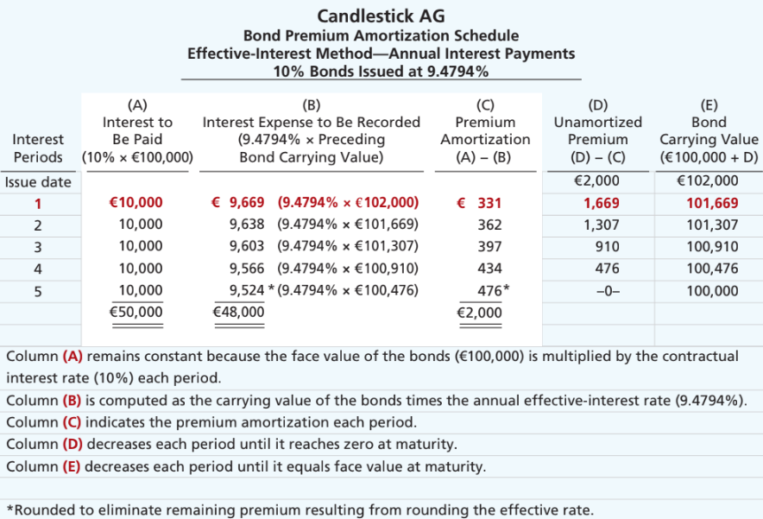
Bond Premium Amortization Schedule
L O 5
Notes:
Issue date: Company owes 102,000 (carrying value).
Int exp = 102,000 * mkt rate = 9669. We are paying more than what we owe. 10,000 covers 2 parts. 331 is used to reduce the principal, the carrying value of the bond.
We do similar exercise as in the discount case.
For last period, we fully allocated premium. The carrying value decreases from issue price to face amount on maturity.

Slide 6
Amortizing Bond Premium - Journal
Illustration: Candlestick AG records the accrual of interest and amortization of premium discount on Dec. 31, as follows:
Dec. 31
Interest Expense 9,669
Bonds Payable 331
Interest Payable 10,000
Illustration 11A.5: Computation of bond premium amortization
L O 5
Notes:
How much cash is to be paid : 10,000 the payable. We are paying more than expense … remaining value is used to reduce the carrying value (i.e., liability)

Slide 7
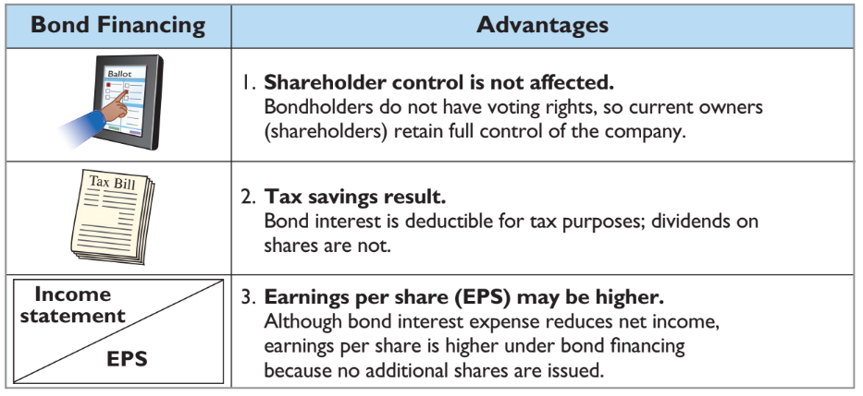
Bond Financing Advantages
Illustration 11.17: Advantages of bond financing over ordinary shares
L O 4
Notes:
Three main advantages of using bond financing for a company:
1. **Shareholder Control is not Affected**: When a company issues bonds, it borrows money without giving away any control over the company. Bondholders are creditors, not owners, and therefore they don't have any voting rights in company decisions. This allows the existing shareholders to retain full control of the company.
2. **Tax Savings Result**: Interest payments made on bonds are considered a business expense and are thus tax-deductible. This reduces the company's taxable income, leading to potential tax savings. In contrast, dividends paid to shareholders are not tax-deductible.
3. **Earnings Per Share (EPS) May Be Higher**: Although interest on bonds does reduce net income because it's an expense, EPS can be higher with bond financing compared to issuing new equity. This is because EPS is calculated by dividing net income by the number of outstanding shares. Issuing bonds does not increase the number of shares, whereas issuing new equity would, potentially diluting EPS.
These advantages highlight why bond financing can be an attractive option for companies looking to raise capital while preserving shareholder value and reducing tax liabilities.

Slide 8
Debt and Equity Financing Example
Illustration: Microsystems is considering two plans for financing the construction of a new €5 million plant. Plan A involves issuance of 200,000 ordinary shares at the current market price of €25 per share. Plan B involves issuance of €5 million, 8% bonds at face value. Income before interest and taxes on the new plant will be €1.5 million. Income taxes are expected to be 30%. Microsystems currently has 100,000 ordinary shares outstanding.
The alternative effects on the return on common shareholders’ equity are shown in the next Illustration.
L O 4

Slide 9
Financing Effects on Earnings
 | Plan A Issue Shares | Plan B Issue Bonds
Income before interest and taxes | €1,500,000 | €1,500,000
Interest (8% × €5,000,000) | — | 400,000
Income before income taxes | 1,500,000 | 1,100,000
Income tax expense (30%) | 450,000 | 330,000
Net income | € 1,050,000 | € 770,000
Outstanding shares | 300,000 | 100,000
Earnings per share | €3.50 | €7.70
Higher interest expense
Tax lower
No share dilution
Higher EPS
Illustration 11.18: Effects on earnings per share─ equity vs. debt
L O 4
Notes:
**Tax Savings Result**: Interest payments made on bonds are considered a business expense and are thus tax-deductible. This reduces the company's taxable income, leading to potential tax savings. In contrast, dividends paid to shareholders are not tax-deductible.
**Earnings Per Share (EPS) May Be Higher**: Although interest on bonds does reduce net income because it's an expense, EPS can be higher with bond financing compared to issuing new equity. This is because EPS is calculated by dividing net income by the number of outstanding shares. Issuing bonds does not increase the number of shares, whereas issuing new equity would, potentially diluting EPS.
Some traders trade only on EPS information and whether it beat or meet earnings benchmark.

Slide 10
Chapter 12：corporations: organization, share transactions, and equity

Slide 11
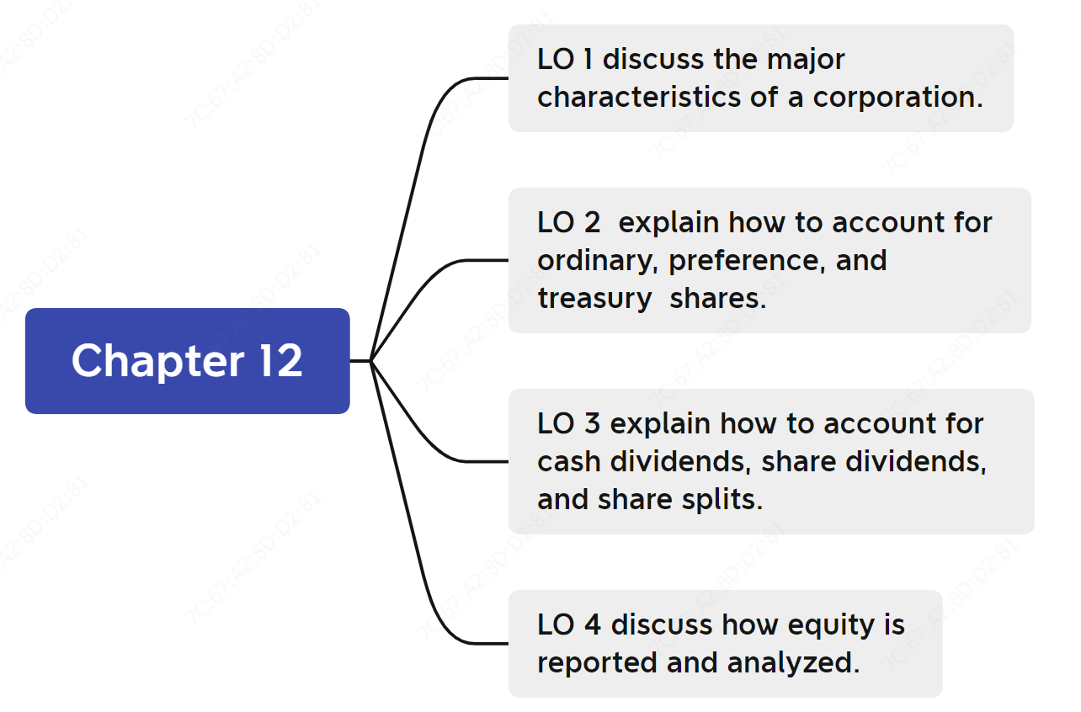
Chapter 12 - Outline

Slide 12
Learning objective 1 Discuss the major characteristics of a corporation

Slide 13
Three forms of business
Sole proprietorship
A business owned by one person
Partnership
A business owned by two or more persons
Corporation
A company that is legally separate from its owners
Our focus

Slide 14




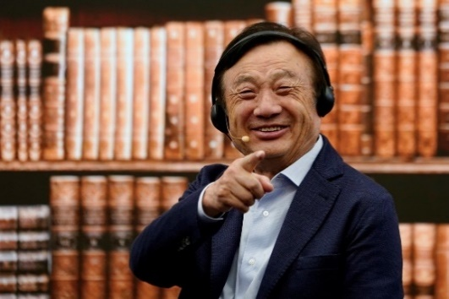
The corporate form of organization
A legal entity separate and distinct from its owners. It has most of the rights and privileges of a person, and also subject to the same duties and responsibilities of a person.
Classified by purpose
1. Not-for-profit (organized for charitable, medical, or educational purposes) , e.g.
2. For profit (organized for the purpose of making profit)
Classified by ownership
1. Publicly held: shares are regularly traded on a national securities exchange
2. Privately held: does not offer its shares for sales to the general public
International committee of the red cross
Bill & Melinda Gates foundation
Alibaba
Source: forbes.com
Huawei
Source: Fortune.com
Source: scmp.com

Slide 15
Characteristics of corporation (1 of 5)
Characteristics that distinguish corporations from proprietorships and partnerships.
Separate legal existence
Limited liability of shareholders
Transferable ownership rights
Ability to acquire capital
Continuous life
Corporate management
Government regulations
Additional taxes
Advantages
Disadvantages
Notes:
Understanding the characteristics of corporations in Accounting 101 is crucial because it provides insight into their unique legal and financial frameworks, including how they are structured, taxed, and regulated, as well as their methods for raising capital and managing risks, all of which significantly influence financial decision-making and reporting.

Slide 16
Characteristics of corporation (2 of 5)
Characteristics’ advantages
Characteristics that distinguish corporations from proprietorships and partnerships.
Separate legal existence
Limited liability of shareholders
Transferable ownership rights
Ability to acquire capital
Continuous life
Corporation acts under its own name rather than in the name of its shareholders
Limited to their investment
Shareholders may sell their shares
Corporation can obtain capital through the issuance of shares
Continuance as a going concern is not affected by the withdrawal, death, or incapacity of a shareholder, employee, or officer
Notes:
1. Separate Legal Existence: A corporation is a legal entity that exists independently of its owners (the shareholders). This means it can own property, enter into contracts, sue, and be sued in its own name, rather than in the names of the shareholders. This separation provides a clear distinction between the business and the personal assets of its owners.
2. Limited Liability of Shareholders: Shareholders have limited liability, which means they are only responsible for the corporation's debts and liabilities up to the amount they have invested. Personal assets of the shareholders are generally not at risk if the corporation incurs debt or is sued.
3. Transferable Ownership Rights: Ownership in a corporation is typically represented by shares of stock, which can be bought and sold without affecting the corporation's operations. This makes it easier to transfer ownership and can attract investors, as they can readily sell their shares if they choose.
4. Ability to Acquire Capital: Corporations have more options to access capital; they can issue stocks and bonds to raise money. This is often more efficient than loans and doesn't require collateral. The ability to sell shares to the public (in the case of a public corporation) is particularly powerful for raising large amounts of capital.
5. Continuous Life: A corporation has a perpetual existence; it does not end with the withdrawal, death, or incapacity of a shareholder, employee, or officer. This stability can be beneficial for long-term planning and operations, and it avoids the need to dissolve and redistribute assets as would be necessary in a partnership or sole proprietorship under similar circumstances.
Each of these advantages contributes to the corporation's ability to grow, endure, and manage risks in a way that is more challenging for other business forms.

Slide 17
Characteristics of corporation (3 of 5)
Advantages and disadvantages
Characteristics that distinguish corporations from proprietorships and partnerships.
Corporate management
Separation of ownership and management often reduces an owner’s ability to actively manage the company
Notes:
- **Separation of Ownership and Management**: In many corporations, especially larger ones, the owners (shareholders) are not typically involved in the day-to-day management of the company. This separation means that owners have less control over the operational decisions of the business, which can be disadvantageous if the management's interests do not align with those of the shareholders.
- **Reduced Owner Influence**: As a result of this separation, an individual owner's ability to influence the direction of the company is often limited to voting on major issues at shareholder meetings or through the board of directors. This can be less satisfying for an owner who wants an active hand in managing the business.
This structure contrasts with proprietorships and partnerships, where owners are typically directly involved in the management of the business. While this separation in a corporation can lead to professional management and a potential increase in efficiency, it can also lead to challenges in governance and oversight.

Slide 18
Characteristics of corporation (4 of 5)
Corporation organization chart
Shareholders
Ultimately, a corporation’s stockholders control the company.
Separation of ownership and management illustrated
Chairman and
Board of
Directors
The board of directors represent shareholders and appoints the CEO.
President and
Chief executive
Officer
The Chief Executive Officer (CEO) runs the company.
General
Counsel/
Secretary
Vice president
Marketing
Vice president
Finance/chief
Financial officer
Vice president
Operations
Vice president
Human
Resources
Treasurer
Controller
Notes:
Advantage: Can combine ppl with mgmt. skill with ppl with money
Disadvantage: CEO is hired to run things for me, so the interest may not be perfectly aligned.

Slide 19
Characteristics of corporation (5 of 5)
Disadvantages
Characteristics that distinguish corporations from proprietorships and partnerships.
Government regulations
Additional taxes
A corporation is subject to numerous governmental regulations
Corporations pay income taxes as a separate legal entity and in addition, shareholders pay taxes on cash dividends
Notes:
1. **Government Regulations**: Corporations are subject to many governmental regulations that can be complex and costly to comply with. The regulations can cover a wide range of areas including securities law, environmental law, employment law, and many others. For corporations, especially public ones, there is also a requirement to disclose financial and operational information regularly, which requires a significant amount of resources to maintain.
2. **Additional Taxes**: Corporations pay income taxes as a separate legal entity, which can lead to what's commonly referred to as "double taxation." This occurs when the corporation pays taxes on its income, and then shareholders also pay taxes on any dividends they receive from that already taxed income. Although there are corporate structures like the S corporation in the U.S. that avoid double taxation, traditional C corporations do not have this benefit, which can be a financial disadvantage.
These factors are often considered when deciding on the best structure for a business. They represent additional burdens that do not typically apply to sole proprietorships and partnerships, where business income is taxed once and regulations may be less stringent.

Slide 20
Forming a corporation
Initial steps:
File application with governmental agency in the jurisdiction in which incorporation is desired
Government grants charter
Corporation develops by-laws, which establish the internal rules and procedures for conducting the affairs of the corporation.

Slide 21
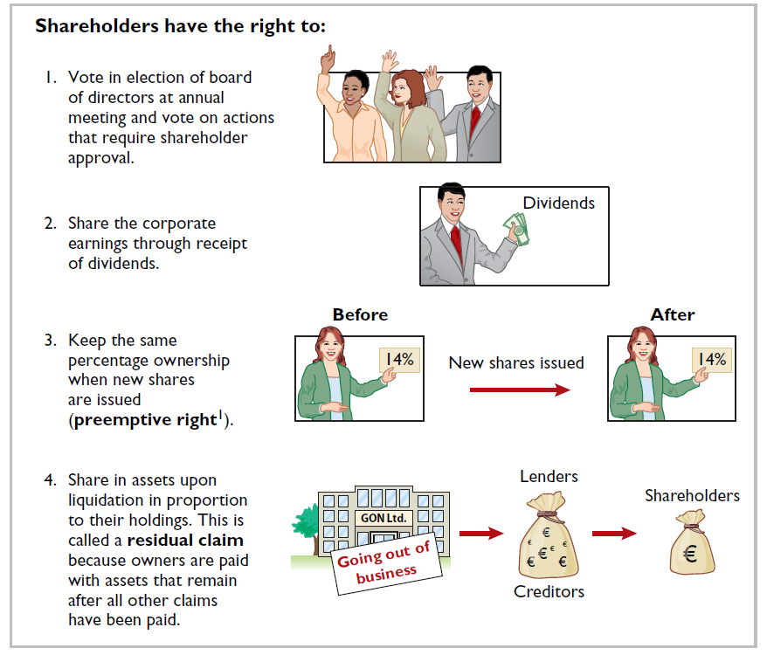
Shareholder rights
When chartered, the corporation may begin selling ownership rights in the form of shares. When a corporation has only one class of shares, it is ordinary shares, which gives the shareholder the following rights.
Voting rights
Rights to receive dividends
Preemptive rights, but not always
Residual claim if the company is dissolved
Notes:
1. **Voting Rights**: Shareholders have the right to vote in the election of the board of directors at the annual general meeting. They also vote on other critical corporate matters requiring shareholder approval, such as amendments to the corporate charter, approval of mergers or acquisitions, and significant corporate policy changes. Some specific type shares give more right to vote, e.g., 3 votes per share as opposed to 1.
2. **Dividend Rights**: Shareholders have the right to share in the corporation's earnings through dividends. While dividends are not guaranteed and can vary in amount, they are a way for shareholders to receive a return on their investment.
3. **Preemptive Rights**: These rights allow shareholders to maintain their proportional ownership in the corporation when new shares are issued. This means that before new shares are offered to the public, existing shareholders have the right to purchase enough shares to keep their ownership percentage constant, preventing dilution of their stake.
Let's say you own a slice of a large pie, which represents a corporation. Your slice is 25% of the pie, meaning you own 25% of the company. Now, the company decides to make the pie bigger by adding more filling, analogous to issuing more shares.
Preemptive rights are like being given the chance to add more filling to your slice before anyone else can, so you can maintain your 25% share of the now larger pie. Without preemptive rights, if the company added more filling (shares) for others, your slice would still be the same absolute size, but it would now represent less than 25% of the pie because the pie got bigger when you didn't add to your slice.
Here's a numerical example:
- Initially, the pie (company) is divided into 4 equal slices (shares), and you own 1 slice (1 share), which is 25%.
- The company decides to add 4 more slices to the pie (issue 4 more shares).
- With preemptive rights, you have the option to buy 1 of the new slices (1 new share) before the new slices are offered to others.
- You exercise this right and purchase an additional slice. Now you have 2 out of 8 total slices (2 shares out of 8), maintaining your 25% of the pie.
Without preemptive rights, if someone else bought the additional slices, you'd still have only 1 out of 8 slices, reducing your share of the pie to 12.5%. Preemptive rights allow you to "keep your piece of the pie" proportional to the pie's new size.
4. **Residual Claims**: Upon liquidation of the corporation, after all creditors have been paid, shareholders have the right to share in the assets that remain. This right is based on their proportionate ownership in the corporation. This means that if the corporation is dissolved, the shareholders will receive any remaining assets after all debts and liabilities have been settled.
Each of these rights plays a significant role in defining the relationship between shareholders and the corporation, providing a level of control and economic benefit appropriate to their ownership stake.

Slide 22
Share issue considerations
When a corporation decides to issue shares, it must resolve a number of basic questions:
How many shares should it authorize for sale?
How should it issue the shares?
What value should the corporation assign to the shares?
Notes:
1. **How many shares should it authorize for sale?**
- The corporation needs to determine the number of shares to offer, which involves assessing how much capital it needs to raise and how the issuance will affect the existing ownership percentages. Issuing too many shares can dilute the ownership too much, while issuing too few may not provide enough capital.
2. **How should it issue the shares?**
- The company must decide on the method of issuing shares. It could be through a public offering (IPO for new companies, or secondary offering for existing public companies), a private placement, or a rights offering to current shareholders. Each method has different regulatory requirements and impacts on current and future shareholders.
3. **What value should the corporation assign to the shares?**
- The corporation needs to set a value for the new shares, known as the 'par value' or, in the case of no-par value shares, the board may set a 'stated value.' This is often a nominal amount that has little to do with the market value but can have legal and accounting implications. For public companies, the market will ultimately determine the price through trading after the issuance.
These considerations are critical because they influence not only the immediate financial position of the company but also its long-term structure and shareholder relations.

Slide 23
Share issue considerations
Authorized shares
Charter indicates amount of shares that a corporation is authorized to sell
Number of authorized shares is often reported in equity section
No formal accounting entry

Slide 24
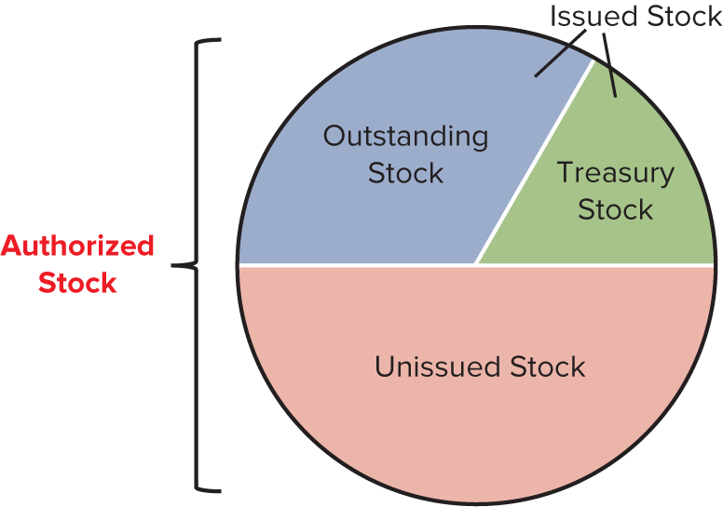
Illustration: authorized, issued, outstanding, and treasury stock
Authorized stock is the maximum number of shares the company is permitted to issue, stated in the company’s articles of incorporation.
Number of issued shares held by investors
Number of shares have been sold to investors.
Number of issued shares repurchased by the company
A company usually does not issue all its authorized stock
Notes:
We can think of the common stockholders as the “true owners” of the business. In most cases, each share of common stock represents one unit of ownership.
Authorized, Issued, Outstanding, and Treasury Stock
For our discussion in this chapter, we need to make clear the different number of shares.
Authorized stock is the total number of shares available to sell, stated in the company’s articles of incorporation.
Issued stock is the number of shares that have been sold to investors. A company usually does not issue all its authorized stock.
The total number of issued shares can then be divided into two categories.
Outstanding stock is the number of issued shares held by investors. Only these shares receive dividends.
Treasury stock is the number of issued shares repurchased by the company.
Illustration 10-6 summarizes the differences between authorized, issued, outstanding, and treasury stock.

Slide 25
Share issue considerations
Par and no-par value shares
Years ago, par value determined legal capital per share that a company must retain in business for protection of corporate creditors
Today many governments do not require a par value
Three types (do not mean much, just know journal entries)
Par value shares
Stated value for no-par Shares
No stated value for no-par Shares

Slide 26
Corporate capital (1 of 3)
Equity is identified by various names:
Stockholders’ equity,
Shareholders’ equity, or
Corporate capital.
The equity section of a corporation’s statement of financial position consists of two parts:
Share capital and
Retained earnings (earned capital).

Slide 27
Corporate capital (2 of 3)
Share capital
Share capital is the total amount of cash and other assets paid in to the corporation by shareholders in exchange for shares.

Slide 28
Corporate capital (3 of 3)
Retained earnings
All the past net income that a corporation retains for future use.
Ending balance of retained earnings = beginning balance of retained earnings + net income over the period – dividends over the period
Net income over a period is recorded in retained earnings by a closing entry. For example, assuming that net income for Delta Robotics in its first year of operations is HK$130,000, the closing entry is:
Income summary
130,000
Retained earnings
130,000
Notes:
Temporary accounts: revenue and expenses.

Slide 29
Retained earnings
If Delta Robotics has a balance of HK$800,000 in share capital—ordinary and HK$130,000 in retained earnings at the end of its first year, its equity section is as follows:
Delta Robotics Statement of Financial Position (partial)
Equity
Share capital—ordinary | HK$800,000
Retained earnings | 130,000
Total equity |  |  | HK$930,000

Slide 30
Do it! 1B: corporate capital
Illustration: at the end of its first year of operation, Doral AG has €750,000 of ordinary shares and net income of €122,000. Assume no dividend is paid in the first year. Prepare (a) the closing entry for net income and (b) the equity section at year-end.
(A) income summary 122,000
Retained earnings 122,000
(B) equity
Share capital—ordinary €750,000
Retained earnings 122,000
total equity €872,000

Slide 31
Learning objective 2 explain how to account for ordinary, preference, and treasury shares

Slide 32
Accounting for share transactions
Accounting for ordinary shares
Primary objective is to identify the specific sources of capital.

Slide 33
Accounting for ordinary shares
Issuing par value ordinary shares for cash
Par value does not indicate a share’s market price
Usually, cash proceeds from issuing par value shares may be equal to, or greater than par value
Issuance of ordinary shares for cash
Credit par value of shares to share capital—ordinary
Record in a separate account portion of proceeds that is above or below par value

Slide 34
Issuing par value ordinary shares for cash (1 of 3)
Illustration: assume that Hydro-Slide SA issues 1,000 shares of €1 par value ordinary shares at par for cash. Prepare the entry to record this transaction.
Cash 1,000
Share capital—ordinary (1,000 x €1) 1,000

Slide 35
Issuing par value ordinary shares for cash (2 of 3)
Now assume that Hydro-Slide issues an additional 1,000 shares of the €1 par value ordinary shares for cash at €5 per share. Prepare the entry to record this transaction.
Cash 5,000
Share capital—ordinary (1,000 x €1) 1,000
Share premium—ordinary 4,000
Determined by par
The amount issued above the par value is credited to share premium-ordinary.

Slide 36
Issuing par value ordinary shares for cash (3 of 3)
Hydro-Slide SA Statement of Financial Position (partial)
Equity
Share capital—ordinary |  | € 2,000
Share premium—ordinary |  | 4,000
Retained earnings |  | 27,000
Total equity |  | €33,000

Slide 37
Issuing no-par ordinary shares (1 of 2)
Illustration: assume that instead of €1 par value shares, Hydro-Slide SA has €5 stated value no-par shares and the company issues 5,000 shares at €8 per share for cash.
Cash 40,000
Share capital—ordinary 25,000
Share premium—ordinary 15,000
When no-par ordinary shares have a stated value, the entries are similar to those illustrated for par value shares.

Slide 38
Issuing no-par ordinary shares (2 of 2)
Illustration: if Hydro-Slide does not assign a stated value to its no-par shares, it records the issuance of the 5,000 shares at €8 per share for cash as follows.
Cash 40,000
Share capital—ordinary 40,000

Slide 39
Issuing ordinary shares for services or non-cash assets
Corporations also may issue shares for:
Services (attorneys or consultants)
Non-cash assets (land, buildings, and equipment)
Cost is either the fair market value of the consideration given up, or the fair market value of the consideration received, whichever is more clearly determinable.

Slide 40
Issuing ordinary shares for services
Illustration: Attorneys have helped Jordan company incorporate. They have billed the company €5,000 for their services. They agree to accept 4,000 shares of €1 par value ordinary shares in payment of their bill. At the time of the exchange, there is no established market price for the shares. Prepare the journal entry for this transaction.
Organization expense 5,000
Share capital—ordinary 4,000
Share premium—ordinary 1,000
The company issues new shares to pay for the organization expense. The organization expense amount is more clearly determinable.
Notes:
Bill: clearly mentions 5000
Shares: no established mkt price,… use 5000 as consideration given up and received.

Slide 41
Issue ordinary shares for non-cash assets
Illustration: Athletic Research AG is an existing publicly held corporation. Its €5 par value shares are actively traded at €8 per share. The company issues 10,000 shares to acquire land recently advertised for sale at €90,000. Prepare the journal entry for this transaction.
Land 80,000
Share capital—ordinary 50,000
Share premium—ordinary 30,000
The company issues new shares to acquire land. The fair value of the shares is more clearly determinable.
Notes:
Land: advertised for 90,000 … but we are assuming we issued 10,000 shares traded at $8… we are considering value of land is 80,000

Slide 42
Accounting for preference shares (1 of 2)
To appeal to more investors, a corporation may issue an additional class of shares, called preference shares.
Typically, preferred shareholders have a priority as to:
Distributions of earnings (dividends).
Assets in event of liquidation.
Generally do not have voting rights.
Accounting for preference shares at issuance is similar to that for ordinary shares.

Slide 43
Accounting for preference shares (2 of 2)
Illustration: Florence SPA issues 10,000 shares of €10 par value preference shares for €12 cash per share. The journal entry to record the issuance is:
Cash 120,000
Share capital—preference 100,000
Share premium—preference 20,000
Preference shares may have a par value or no-par value.

Slide 44
Do it! 2: issuance of shares (1 of 3)
Illustration: HeFei ltd. begins operations on March 1 by issuing 1,000,000 shares of €10 par value ordinary shares for cash at ¥12 per share. Journalize the issuance of the shares on March 1 assuming the shares are not publicly traded.
Cash 12,000,000
Share capital—ordinary 10,000,000
Share premium—ordinary 2,000,000

Slide 45
Do it! 2: issuance of shares (2 of 3)
Illustration: on March 15, HeFei ltd. issues 50,000 ordinary shares to attorneys in settlement of their bill of ¥600,000 for organization costs. Journalize the issuance of these shares.
Organization expense 600,000
Share capital—ordinary 500,000
Share premium—ordinary 100,000
Notes:
Still $10 … 50,000 shares

Slide 46
Do it! 2: issuance of shares (3 of 3)
Illustration: on March 28, HeFei issues 15,000 shares of ¥100 par value preference shares for cash at ¥250 per share. Journalize the issuance of these shares.
Cash 3,750,000
Share capital—preference (15,000 × ¥100) 1,500,000
Share premium—preference (15,000 × ¥150) 2,250,000
Notes:
Preference shares have priority on dividends.

Slide 47
Accounting for treasury shares
Treasury shares are a corporation’s own shares that it has reacquired from shareholders but not retired.
Corporations acquire treasury shares for various reasons:
To reissue the shares to officers and employees under bonus and share compensation plans.
To enhance the share’s market value.
To have additional shares available for use in the acquisition of other companies.
To increase earnings per share.

Slide 48
Illustration: authorized, issued, outstanding, and treasury stock
Authorized stock is the maximum number of shares the company is permitted to issue, stated in the company’s articles of incorporation.
Number of issued shares held by investors
Number of shares have been sold to investors.
Number of issued shares repurchased by the company
A company usually does not issue all its authorized stock
Notes:
We can think of the common stockholders as the “true owners” of the business. In most cases, each share of common stock represents one unit of ownership.
Authorized, Issued, Outstanding, and Treasury Stock
For our discussion in this chapter, we need to make clear the different number of shares.
Authorized stock is the total number of shares available to sell, stated in the company’s articles of incorporation.
Issued stock is the number of shares that have been sold to investors. A company usually does not issue all its authorized stock.
The total number of issued shares can then be divided into two categories.
Outstanding stock is the number of issued shares held by investors. Only these shares receive dividends.
Treasury stock is the number of issued shares repurchased by the company.
Illustration 10-6 summarizes the differences between authorized, issued, outstanding, and treasury stock.

Slide 49
Purchase of treasury shares (1 of 3)
Companies generally use cost method
Debit treasury shares for price paid to reacquire shares
Treasury shares is a contra equity account
Reduces equity

Slide 50
Purchase of treasury shares (2 of 3)
Mead, Ltd. Statement of Financial Position (partial)
Equity
Share capital—ordinary, HK$50 par value, 100,000
shares issued and outstanding | HK$5,000,000
Retained earnings | 2,000,000
Total equity | HK$7,000,000
Illustration: on February 1, 2020, Mead acquires 4,000 shares of its stock at HK$80 per share. The entry is as follows.
Treasury shares 320,000
Cash 320,000
Notes:
Company buys back own stock from the market… when it does this, it reduces equity. Treasury shares is contra equity.

Slide 51
Purchase of treasury shares (3 of 3)
Mead, Ltd. Statement of Financial Position (partial)
Equity
Share capital—ordinary, HK$50 par value, 100,000
shares issued and 96,000 shares outstanding | HK$5,000,000
Retained earnings | 2,000,000
 | 7,000,000
Less: Treasury stock (4,000 shares) | 320,000
Total equity | HK$6,680,000
Both the number of shares issued (100,000) and the number of shares held as treasury (4,000) are disclosed.

Slide 52
Sale of treasury shares above cost
Illustration: on July 1, Mead, ltd. sells for HK$100 per share 1,000 of the 4,000 treasury shares previously acquired at HK$80 per share. The entry is as follows.
Cash 100,000
Treasury shares 80,000
Share premium—treasury 20,000
A corporation does not realize a gain or suffer a loss from shares transactions with its own shareholders.
Notes:
We are selling the treasury stock again … but at a premium … sell at 100,000
Essentially, sharedholders are investing additional money… we call this share premium.

Slide 53
Sale of treasury shares below cost (1 of 2)
If Mead, ltd. sells an additional 800 treasury shares on October 1 at HK$70 per share, it makes the following entry.
Cash (800 × HK$70) 56,000
Share premium—treasury 8,000
treasury shares 64,000
Treasury Shares |  |  |  |  | Share Premium––Treasury
Feb. 1 | 320,000 | July 1 | 80,000 |  | Oct. 1 | 8,000 | July 1 | 20,000
 |  | Oct. 1 | 64,000 |  |  |  | Oct. 1 Bal. | 12,000
Oct. 1 Bal. | 176,000
Notes:
64000: previously acquired at $80

Slide 54
Sale of treasury shares below cost (2 of 2)
On December 1, assume that Mead, ltd. sells its remaining 2,200 shares at HK$70 per share and makes the following entry.
Cash (2,200 × HK$70) 154,000
Share premium—treasury 12,000
Retained earnings 10,000
Treasury shares 176,000
Balance fully reduced to zero
The additional excess of cost
When a company fully depletes the credit balance in the Share Premium – Treasury, it debits to Retained Earnings any additional excess of cost over selling price.
Notes:
Sell T/S below cost, if there is sufficient share prem treasury, we reduce.
If not, we reduce from RE account. Equity reduced.
Sold at a Loss (below cost): If the sale price is less than the cost of the treasury shares and there are no sufficient funds in the additional paid-in capital account from previous sales of treasury shares at a premium (or a specific share premium account for treasury shares), the company must recognize this loss. Because the loss cannot be absorbed by the paid-in capital account, the company has to report the loss by reducing retained earnings.

Slide 55
Do it! 2B: treasury shares
Salvador SA purchases 3,000 shares of its R$50 par value ordinary shares for R$180,000 cash on July 1. It will hold the shares in the treasury until resold. On November 1, the corporation sells 1,000 treasury shares for cash at R$70 per share. Journalize the treasury share transactions.
July 1 Treasury Shares 180,000
Cash 180,000
Nov. 1 Cash 70,000
Treasury Shares 60,000
Share Premium—Treasury 10,000
Notes:
Buy back… recorded at 180,000;
Resale: stated value is $60.
Cost per share: 60.

Slide 56
Learning objective 3 explain how to account for cash dividends, share dividends, and share splits

Slide 57
Dividends and splits
Distribution of cash or shares to shareholders on a pro rata (proportional to ownership) basis.
Types of dividends:
Cash (most frequent, covered)
Property (infrequent, not covered)
Shares (somewhat frequent, covered)
Scrip (promissory note to pay cash, infrequent, not covered)

Slide 58
Accounting for cash dividends (1 of 3)
For a corporation to pay a cash dividend, it must have:
Retained earnings - payment of cash dividends from retained earnings is legal in all jurisdictions.
Adequate cash.
A declaration of dividends by board of directors.
Notes:
In order to pay dividends, company must have some cash to pay.

Slide 59
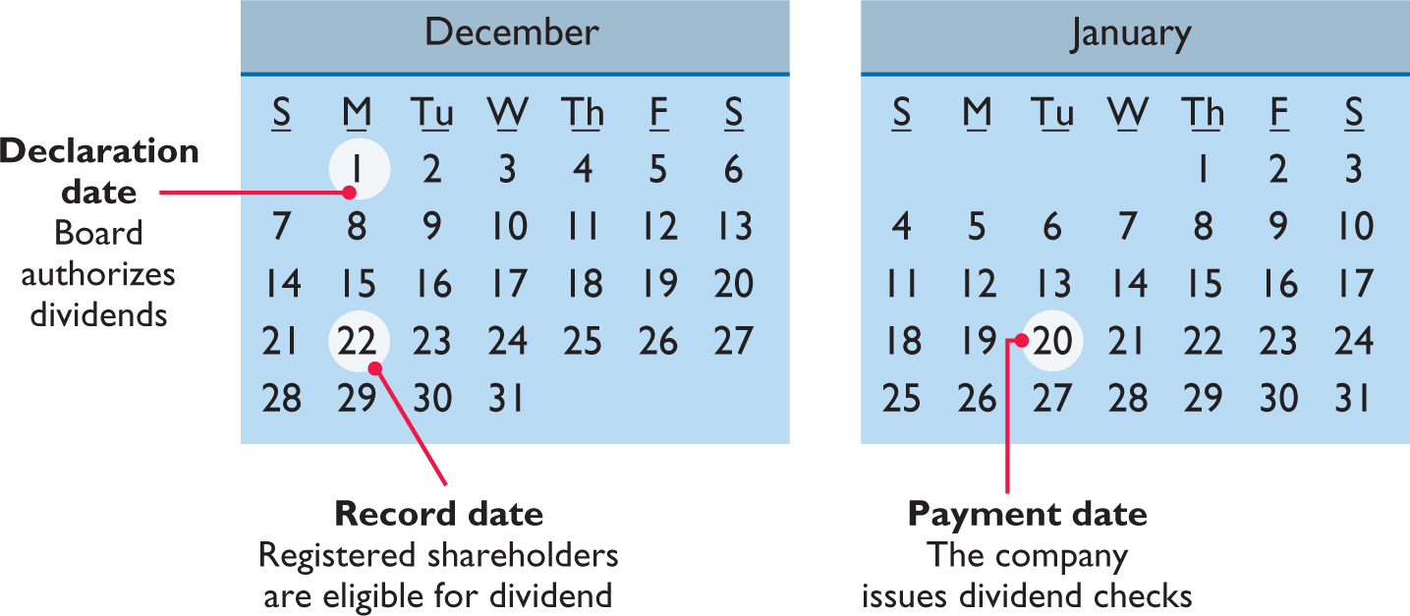
Accounting for cash dividends (2 of 3)
Three dates are important:
Notes:
For cash divs, we have three dates.
Declaration date: board of directors declare that company will pay dividends. [create liability for company]
Record date: list of shareholders may change over time … who should receive the dividends… we use record date to decide… company will record shareholders that will receive divs on this date
Paymnet date: company pays.

Slide 60
Accounting for cash dividends (3 of 3)
Illustration: on December 1, 2020, the directors of media general declare a €0.50 per share cash dividend on 100,000 shares of €10 par value ordinary shares. The dividend is payable on January 20 to shareholders of record on December 22.
Dec. 1 Cash Dividends 50,000
Dividends Payable 50,000
Dec. 22 no entry
Jan. 20 Dividends Payable 50,000
Cash 50,000
Declaration Date
Record Date
Payment Date
Notes:
Upon declaration, there is liability to pay.

Slide 61
Dividend preferences (1 of 3)
Preference Shareholders
Right to receive dividends before ordinary shareholders
Per share dividend amount is stated as a percentage of preference shares par value or as a specified amount
Cumulative dividend – if the preference shares is dividend cumulative, preference shareholders must be paid both current-year dividends and any unpaid prior-year dividends before ordinary shareholders are paid dividends
Noncumulative dividend – if the preference shares are dividend noncumulative dividend, there is no need to pay any unpaid prior-year dividends

Slide 62
Dividend preferences (2 of 3)
Cumulative dividend
Illustration: scientific leasing has 5,000 shares of 7%, €100 par value, cumulative preference shares outstanding. Each €100 share pays a €7 dividend (.07 × €100). The annual dividend is €35,000 (5,000 × €7 per share). If dividends are two years in arrears, preference shareholders are entitled to receive the following dividends.
Dividends in arrears (€35,000 × 2) € 70,000
Current-year dividends 35,000
Total preference dividends €105,000
Notes:
7% … for each preference share, it is entitled to get 7%.
Dividends in arrears: dividens that have not been paid in previous years.
Pref share holders get the portion of pie first.

Slide 63
Dividend preferences (3 of 3)
Allocating cash dividends between preference and ordinary shares
Holders of cumulative preference shares must be paid any unpaid prior-year dividends and their current year’s dividend before ordinary shareholders receive dividends.

Slide 64
Allocating cash dividends (1 of 3)
Illustration: on December 31, 2019, IBR inc. has 1,000 shares of 8%, €100 par value cumulative preference shares. It also has 50,000 shares of €10 par value ordinary shares outstanding. At December 31, 2019, the directors declare a €6,000 cash dividend. Assume that the company had not missed any dividends in previous years. Calculate the annual preferred dividend.
€100 par x 8% x 1,000 shares = €8,000
Prepare the entry to record the declaration of the dividend.
Dec. 31 Cash Dividends 6,000
Dividends Payable 6,000
Notes:
2000 dividends are in arrears, because they only declared 6000 divs.

Slide 65
Allocating cash dividends (2 of 3)
Illustration: at December 31, 2020, IBR declares a €50,000 cash dividend. Show the allocation of dividends to each class of stock.
Total dividend |  |  | €50,000
Allocated to preference shares
Dividends in arrears, 2019 (1,000 × €2) | €2,000
2020 dividend (1,000 × €8) | 8,000 |  | 10,000
Remainder allocated to common shares |  |  | €40,000

Slide 66
Allocating cash dividends (3 of 3)
Illustration: at December 31, 2020, IBR declares a €50,000 cash dividend. Prepare the entry to record the declaration of the dividend.
Dec. 31 Cash Dividends 50,000
Dividends Payable 50,000
Notes:
No differentiation between different shares in journal entries.

Slide 67
Do it! 3A: dividends on preference and ordinary shares (1 of 3)
Master Mind Gaming has 2,000 shares of 6%, ¥100 par value preference shares outstanding at December 31, 2020. At December 31, 2020, the company declared a ¥60,000 cash dividend. Determine the dividend paid to preference shareholders and ordinary shareholders under each of the following scenarios.
The preference shares are non-cumulative, and the company has not missed any dividends in previous years.
Preference shareholders are paid only this year’s dividend
Preference shareholders = ¥12,000 (2,000 x .06 x ¥100)
Ordinary shareholders = ¥48,000 (¥60,000 - ¥12,000)
Notes:
100 * 0.06 * 2000 = 12,000 for prefs. Didn’t miss any divs previous years.

Slide 68
Do it! 3A: dividends on preference and ordinary shares (2 of 3)
Master Mind Gaming has 2,000 shares of 6%, ¥100 par value preference shares outstanding at December 31, 2020. At December 31, 2020, the company declared a ¥60,000 cash dividend. Determine the dividend paid to preference shareholders and ordinary shareholders under each of the following scenarios.
The preference shares are non-cumulative, and the company did not pay a dividend in each of the two previous years.
Past unpaid dividends do not have to be paid
Preference shareholders = ¥12,000 (2,000 x .06 x ¥100)
Ordinary shareholders = ¥48,000 (¥60,000 - ¥12,000)

Slide 69
Do it! 3A: dividends on preference and ordinary shares (3 of 3)
Master Mind Gaming has 2,000 shares of 6%, ¥100 par value preference shares outstanding at December 31, 2020. At December 31, 2020, the company declared a ¥60,000 cash dividend. Determine the dividend paid to preference shareholders and ordinary shareholders under each of the following scenarios.
The preference shares are cumulative, and the company did not pay a dividend in each of the two previous years.
Dividends that have been missed (arrears) must be paid
Preference shareholders = ¥36,000 (3 x 2,000 x .06 x ¥100)
Ordinary shareholders = ¥24,000 (¥60,000 - ¥36,000)
Notes:
Company didn’t pay in the two previous years! 3 because 2 + 1

Slide 70
Accounting for share splits (1 of 3)
Issuance of additional shares to shareholders according to their percentage ownership
Reduction in par or stated value per share
Increase in number of shares outstanding
Reduces market value of shares
No journal entry recorded, no effect on the balances in any equity accounts
No effect on share capital, share premium, retained earnings, or total equity.

Slide 71
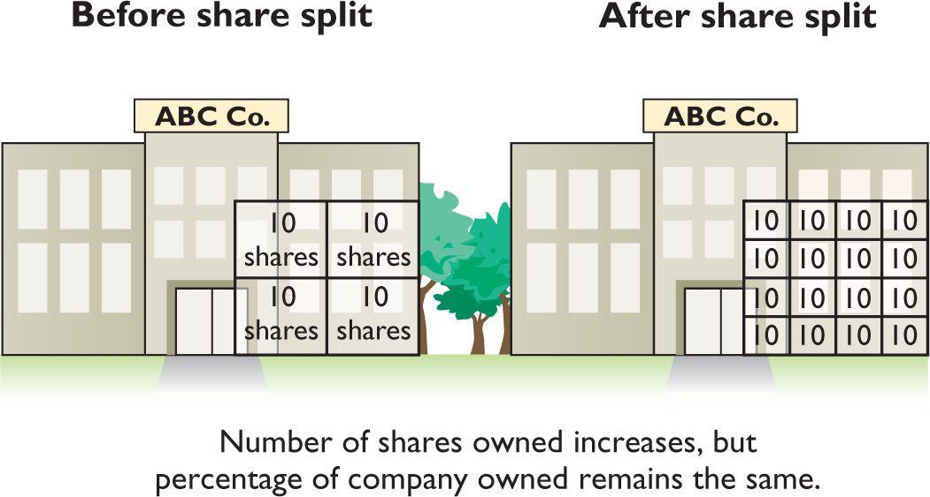
Accounting for share splits (2 of 3)
Effect of 4-for-1 stock split for shareholders

Slide 72
Accounting for share splits (3 of 3)
Effects for DanShui ltd., Assuming that it splits its 50,000 ordinary shares on a 2-for-1 basis.
 | Before Share Split |  | Change |  | After Share Split
Equity
Share capital—ordinary | NT$5,000,000 |  | NT$ –0– |  | NT$5,000,000
Share premium—ordinary | –0– |  | –0– |  | –0–
Retained earnings | 3,000,000 |  | –0– |  | 3,000,000
Total equity | NT$8,000,000 |  | NT$ –0– |  | NT$8,000,000
Outstanding shares | 50,000 |  | +50,000 |  | 100,000
Par value per share | NT$100.00 |  | −NT$50.00 |  | NT$50.00

Slide 73
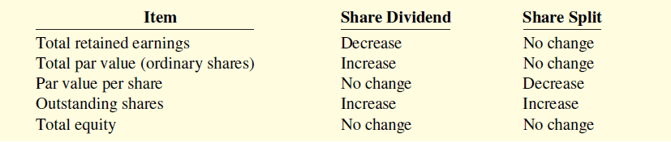
Comparison between Share Dividend and Share Split
Differences between the effects of share dividends and share splits

Slide 74
Do it! 3B: share splits (1 of 2)
Sing CD has had five years of record earnings. Due to this success, the market price of its 500,000 shares of £2 par value ordinary shares has tripled from £15 per share to £45. During this period, the sum of share capital and share premium remained the same at £2,000,000. Retained earnings increased from £1,500,000 to £10,000,000. CEO Joan Elbert is considering a 2-for-1 share split. She asks you to show the before-and-after effects on retained earnings, total equity, shares outstanding, and par value per share.

Slide 75
Do it! 3B: share splits (2 of 2)
Sing CD has had five years of record earnings. Due to this success, the market price of its 500,000 shares of £2 par value ordinary shares has tripled from £15 per share to £45. CEO Joan Elbert is considering a 2-for-1 share split.
 | Original Balances |  |  | After Split
Share capital/premium | £2,000,000 |  |  | £2,000,000
Retained earnings | 10,000,000 |  |  | 10,000,000
Total equity | £12,000,000 |  |  | £12,000,000
Shares outstanding | 500,000 |  |  | 1,000,000
Par value per share | £2.00 |  |  | $1.00

Slide 76
Learning objective 4 discuss how equity is reported and analyzed

Slide 77
Reporting and analyzing equity
Retained earnings
Includes all the past net income that a company retains in the business.
Part of shareholders’ claim on total assets of corporation
Does not represent a claim on any specific asset
Amount cannot be associated with the balance of any asset account

Slide 78
Retained earnings (1 of 3)
If cumulative losses exceed cumulative income over a company’s life, a debit balance in retained earnings results
Debit balance is identified as a deficit
Statement of Financial Position (partial)
Equity
Share capital—ordinary | €800,000
Retained earnings (deficit) | (50,000)
Total equity | €750,000

Slide 79
Retained earnings (2 of 3)
In some cases there may be retained earnings restrictions.
These make a portion of the retained earnings balance currently unavailable for dividends
Companies generally disclose retained earnings restrictions in the notes to the financial statements.
Tektronix Inc. Notes to the Financial Statements
Certain of the Company’s debt agreements require compliance with debt covenants. Management believes that the Company is in compliance with such requirements. The Company had unrestricted retained earnings of $223.8 million after meeting those requirements.

Slide 80
Retained earnings (3 of 3)
Statement for Graber SA, based on assumed data.
Graber SA Statement of Retained Earnings For the Year Ended December 31, 2020
Balance, January 1 | €1,050,000
Add: Net income | 410,000
 | 1,460,000
Less: Cash Dividends | 100,000
Share Dividends | 200,000
Balance, December 31 | €1,160,000

Slide 81
Statement of financial position
Graber SA Statement of Financial Position (partial)
Equity
Share capital—preference, 9% €100 par value,
cumulative, callable at €120, 10,000 shares authorized, 6,000 shares issued and outstanding |  |  | € 600,000
Share capital—ordinary, no-par, €5 stated value, 500,000 shares authorized, 400,000 shares issued and 390,000 outstanding | €2,000,000
Ordinary share dividends distributable | 50,000 |  | 2,050,000
Share premium—preference | 30,000
Share premium—ordinary | 1,050,000 |  | 1,080,000
Retained earnings (see Note R) |  |  | 1,160,000
Less: Treasury shares (10,000 shares) |  |  | 80,000
Total equity |  |  | €4,810,000
Note R: Retained earnings is restricted for the cost of treasury shares, €80,000.

Slide 82
Do it! 4A: equity section (1 of 2)
Jennifer NV has issued 300,000 shares of €3 par value ordinary shares. It is authorized to issue 600,000 shares. The share premium on the ordinary shares is €380,000. The corporation has reacquired 15,000 shares at a cost of €50,000 and is currently holding those shares. Treasury shares were reissued in prior years for €72,000 more than their cost. The corporation also has 4,000 shares issued and outstanding of 8%, €100 par value preference shares. It authorized 10,000 shares. The share premium on the preference shares is €25,000. Retained earnings is €610,000.
Prepare the equity section of the statement of financial position.

Slide 83



Do it! 4A: equity section (2 of 2)
Jennifer NV Statement of financial position (partial)
Equity
Share capital, preference 8%, €100 par value, 10,000 shares
authorized, 4,000 shares issued and outstanding |  |  | € 400,000
Share capital, ordinary, €3 par value, 600,000 shares
authorized, 300,000 shares issued, and 285,000
shares outstanding |  |  | 900,000
Share premium—preference | € 25,000
Share premium—ordinary | 380,000
Share premium—treasury | 72,000 |  | 477,000
Retained earnings |  |  | 610,000
Less: Treasury shares (15,000 shares) |  |  | 50,000
Total equity |  |  | €2,337,000

Slide 84
Analysis
Return on ordinary shareholders’ equity
Indicates how many euros of net income the company earned for each euro invested by ordinary shareholders
Carrefour’s (FRA) beginning and ending ordinary shareholders’ equity was €8,047 and €8,597 million respectively. Net income was €1,263 million, no preference shares were outstanding.
Net Income minus Preference Dividends | ÷ | Average Ordinary Shareholders’ Equity | = | Return on Ordinary Shareholders’ Equity
(€1,263 - €0) | ÷ | (€8,047 + €8,597) | = | 15.2%
 |  | 2
Notes:
Earnings that belong to ordinary shareholders.

Slide 85
Do it! 4B: return on shareholders’ equity (1 of 2)
On January 1, 2020, Siena purchased 2,000 treasury shares. Other information regarding Siena is provided below.
 | 2019 |  | 2020
Net income | €110,000 |  | €110,000
Dividends on preference shares | 10,000 |  | 10,000
Dividends on ordinary shares | 2,000 |  | 1,600
Weighted-average number of shares outstanding | 10,000 |  | 8,000
Ordinary shareholders’ equity, beginning of year | 500,000 |  | 400,000
Ordinary shareholders’ equity, ending of year | 500,000 |  | 400,000
*Adjusted for purchase of treasury shares.
*
*
Compute return on ordinary shareholders’ equity for each year.

Slide 86
Do it! 4B: return on shareholders’ equity (2 of 2)
 | 2019 |  | 2020
Net income | €110,000 |  | €110,000
Dividends on preference shares | 10,000 |  | 10,000
Dividends on ordinary shares | 2,000 |  | 1,600
Weighted-average number of shares outstanding | 10,000 |  | 8,000
Ordinary shareholders’ equity, beginning of year | 500,000 |  | 400,000
Ordinary shareholders’ equity, ending of year | 500,000 |  | 400,000
*Adjusted for purchase of treasury shares.
*
*
Compute return on ordinary shareholders' equity for each year.
2019 |  | 2020
(€110,000 – €10,000) | = 20% | (€110,000 – €10,000) | = 25%
(€500,000 + €500,000)/2 |  | (€400,000 + €400,000)/2

