Slide 1
Financial Accounting
IFRS 5th Edition
Weygandt ● Kimmel
Chapter 14
Statement of Cash Flows
This slide deck contains animations. Please disable animations if they cause issues with your device.
Copyright © John Wiley & Sons, Inc.

Slide 2
Chapter Outline
Learning Objectives
LO 1 Discuss the usefulness and format of the statement of cash flows.
LO 2 Prepare a statement of cash flows using the indirect method.
LO 3 The direct method.
LO 4 Analyze the statement of cash flows.

Slide 3
Learning Objective 1 Discuss the Usefulness and Format of the Statement of Cash Flows.
L O 1

Slide 4
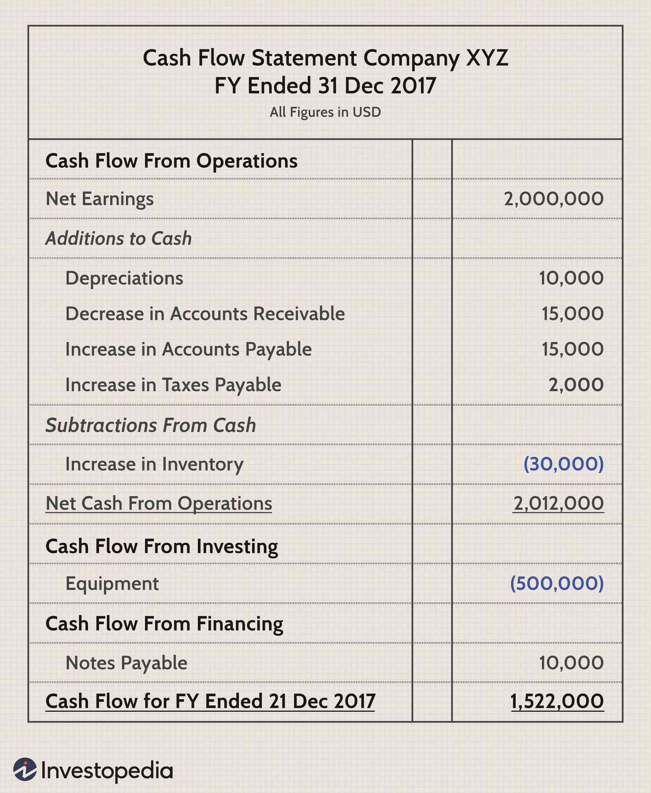

Slide 5
Usefulness and Format
Statement of Cash Flows provides information to help assess:
Entity’s ability to generate future cash flows.
Entity’s ability to pay dividends and meet obligations.
The reasons for the difference between net income and net cash provided (used) by operating activities.
The cash investing and financing transactions during the period.
L O 1

Slide 6
Statement of Cash Flow
Provides summary of cash inflows and outflows during each reporting period
Cash inflow: cash received by the company
Cash outflow: cash paid by the company
Net cash flow: difference between the two
SCF reports net cash flow from three sections:
Operating, Investing, and Financing Activities
L O 1

Slide 7
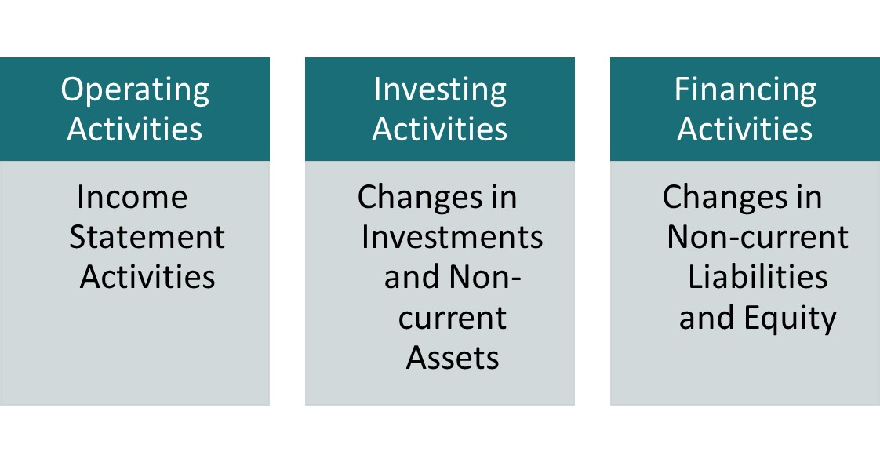
Classification of Cash Flows
Buying/selling PPE, etc.
Issue bond, stock, paying dividend, etc.
L O 1

Slide 8
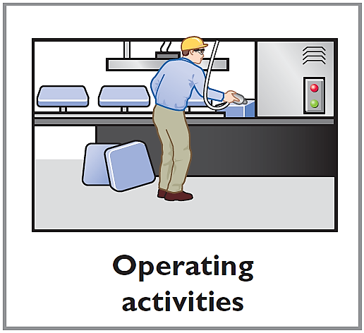
Classification of Cash Flows - Operating
Operating activities—Income statement items
Cash inflows:
From sale of goods or services.
From interest received and dividends received.
Cash outflows:
To suppliers for inventory.
To employees for wages.
To government for taxes.
To lenders for interest.
To others for expenses.
Illustration 14.1 (Partial): Typical receipt and payment classifications
L O 1
Notes:
Cash coming in and out from company’s primary business operations.
Interest & dividends: simply know that these are from income statement (int rev, div renv, int exp etc.)
Note that depr is not included because there is no cash payment for depr exp

Slide 9
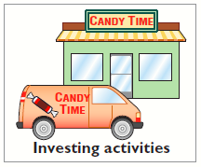
Classification of Cash Flows - Investing
Investing activities—Changes in investments and non-current assets
Cash inflows:
From sale of property, plant, and equipment.
From sale of investments in debt or equity securities of other entities.
From collection of principal on loans to other entities.
Cash outflows:
To purchase property, plant, and equipment.
To purchase investments in debt or equity securities of other entities.
To make loans to other entities.
Illustration 14.1 (Partial): Typical receipt and payment classifications
L O 1
Notes:
Company’s investments in the future. Cash spent on long-term assets and cash received from selling these assets.

Slide 10
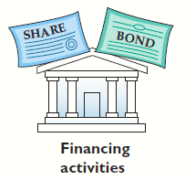
Classification of Cash Flows - Financing
Financing activities—Changes in non-current liabilities and equity
Cash inflows:
From sale of ordinary shares.
From issuance of long-debt (bonds and notes).
Cash outflows:
To shareholders as dividends.
To redeem long-term debt or reacquire
ordinary shares (treasury shares).
Note from the two slides ago, receiving dividend is operating cash flow.
L O 1
Notes:
Cash transactions related to borrowing money, repaying debt, selling shares, paying dividends.
Dividends are not an expense and have no impact on net income.

Slide 11
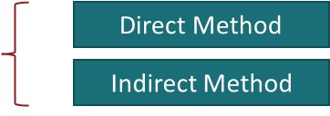
Format of the Statement of Cash Flows
Order of Presentation:
Operating activities.
Investing activities.
Financing activities.
L O 1

Slide 12
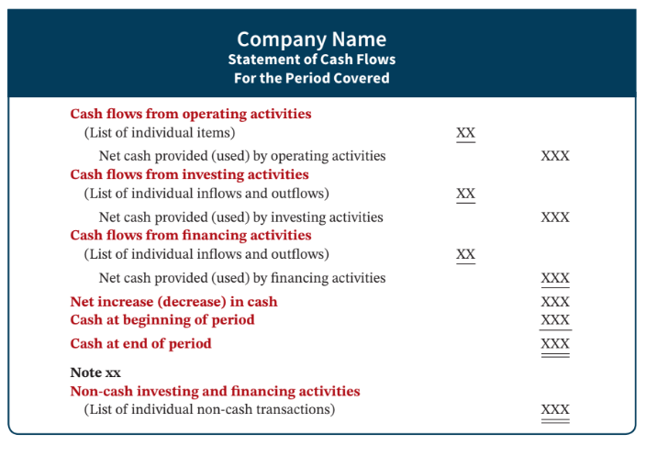
Statement of Cash Flow Example
Illustration 14.3: Format of statement of cash flows
L O 1

Slide 13
DO IT! 1: Cash Flow Activities
Classify each of these transactions by type of cash flow activity. Hu Na Ltd. had these transactions:
Issued 100,000 HK$50 par value ordinary shares for HK$8,000,000 cash.
Borrowed HK$2,000,000 from Castle Bank, signing a 5-year note bearing 8% interest.
Purchased two semi-trailer trucks for HK$1,700,000 cash.
Paid employees HK$120,000 for salaries and wages.
Collected HK$200,000 cash for services performed.
L O 1

Slide 14
DO IT! 1: Cash Flow Activities – Solution
Classify each of these transactions by type of cash flow activity. Hu Na Ltd. had these transactions:
Issued 100,000 HK$50 par value ordinary shares for HK$8,000,000 cash. Financing
Borrowed HK$2,000,000 from Castle Bank, signing a 5-year note bearing 8% interest. Financing
Purchased two semi-trailer trucks for HK$1,700,000 cash. Investing
Paid employees HK$120,000 for salaries and wages. Operating
Collected HK$200,000 cash for services performed. Operating
L O 1

Slide 15
Learning Objective 2 Prepare a Statement of Cash Flows Using the Indirect Method.
L O 2

Slide 16
Cash flow overview
Compare inflow and outflow to compute net cash flow
Operating Activities
Investing Activities
Financing Activities
L O 2

Slide 17
Classification of Cash Flows
Buying/selling PPE, etc.
Issue bond, stock, paying dividend, etc.
L O 1

Slide 18
Highlights
Operating activities
Interest received from investments
Interest paid on bonds or notes payable
Dividends from investments
Why? Because each is a cash flow from activities reported in income statement (interest revenue, interest expense, dividend revenue)
Financing activities
Dividends paid to stockholders
Why? Dividends are not an expense. Therefore, paying dividends has no effect on net income.
L O 2
Notes:
Dividend paid is not an expense.

Slide 19
Statement of Cash Flow Example
Illustration 14.3: Format of statement of cash flows
L O 1

Slide 20
Significant non-cash activities
Not all of a company’s significant activities involve cash. Examples:
Issuance of shares to purchase assets
Conversion of bonds into ordinary shares
Issuance of debt to purchase assets
Exchange of plant assets
Companies report significant activities that do not affect cash in either a
Supplementary schedule
Separate note to the financial statements
L O 2
Notes:
Non-cash activities are disclosed even though it does not involve cash. There is no cash impact, but this is still disclosed.

Slide 21
Format of the Statement of Cash Flows
Order of Presentation:
Operating activities.
Investing activities.
Financing activities.
L O 1
Notes:
Indirect method is more widely adopted.

Slide 22
Preparing the Statement of Cash Flows
Three sources of information:
Current income statement
Revenue and expenses: determine CF from operating
Comparative statements of financial position
Compare current year to previous year – i.e., look at changes to identify cash flow
Additional information
Sometimes, additional information is needed to determine inflow and outflow of cash
L O 2

Slide 23
Preparation – Step 1
Cash flow from operating activities (CFO)
Illustration 14.4 (Partial): Three major steps in preparing the statement of cash flows
L O 2

Slide 24
Indirect and Direct Methods in operating cash flow
Companies must convert net income from an accrual basis to a cash basis using either of two methods.
Indirect method adjusts net income for items that do not affect cash.
Direct method shows operating cash receipts and payments.
L O 2

Slide 25
Methods Adopted by Companies
Companies favor the indirect method for two reasons:
It is easier and less costly to prepare.
It focuses on differences between net income and net cash flow from operating activities
L O 2

Slide 26
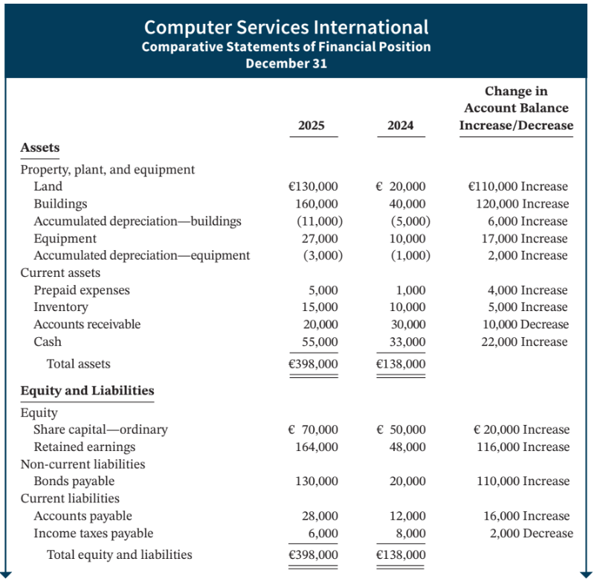
Indirect Method Illustrated
Illustration 14.5 (Partial): Comparative statements of financial position, income statement, and additional information for Computer Services International
L O 2

Slide 27
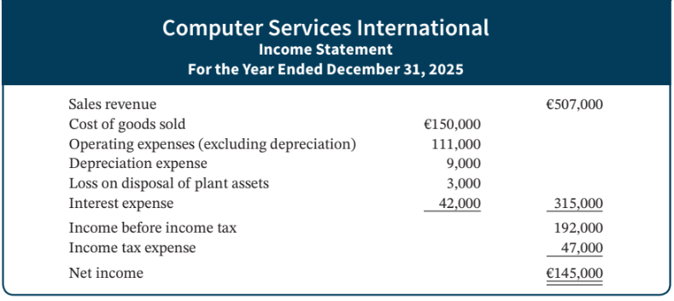
Indirect Method Illustrated – Income Statement
Illustration 14.5 (Partial): Comparative statements of financial position, income statement, and additional information for Computer Services International
L O 2

Slide 28
Indirect Method Illustrated – Further Information
Additional information for 2025:
Depreciation expense was comprised of €6,000 for building and €3,000 for equipment.
The company sold equipment with a book value of €7,000 (cost €8,000, less accumulated depreciation €1,000) for €4,000 cash.
Issued €110,000 of long-term bonds in direct exchange for land.
A building costing €120,000 was purchased for cash. Equipment costing €25,000 was also purchased for cash.
Issued ordinary shares for €20,000 cash.
The company declared and paid a €29,000 cash dividend.
L O 2

Slide 29
Indirect Method Illustrated
Net Income | +/− | Adjustments | = | Net Cash Provided/Used by Operating Activities
 |  | I. Add back non-cash expenses, such as depreciation expense and amortization expense. II. Deduct gains and add losses that resulted from investing and financing activities. III. Analyze changes to non-cash current asset and current liability accounts.
Illustration 14.6: Three types of adjustments to convert net income to net cash provided by operating activities
L O 2
Notes:
NI … is based on accrual basis. We are shifting accrual basis to cash basis by making necessary adjustments.

Slide 30
Indirect Method Illustrated
Net Income | +/− | Adjustments | = | Net Cash Provided/Used by Operating Activities
 |  | I. Add back non-cash expenses, such as depreciation expense and amortization expense. II. Deduct gains and add losses that resulted from investing and financing activities. III. Analyze changes to non-cash current asset and current liability accounts.
Illustration 14.6: Three types of adjustments to convert net income to net cash provided by operating activities
L O 2
Notes:
NI … is based on accrual basis. We are shifting accrual basis to cash basis by making necessary adjustments.

Slide 31
I. Add back Depreciation Expense
Although depreciation expense reduces net income, it does not reduce cash. The company must add it back to net income.
Cash flows from operating activities
Net income | €145,000
Adjustments to reconcile net income to net cash provided by operating activities:
Depreciation expense | 9,000
Net cash provided by operating activities | €154,000
Illustration 14.7: Adjustment for depreciation
L O 2
Notes:
Depr & amortization: allocation of cost over useful life. They do not involve actual cash outflow. They reduce NI but not the cash balance. So when computing, you add back.
NI involves these items.

Slide 32
Indirect Method Illustrated
Net Income | +/− | Adjustments | = | Net Cash Provided/Used by Operating Activities
 |  | I. Add back non-cash expenses, such as depreciation expense and amortization expense. II. Deduct gains and add losses that resulted from investing and financing activities. III. Analyze changes to non-cash current asset and current liability accounts.
Illustration 14.6: Three types of adjustments to convert net income to net cash provided by operating activities
L O 2
Notes:
NI … is based on accrual basis. We are shifting accrual basis to cash basis by making necessary adjustments.

Slide 33
II. Loss on Disposal of Plant Assets
Companies should report cash received from the sale (disposal) of plant assets in the investing activities section. Therefore,
any loss on sale is added to net income in the operating section.
any gain on sale is deducted from net income in the operating section.
L O 2
Notes:
Convert NI (accrual) to cash basis… gains and losses may involve cash; but these are reported in the investing section.
The accounting number in gains and losses are added and subtracted to compute net income. We are doing the indirect method, which is computing CFO (CF from operating). Thus,
Losses reduce NI … so you add back.
Gains increase NI … so deduct.

Slide 34
Step 1: Loss Example
Cash flows from operating activities
Net income |  | €145,000
Adjustments to reconcile net income to net cash provided by operating activities:
Depreciation expense | €9,000
Loss on disposal of plant assets | 3,000 | 12,000
Net cash provided by operating activities |  | €157,000
Illustration 14.8: Adjustment for loss on disposal of plant assets
L O 2

Slide 35
Indirect Method Illustrated
Net Income | +/− | Adjustments | = | Net Cash Provided/Used by Operating Activities
 |  | I. Add back non-cash expenses, such as depreciation expense and amortization expense. II. Deduct gains and add losses that resulted from investing and financing activities. III. Analyze changes to non-cash current asset and current liability accounts.
Illustration 14.6: Three types of adjustments to convert net income to net cash provided by operating activities
L O 2
Notes:
Adjust changes to non-cash current assets and current liabilities.

Slide 36
III Part 1: Changes to Non-Cash Current Asset Accounts
To arrive at net cash provided by operating activities
Add the decreases in current asset accounts.
Deduct the increases in current asset accounts.
L O 2

Slide 37
Non-Cash Current Assets
Accounts receivables
Increases in AR (Deduct)
Decreases in AR (Add back)
Inventory
Increases in Inventory (Deduct)
Decreases in Inventory (Add back)
Prepaid Expenses
Increases in Prepaid Exp (Deduct)
Decreases in Prepaid Exp (Add back)

Slide 38
Non-Cash Current Assets
Accounts receivables
Increases in AR (Deduct)
Decreases in AR (Add back)
Inventory
Increases in Inventory (Deduct)
Decreases in Inventory (Add back)
Prepaid Expenses
Increases in Prepaid Exp (Deduct)
Decreases in Prepaid Exp (Add back)

Slide 39
Why add back decrease in AR?
When the Accounts Receivable balance decreases, you have received cash.
But this does not affect NI. Why?
Revenue was recognized when sale was made not when cash is received.
To reconcile, need to add back decreases.
Illustration 14.9: Analysis of accounts receivable
L O 2
Notes:
A/R
decreases mean cash has been received … this increases actual cash, but does not affect NI (revenue was recognized when sale was made, not when cash received) … thus decrease must be added to NI.

Slide 40
What about increase in AR?
When the Accounts Receivable balance increases, you made more credit sales.
But you did not receive cash.
Thus, NI has increased but cash has stayed same.
To reconcile, need to subtract increases.
Illustration 14.9: Analysis of accounts receivable
L O 2
Notes:
A/R
increase mean more sales on credit and not reception of cash… increases NI but not cash … thus increase must be deducted from NI.

Slide 41
Non-Cash Current Assets
Accounts receivables
Increases in AR (Deduct)
Decreases in AR (Add back)
Inventory
Increases in Inventory (Deduct)
Decreases in Inventory (Add back)
Prepaid Expenses
Increases in Prepaid Exp (Deduct)
Decreases in Prepaid Exp (Add back)

Slide 42
Decrease in inventory, add back
When the Inventory balance decreases, more goods have been sold than have been purchased. COGS higher than purchases.
Cash outflow is lower than COGS.
Example: Cash outflow = 30; COGS = 50;
Net income decreases by more (-50) compared to decrease in CF (-30).
To reconcile, need to add back decrease.
L O 2
Notes:
Let’s assume purchases are all made on cash. Purchases made on credit will be dealt later with account payable.

Slide 43
Increases in inventory (Deduct)
When the inventory balance increases, company purchased more inventory than it sold.
Cash outflow is higher than COGS.
Example: Cash outflow = 50; COGS = 30;
Net income decreases by less (-30) compared to decrease in CF (-50).
To reconcile, need to subtract increases.
L O 2
Notes:
Inv:

Slide 44
Non-Cash Current Assets
Accounts receivables
Increases in AR (Deduct)
Decreases in AR (Add back)
Inventory
Increases in Inventory (Deduct)
Decreases in Inventory (Add back)
Prepaid Expenses
Increases in Prepaid Exp (Deduct)
Decreases in Prepaid Exp (Add back)

Slide 45
Changes to Prepaid Expense
When the Prepaid Expense balance increases, the cash paid for expenses is higher than expenses reported on an accrual basis.
The company deducts from net income the increase.
When the Prepaid Expense balance decreases, the cash paid for expenses is less than expenses reported on an accrual basis.
The company adds back to net income the decrease.
L O 2
Notes:
Prepaid

Slide 46
III Part 1: Adjustments in Operating Activities
Cash flows from operating activities
Net income |  | €145,000
Adjustments to reconcile net income to net cash provided by operating activities:
Depreciation expense | € 9,000
Loss on disposal of plant assets | 3,000
Decrease in accounts receivable | 10,000
Increase in inventory | (5,000)
Increase in prepaid expenses | (4,000) | 13,000
Net cash provided by operating activities |  | €158,000
Illustration 14.10: Adjustments for changes in current asset accounts
L O 2

Slide 47
III Part 2: Changes to Non-Cash Current Liability Accounts
To arrive at net cash provided by operating activities
Add the increases in current liability accounts.
Deduct the decreases in current liability accounts.
L O 2

Slide 48
Changes to Non-Cash Current Liability Accounts
When Accounts Payable increases, the company received more in goods than it actually paid for.
Example: Purchases (50); Cash outflow (30)
Effect on NI (-50); Effect on cash outflow (-30)
We need to add back increase to net income to get to net CF from operating.
Conversely, when AP decreases -> company is paying off the supplies using cash, so it is cash decreasing. We deduct decrease from NI.
L O 2
Notes:
Increase in A/P … cash has not left company yet.
E.g., receives material of $10,000 … has not paid supplier. Increase in $10,000 is increases AP and is an expense. Cash has not been paid yet. Thus, need to add back.
Decrease in A/P … company pays off … expenses were recognized in when incurred … but cash has left when AP decrease… thus, need to deduct decrease to match.
E.g., had 10,000 in AP .. Paid 4000 … payment of 4000 is cash outflow.

Slide 49
Changes to Non-Cash Current Liability Accounts
When Income Taxes Payable decreases, the company is paying off the tax expense that incurred in the previous period but hasn’t been paid in cash yet. The decrease is subtracted from net income to determine net cash provided by operating activities.
Example: Company has $1000 tax payable as of the beginning of the year. It does not have any other revenue or expense during the year. The only activity it did was to pay off the $1000 tax payable.
Cash + other asset = tax payable +RE
-1000 -1000 0
L O 2

Slide 50
III Part 2: Current Liability Changes Illustrated
Cash flows from operating activities
Net income |  | €145,000
Adjustments to reconcile net income to net cash provided by operating activities:
Depreciation expense | € 9,000
Loss on disposal of plant assets | 3,000
Decrease in accounts receivable | 10,000
Increase in inventory | (5,000)
Increase in prepaid expenses | (4,000)
Increase in accounts payable | 16,000
Decrease in income taxes payable | (2,000) | 27,000
Net cash provided by operating activities |  | €172,000
Illustration 14.11: Adjustments for changes in current liability accounts
L O 2

Slide 51
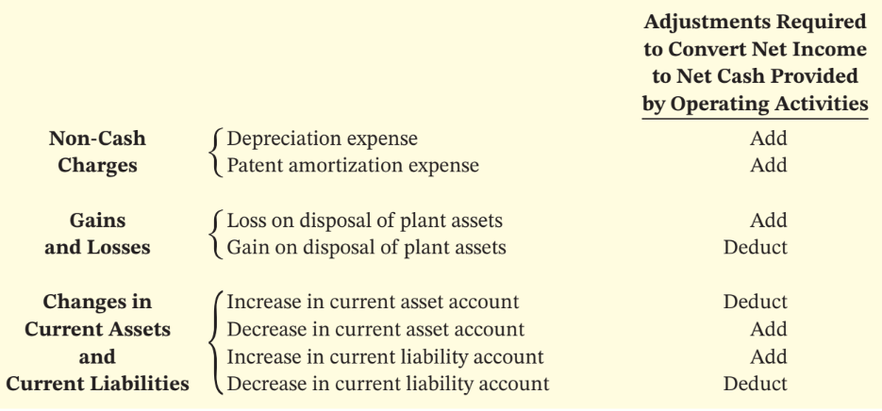
Summary of Conversion to Net Cash Provided by Operating Activities—Indirect Method
L O 2

Slide 52
Cash flows from operating activities
Net income |  | €145,000
Adjustments to reconcile net income to net cash provided by operating activities:
Depreciation expense | € 9,000
Loss on disposal of plant assets | 3,000
Decrease in accounts receivable | 10,000
Increase in inventory | (5,000)
Increase in prepaid expenses | (4,000)
Increase in accounts payable | 16,000
Decrease in income taxes payable | (2,000) | 27,000
Net cash provided by operating activities |  | €172,000
Add back deprecation
Add back loss
Add decrease in CA
Deduct increase in CA
Deduct increase in CA
Add increases in CL
Deduct decrease in CL
Illustration 14.11: Adjustments for changes in current liability accounts
L O 2

Slide 53
DO IT! 2a: Net Cash Provided by Operating Activities
Josh’s Photo Plus reported net income of £73,000 for 2025. Included in the income statement were depreciation expense of £7,000 and a gain on disposal of plant assets of £2,500. Josh’s comparative statements of financial position show the following balances.
 | 12/31/24 | 12/31/25
Accounts receivable | £17,000 | £21,000
Accounts payable | 6,000 | 2,200
Calculate net cash provided by operating activities for Josh’s Photo Plus.
L O 2

Slide 54
DO IT! 2a: Net Cash Provided by Operating Activities – Solution
Cash flows from operating activities
Net income |  | £73,000
Adjustments to reconcile net income to net cash provided by operating activities:
Depreciation expense | € 7,000
Gain on disposal of plant assets | (2,500)
Increase in accounts receivable | (4,000)
Decrease in accounts payable | (3,800) | (3,300)
Net cash provided by operating activities |  | £69,700
L O 2

Slide 55
Step 2: Investing Activities
Analyze Changes in Non-Current Asset and Liability Accounts and Record as Investing and Financing Activities, or Disclose as Non-Cash Transactions.
The company purchased land of €110,000 by issuing long-term bonds. This is a non-cash investing and financing activity that merits disclosure in a separate schedule, but does not affect cash flow.
A building costing €120,000 was purchased for cash. (cash outflow of 120,000)
Equipment costing €25,000 was also purchased for cash. (cash outflow of 25,000)
The company sold equipment with a book value of €7,000 (cost €8,000, less accumulated depreciation €1,000) for €4,000 cash.
L O 2

Slide 56
Step 2: Investing Activities
Analyze Changes in Non-Current Asset and Liability Accounts and Record as Investing and Financing Activities, or Disclose as Non-Cash Transactions.
The company purchased land of €110,000 by issuing long-term bonds. This is a non-cash investing and financing activity that merits disclosure in a separate schedule, but does not affect cash flow.
A building costing €120,000 was purchased for cash. (cash outflow of 120,000)
Equipment costing €25,000 was also purchased for cash. (cash outflow of 25,000)
The company sold equipment with a book value of €7,000 (cost €8,000, less accumulated depreciation €1,000) for €4,000 cash.
L O 2
Notes:
No entry, since does not affect cash flow.

Slide 57
Step 2: Investing Activities
Analyze Changes in Non-Current Asset and Liability Accounts and Record as Investing and Financing Activities, or Disclose as Non-Cash Transactions.
The company purchased land of €110,000 by issuing long-term bonds. This is a non-cash investing and financing activity that merits disclosure in a separate schedule, but does not affect cash flow.
A building costing €120,000 was purchased for cash. (cash outflow of 120,000)
Equipment costing €25,000 was also purchased for cash. (cash outflow of 25,000)
The company sold equipment with a book value of €7,000 (cost €8,000, less accumulated depreciation €1,000) for €4,000 cash.
L O 2

Slide 58
Step 2: Investing Activities
Cash flows from investing activities
Purchase of building | (120,000)
Purchase of equipment | (25,000)
Disposal of plant assets | 4,000
Net cash used by investing activities |  | (141,000)
L O 2

Slide 59
Step 2: Investing Activities
Analyze Changes in Non-Current Asset and Liability Accounts and Record as Investing and Financing Activities, or Disclose as Non-Cash Transactions.
The company purchased land of €110,000 by issuing long-term bonds. This is a non-cash investing and financing activity that merits disclosure in a separate schedule, but does not affect cash flow.
A building costing €120,000 was purchased for cash. (cash outflow of 120,000)
Equipment costing €25,000 was also purchased for cash. (cash outflow of 25,000)
The company sold equipment with a book value of €7,000 (cost €8,000, less accumulated depreciation €1,000) for €4,000 cash.
L O 2

Slide 60
Step 2: Investing Activities
Cash flows from investing activities
Purchase of building | (120,000)
Purchase of equipment | (25,000)
Disposal of plant assets | 4,000
Net cash used by investing activities |  | (141,000)
L O 2

Slide 61
Step 2: Investing Activities
Analyze Changes in Non-Current Asset and Liability Accounts and Record as Investing and Financing Activities, or Disclose as Non-Cash Transactions.
The company purchased land of €110,000 by issuing long-term bonds. This is a non-cash investing and financing activity that merits disclosure in a separate schedule, but does not affect cash flow.
A building costing €120,000 was purchased for cash. (cash outflow of 120,000)
Equipment costing €25,000 was also purchased for cash. (cash outflow of 25,000)
The company sold equipment with a book value of €7,000 (cost €8,000, less accumulated depreciation €1,000) for €4,000 cash.
L O 2

Slide 62
Step 2: Equipment Journal Entry
The company sold equipment with a book value of €7,000 (cost €8,000, less accumulated depreciation €1,000) for €4,000 cash.
Cash | 4,000
Accumulated Depreciation—Equipment | 1,000
Loss on Disposal of Plant Assets | 3,000
Equipment |  | 8,000
L O 2

Slide 63
Step 2: Investing Activities
Cash flows from investing activities
Purchase of building | (120,000)
Purchase of equipment | (25,000)
Disposal of plant assets | 4,000
Net cash used by investing activities |  | (141,000)
L O 2

Slide 64
Step 2: Financing Activities
The company increased Share Capital—Ordinary by issuing shares of stock for €20,000. This is a cash inflow reported in the financing activities section of the Statement of Cash Flows.
The company paid dividends of €29,000. The decrease in retained earnings is a cash outflow that is reported in the financing activities section.
L O 2

Slide 65
Step 2: Partial Statement of Cash Flows
Cash flows from financing activities
Issuance of ordinary shares | 20,000
Payment of cash dividends | (29,000)
Net cash used by financing activities |  | (9,000)
Illustration 14.14 (Partial): Statement of cash flows, 2025──indirect method
L O 2

Slide 66
Step 2: Financing Activities
The company increased Share Capital—Ordinary by issuing shares of stock for €20,000. This is a cash inflow reported in the financing activities section of the Statement of Cash Flows.
The company paid dividends of €29,000. The decrease in retained earnings is a cash outflow that is reported in the financing activities section.
L O 2

Slide 67
Step 2: Partial Statement of Cash Flows
Cash flows from financing activities
Issuance of ordinary shares | 20,000
Payment of cash dividends | (29,000)
Net cash used by financing activities |  | (9,000)
Illustration 14.14 (Partial): Statement of cash flows, 2025──indirect method
L O 2

Slide 68
Cash flows from operating activities
Net income |  | €145,000
Adjustments to reconcile net income to net cash provided by operating activities:
Depreciation expense | € 9,000
Loss on disposal of plant assets | 3,000
Decrease in accounts receivable | 10,000
Increase in inventory | (5,000)
Increase in prepaid expenses | (4,000)
Increase in accounts payable | 16,000
Decrease in income taxes payable | (2,000) | 27,000
Net cash provided by operating activities |  | €172,000
Add back deprecation
Add back loss
Add decrease in CA
Deduct increase in CA
Deduct increase in CA
Add increases in CL
Deduct decrease in CL
Illustration 14.11: Adjustments for changes in current liability accounts
L O 2

Slide 69
Putting everything together
Cash flows from investing activities
Purchase of building | (120,000)
Purchase of equipment | (25,000)
Disposal of plant assets | 4,000
Net cash used by investing activities |  | (141,000)
Cash flows from financing activities
Issuance of ordinary shares | 20,000
Payment of cash dividends | (29,000)
Net cash used by financing activities |  | (9,000)
Net increase in cash |  | 22,000
Cash at beginning of period |  | 33,000
Cash at end of period |  | €55,000
Note 1
Non-cash investing and financing activities
Issuance of bonds payable to purchase land |  | €110,000

Slide 70
Putting everything together
Cash flows from investing activities
Purchase of building | (120,000)
Purchase of equipment | (25,000)
Disposal of plant assets | 4,000
Net cash used by investing activities |  | (141,000)
Cash flows from financing activities
Issuance of ordinary shares | 20,000
Payment of cash dividends | (29,000)
Net cash used by financing activities |  | (9,000)
Net increase in cash |  | 22,000
Cash at beginning of period |  | 33,000
Cash at end of period |  | €55,000
Note 1
Non-cash investing and financing activities
Issuance of bonds payable to purchase land |  | €110,000

Slide 71
Putting everything together
Cash flows from investing activities
Purchase of building | (120,000)
Purchase of equipment | (25,000)
Disposal of plant assets | 4,000
Net cash used by investing activities |  | (141,000)
Cash flows from financing activities
Issuance of ordinary shares | 20,000
Payment of cash dividends | (29,000)
Net cash used by financing activities |  | (9,000)
Net increase in cash |  | 22,000
Cash at beginning of period |  | 33,000
Cash at end of period |  | €55,000
Note 1
Non-cash investing and financing activities
Issuance of bonds payable to purchase land |  | €110,000
172,000 – 141,000 – 9,000

Slide 72
Putting everything together
Cash flows from investing activities
Purchase of building | (120,000)
Purchase of equipment | (25,000)
Disposal of plant assets | 4,000
Net cash used by investing activities |  | (141,000)
Cash flows from financing activities
Issuance of ordinary shares | 20,000
Payment of cash dividends | (29,000)
Net cash used by financing activities |  | (9,000)
Net increase in cash |  | 22,000
Cash at beginning of period |  | 33,000
Cash at end of period |  | €55,000
Note 1
Non-cash investing and financing activities
Issuance of bonds payable to purchase land |  | €110,000
172,000 – 141,000 – 9,000

Slide 73
Putting everything together
Cash flows from investing activities
Purchase of building | (120,000)
Purchase of equipment | (25,000)
Disposal of plant assets | 4,000
Net cash used by investing activities |  | (141,000)
Cash flows from financing activities
Issuance of ordinary shares | 20,000
Payment of cash dividends | (29,000)
Net cash used by financing activities |  | (9,000)
Net increase in cash |  | 22,000
Cash at beginning of period |  | 33,000
Cash at end of period |  | €55,000
Note 1
Non-cash investing and financing activities
Issuance of bonds payable to purchase land |  | €110,000
172,000 – 141,000 – 9,000

Slide 74
Step 3: Net Change in Cash
Compare the beginning and ending cash balances on the Statement of Financial Position with those on the Statement of Cash Flows and be sure they agree.
CF operating + CF investing + CF financing = changes in cash
172,000 +(-141,000)+ (-9,000) = 22,000
L O 2

Slide 75
L O 2

Slide 76
DO IT! 2b: Indirect Method
Use the following Comparative Statements of Financial Position, Income Statement, and additional information to prepare a statement of cash flows using the indirect method.
Additional information (all amounts in thousands of NT$):
Operating expenses include depreciation expense of NT$33,000. (CFO)
Equipment with a cost of NT$41,000 and a book value of NT$36,000 was sold for NT$34,000 cash. (CIO)
Land was sold at its book value for cash. (CIO)
Interest expense of NT$12,000 was paid in cash. (CFO)
Equipment with a cost of NT$166,000 was purchased for cash. (CIO)
Bonds of NT$10,000 were redeemed at their face value for cash. (CFF)
Ordinary shares (NT$1 par) of NT$130,000 were issued for cash. (CFF)
Cash dividends of NT$55,000 were declared and paid in 2025. (CFF)
Ordinary shares of NT$30,000 were issued in exchange for land. (no effects)
L O 2

Slide 77
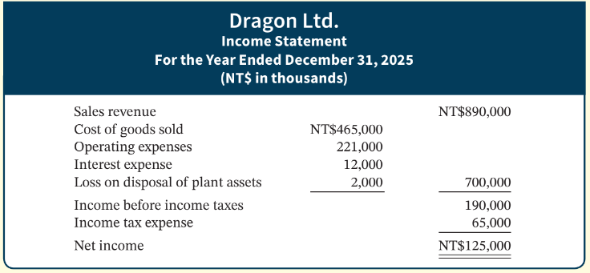
DO IT! 2b: Income Statement
L O 2

Slide 78
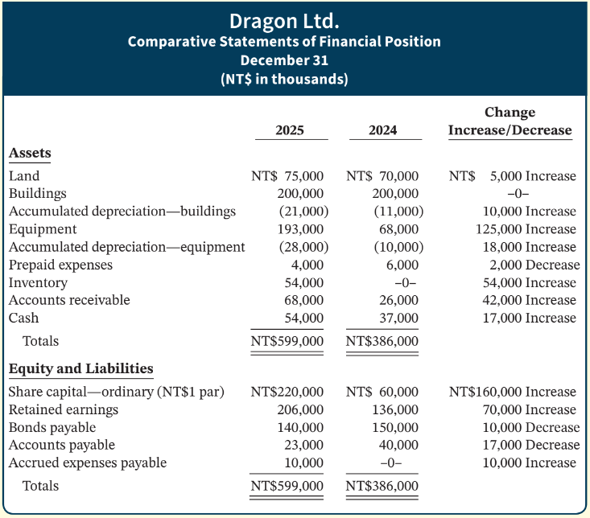
DO IT! 2b: Statement of Financial Position
L O 2

Slide 79
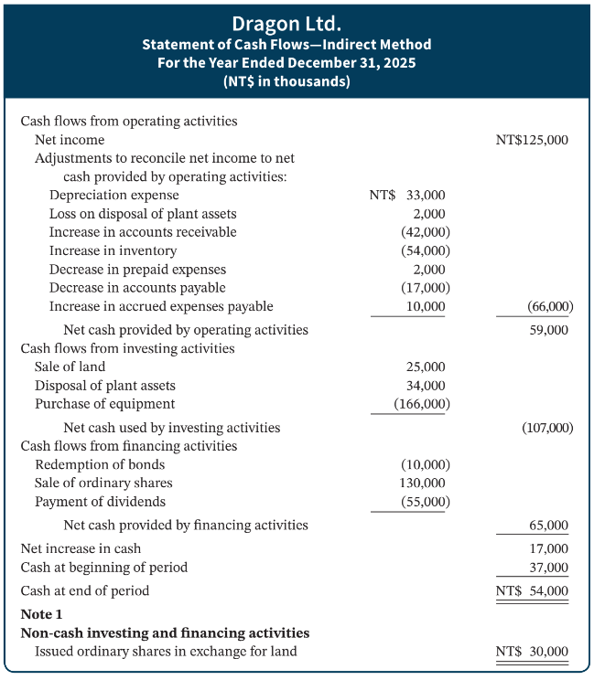








DO IT! 2b - Solution
L O 2

Slide 80
DO IT! 2b: Statement of Financial Position
Add to NI
Deduct from NI
Deduct from NI
Deduct from NI
Add to NI
L O 2

Slide 81
Learning Objective 4 Prepare a Statement of Cash Flows Using the Direct Method.
L O 4

Slide 82
Operating Activities (Direct)
Determine Net Cash Provided/Used by Operating Activities by Converting Net Income from an Accrual Basis to a Cash Basis.
An efficient way to apply the direct method is to analyze the items reported in the income statement in the order in which they are listed.
L O 4
Notes:
Look at cash inflow and outflow from operating … look into each account.

Slide 83
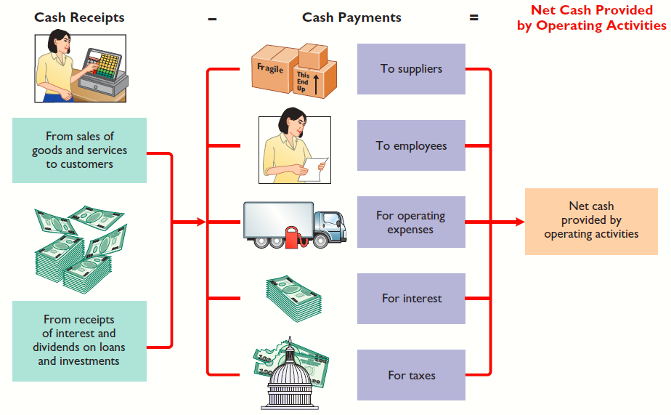
Operating Activities (Direct)
Illustration 14A.2: Major classes of cash receipts and payments
L O 4
Notes:
Directly look into cash inflow and outflow

Slide 84
Cash Receipts (Direct Method)
A company must consider the change in accounts receivable to determine how much of revenue was from cash receipts.
When revenues on an accrual basis are higher than cash receipts, accounts receivable increases. The company deducts the increase from sales revenue.
When accounts receivable decreases, the company adds the decrease to sales revenue.
L O 4

Slide 85
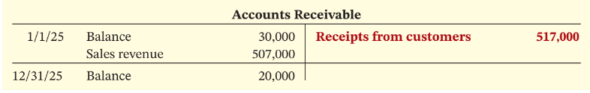
Cash Receipts Example (Direct)
For Computer Services, accounts receivable decreased €10,000.
Sales revenue | €507,000
Add: Decrease in accounts receivable | 10,000
Cash receipts from customers | €517,000
Illustration 14A.3-5: Computation of cash receipts from customers (3) Analysis of accounts receivable (4) and Formula to compute cash receipts from customers──direct method (5)
L O 4

Slide 86
Cash Payments (Direct)
A company must calculate purchases for the year to determine how much of cash was paid to suppliers.
When inventory increases, purchases have exceeded cost of goods sold.
Cost of goods sold | €150,000
Add: Increase in inventory | 5,000
Purchases | €155,000
Illustration 14A.6: Computation of purchases
L O 4

Slide 87
Cash Payments to Suppliers
A company must calculate how much of cash was paid to suppliers by adjusting purchases by the change in accounts payable.
When accounts payable increase, a company deducts the increase from purchases.
When accounts payable decrease, a company adds the decrease to purchases.
Purchases | €155,000
Deduct: Increase in accounts payable | 16,000
Cash payments to suppliers | €139,000
Illustration 14A.7: Computation of cash payments to suppliers
L O 4

Slide 88
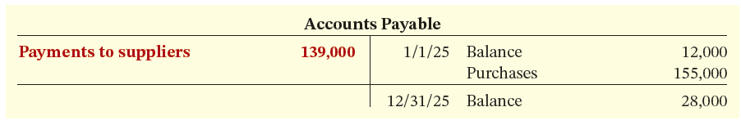
Formula for Cash Payments
In 2025, Computer Services Company’s inventory increased €5,000 and accounts payable increased € 16,000. Cash payments to suppliers were €139,000.
Illustration 14A.8: Analysis of accounts payable
Illustration 14A.9: Formula to compute cash payments to suppliers──direct method
L O 4

Slide 89
Cash Payments for Operating Expenses
A company needs to adjust operating expenses by changes in prepaid expenses and accrued expenses payable.
When prepaid expenses increase, cash paid for operating expenses is higher than operating expenses reported on the income statement.
To determine cash payments for operating expenses, a company deducts an increase in accrued expenses payable from operating expenses on the income statement (operating expenses on an accrual basis are higher than they are on a cash basis).
L O 4

Slide 90
Formula for Cash Payments for Operating Expenses
Wage payables, taxes payables, etc.
Illustration 14A.11: Formula to compute cash payments for operating expenses ─ direct method
Operating expenses | €111,000
Add: Increase in prepaid expenses | 4,000
Cash payments for operating expenses | €115,000
Illustration 14A.10: Computation of cash payments for operating expenses.
L O 4

Slide 91
Formula to Compute Payment for Taxes
Income taxes payable decreased €2,000.
Income tax expense | €47,000
Add: Decrease in income taxes payable | 2,000
Cash payments for income taxes | €49,000
Illustration 14A.12: Computation of cash payments for income taxes.
Illustration 14A.13: Formula to compute cash payments for income taxes – direct method
L O 4

Slide 92
Operating Activities Calculation
Operating activities section of the statement of cash flows of Computer Services.
Cash flows from operating activities
Cash receipts from customers |  | €517,000
Less: Cash payments:
To suppliers | €139,000
For operating expenses | 115,000
For interest expense | 42,000
For income taxes | 49,000 | 345,000
Net cash provided by operating activities |  | €172,000
Illustration 14A.14: Operating activities section of the statement of cash flows
L O 4

Slide 93
Direct method should give you the same results as the indirect method!
L O 3

Slide 94
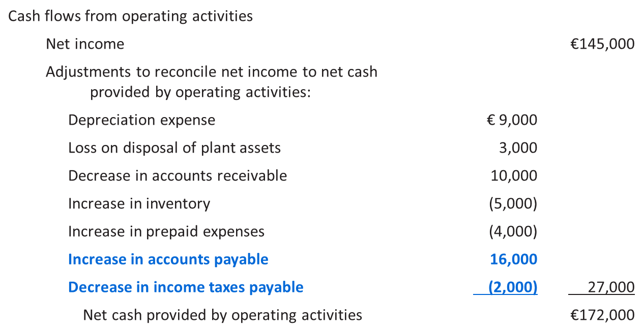
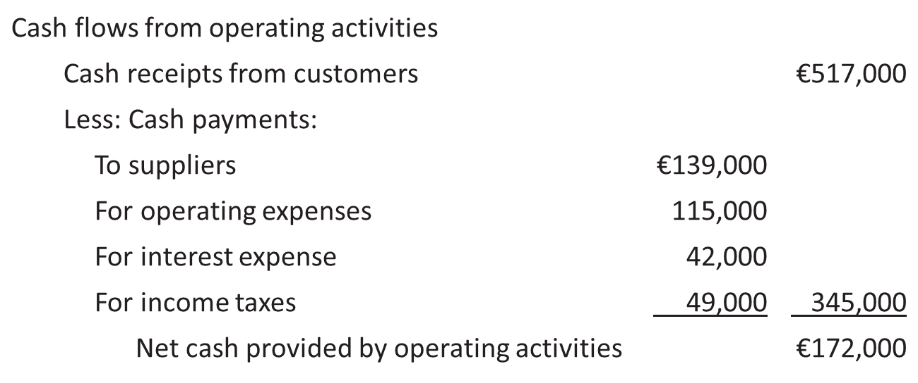
Proof of Direct method = Indirect method
Start with direct method
Rev + decreases in AR – (COGS + increases in inventory- increases in AP) – (operating exp + Increase in prepaid expenses) – interest expense – (taxes exp + decreases in taxes payables)
(rearrange)
Rev – COGS - operating exp – interest expense - taxes exp + decreases in AR - increases in inventory+ increases in AP - Increase in prepaid expenses - decreases in taxes payables
= NI + decreases in AR - increases in inventory+ increases in AP - Increase in prepaid expenses - decreases in taxes payables indirect method

Slide 95
Learning Objective 4 Free cash flow
L O 3

Slide 96
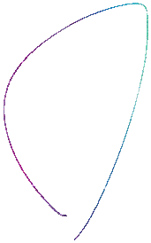
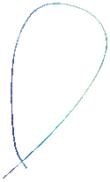
Free Cash Flow (FCF)
Free cash flow describes the net cash provided by operating activities after adjustment for capital expenditures and dividends. In other words, cash flow that companies can freely use.
Free Cash Flow | = | Net Cash Provided by Operating Activities | − | Capital Expenditures | − | Cash Dividends
Used as alternate measure of operating CF.
Net cash from operating fails to take in account that company needs to invest in new assets to maintain current level of operations.
FCF is also often used by managers and investment bankers in company valuation i.e., DCF.
L O 3

Slide 97
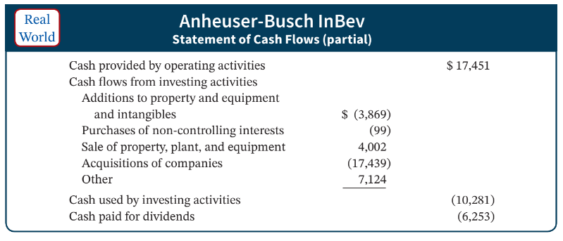
Using Cash Flows to Evaluate a Company
Illustration 14.16: Anheuser-Busch InBev cash flow information ($ in millions)
L O 3

Slide 98
Free Cash Flow Calculation
The company generated a significant amount of cash from its operations, but it spent most of it to buy property, plant, and equipment, and to pay dividends.
Cash provided by operating activities | $17,451
Less: Expenditures on property and equipment | 3,869
Dividends paid | 6,253
Free cash flow | $ 7,329
Illustration 14.17: Calculation of Anheuser-Busch InBev cash free flow ($ in millions)
L O 3

Slide 99
Summary
Classification of cash flows
Indirect method of CFO [start with NI, then adjust]
Direct method of CFO [cash received – cash paid]
Computing CFF and CFI
Free cash flow

