Slide 1
2111 Final Review

Slide 2
Final Exam
5/12/2024 (Sunday)
1:30 PM to 3:30 PM
More details regarding venue to be announced
Comprehensive, more weight on material after midterm
What do bring
Student card
Pencil and eraser
Pen
Calculator (no internet, no scientific calculator, no financial calculator)

Slide 3
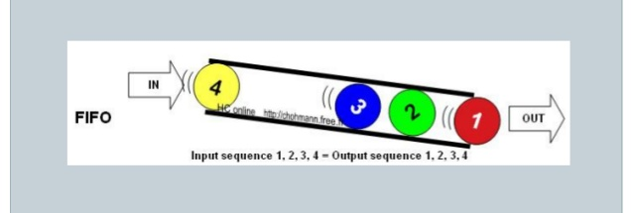
FIFO
First-in-first-out (FIFO) method

Slide 4
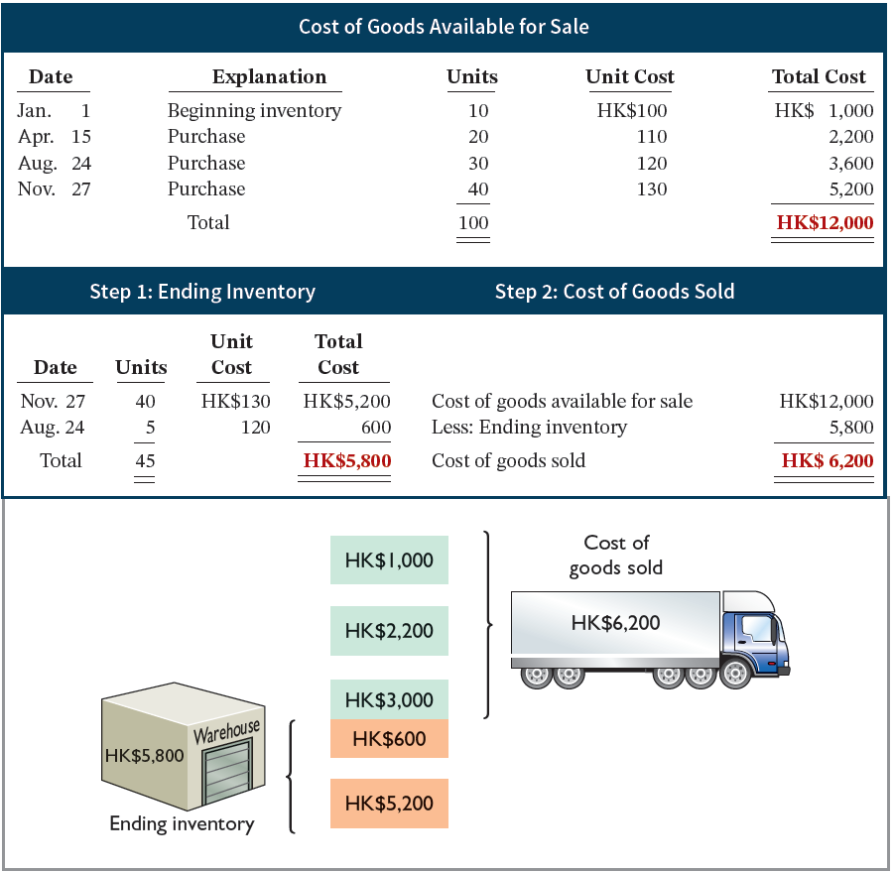
First-In, First-Out (FIFO) Allocation
The beg inventory is 10 units
At the end of the year, there are 45 units left in the inventory (i.e., sold 55 units)
L O 2
Notes:
COGS: 10* 100 + 20 * 110 + 25 * 120 = 1000 + 2200 + 3000 = 6200
Ending Inv: 40*130 + 5 * 120 = 5200 + 600 = 5800

Slide 5
Average-Cost – Illustration 6.8
Allocates cost of goods available for sale on the basis of weighted-average unit cost incurred.
Applies weighted-average unit cost to units on hand to determine cost of ending inventory.
Assumes that goods are similar in nature.
Cost of Goods Available for Sale | ÷ | Total Units Available for Sale | = | Weighted-Average Unit Cost
HK$12,000 | ÷ | 100 | = | HK$120
Illustration 6.8: Formula for weighted-average unit cost
L O 2

Slide 6
Average-Cost Allocation
Cost per item = 120
COGS (sold 55 units)
55 * 120 = 6,600
Ending Inventory (45 units in ending inventory)
45 * 120 = 5,400
Illustration 6.9: Allocation of costs─ average-cost method
L O 2

Slide 7
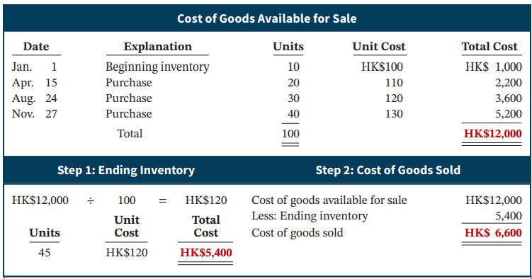
Average-Cost Allocation
Illustration 6.9: Allocation of costs─ average-cost method
L O 2

Slide 8
Account receivables
Allowance Method for Uncollectible Accounts
Companies estimate uncollectible accounts receivable at the end of each period.
Recognize bad debt expense:
Bad Debt Expense
Allowance for Doubtful Accounts (a contra-asset account)
Write off:
Allowance for Doubtful Accounts
Accounts Receivable

Slide 9
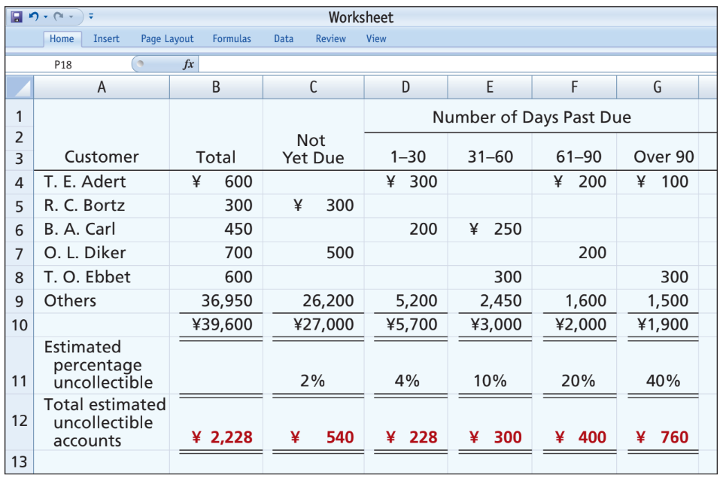
Estimating the Allowance – Aging
Percentage-of-Receivables Basis
Illustration 8.7: Aging schedule
L O 2

Slide 10
Allowance Method for Uncollectibles
Recording Estimated Uncollectibles
Illustration: Hampson Furniture has credit sales of €1,200,000 in 2025, of which €200,000 remains uncollected at December 31. The credit manager estimates that €12,000 of these receivables will be uncollectible.
Dec. 31
Bad Debt Expense 12,000
Allowance for Doubtful Accounts 12,000
L O 2

Slide 11
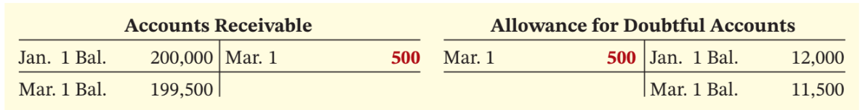
Write-off Example
Illustration: The financial vice president of Hampson Furniture authorizes a write-off of the €500 balance owed by R.A. Ware on March 1, 2026. The entry to record the write-off is as follows.
Mar. 1
Allowance for Doubtful Accounts 500
Accounts Receivable 500
Illustration 8.4: General ledger balances after write-off
L O 2

Slide 12
Depreciation Methods
Management selects the method it believes best measures an asset’s contribution to revenue over its useful life.
Examples include:
Straight-line method
Double declining-balance
Units-of-activity method
L O 2

Slide 13
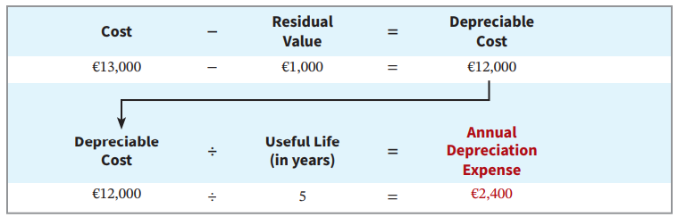
Straight-Line Method
Depreciable cost = Cost less residual value
Expense is the same amount for each year
Illustration 9.8: Formula for straight-line method
L O 2

Slide 14
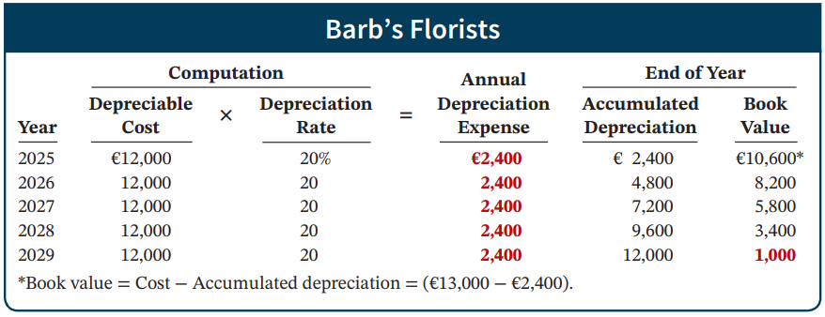
Straight-Line Method: Schedule
Illustration 9.9: Straight-line depreciation schedule
Journal entry at end of 2025:
Depreciation Expense 2,400
Accumulated Depreciation 2,400
L O 2

Slide 15
Double Declining-Balance: rate is double the straight-line rate
Declining-Balance Rate = 2 * straight line rate = 2* 20%=40%
Book Value at Beginning of Year | × | Declining-Balance Rate | = | Annual Depreciation Expense
€13,000 | × | 40% | = | €5,200
Illustration 9.12: Formula for declining-balance method
L O 2

Slide 16
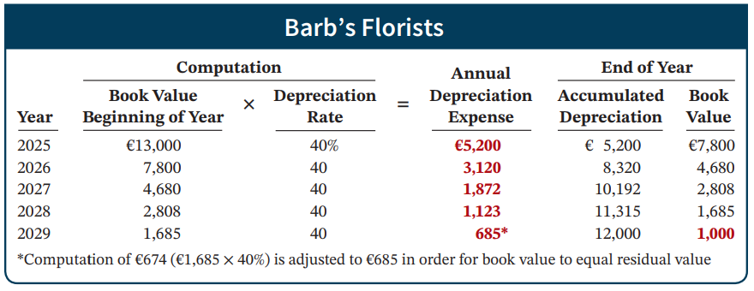
Double Declining-Balance Method Schedule
Illustration 9.13: Double-declining-balance depreciation schedule
L O 2

Slide 17
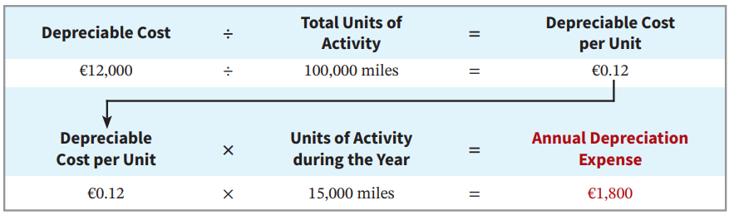
Units-of-Activity Formula
Companies estimate total units of activity to calculate depreciable cost per unit
Expense varies based on units of activity
Depreciable cost is cost less salvage value
L O 2

Slide 18
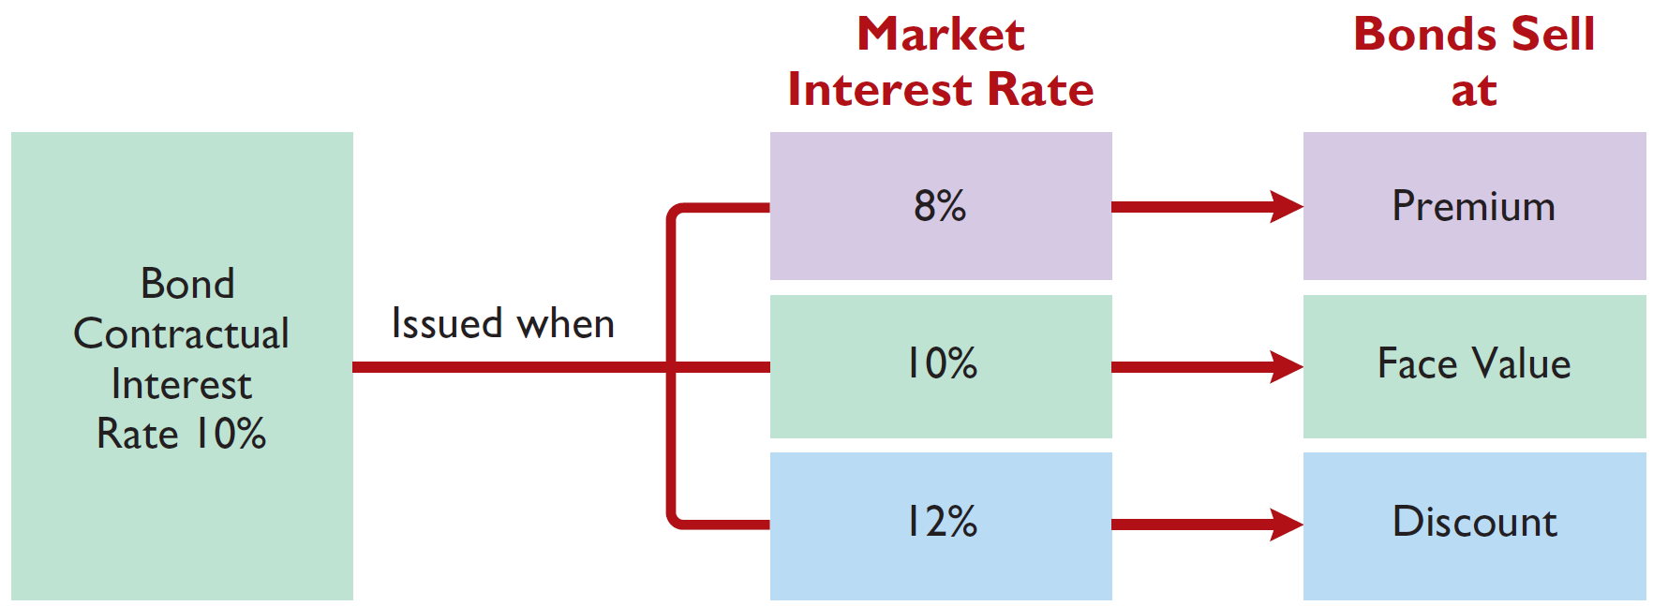
Discount or Premium on Bonds
Assume that on January 1, 2025, Candlestick AG sells €100,000 (principal value), five-year, 10% contractual rate (i.e., coupon rate) bonds for $xxx (market price)
Bond price>principal
Bond price=principal
Bond price<principal
Illustration 11.5: Interest rates and bond prices
L O 2

Slide 19
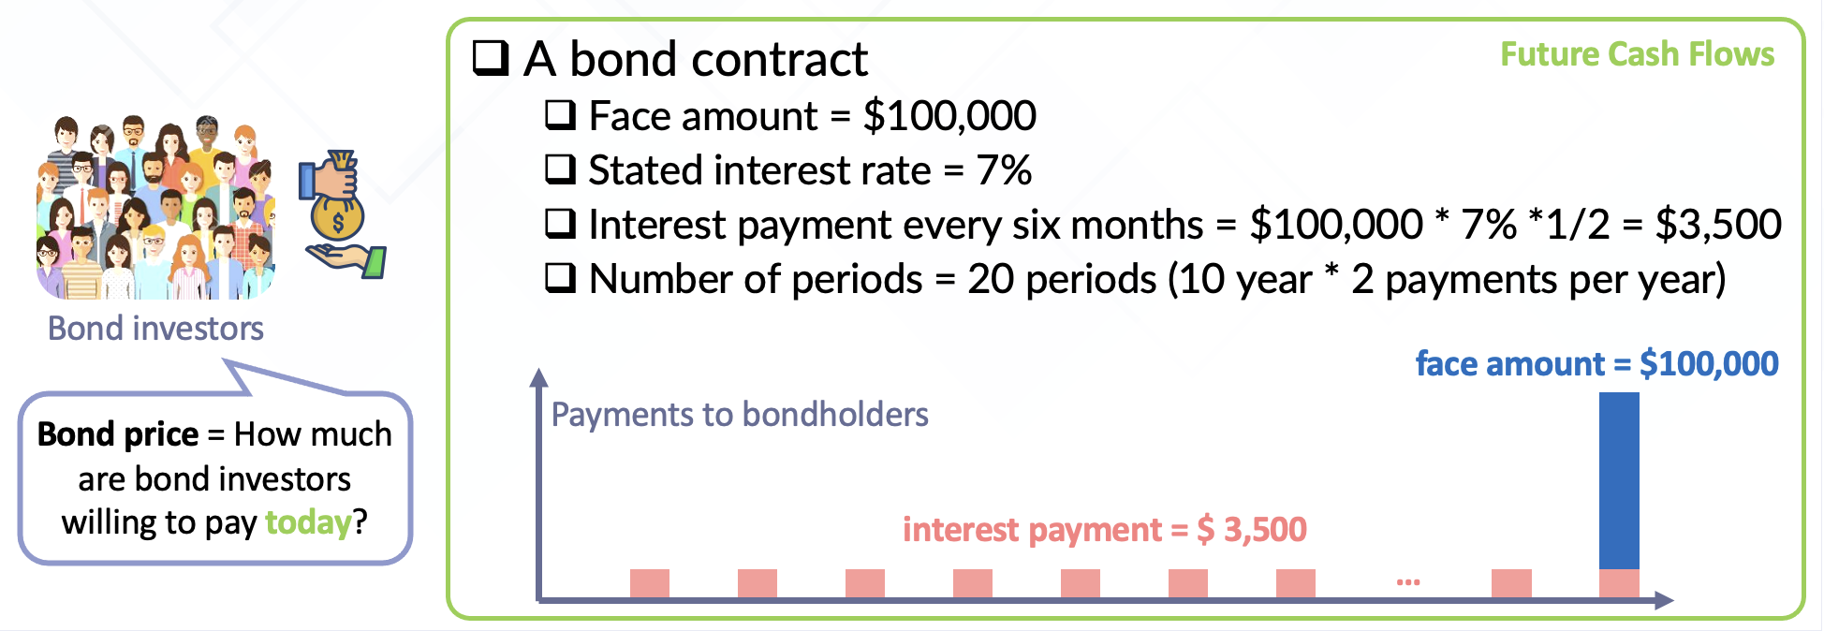
Bond Pricing Intuition
Notes:
The stated interest rate: Specified in the bond contract
Used to compute interest payments
The market interest rate: not specified in the bond contract.
Investors’ demand a higher market rate for bonds that have a higher default risk
Used to compute price of bond

Slide 20
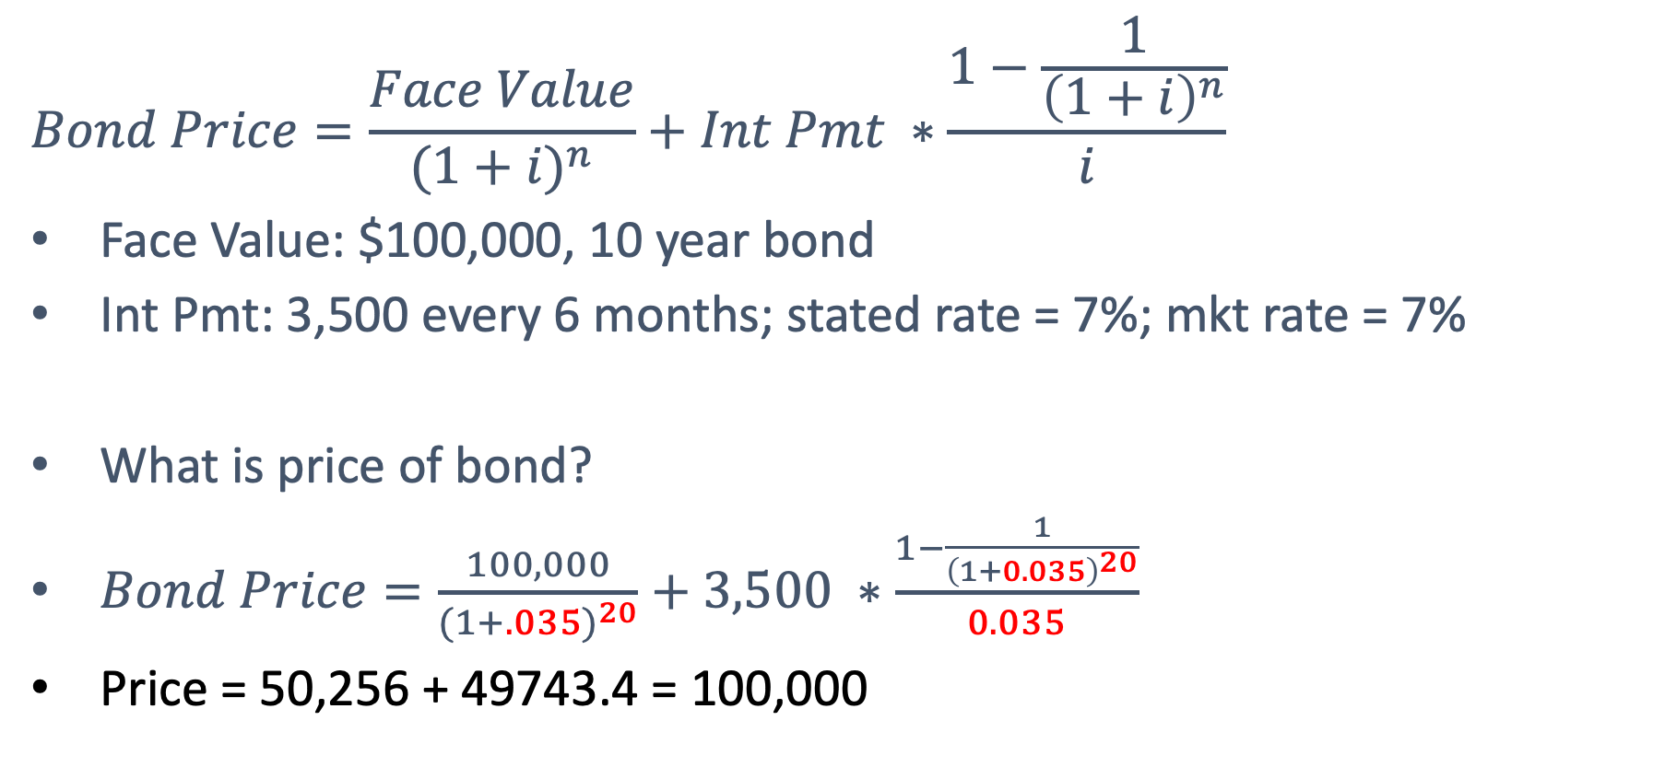
Bond Pricing (1)
$$Bond Price=\frac{Face Value}{{(1+i)}^{n}}+Int Pmt ∗\frac{1−\frac{1}{{\left(1+i\right)}^{n}}}{i}$$
Face Value: $100,000, 10 year bond
Int Pmt: 3,500 every 6 months; stated rate = 7%; mkt rate = 7%
What is price of bond?
$Bond Price=\frac{100,000}{{(1+.035)}^{20}}+3,500 ∗\frac{1−\frac{1}{{\left(1+0.035\right)}^{20}}}{0.035}$
Price = 50,256 + 49743.4 = 100,000

Slide 21
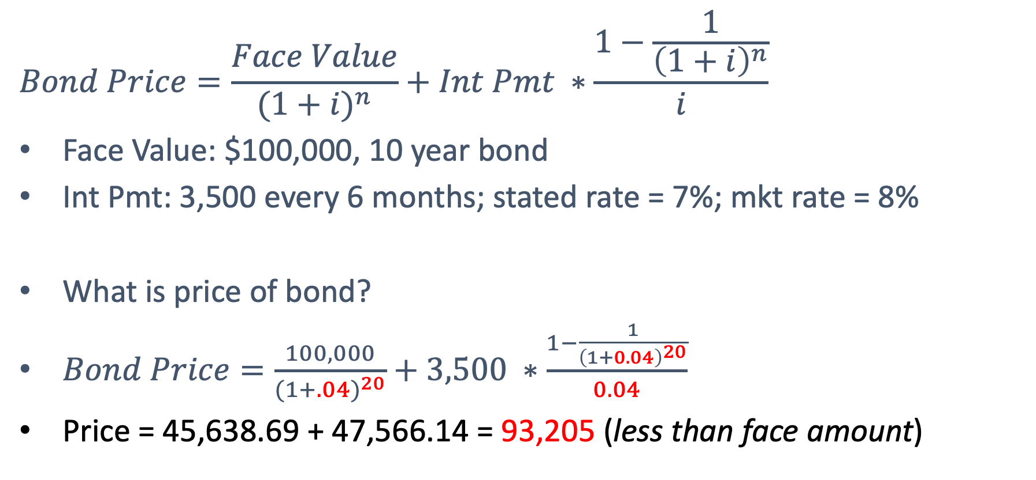
Bond Pricing (2)
$$Bond Price=\frac{Face Value}{{(1+i)}^{n}}+Int Pmt ∗\frac{1−\frac{1}{{\left(1+i\right)}^{n}}}{i}$$
Face Value: $100,000, 10 year bond
Int Pmt: 3,500 every 6 months; stated rate = 7%; mkt rate = 8%
What is price of bond?
$Bond Price=\frac{100,000}{{(1+.04)}^{20}}+3,500 ∗\frac{1−\frac{1}{{\left(1+0.04\right)}^{20}}}{0.04}$
Price = 45,638.69 + 47,566.14 = 93,205 (less than face amount)

Slide 22
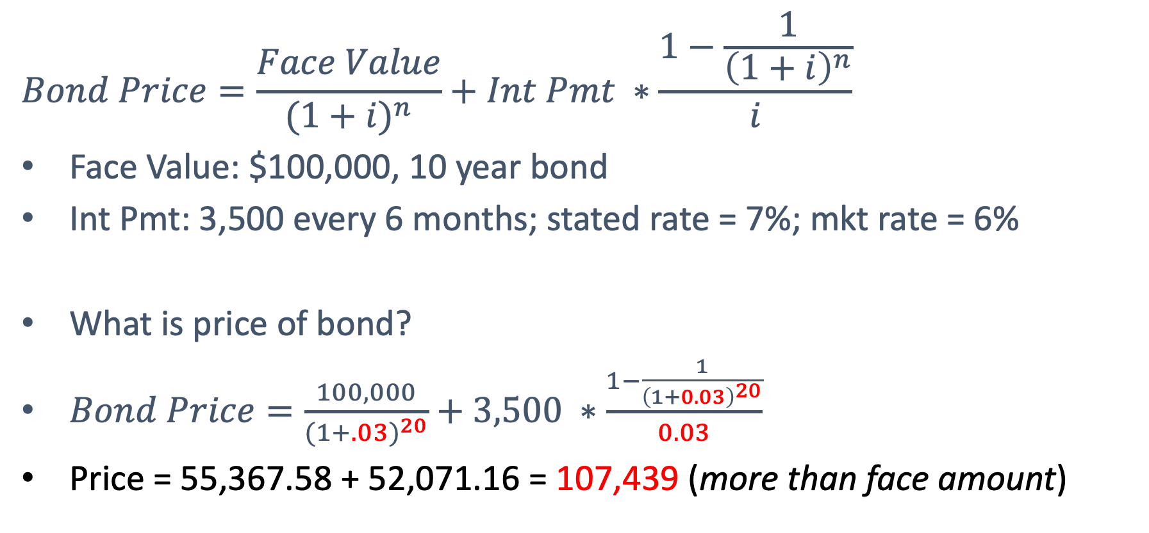
Bond Pricing (3)
$$Bond Price=\frac{Face Value}{{(1+i)}^{n}}+Int Pmt ∗\frac{1−\frac{1}{{\left(1+i\right)}^{n}}}{i}$$
Face Value: $100,000, 10 year bond
Int Pmt: 3,500 every 6 months; stated rate = 7%; mkt rate = 6%
What is price of bond?
$Bond Price=\frac{100,000}{{(1+.03)}^{20}}+3,500 ∗\frac{1−\frac{1}{{\left(1+0.03\right)}^{20}}}{0.03}$
Price = 55,367.58 + 52,071.16 = 107,439 (more than face amount)

Slide 23
Effective-Interest Method Computation
Amortization of the discount or premium results in interest expense equal to a constant percentage of the carrying value.
Illustration 11A.1: Computation of amortization─effective-interest method
L O 5

Slide 24
Amortizing Bond Discount - Journal
Illustration: Assume that on January 1, 2025, Candlestick AG sells €100,000, five-year, 10% bonds for €98,000 (98% of face value). The effective market interest rate is 10.5348%
Cash 98,000
Bonds Payable 98,000
L O 5

Slide 25
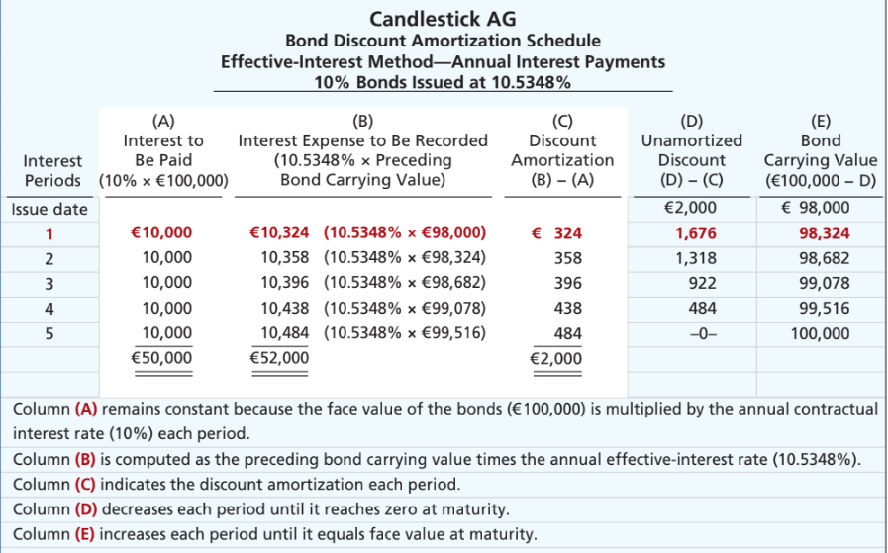
Bond Discount Amortization Schedule
Illustration 11A.2: Bond discount amortization schedule
L O 5
Notes:
Bond carrying value: On issue date, company sell at issue price of 98,000. This is how much we owe to bondholders (carrying value).
Total unamortized discount = 2000 (difference between face value and carrying value)
Interest payment (Col A): 5 payments of 10,000 in interest to bondholder.
Interest Exp (Col B): Apply market rate to the carrying amount of the bond at beginning of year. Reflects the cost of borrowing based on market conditions when bond was issued. In short, how much does company owe to bondholders.
Amortization of Discount (Col C): Since mkt rate is higher than coupon rate, int expense is more than the payment. The difference is the discount being amortized for the year. We are not paying enough. We owe more money to bondholders. We owe more, so carrying value is increased.
Carrying value (Col E): Increases by the amortized discount each year. By end of term, carrying amount equals face value.
Carrying value of bonds at beginning:
Carrying value is initially reported at issuance price (98,000)… liability as Bond Payable. Over time, it is adjusted for amortization, in this case, portion of discount is recognized as expense. Thus, carrying value increases. Think of bond discount as a deferred cost … we are spreading out the discount over the life of the bond. When we recognize the deferred cost each year, the carrying value (i.e., liability) increases until it matches the amount that will be paid in maturity.
Difference between interest to be paid (10,000 per year) and interest expense, we get discount.

Slide 26
Amortizing Bond Discount - Journal
Illustration: Candlestick AG records the accrual of interest and amortization of bond discount on Dec. 31, as follows:
Year 1 Dec. 31
Interest Expense 10,324
Bonds Payable 324
Interest Payable 10,000
Step 1. Interest Expense = carrying value at the beg period (98,000) * effective market interest rate (10.5348%)=10324
Step 2. Interest paid: face value * contractual rate =10,000
Step 3. Amortization: 324
L O 5

Slide 27
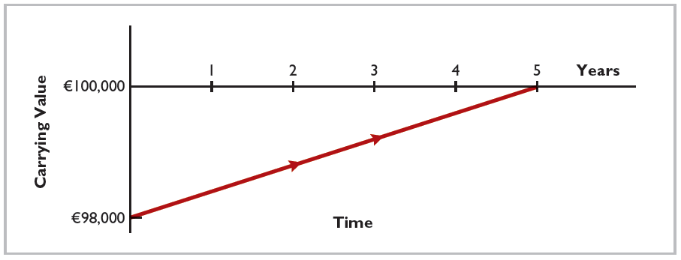
Amortization of Bond Discount
Illustration 11.9: Amortization of bond discount
L O 2

Slide 28
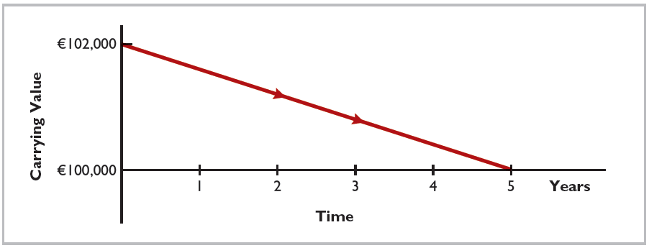
Amortization of Bond Premium
Illustration 11.13: Amortization of bond premium
L O 2

Slide 29
Excise: cash flow (also in slides Ch 14)
Use the following Comparative Statements of Financial Position, Income Statement, and additional information to prepare a statement of cash flows using the indirect method.
Additional information (all amounts in thousands of NT$):
Operating expenses include depreciation expense of NT$33,000. (CFO)
Equipment with a cost of NT$41,000 and a book value of NT$36,000 was sold for NT$34,000 cash. (CIO)
Land was sold at its book value for cash. (CIO)
Interest expense of NT$12,000 was paid in cash. (CFO)
Equipment with a cost of NT$166,000 was purchased for cash. (CIO)
Bonds of NT$10,000 were redeemed at their face value for cash. (CFF)
Ordinary shares (NT$1 par) of NT$130,000 were issued for cash. (CFF)
Cash dividends of NT$55,000 were declared and paid in 2025. (CFF)
Ordinary shares of NT$30,000 were issued in exchange for land. (no effects)
L O 2

Slide 30
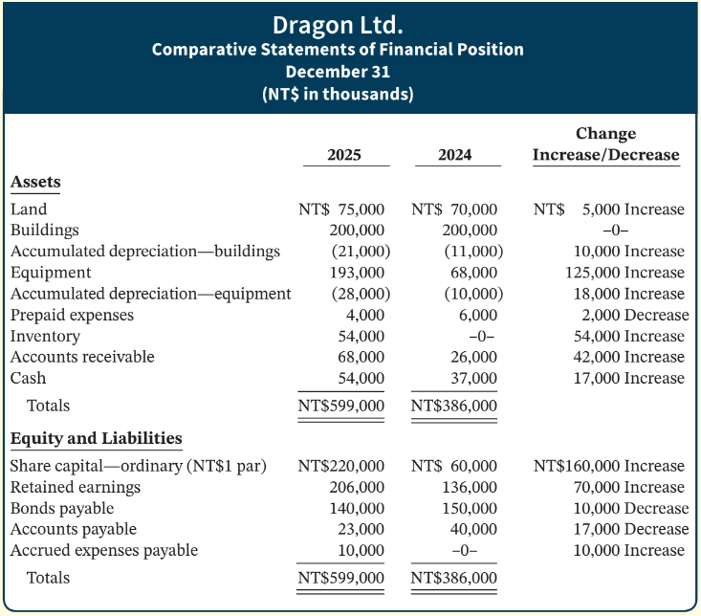
Excise: cash flow (also in slides Ch 14)
L O 2

Slide 31
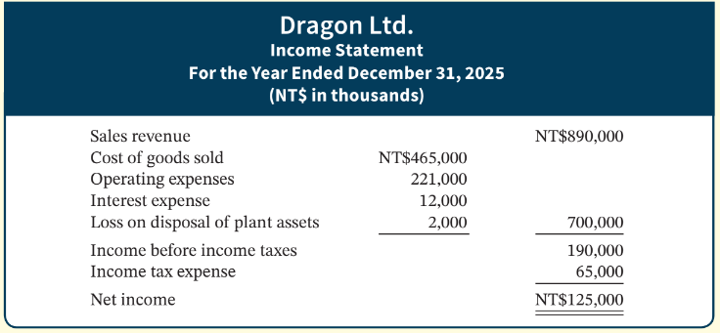
Excise: Indirect Method (also in slides Ch 14)
L O 2

Slide 32
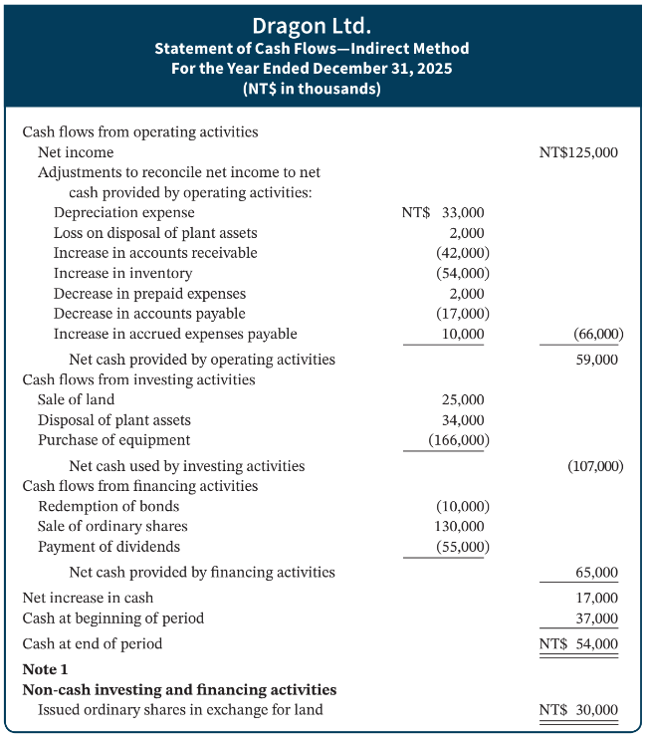
DO IT! 2b - Solution
L O 2

Slide 33
Chapter 15 Ratio analysis

Slide 34
Summary of Ratios – Liquidity
Ratio | Formula | Purpose or Use
Liquidity Ratios
Current ratio |  | Measures short-term debt-paying ability.
Acid-test (quick) ratio |  | Measures immediate short-term liquidity.
Accounts receivable turnover |  | Measures liquidity of accounts receivable.
Inventory turnover |  | Measures liquidity of inventory.
Illustration 15.26 (partial): Summary of liquidity, profitability, and solvency ratios
L O 2

Slide 35
Summary of Ratios – Profitability
Profitability Ratios
Profit margin |  | Measures net income generated by each currency unit of sales.
Asset turnover |  | Measures how efficiently assets are used to generate sales.
Return on assets |  | Measures overall profitability of assets.
Return on ordinary shareholders’ equity |  | Measures profitability of owners’ investment.
Earnings per share (EPS) |  | Measures net income earned on each ordinary share.
Price-earnings (P-E) ratio |  | Measures the ratio of the market price per share to earnings per share.
Payout ratio |  | Measures percentage of earnings distributed in the form of cash dividends.
Illustration 15.26 (partial): Summary of liquidity, profitability, and solvency ratios
L O 2

Slide 36
Summary of Ratios – Solvency
Solvency Ratios
Debt to assets ratio |  | Measures the percentage of total assets provided by creditors.
Times interest earned |  | Measures ability to meet interest payments as they come due.
Illustration 15.26 (partial): Summary of liquidity, profitability, and solvency ratios
L O 2

Slide 37
Good luck on finals!
Thank you and keep in touch!

