Slide 1


CS 556 Midterm Project
Efficient Multigrid Solutions for 3D Poisson Problems
Jiong Chen, Yue Yuan
2024/11/21

Slide 2



Brief Intro to Problem
3D Poisson Problem
Discrete Form
Au=f
FDM:
ELECTRICAL & COMPUTER ENGINEERING
GRAINGER ENGINEERING

Slide 3








V-cycle Multigrid Workflow
ELECTRICAL & COMPUTER ENGINEERING
GRAINGER ENGINEERING

Slide 4
Methodology
V-cycle Multigrid Smoother
Damped-Jacobi smoother
Chebyshev smoother (1-st kind)
Chebyshev smoother (4-th kind)
V-cycle Multigrid + PCG
Algebraic Multigrid
ELECTRICAL & COMPUTER ENGINEERING
GRAINGER ENGINEERING

Slide 5
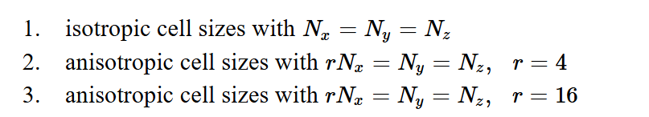

Experiments Setting
Different Mesh Type
Different Mesh Size
Different Smoother
Damped-Jacobi smoother
Chebyshev smoother (1-st kind)
Chebyshev smoother (4-th kind)
ELECTRICAL & COMPUTER ENGINEERING
GRAINGER ENGINEERING

Slide 6


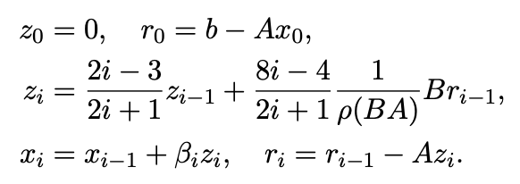
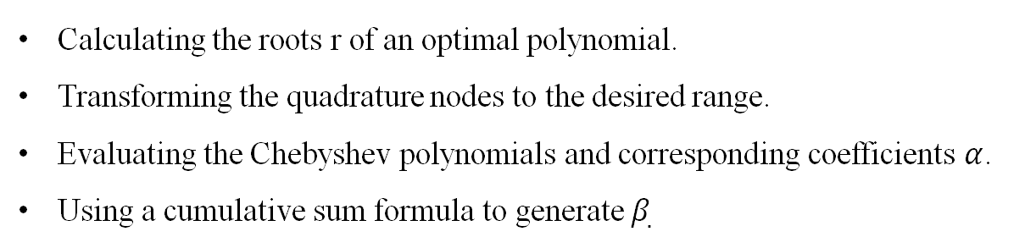

Multigrid Smoother
Chebyshev smoother (4-th kind)
Upper portion
Avoid $λ^{∗}$?
Optimal Bounds!
Calculating the roots r of an optimal polynomial.
Transforming the quadrature nodes to the desired range.
Evaluating the Chebyshev polynomials and corresponding coefficients $α$.
Using a cumulative sum formula to generate $β_{.}$
Lottes, J. (2023). Optimal polynomial smoothers for multigrid V‐cycles. Numerical Linear Algebra with Applications, 30(6), e2518.
ELECTRICAL & COMPUTER ENGINEERING
GRAINGER ENGINEERING

Slide 7
Multigrid Smoother -- Result
ELECTRICAL & COMPUTER ENGINEERING
GRAINGER ENGINEERING

Slide 8
V-cycle Multigrid + PCG
V-cycle Multigrid provides approximate solution of Ae = r
Use V-cycle Multigrid to suggest the new dimension in conjugate gradient method
CG eliminates the low-frequency error better
The number of iteration needed shrinks
ELECTRICAL & COMPUTER ENGINEERING
GRAINGER ENGINEERING

Slide 9
V-cycle Multigrid + PCG -- Result
ELECTRICAL & COMPUTER ENGINEERING
GRAINGER ENGINEERING

Slide 10
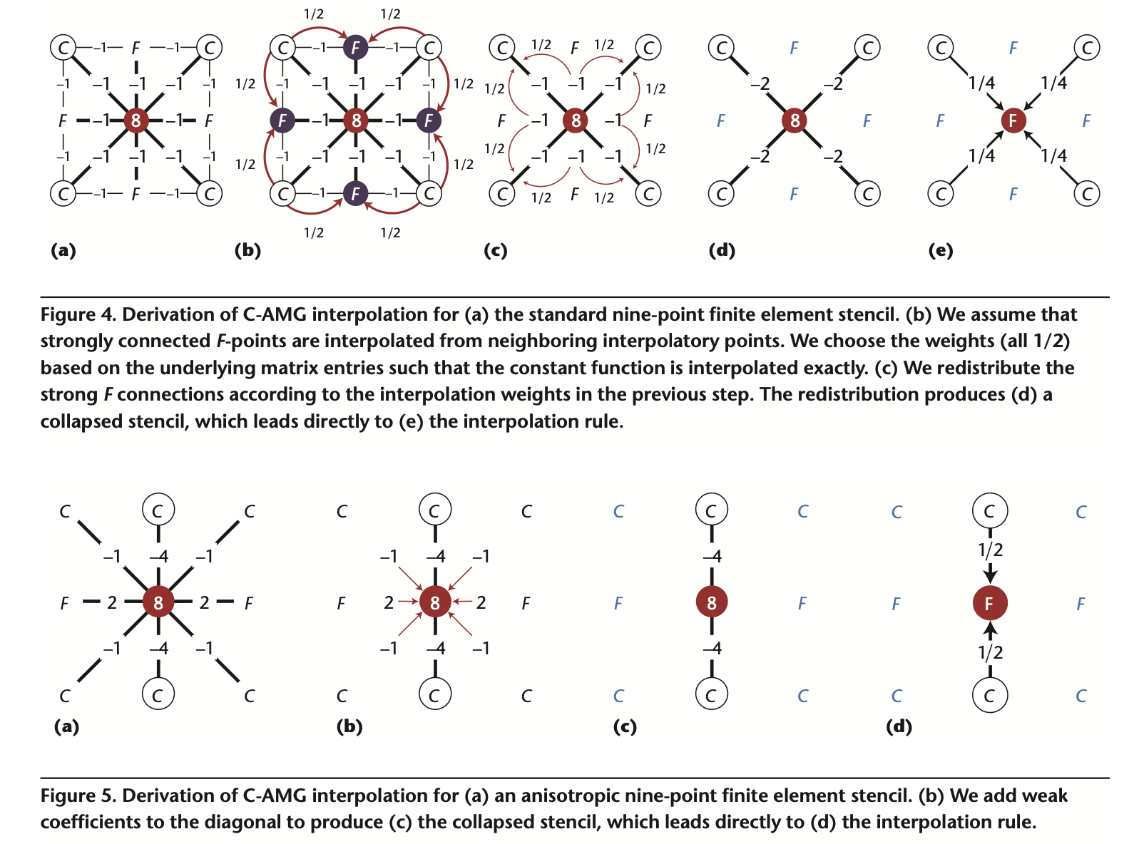
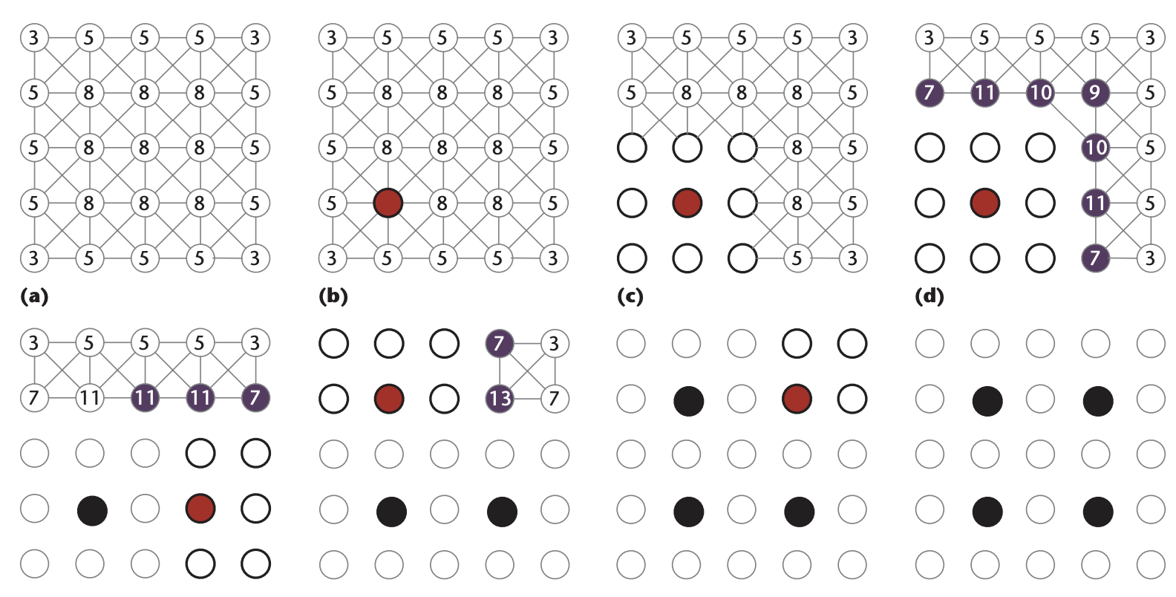

Algebraic Multigrid
Without geometric grid required
“Collapsing the stencil”
How to obtain $R$, $A^{c}$? C-AMG
R. D. Falgout, "An introduction to algebraic multigrid," in Computing in Science & Engineering, vol. 8, no. 6, pp. 24-33, Nov.-Dec. 2006,
https://github.com/EnigmaHuang/Classic_AMG_Demo
ELECTRICAL & COMPUTER ENGINEERING
GRAINGER ENGINEERING

Slide 11
Algebraic Multigrid -- Result
Iteration Number
Isotropic | without KSP
Nx | damped-Jacobi | Cheb1 | Cheb4 | AMG-Jacobi | AMG-Cheb1 | AMG-Cheb4
4 | 2 | 2 | 3 | 2 | 2 | 4
8 | 4 | 5 | 5 | 3 | 3 | 5
16 | 13 | 16 | 5 | 4 | 4 | 5
32 | 51 | 53 | 6 | 5 | 4 | 5
64 | 202 | 173 | 18
Time
Isotropic | without KSP
Nx | damped-Jacobi | Cheb1 | Cheb4 | AMG-Jacobi | AMG-Cheb1 | AMG-Cheb4
4 | 0.0034292 | 0.0034357 | 0.0093333 | 0.0027 | 0.0093 | 0.0008
8 | 0.0041302 | 0.0061889 | 0.0073353 | 0.0037 | 0.0056 | 0.003
16 | 0.042043 | 0.052367 | 0.016385 | 0.0159 | 0.0176 | 0.0174
32 | 1.2026 | 1.289 | 0.15687 | 0.2113 | 0.1619 | 0.1918
64 | 65.2581 | 59.7655 | 6.1412
Iteration Number
Anisotropic r= 4 | without KSP
Nx | damped-Jacobi | Cheb1 | Cheb4 | AMG-Jacobi | AMG-Cheb1 | AMG-Cheb4
4 | 9 | 12 | 5 | 5 | 6 | 5
8 | 34 | 38 | 7 | 7 | 8 | 5
16 | 134 | 125 | 12
32 | 542 | 408 | 51
Time
Anisotropic r= 4 | without KSP
Nx | damped-Jacobi | Cheb1 | Cheb4 | AMG-Jacobi | AMG-Cheb1 | AMG-Cheb4
4 | 0.01233 | 0.014797 | 0.007826 | 0.0047 | 0.0053 | 0.0131
8 | 0.1891 | 0.24746 | 0.03607 | 0.0499 | 0.0564 | 0.0555
16 | 7.4168 | 6.44366 | 0.70411
32 | 386.9949 | 270.5751 | 32.5197
Consistent iteration number.
Shorter duration of v-cycle.
ELECTRICAL & COMPUTER ENGINEERING
GRAINGER ENGINEERING

Slide 12
V-cycle Multigrid vs FDM
ELECTRICAL & COMPUTER ENGINEERING
GRAINGER ENGINEERING

Slide 13
Conclusion
Implementation:
V-cycle Multigrid Smoother
Damped-Jacobi smoother
Chebyshev smoother (1-st kind)
Chebyshev smoother (4-th kind)
V-cycle Multigrid + PCG
Algebraic Multigrid
With C-AMG, iteration number are ~constant for all size problems
With optimal bounds, 4th order Chebyshev out-performs the other smoothers.
C-AMG: coarse matrix generation and interpolation method can be improved for large matrices.
ELECTRICAL & COMPUTER ENGINEERING
GRAINGER ENGINEERING

Slide 14
Thank you!
Question?
Jiong Chen, Yue Yuan
ELECTRICAL & COMPUTER ENGINEERING
GRAINGER ENGINEERING

