Slide 1
Optical Recognition
of Handwritten Digits
Presentation by: LY Sovanleng and THUO Menghor

Slide 2
Table of contents
01
02
03
04
Introduction
K-means Model
Hierarchical Model
Conclusion

Slide 3
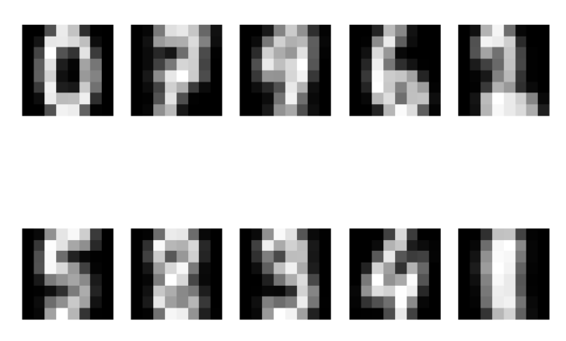
Introduction
Optical Recognition of Handwritten Digits Data Set
43 people
Optdigits.tra : 30 people
Optdigits.tes : 13 people
The data set contains:
64 features : range 0,…,16
1 target variable : class code 0,..,9
Notes:
We are working on the Optical Recognition of Handwritten Digits Dataset which is contributed by a totalof 43 people, 30 contributed to the training dataset and different 13 to the test set. The dataset contains 64 feature that has integer type in the range 0..16, and the last attribute which is the target variable is the class code 0..9

Slide 4
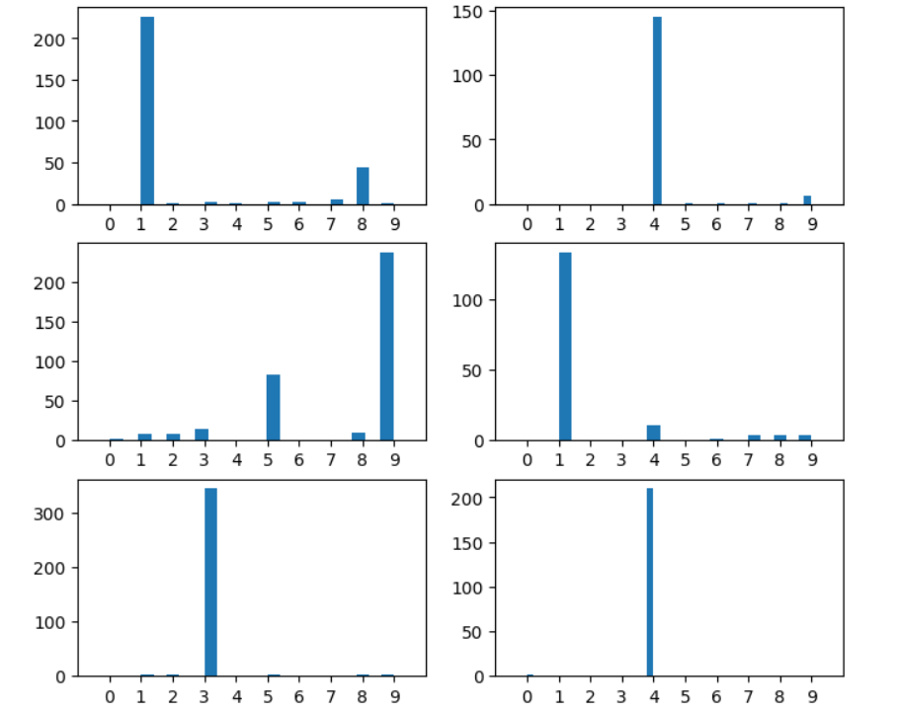
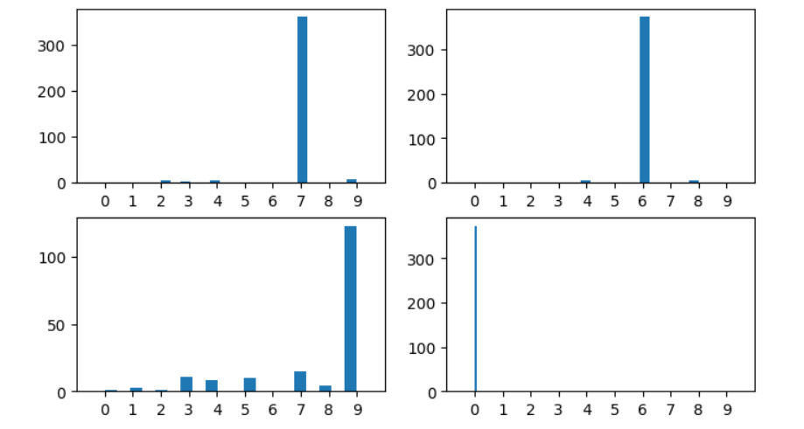
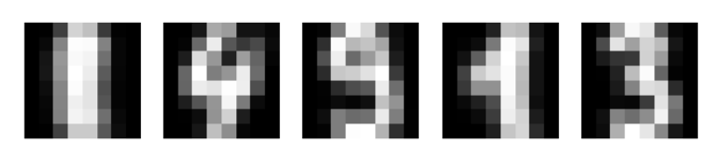

Training Dataset
Notes:
First, we are working on training dataset, by using K-mean model, we cluster the data into 10 cluster, like you can see, we have 10 histogram of each cluster which show the frequency of each class in each cluster, for the first cluster(pic1) the class that has the most frequecy, which mean it’s the best represent of this cluster in class1. However, we also notice that it’s mix with a few data from class 8.. If we take a look at the image, we can see that some cluster represent well by the a class, for example the last histogram witch represent by class 0, whereas the third histogram(seconde left), even though it best represent by class 9, it still confuse by class 5 which is also appear in this cluster.

Slide 5
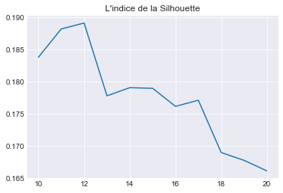
Training Dataset
Silhouette index: 0.1891
The best clustering K = 12
Notes:
Now, we are trying to find the best K by calculate the Silhouette index of the model between 10 to 20 cluster. As result, the best number of cluster is 13 with the maximum value of the Silhouette Index.

Slide 6
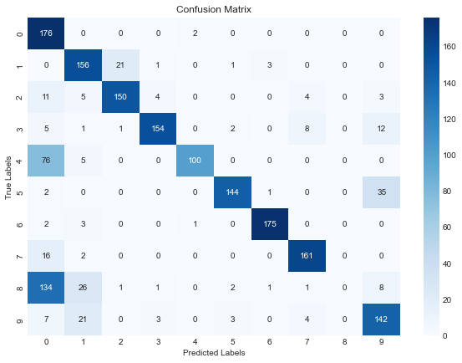
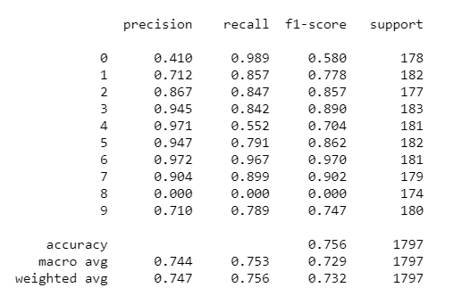
Testing Dataset
Cluster k=12
Notes:
We classify the testing dataset by using the model that we train by the training dataset by searching for the nearest clustering for each point of the testing dataset and give the label base on the label of that nearest cluster. As a result, we get the confusion matrix which can show the performance of our model. The model seem to to well on class 0,...

Slide 7
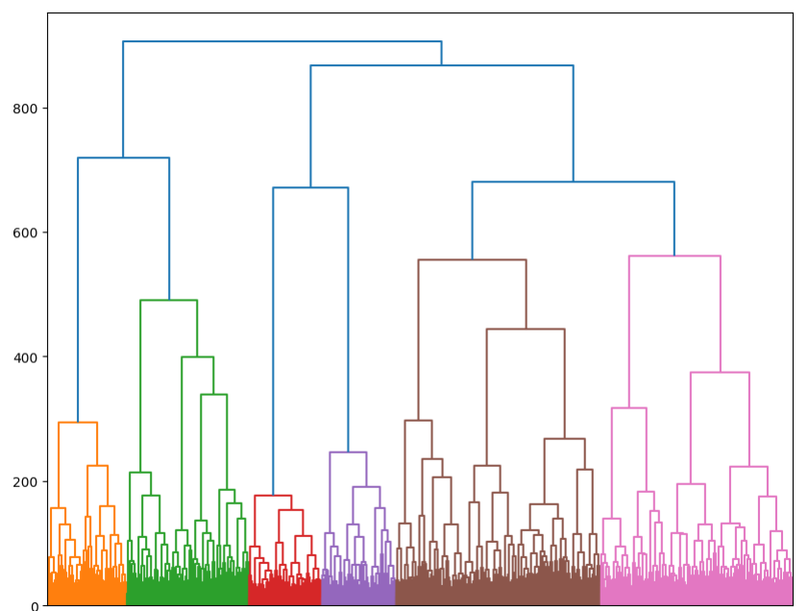
Hierarchical Clustering
Dendrogram

Slide 8
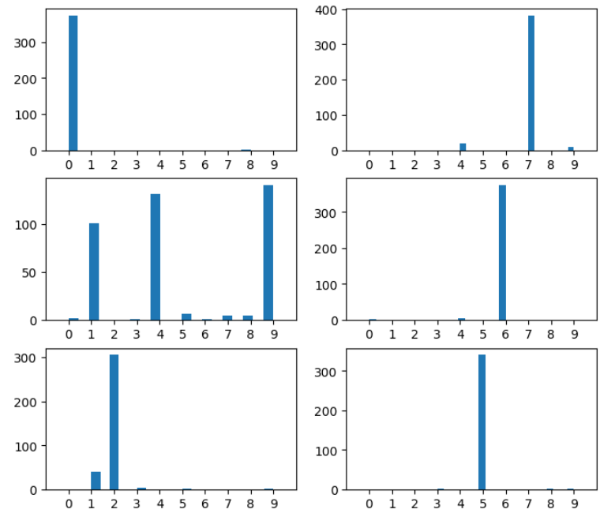
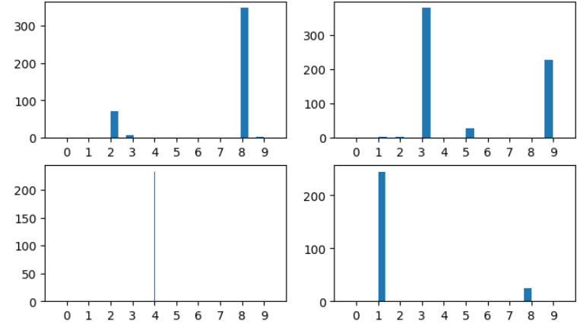


Training Dataset

Slide 9
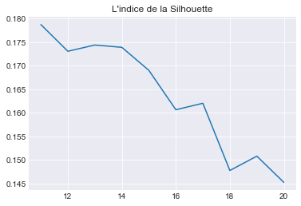
Training Dataset
Silhouette index: 0.1787
The best clustering K = 11

Slide 10
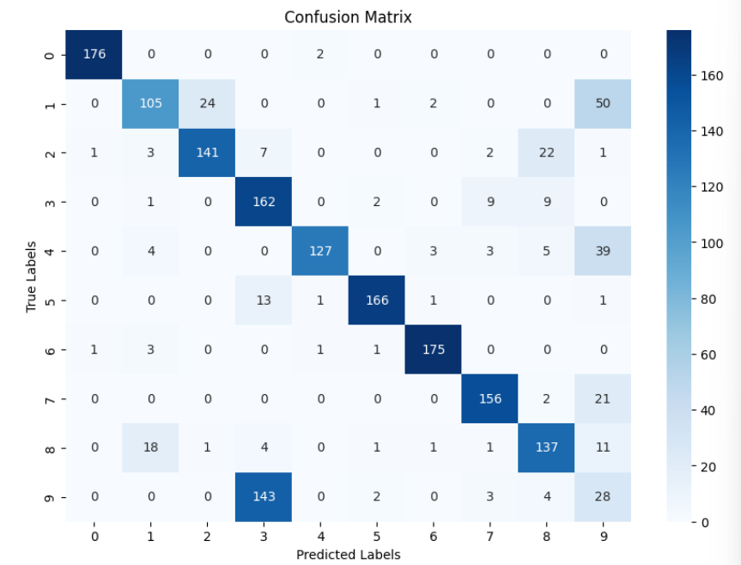
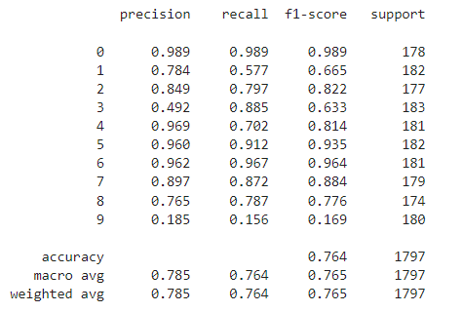
Testing Dataset
Cluster k=10
Notes:
Silhouette Score: This metric can help assess how well the clusters are formed. And the best K determined based on maximum silhouette score.

Slide 11
Conclusion
K-means Model
Hierarchical Model
Accuracy = 0.756
Accuracy = 0.764
Silhouette index: 0.1891
Silhouette index: 0.1787
Notes:
K-mean: affect by the initialisation
Hierarchical : not affected by the initialisation
Hierarchical clustering provides slightly better accuracy and is more robust against initialization issues.
The optimal number of clusters and the Silhouette index are crucial for determining the best clustering solution.

Slide 12
Thank You
Q&A

