Slide 1
Part 2: Creating a map to check whether parking slots are empty
It is difficult to find a recording video in the public parking lot.
In order to simulate the project, we just use 4 images including
14 parking slots and some vehicles in different locations.

Slide 2
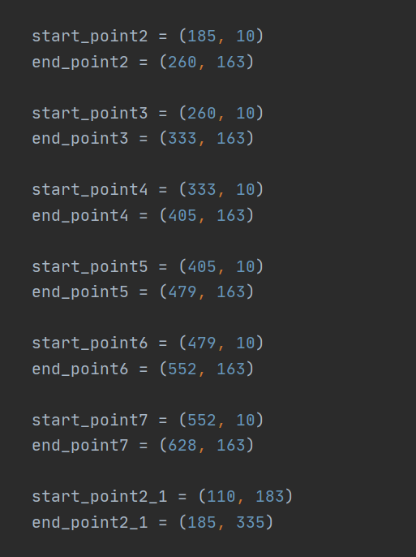
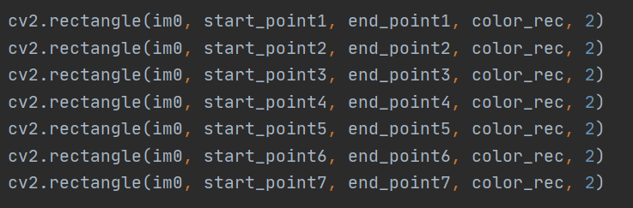
In order to achieve mapping, I firstly draw 14 bounding boxes in the 640x320 video recording camera view. Those 14 bounding boxes positions are fixed. Each boxes would have their own coordinate

Slide 3
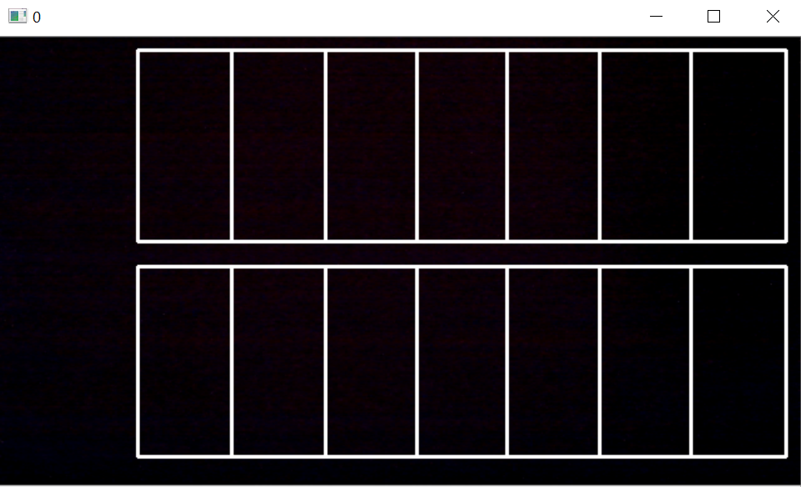
Those bounding boxes would be used to match the parking slots to see whether a car is inside the bounding boxes

Slide 4
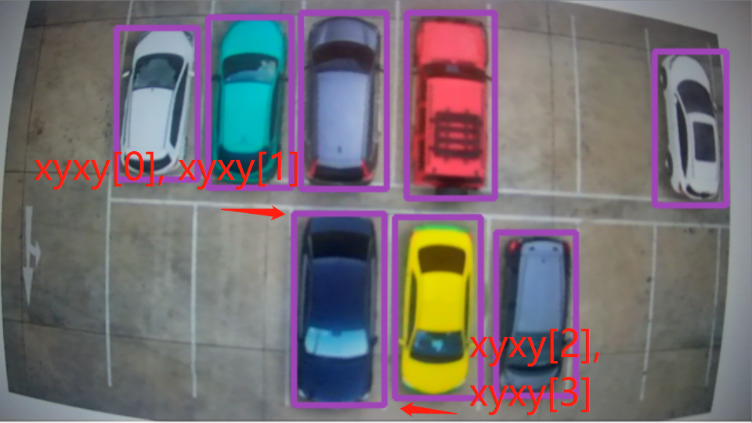
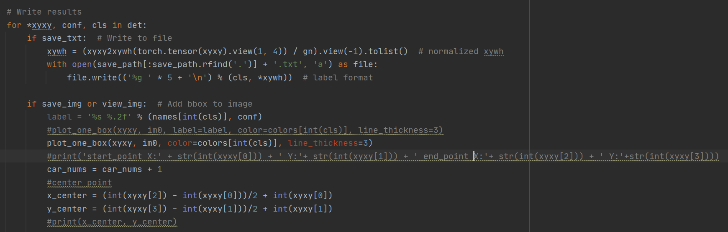
Inside the detect() function, when the algorithm detects the vehicle objects in the video. The vehicle pixel locations (x, y) are stored in the det.
In this for loop, xyxy[] which is obtained from det object is the pixel location corresponding to each detected vehicle.
Obtain their center point

Slide 5
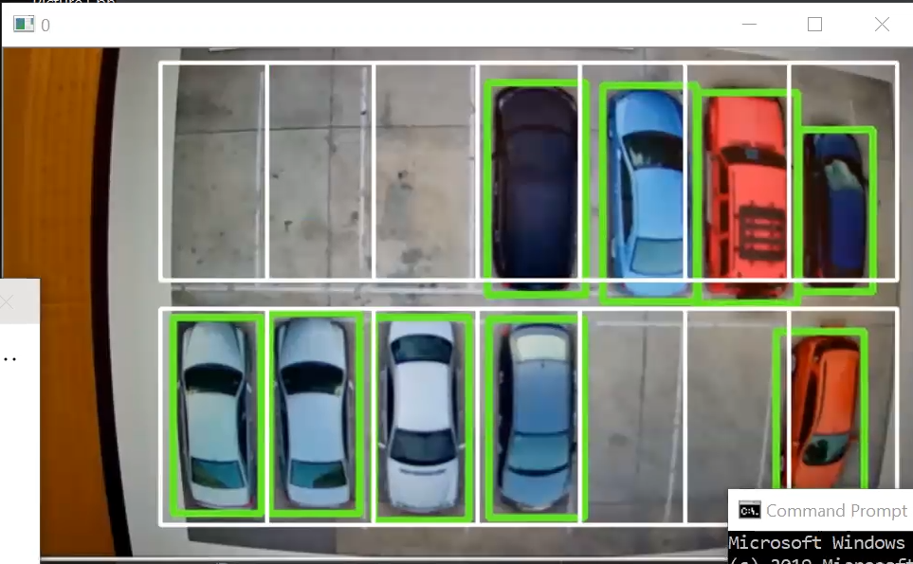
Check their center points to see if they are inside the bounding boxes.
The park_nums[0-13] array is used to recording whether the parking slots are occurred.

Slide 6
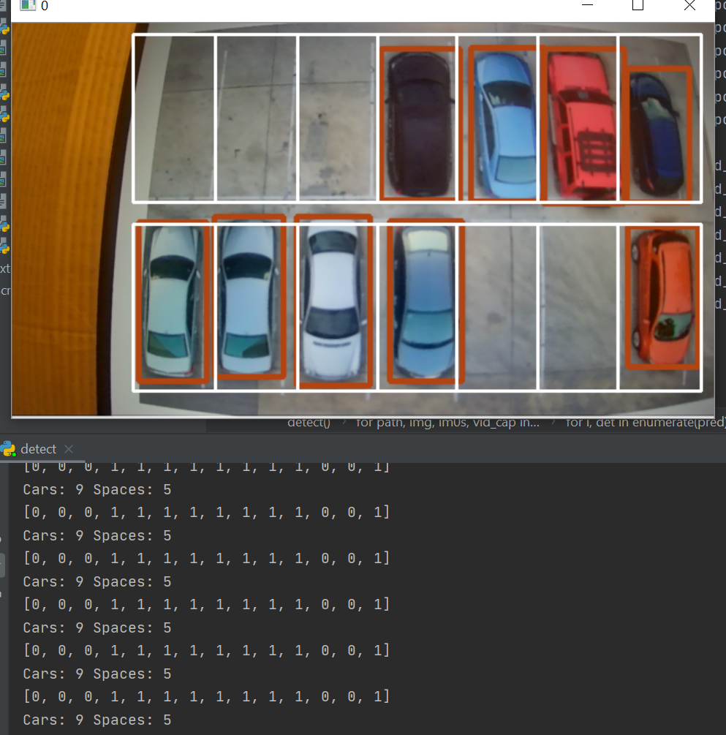
In this case, from the image, we can see that there 5 parking slots are empty. In the terminal,
It is printing out the message showing that the first three, and second and third last parking slots are empty. The rest of parking slots are occurred. 0 represents the empty parking slots, and 1 represents the occurred parking slots.
There are total 9 cars and 5 spaces in this case.

Slide 7
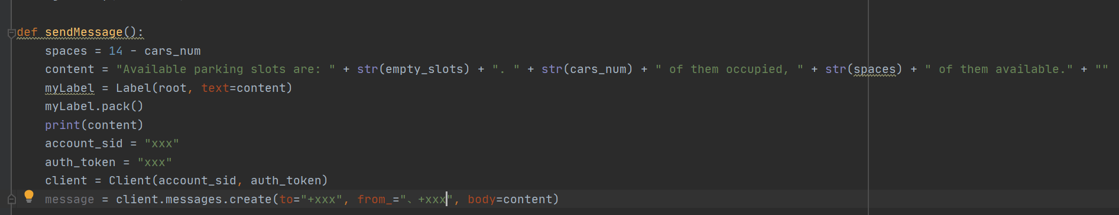
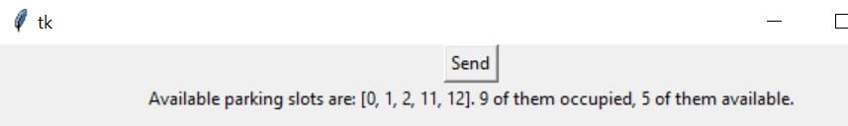
Part 3: Sending message to Phone
Using twilio to send message to phone
Creating a button to send message when pressing

Slide 8
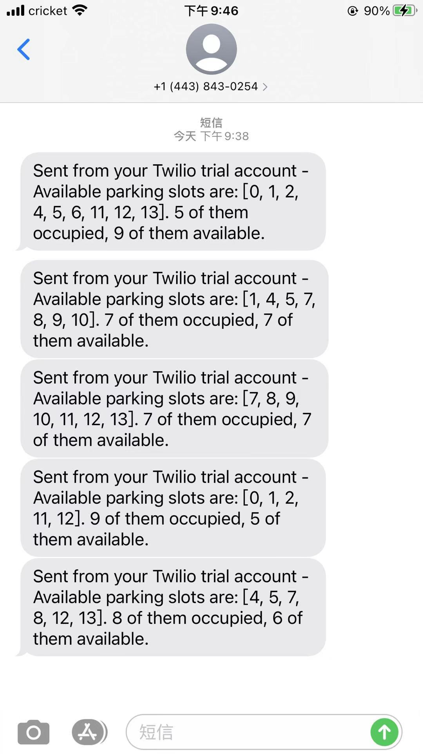
Receiving message
Once I clicked the button, phone would receive a message including the parking space information

Slide 9
Demo
https://youtu.be/imCjEio-sbw

Slide 10
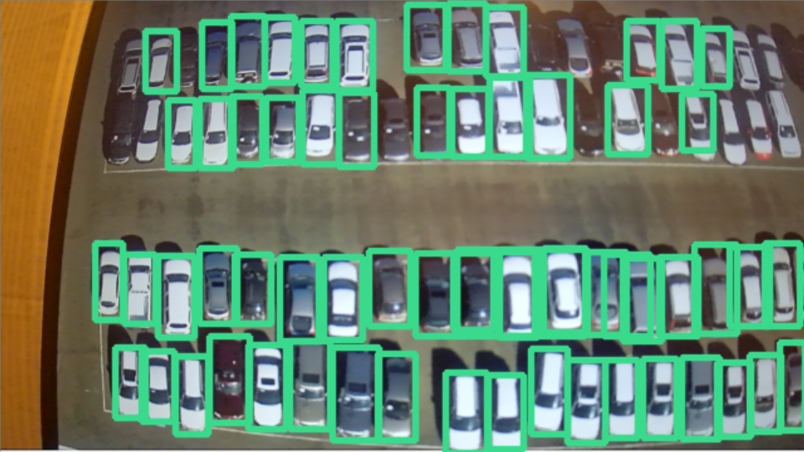
Summary
In this project, it has good prediction on a smaller scale of parking lot such as the demo that we showed.
Testing on larger scale of parking lot would require a lot of images to train in order to get a good prediction result. It is time consuming on training the model. In addition, the training should include different angel of car view. In our project, the training data set only includes the top view of cars.
Due to the limitation of camera, the edges of the image recorded by camera are curved, which would affect the prediction.
It would need a lot of time to create bounding boxes to achieve mapping on the larger scale of parking lots.
The system should work on the outdoor parking lots because the cameras will be equipped at the top of place to get the top view images. Each camera should be able to detect more than 100 parking slots, and it only needs few cameras to capture the whole parking lot.
Due to the higher performance of CNN model, it is hard to affect the system by external factors such as weather and shopping carts.
The system can provide useful message to people to find an available parking slot in large outdoor parking lot during the peak time.

