Slide 1
Creating a map to check whether parking slots are empty
It is difficult to find a recording video in the public parking lot.
In order to simulate the project, we just use 4 images including
14 parking slots and some vehicles in different locations.

Slide 2
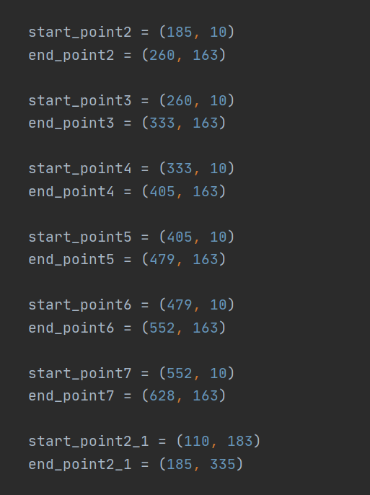
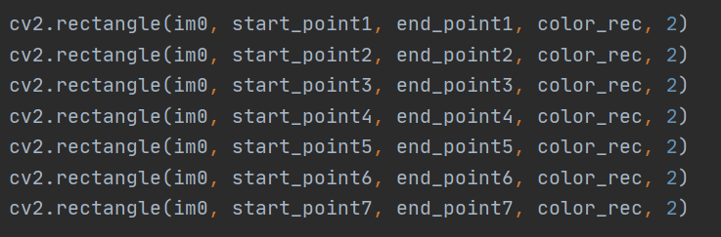
In order to achieve mapping, I firstly draw 14 bounding boxes in the 640x320 video recording camera view. Those 14 bounding boxes positions are fixed. Each boxes would have their own coordinate

Slide 3
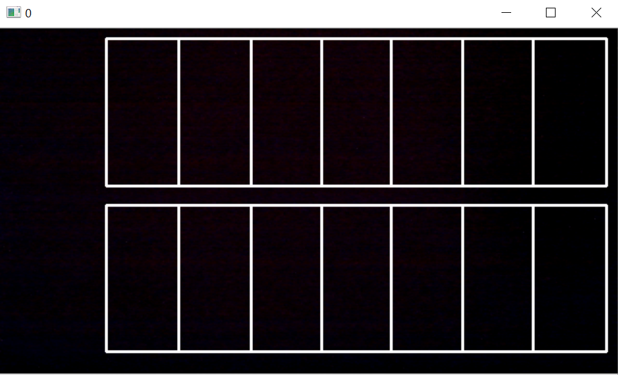
Those bounding boxes would be used to match the parking slots to see whether a car is inside the bounding boxes

Slide 4
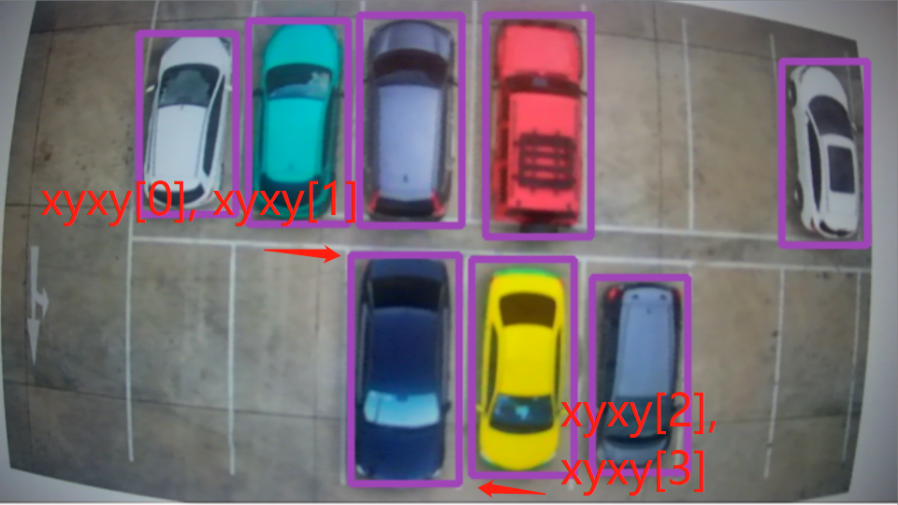
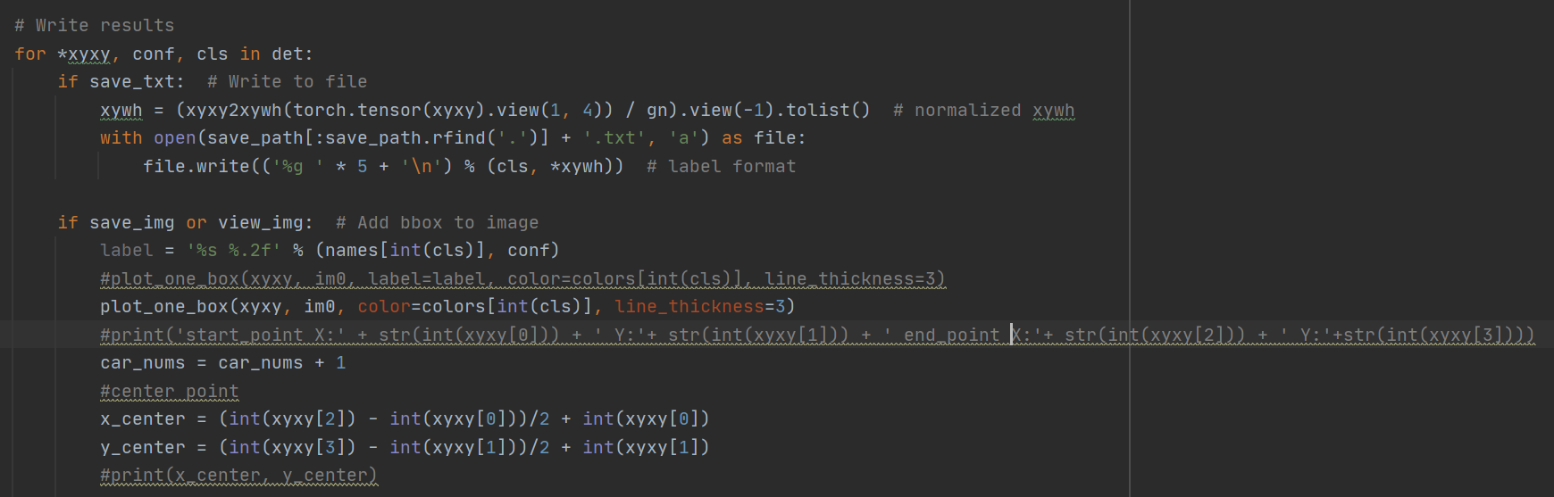
Inside the detect() function, once it detects the vehicle objects in the video. The vehicle pixel locations (x, y) are stored in the det.
In this for loop, xyxy[] which is obtained from det object is the pixel location corresponding to the detected vehicle.
Obtain their center point

Slide 5
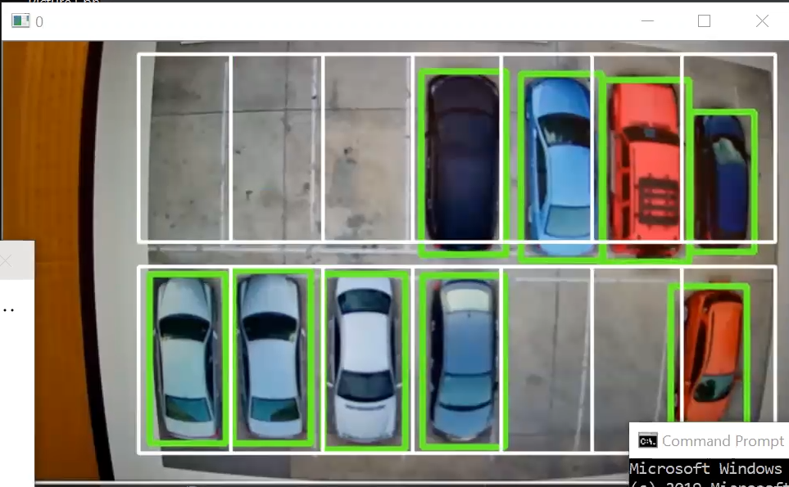
Check their center point to see if it is inside the bounding boxes.
The park_nums[0-13] array is used to recording whether the parking slots are occurred.

Slide 6
Demo

