Slide 1
Outdoor Smart Parking System

Slide 2
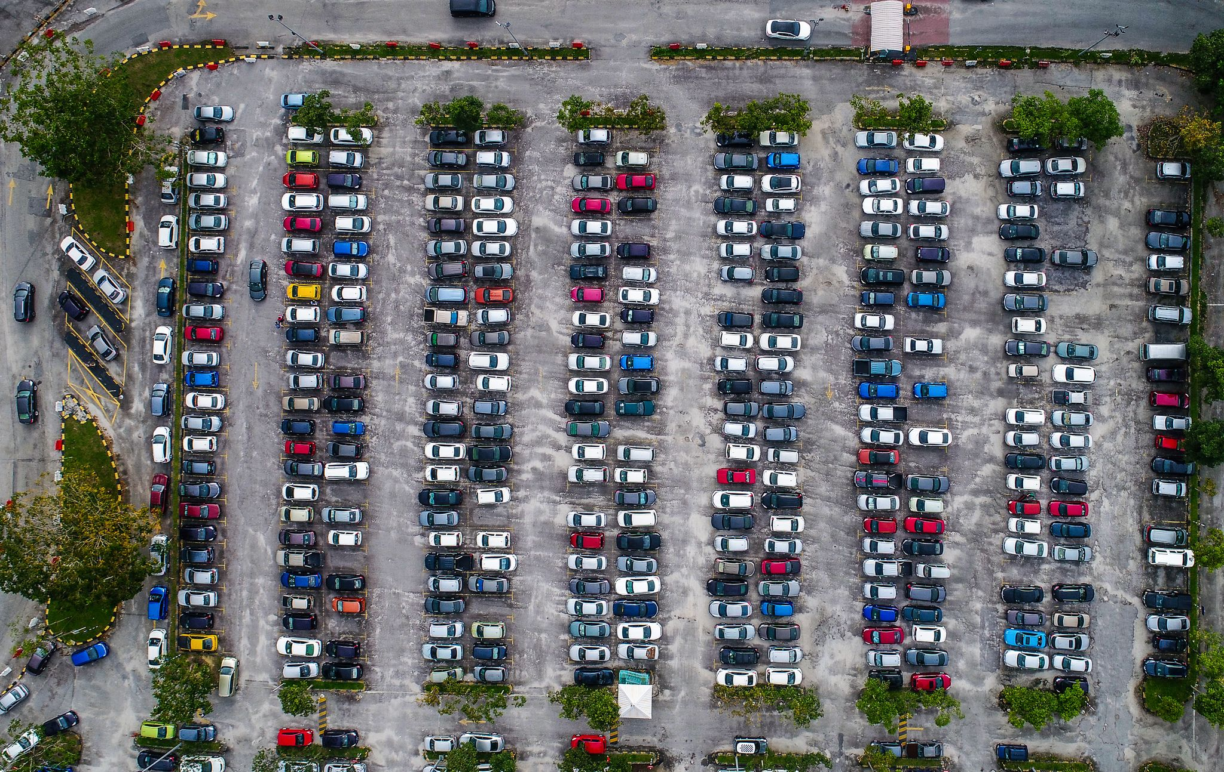
Finding parking spot can be time consuming especially during peak hours.
What if we can check which parking slot is available and notify drivers to find it.

Slide 3
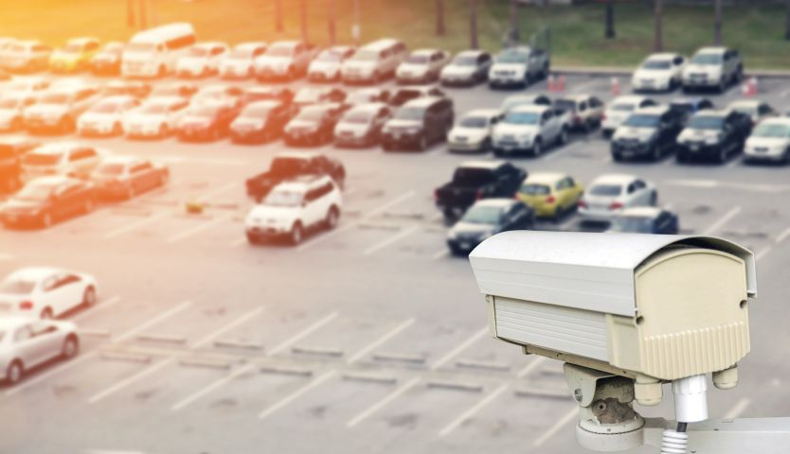
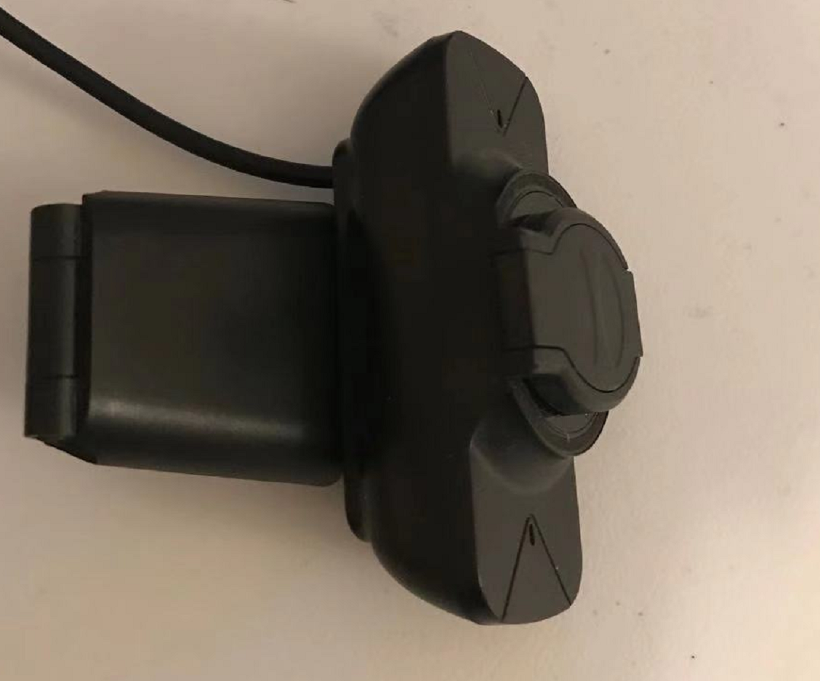






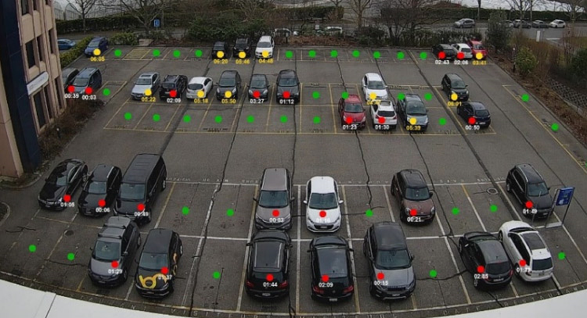

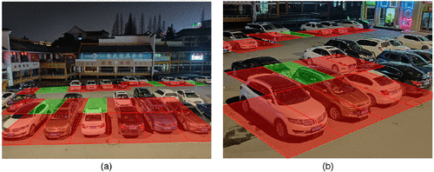
Using Camera to keep track of which parking slot is empty.
https://ascelibrary.org/doi/10.1061/JTEPBS.0000420

Slide 4
Using Camera to check the parking spot. (CNN)
To simulate the project, we will use camera to look at a video that recording a parking lot.
Base on the vehicle location (pixel coordinates) in the image, we write an algorithm to figure out the actual location that the vehicle occurs. Then, we can know that which parking spots are available as well as the number of available parking spots.
The parking lot information will be sent to other device such as mobile phone to notify drivers.

Slide 5
Week4: Decide equipment, research, programming language.
Week5: Apply Machine learning to recognize cars (Analysis which models can be used)
Week6: Testing image recognition, optimize the model
Week7: Create a map that correspond to the parking lot.
Week8: Matching the available parking slot
Week9: Sending data to other device (mobile phone)
Week10: Demo, final presentation

Slide 6
Machine Learning CNN
Camera
Communication
Apps

Slide 7
Reference:
https://mobidev.biz/blog/iot-based-smart-parking-system
https://ascelibrary.org/doi/10.1061/JTEPBS.0000420

