Slide 1
SWAP-Assembler: Scalable Genome Assembler towards Millions of Cores – Practice and Experience
Jintao Meng
PhD Candidate
Shenzhen Institutes of Advanced Technology, CAS
Institute of Computing Technology, CAS
Advisor: Shengzhong Feng, Yanjie Wei
Collaboration with BingQiang Wang
Supervisor: Pavan Balaji
Mentors: Sangmin Seo
Oct 29, 2014

Slide 2
Outline of the Talk
Overview of Genome Assembly problem
Importance, Challenges, and strategies
Parallel Genome Assembly
Previous works
Contributions of SWAP-Assembler
Optimization work on Mira for SWAP-Assembler
Optimization strategy
Input & Output optimization
Kmer Graph Construction
Edge Merging
Performance comparison & Evaluation
Human data results
Experimental Results
Summary
Future Work
Acknowledgements

Slide 3


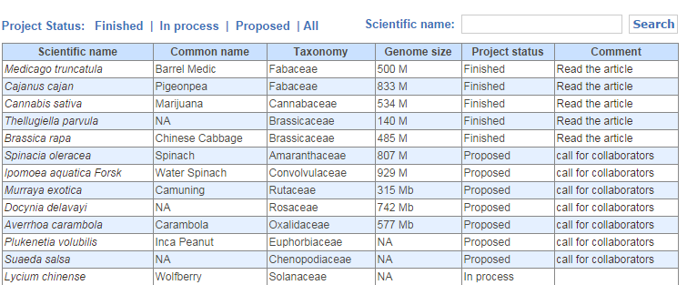
Importance of Parallel Assembly
Big data in Biology： Supporting Big Science
Million Plant & Animal Genome Project
Million Human Genomes Project
Million Microecosystem Genome Project
Money & Time Cost: Saving Money &Time
For 1 million Human dataset, assembling on one server needs 5479 years
Building large memory cluster with 5 billion Dollars – reduce to 1 month
Or use Mira + SWAP: 1 month
System Scalability： Analysis Automatically
Scalable data storage
Scalable software and analysis pipeline
Genome Assembly and Sequence Alignment are two fundamental tools in data analysis pipeline.
There are plenty of scalable alignment tools, such as mpiBLAST, SOAP2, etc.
But No Genome Assembler can scale beyond 1024 cores.
This work here is to cover the gap with Mira (768k cores).
Notes:
Huge data has been generated in biology. For example, Million plant animal genome project, million human genome project, and million microecosystem project, each of them will have more than 1000 PB.
With these huge data, Storage, processing and analysis is very challenge.
A scalable system is needed to handle these huge data. So the first thing is to have scalable storage. and then we need scalable softwares or pipelines. The fundamental tools in data analysis in biology is genome assembly and sequence alignment. Currently, there are plenty of scalable alignment tools, but no genome assembler can scale beyond 1024 cores.
The work here is to cove this gap with Mira.

Slide 4
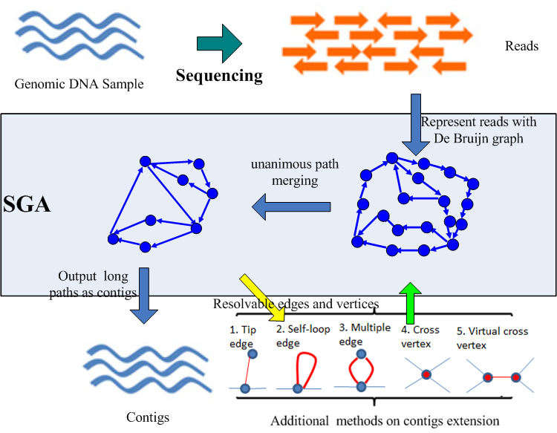
Genome assembly and major steps of DBG based strategy
Fundamental Idea
Reconstruct the reference (contigs) by extending overlapped sequences generated by sequencing equipments.
Three dominated strategies
Overlap-Layout-Consensus
De Bruijn Graph
String Graph
Major steps in DBG
Kmer graph construction
Edge merging / Node merging
Generate Contigs
Scaffolding
Major steps in DBG

Slide 5

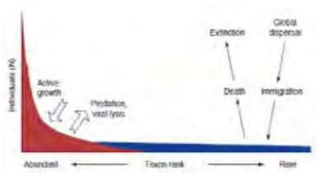
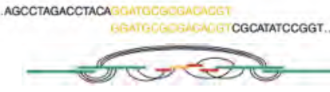

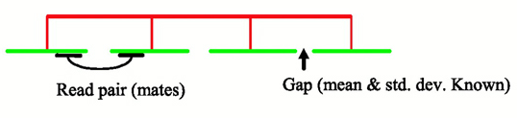
Challenge issues in Parallel Genome Assembly
I/O Intensive
Parallel I/O for TB data
Memory Intensive
Memory usage is 50X input data (~PB)
Data compression (>10)
Communication Intensive
Data distribution &exchange
Kmer spectrum analysis
Non-embarrassingly parallel
inter-communication between graph vertices
Dynamic graph topology
Access collision avoidance
Genome Assembly
Input Parallelization
Kmer Graph Analysis
Graph Construction
Edge Merging
Contig Generation
Scaffolding

Slide 6
Previous published parallel assemblers
ABySS JT. Simpson, Genome Research/Nature Methods, 2009
Contributions： Implement the traditional DBG strategy over MPI
Ray/Ray-meta Sebastien, JCB/Genome Biology, 2012
Contributions ： Develop a general distributed engineer for traditional DBG strategy with MPI
YAGA BG. Jackson, S.aluru, ICPP /IPDPS /BMC Bioinformatics 2009
Innovation points ： Bi-directed DBG graph, and list ranking algorithm for unanimous path merging
BGI Hecate Project, Contrail Project (Assembly on the Cloud)
PASHA Yongchao Liu, BMC Bioinformatics, 2011
Contributions ：Multi-thread in kmer statistics & path concatenation (one thread for one path, no intra-path parallelism).
Limitation: Share Memory Architecture, intra-path parallelism.

Slide 7
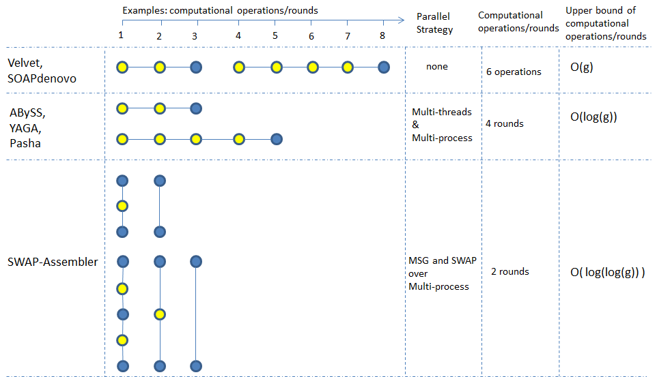
Contributions in SWAP-Assembler
GA strategy
Multi-step Bi-directed DBG strategy
Release parallelisms with Semi-group
Computing Model
SWAP computing model
Fully parallelized assembler

Slide 8





Complexity of SWAP-Assembler
SWAP in Edge Merging Part: Lowest limit of other work:
Computing Complexity ABySS, Pasha
Communication volume ABySS, Pasha
(Implicit) Communication round YAGA
Speedup:
Here, g is the length genome size, n the sequence data size.
b, c and r is constant numbers, q is the proportion of the repeats in the genome.
L is the communication latency , S is the startup time for each message.

Slide 9
Performance results of SWAP-Assembler 0.3
Performance results on Hg 14 (3.2GB) with SWAP-Assembler version 0.3 on Cetus.
5 steps in SWAP-Assembler
Time breakdown for each step varies a lot under different number of cores
The time consuming steps are input&output, graph construction, graph simplification
Percentage of time usage in each step
Speedup
Number of Cores (ppn=16)

Slide 10
Performance results of SWAP-Assembler
Performance results on Human data (250GB) with SWAP-Assembler version 0.3.
Major steps of SWAP-Assembler
The proportion of time usage for each step is irregular.
The time consuming step are input&output, graph construction, graph simplification
Percentage of time usage in each step
Speedup
Number of Cores (ppn=16)

Slide 11
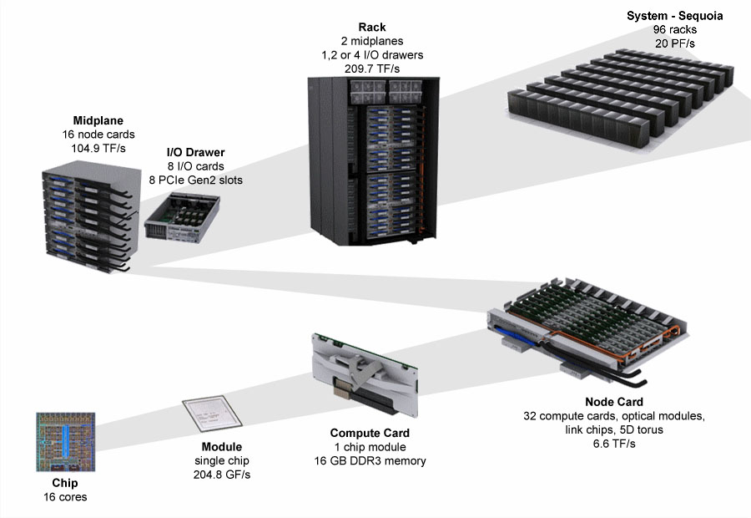
Optimization strategy on Mira for SWAP-Assembler
5D torus
(4,4,4,8,2)
5D torus
(8,16,16,16,2)
Optimize dominated time consuming steps:
input & output
kmer graph construction
graph simplification (edge merging)
Objective
keep the percentage of time usage in each step constant when the number of cores increases
Minimize the communication & memory usage
Scale to as many cores & as larger dataset as we can
5D torus
(4,4,4,4,2)
5D torus
(2,2,2,2,2)
BG/Q Scaling Architecture

Slide 12
input & output
Optimization points
Data Partition: Input data is divided into p virtual data blocks, the begin and end position for each block is automatically separated at the beginning symbol of reads (Location).
Dynamical balance: Each data blocks is further divided into multiple pieces of fixed length (16M). Each round all process collectively read some pieces of data into memory.
Benefits:
Minimize the memory usage by processing only part of data in each round.
Support data size self-adjustment in kmer graph construction part
A0
A1
A2
A3
B0
B1
B2
B3
C0
C1
C2
C3
P0
P1
P2
Network
Kmer
Graph
Kmer
Graph
Kmer
Graph

Slide 13
input & output
Optimization points
Data Partition: Input data is divided into p virtual data blocks, the begin and end position for each block is automatically separated at the beginning symbol of reads (Location).
Dynamical balance: Each data blocks is further divided into multiple pieces of fixed length (16M). Each round all process collectively read some pieces of data into memory.
Benefits:
Minimize the memory usage by processing only part of data in each round.
Support data size self-adjustment in kmer graph construction part
A0
A1
A2
A3
B0
B1
B2
B3
C0
C1
C2
C3
P0
P1
P2
Network
Kmer
Graph
Kmer
Graph
Kmer
Graph
13

Slide 14
Performance improvements on IO lib
New IO lib
Location is to automatically cut the reads from its begin symbol of ‘>’, this can prevent cutting in the middle of one reads.
Old IO Lib

Slide 15
Kmer graph construction
Optimization points
Aggregated network bisection bandwidth increases proportionally with the number of cores. (Dong Chen, SC’2012)
Keep the message size constant by proportionally increasing the number of data pieces with the number of cores
Benefits
To fully exploit interconnection BW in 5D torus and keep communication efficiency
D1D0
P3
P2
D0
C0
C0C1
A1A0
P0
P1
B0B1
2D torus Network

Slide 16
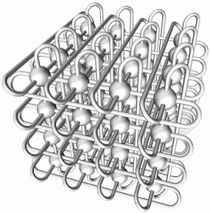
Kmer graph construction – quadrupling No. of Proc
H3H2H1H0
P7
P6
F0F1F2F3
E3E2E1E0
P4
P5
F0F1F2F3
D3D2D1D0
P3
P2
C0C1C2C3
A3A2A1A0
P0
P1
B0B1B2B3
3D torus Network

Slide 17
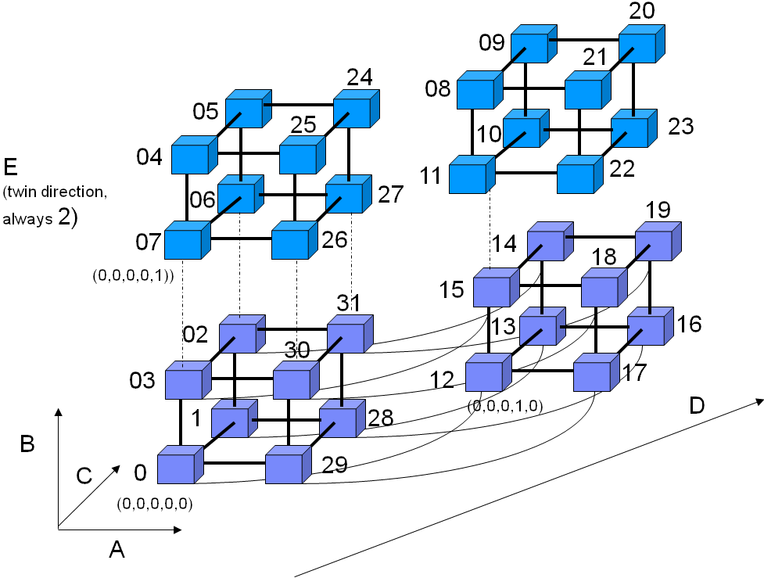
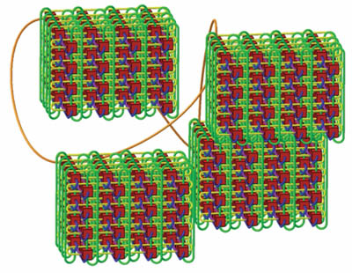
Kmer graph construction – 8X No. of Proc
Optimization points
Aggregated network bisection bandwidth increases proportionally with the number of cores. (Dong Chen, SC’2012)
Keep the message size constant by proportionally increasing the number of data pieces with the number of cores
Benefits
To fully exploit interconnection BW in 5D torus and keep communication efficiency
4D Torus Network

Slide 18
Graph simplification (edge merging)
Optimization points
Sending & Recving multiple messages to/from all its neighbors within one loop instead of one message to one neighbor in each loop.
Benefits
Minimize time in SWAP protocol on edge merging.
Time Line
0
Lock
Lock
1
2
Lock reply
Lock reply
0
Notify
Data
Notify
Data
1
2
Communication protocol in
SWAP on Edge merging

Slide 19
graph simplification (edge merging)
Compute Routine
Lock Stage :
Post MPI_Isend(compReq) //Lock
Post MPI_Irecv(compReq+1) //Lock Reply
Post MPI_Isend(compReq+2)
Post MPI_Irecv(compReq+3)
Call RecvProc(4, compReq) //Wait until finish
Notify Stage :
Post MPI_Isend(compReq) //Notification &data size
Post MPI_Isend(compReq+1) //Data
Post MPI_Isend(compReq+2)
Post MPI_Isend(compReq+3)
Call RecvProc(4, compReq) //Wait until finish
Compute Routine
Lock Stage :
Post MPI_Isend(compReq) //Lock
Post MPI_Irecv(compReq+1) //Lock Reply
Call RecvProc(2, compReq) //Wait until finish
Notify Stage :
Post MPI_Isend(compReq) //Notification &data size
Post MPI_Isend(compReq+1) //Data
Call RecvProc(2, compReq) //Wait until finish
Time Line
0
Lock
Lock
1
2
Lock reply
Lock reply
RecvProc Routine (Service Routine)
While(1)
{
Post MPI_Testall(2, compReq, &flag)
if(flag) break;
Post MPI_Test(&globalReq, &flag)
if(flag==0) continue;
Doing work here…..
Post MPI_Irecv(&globalReq)
}
0
Notify
Data
Notify
Data
1
2
Note that:
Two neighbors can share the same loop in both Lock and Notify stage.
Can not understand this. Please explain more to your audience.
Communication protocol in
SWAP on Edge merging

Slide 20
Graph simplification (edge merging)
After Message Combining, the Idle time stops increase and keeps constant.
We can’t eliminate all the idle time.
Due to the difficulty in recording the time used in sending & recving nonblocking messages in computing routine, these time usage has been gathered into Idle time.
Percentage of time usage

Slide 21
Performance Improvements
With the human dataset on 32k cores, SWAP with optimization on IO and Kmer graph construction has a speedup of 4.9X.
SWAP with optimization on all three steps gain a speedup of 10X, and the efficiency is 62%.

Slide 22
Percentage of time usage for SWAP 0.3
The percentage of time usage on original SWAP 0.3.
The number of cores is set to be less than 16k cores, so there is no records equal and beyond 16k cores.
Percentage of time usage
Number of Cores

Slide 23
Percentage of time usage for SWAP + IO + KmerGraph
Percentage of time usage
Number of Cores

Slide 24
Percentage of time usage for SWAP + IO + KmerGraph + Edge merging (SWAP 0.4)
Percentage of time usage
Number of Cores

Slide 25
Performance results for mixed fish & human dataset (500GB, 3.8 billion reads)
With mixed fish and human dataset (0.5TB is used), SWAP scales to 256k cores with an efficiency of 24.2%.
Percentage of time usage for each step
Speedup
Number of Cores

Slide 26
Performance results for 1k human project dataset (4TB, 30 billion reads)
With parts of 1k human project dataset (4TB is used, and 120T in total) SWAP scales to 256k cores with an efficiency of 27.5%.
Percentage of time usage for each step
Speedup
Number of Cores

Slide 27
Summary
SWAP-Assembler contributions
Simplify the GA problem to a commutative operation over semi-group
Lowest complexity on computation, communication, and (virtual) communication round
Optimization on Mira
Input & output -> Data partition
kmer graph construction -> Communication
graph simplification -> Message Combination
Conclusion on our work:
Ratio of the steps in SWAP keeps constant. Explain more for the meaning and value
Scalability to 256k cores with an efficiency of 27.5% on 4T data.

Slide 28
Future Work
Software scalability
Continue optimize SWAP step by step to the whole MIRA (768k cores) by approaching MIRA’s peak performance. (Dong Chen, SC 2012)
Overlap IO & Kmer Graph Construction to hide the computing, communication cost behind the IO cost.
New algorithm for edge merging
Try to use Independent Set method on SWAP in edge merging (maximize the degree of parallelism in edge merging)
List ranking for BSP & Pragel framework for genome assembly on the Cloud.
Application to new area
Breakthrough the biology problems in metagenome with uneven depth
Apply the parallel DBG methods into alignment & SNP search (SC 2014)

Slide 29




Acknowledgements
Thanks to
Supervisor: Pavan Balaji
Mentor: Sangmin Seo
Technical thanks to
Huiwei Lv, Rob Latham for MPICH & IO
Sheng Di, Dong Chen for Torus
Sabestien, FangFang Xia for GA
PMRS team members for Meeting
Yanjie Wei, Bingqiang Wang for Review
Special thanks to
Renbo Pang, Xiaomin Zhu

