Slide 1
SWAP-Assembler: Scalable and Efficient Genome Assembly towards Thousands of Cores
Jintao Meng, PH.D candidate
Shenzhen Institutes of Advanced Technology (SIAT), Chinese Academy of Science, Shenzhen, China
Recomb-seq 2014, Pittsburgh, 2014.3.31
Notes:
Hello everyone, I am Jintao Meng, a Ph.D student from Shenzhen Institutes of Advanced Technology, CAS. Now I will give my talk on “SWAP-Assembler: Scalable and Efficient Genome Assembly towards Thousands of Cores”.

Slide 2
Outline
Background
Multi-step Bi-directed Graph (MSG)
Implementation of SWAP-Assembler
Performance Analysis
Conclusions and Future Works
Notes:
This topic includes the following five parts. Firstly, the Background, then Multi-step Bi-directed Graph(MSG), implementation of SWAP-Assembler and its performance analysis, finally the conclusions and future works will be given.

Slide 3
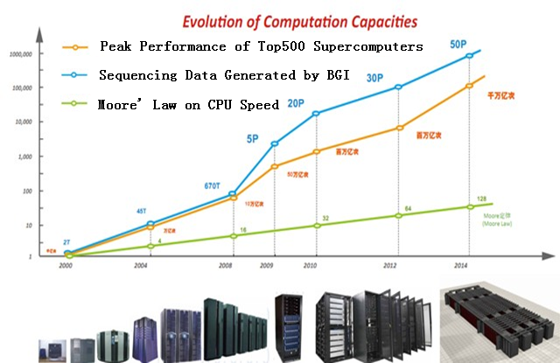
Background
1st Generation
2nd Generation
3rd Generation Seq Tech
Big data is a trend in biology.
Sequencing data in BGI is approaching to 50 PB in 2014.
Supercomputer will be an available platform for biology data processing.
Notes:
Big data is a trend in biology, the sequencing data generated by BGI is approaching to 50 PB in 2014. According to this figure, Supercomputer can match the computing speed with the data increasing speed.

Slide 4
Background
Genome assembly examples on big data
Spices | Ref size | Data size (100X) | Memory usage
Human | 3 G | 0.6 T | 0.5 ~ 2 TB
Wheat | 16 G | 3.2 T | 2.0 ~ 10 TB
Salamander | 45 G | 9 T | 7.5 ~ 30 TB
Human gut metagenome | ? (1200 patients) | 12 T | 10 ~ 40 TB
Due to the huge memory usage and long execution time, assembling with supercomputer becomes a better option.
Notes:
There several genome assembly examples on big data. Human has a reference size of 3G bytes, and its raw data size in fastq format is 0.6 TB. To assemble this dataset, 0.5 to 2 TB memory will be used, and the time usage is about 1 week. The largest dataset in this table is human metagenome, which is named as human’s second genome. BGI has sequenced 1200 patients and generated 12TB data. Without error correction tools, the memory usage will approach to 40 TB, and the time usage will more than half a year.

Slide 5
Background
Sequential Genome Assembly Strategy
    OLC (Overlap Layout Consensus), such as CAP3 [Huang, 1999], SSAKE [Warren, 2006], VCAKE [Jack, 2007]
    De Bruijn graph based, such as ALLPATHS [Butler 2008], Velvet [Zerbino, 2008], etc.
Parallel Genome Assembly Strategy
  Thread Parallel (DBG) : SOAPdenovo [Li, 2009], IDBA [Peng, 2010], Pasha [Liu, 2011]. (scales to 64cores)
  Process Parallel (DBG) : ABySS[Simpson, 2009], Ray [Boisvert 2010], YAGA [Jackson, 2009], etc. (scales to 256 cores)
De bruijn graph (DBG) is popular for parallel assembly on big data.
Notes:
Sequential assembly strategies can be classified into two categories, OLC and De Bruijn graph. Most state-of-the-art parallel assembly methods are developed using the De Bruijn graph strategy. These parallel assemblers can scale to at most 256 cores.
Highly scalable parallel algorithm still very rare, and our research is focused on parallel algorithm for massive sequences beyond 1000 cores.

Slide 6
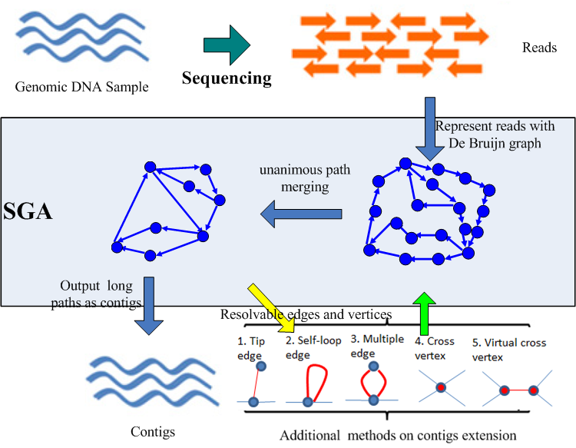
Multi-step bi-directed graph
Major steps of DBG based strategy on generating contigs
Notes:
The major step of DBG based strategy on generating contigs is plot in this figure.

Slide 7
Multi-step bi-directed graph
Difference between DBG and MSG
 | De Bruijn Graph (DBG) | Multi-step bi-directed Graph (MSG)
Node | k-mers | k-molecules
Edge | Directed, exists between two nodes (k-mers) a and b, when (k-1) suffix of a and (k-1) prefix of b are the same. | multi-step bi-directed edges, all the edges and edge merging operation is a semi-group.
Methods | Merging k-mers through an unanimous path results in contigs | Merging all semi-extended edges to full-extended edges (contigs) in parallel.
Notes:
The difference between DBG and MSG, is demonstrated in the table as below:
For DBG, the node is k-mers, and for MSG the node is k-molecules.
In DBG, the edge is directed and exists between two nodes a and b, if and only if suffix of a and prefix of b are the same, whereas the edge in MSG is multi-step bi-directed edges.
However in both two methods, they aim to merge nodes in one unaminous path into contigs.

Slide 8
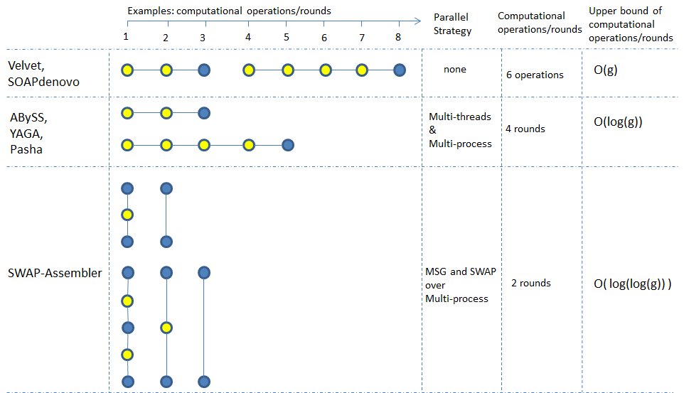
Multi-step bi-directed graph
An example to demonstrate the difference between sequential assemblers, parallel assemblers and SWAP-Assembler.
Notes:
Here is an example to demonstrate the difference between sequential assemblers, parallel assemblers and SWAP-Assembler.
There are two linked paths with 3 nodes and 5 nodes, merging a linked path with 3 nodes needs 2 operations/rounds, and merging a path with 5 nodes needs 4 operations/rounds. To assemble these two paths, sequential assemblers need 6 operations, and parallel assemblers need 4 rounds. For SWAP-Assembler different processes can merge several edges on the same path in parallel, and merging of these 2 paths can be finished in 2 rounds. The upper bound of the three assembly strategies on merging k-mers/edges are bounded by O(g), O(log(g), and O(log(log(g))) respectively, here g denotes the genome.
In the following part, we will give the two key approaches on parallelizing this work, these two approaches are MSG and SWAP.
In the rest part, we will introduce these two key approaches.

Slide 9
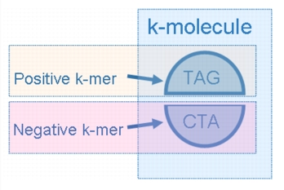

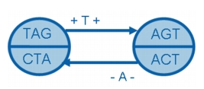


Multi-step bi-directed graph
Multi-step bi-directed De Bruijn Graph
Vertex set
Edge set
if ɑ is a positive, then its direction d_{ɑ} is ‘+’,
otherwise is ‘-’;
An edge generated by read …TAGT…
Notes:
For a given string s, the vertex set of MSG is all k-molecules generated by s. Each edge is a tuple with five elements, they are the source k-molecule alpha, the end k-molecule beta, the direction of alpha and beta and the label of this edge, which is the last nucleotide of beta.

Slide 10
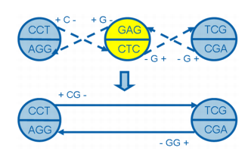


Multi-step bi-directed graph
Edge merging operation
Multi-step bi-directed edge is obtained by merging two 1-step bi-directed edge using edge merging operation:
Where directions of β are same on the two edges.
A MSG derived from read set S is:
An example of edge merging operation
Notes:
Multi-step bi-directed edge can be obtained by merging two 1-step bi-directed edges using the edge merging operation. In the right side, this is an example of edge merging operation.
Finally we can get a MSG derived from read set S, and the formula is described in the right side.

Slide 11
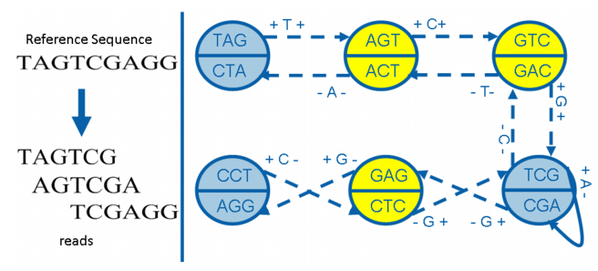
Multi-step bi-directed graph
Example
Dotted edges can be merged
Yellow vertices can be extended further
Gray vertices can not be extended further
(Neighbor = RC)

Slide 12
Multi-step bi-directed graph
Example
The reference is on this path TAGTCGAGG.
TAG
CTA
+ TCG+
+ CG+
CCT
AGG
TCG
CGA
+ A -
-CTA-
- GG-
The final graph has only gray vertices;
Final contigs : TAGTCG, CCTCG (RC:CGAGG).

Slide 13
Properties
Properties of MSG
Property 1. The set of full-extend edges is the final contigs.
Property 2. Edge merging operation is associative.
Semi-extended edges associated with the edge merging operation is a semi-group.
According to the associativity law of semi-group,
  Final contigs will be same regardless of the merging order.
  Edge merging operations can be computed in parallel.
Notes:
Within a MSG, Property 1 shows that the set of full-extend edges is corresponding to the set of contigs. Property 2 ensures that the edge merging operation ­over the set of multi-step bi-directed edges is semi-group, and this connects the genome assembly problem with edge merging operations in semi-group.
According to the associativity law of semi-group, the final full-extended edges or contigs will be the same as long as all edges have been merged regardless of the merging order, thus these edge merging operations can be computed in parallel.

Slide 14
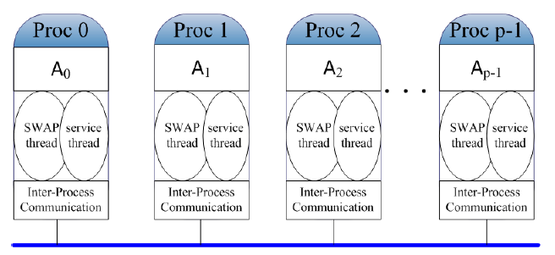
SWAP
SWAP: Small World Asynchronous Parallel model
The basic schedule of SWAP is: Lock-Computation-Unlock
Lock action is applied to each vertex’s small world( sent a trylock first; if neighbor is free, then lock it)
Computation and Modification of this small world’s attributes
Unlock action will be triggered to release this small world.
2 threads is needed:
One for sending/receiving
One for computing

Slide 15
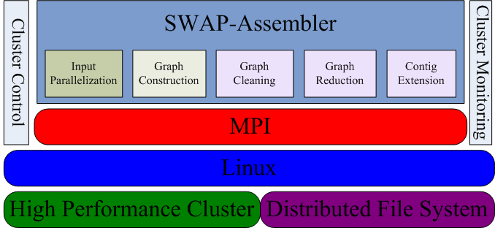
SWAP-Assembler
SWAP-Assembler architecture and its five steps
Notes:
SWAP-Assembler consists with five steps, including input parallelization, graph construction, graph cleaning, graph reduction, and contig extension.

Slide 16
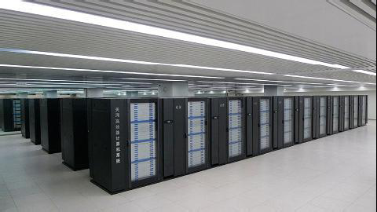
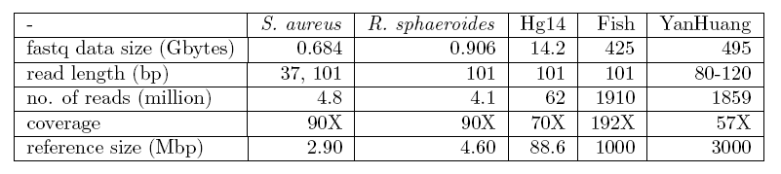
Performance Analysis
Supercomputer:
TianHe 1A (512 12-core servers with 24GB memory)
Data：
S. aureus, R. sphaeroides, Hg14, Fish
and Yanhuang.
Notes:
512 server in TianHe 1A is provided as our cluster.
Five dataset including S.aur, R. spha, Hg14, Fish and Yanhuang is downloaded for the performance evaluation.

Slide 17
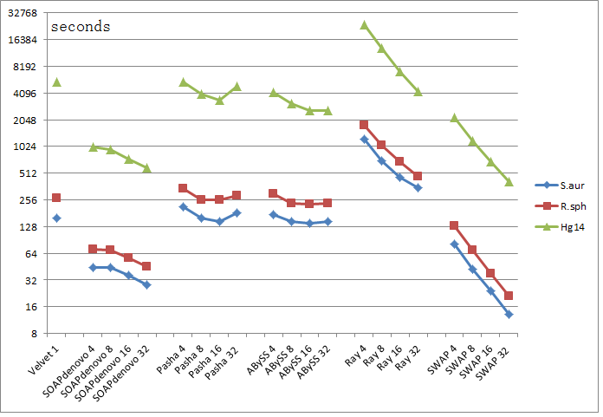
Performance Analysis
Performance comparison on Share Memory Machine with 32 cores:
SWAP-Assembler achieves nearly linear speedup and is more efficient than Ray.
Notes:
To evaluate the performance by comparing with non-parallel assemblers and other parallel assemblers which can not run on distributed servers. Five assemblers are tested on a share memory machine with 32 cores.
Results shows that SWAP-Assembler achieves nearly linear speedup and is more efficient than Ray.

Slide 18
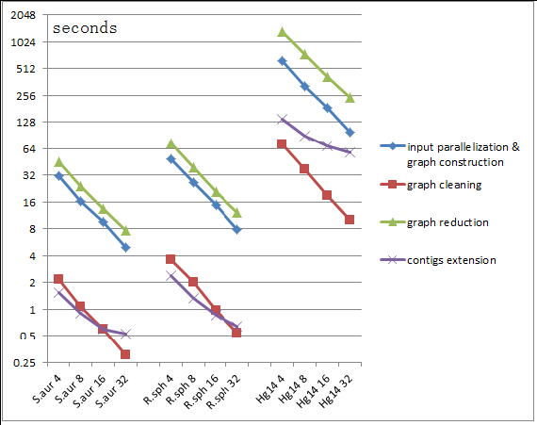
Performance Analysis
Performance evaluation of SWAP-Assembler’s five steps :
Input parallelization & graph construction, graph cleaning and graph reduction achieve nearly linear speedup, whereas contig extension does not benefit as much as other steps.
Notes:
After evaluating the scalability of SWAP-Assembler’s five steps, Input parallelization & graph construction, graph cleaning and graph reduction can achieve nearly linear speedup, whereas contig extension does not benefit as much as other steps.
As in last step of contig extension, all the final results need to be gathered into one process, and this affects its scalability.

Slide 19
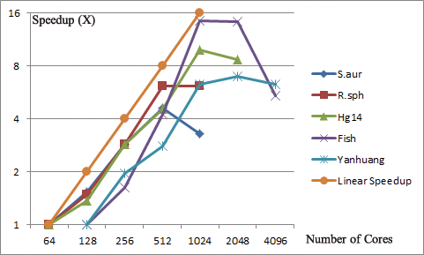
Performance Analysis
Scalability test on TianHe 1A with 4096 cores:
With 2048 cores, Fish and YanHuang genome can be assembled in 16 minutes and 26 minutes, respectively.
SWAP-Assembler relies on high performance networks. Explosively communication beyond the capacity of the network tails down its performance.
SWAP-Assembler achieves nearly linear speedup on processing five datasets.
Notes:
To test the scalability of SWAP-Assembler on 4096 cores, SWAP-Assembler is used to assemble five datasets with the cores increasing from 64 to 4096.
This figure confirms that SWAP-Assembler achieves nearly linear speedup on processing all five datasets. Specially, with 2048 cores, Fish and YanHuang genome can be assembled in 16 minutes and 26 minutes, respectively.
SWAP-Assembler relies on high performance networks. With the increasing number of cores, the explosive packets and communication bandwidth in SWAP will increase accordingly. When it beyond the capacity of network, the performance decreases. The spin-in and spin-out technology and message compress method maybe helpful for SWAP.

Slide 20
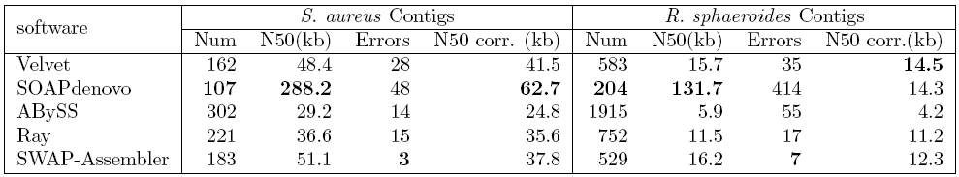
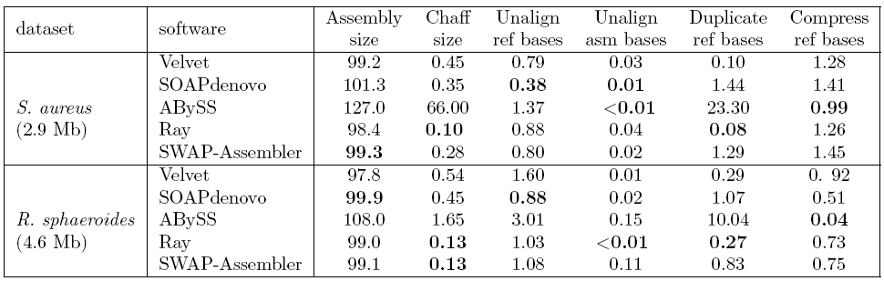
Performance Analysis
Quality Assessment on two small datasets:
SWAP-Assembler generates
the least number of error contigs.
SWAP-Assembler has good quality of contigs on chaff size and unalign ref bases.
Contig statistics on the assembly results of S. aureus, R. sphaeroides datasets.
Notes:
To be compatible with the comparison results of GAGE, two small datasets in GAGE is downloaded to test SWAP-Assembler.
In the first table, SWAP-Assembler generates the least number of error contigs on both small datasets.
In the second table, SWAP-Assembler has good quality of contigs on chaff size and unalign ref bases.

Slide 21
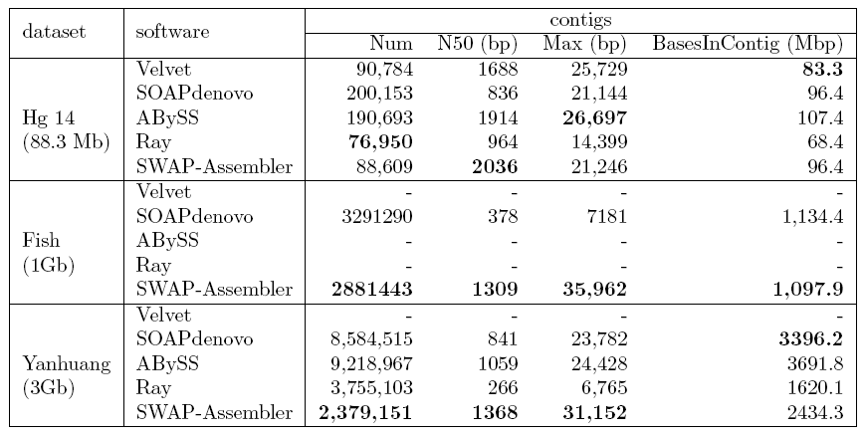
Performance Analysis
Quality assessment on three larger datasets:
SWAP-Assembler generates the longest length of contig N50.
Contig statistics of Hg14, Fish and YanHuang datasets.
Notes:
To further assess the quality results on larger datasets, Hg14, Fish and Yanhuang is used to evaluate these five assemblers.
The result shows that SWAP-Assembler generates the longest length of contig N50.

Slide 22
Conclusions and Future works
Two fundamental contribution in SWAP-Assembler
  MSG resolves the computational interdependence in genome assembly using a semi-group.
  SWAP computational framework triggers parallel computation of all operations in the semi-group.
Highly scalable and efficient
  Nearly linear speedup to 2048 cores on Yanhuang datasets (500G).
  Fastest assembler in all five compared assemblers.
Good results on contigs
  For small datasets: N50 size is large, error rate is low.
  For large datasets: N50 size is longest.

Slide 23
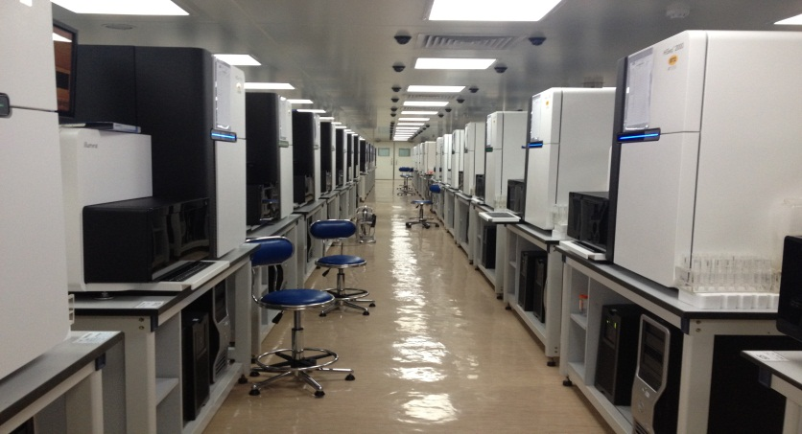

Conclusions and Future works
Sequencing Machine in BGI shenzhen
Using MPI-3 RMA and active messages – Optimization
Massive matagenomics assembly
SNP and INDEL calling using de novo assembly
More …
Using TianHe 2B in Guangzhou

Slide 24



Acknowledgement
Thanks for suggestions from:
  Francis YL Chin, SM.Yiu, Y. Peng, C.M. Leung, Y. Wang from HKU
  Anonymous reviewers invited by recomb-seq 2014
Thanks for the computing resources provided by TianHe 1A at National Supercomputer Center in Tianjin.
This work is co-funded by NSFC, Shenzhen Peacock Plan and Sci Tech and Innovation Committee of Shenzhen.

Slide 25
Questions

Slide 26


