Slide 1
Small World Asynchronous Parallel Model for Genome Assembly
Jintao Meng, Yanjie Wei, Jiefeng Cheng, Bingqiang Wang, Shengzhong Feng
Presented by Jintao Meng
Shenzhen Institute of Advanced Technology (SIAT), CAS, Shenzhen, China

Slide 2
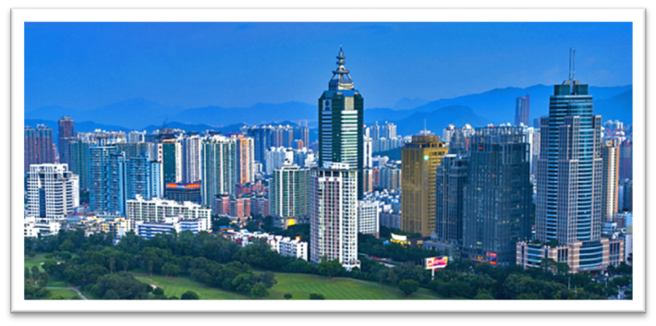
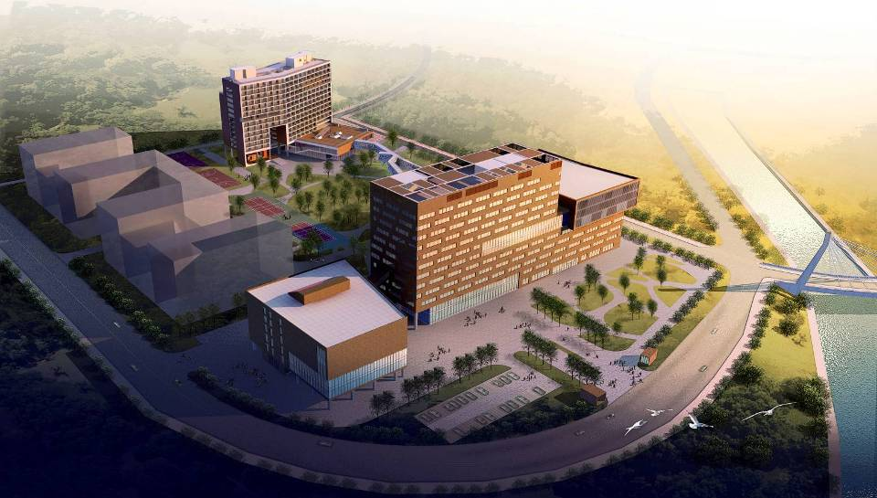
SIAT@Shenzhen
Shenzhen (left) a small fishing village 30 years ago, now a city with 14 million people
SIAT (right), CAS is established in 2006
Now ~1500 people; 4 institutes;
Average age of researchers:32

Slide 3
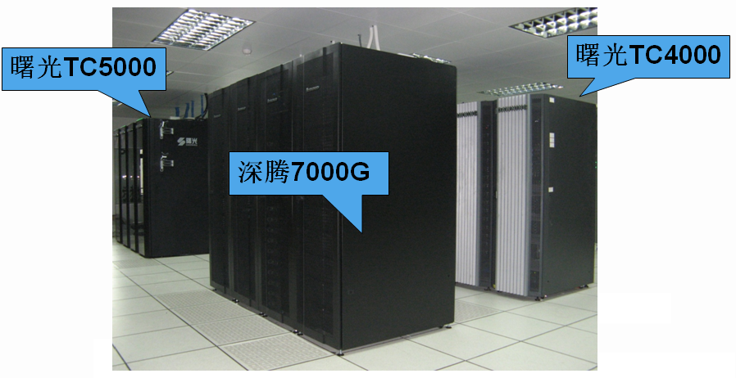
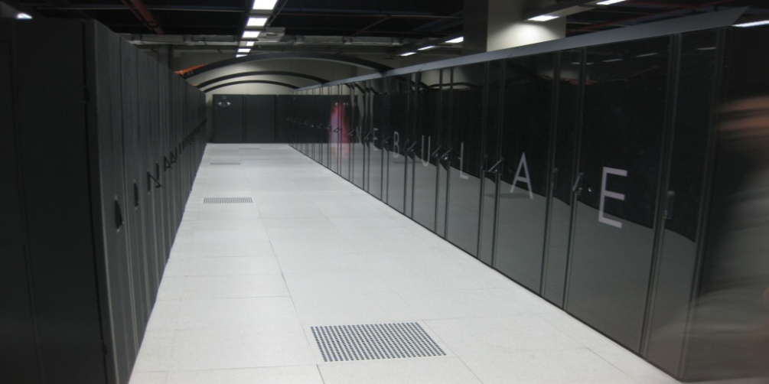
DAWNING 5K, 6K
Dawning 5000 (left, TC5000), center for high performance computing, SIAT, 10Tflops
Shenteng7000G (left, in the middle), 200Tflops (GPU)
Nebulae (right), Dawning 6000, National Super Computing Center at Shenzhen (NSCCSZ), 120640 cores, 1.27PFlops, top10 (in Top500)

Slide 4
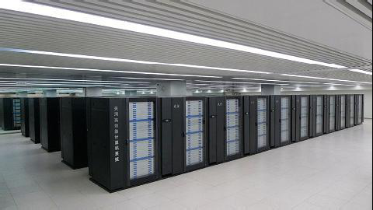
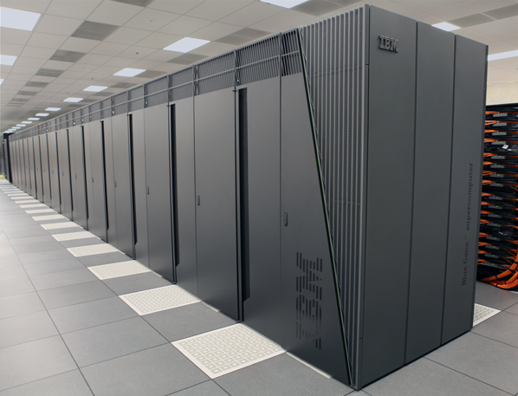
TH1A & Blue Gene Q
TH1A (left), TianHe 1A, National Supercomputing Center in Tianjin, 186368 cores, top 5 (in Top500) , 200 servers
Mira (right), BlueGene/Q Supercomputer in Argonne National Lab. 786432 cores, top3 (in Top500), 256 servers

Slide 5
Genome Assembly
Background
Multi-step Bi-directed Graph
Small World Asynchronous Parallel Model (SWAP)
Performance Analysis
Possible future directions

Slide 6
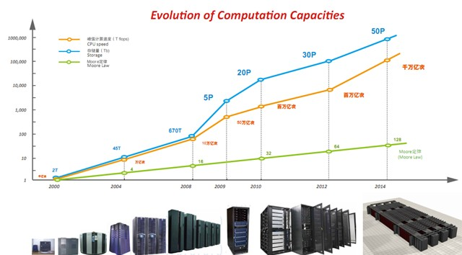
Background
1st Generation
2nd Generation
3rd Generation Sequencing Tech
Computer power doubles every 18 or 24 months! "Moore’ Law"
Sequencing throughput has recently been increasing at a rate of about 5-fold per year!
Stein LD. The case for cloud computing in genome informatics. Genome Biol, May 2010, vol. 11, issue. 5, pp. 207.

Slide 7
Background
Background: big data
E. coli Genome: 4.9M
Caenorhaditis elegans Genome: 100M
Human Genome: 3G
Wheat Genome: 16G
Salamander: 45G
Human : 3 billion DNA units
For 80~100 coverage sequencing: ~600GB data

Slide 8
Background
Algorithms
OLC (Overlap Layout Consensus), such as SSAKE, VCAKE, PE-assembler
De Bruijn graph based, such as ABySS, ALLPATHS, Velvet, SOAPdenovo, IDBA etc.
Challenges
Big data (high-throughput sequencing).
Error reads, repeats, slips
Euler tour problem is NP-hard.

Slide 9
Background
Parallel assemblers
  ABySS (scales to 64 cores)
  YAGA (scales to 256 cores)
Mapreduce Programming Framework
  Can only handle Embarrassingly-parallel problems, such as frequency statistics, sorting, indexing, etc,
Graph Computing Frameworks
  PBGL, Boost Graph lib (limited scalability)
  Google’s Pregel (hundreds of cores)
We endeavor to further improve the scalability on genome assembler by
  Multi-step bi-directed graph (mathematically operable)
  New computational model – SWAP (software computable )

Slide 10
Multi-step bi-directed graph
De Bruijn graph
Node: K-mer and its reverse complement
Edge: directed, exists between two nodes (K-mers) a and b when (K-1) suffix of a and (K-1) prefix of b are the same.
Each read (contig) is a path in this graph.
By connecting vertex pairs through edge, this approach results in contigs

Slide 11
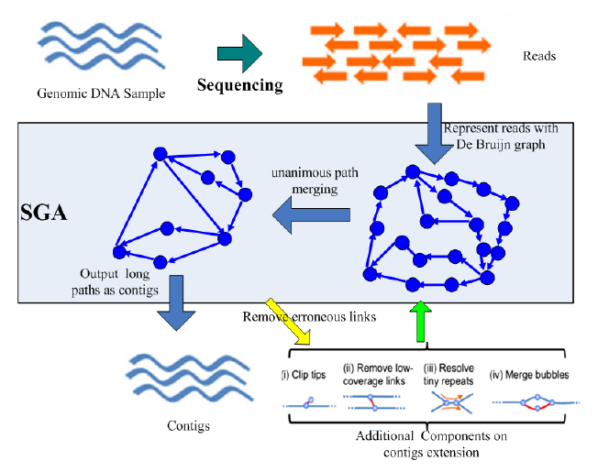
Multi-step bi-directed graph
De Bruijn graph based method

Slide 12
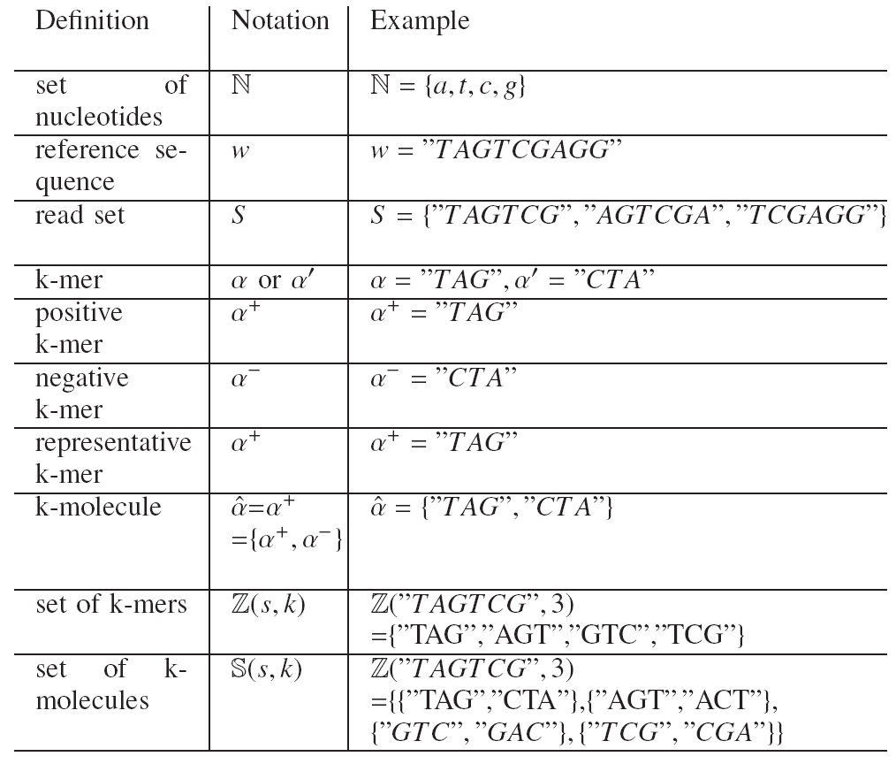
Notations
NOTATION
In our model
(De Bruijn)

Slide 13




Multi-step bi-directed graph
Bi-directed De Bruijn Graph in our framework
Degree of a K-molecule: # of edges attached to the K-molecule
1-Step bi-directional graph for a string s
Vertex set
Edge set
if ɑ is a positive, then its direction d_{ɑ} is ‘+’, otherwise is ‘-’;

Slide 14


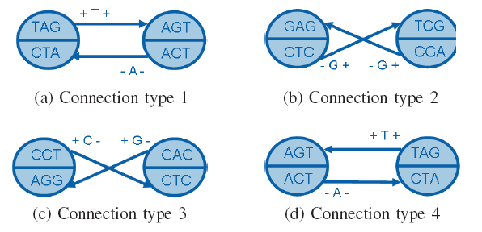


Multi-step bi-directed graph
Bi-directed De Bruijn Graph in our framework
Four possible connections: edge is attached to the first K-molecule.

Slide 15
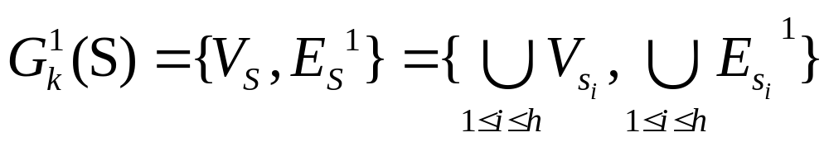




Multi-step bi-directed graph
Bi-directed De Bruijn Graph in our framework
For a group of strings/reads S={S₁, S₂, … S_{n}}
A one step bi-directed de brujin graph of S in order of k
Reads can be obtained by concatenating the first K-molecule and the edge labels/contents on the path
Multi-step bi-directed graph is obtained by edge merging operation
when directions of beta are same on two edges and

Slide 16
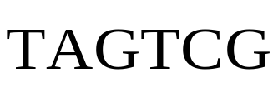
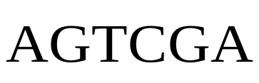
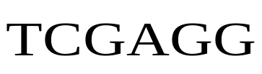

Multi-step bi-directed graph
Example
Input reads
TAG
CTA
+ T/A+
AGT
ACT
+ C/T +
GTC
GAC
Yellow vertex can be extend further
Dotted edges can be merged
+ G/C +
CCT
AGG
+ C/G -
GAG
CTC
- G/G +
TCG
CGA
Reference Sequence
Gray vertices can not be extended further
(Neighbor = RC)
+ A/A -

Slide 17
Multi-step bi-directed graph
Example
TAG
CTA
+ TCG/CTA+
CCT
AGG
+ CG/GG -
TCG
CGA
+ A/A -
The final graph has only gray vertices;
Final contigs : TAGTCG, CCTCG (RC:CGAGG).

Slide 18
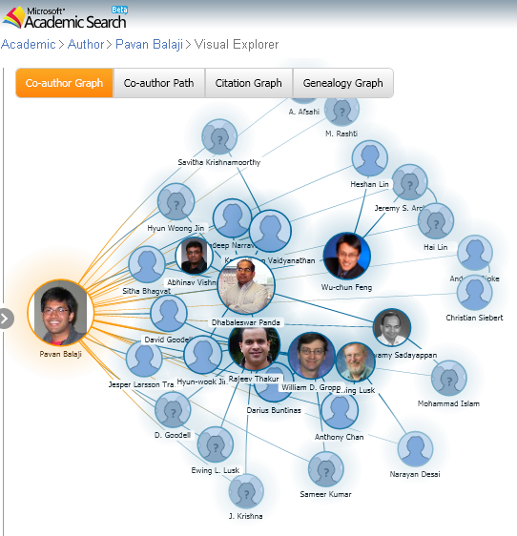
SWAP
Small world for parallel computing
Real world is decentralized
and asynchronous world
Small World: a small group of people who are cooperating with each other.
Pavan Balaji‘s co-author graph
(Microsoft Academic Research)

Slide 19
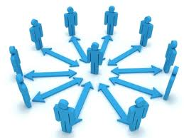
SWAP
SWAP: Small World Asynchronous Parallel model
Our Small World: Vertex, its limited neighbors, all edges between them. (Locality)
In our model, little computing work per vertex, random access to its neighbors. (data intensive)
Parallelization: computing/merging in small world of each vertex
A Small world
You
Friends
Relationship

Slide 20
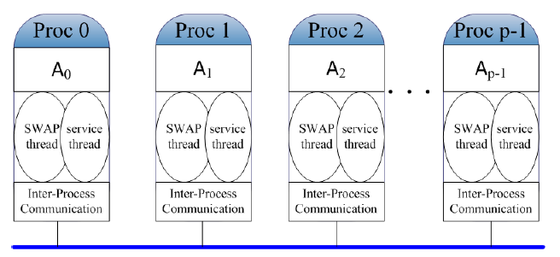
SWAP
SWAP: Small World Asynchronous Parallel model
The basic schedule of SWAP is: Lock-Computation-Unlock
Lock operation is applied to each vertex’s small world( sent a trylock first; if neighbor is free, then lock it)
Computation and Modification of this small world’s attributes
Unlock operation will be triggered after computation and modification.
Each process with 2 threads:
One for sending/receiving
One for computing

Slide 21
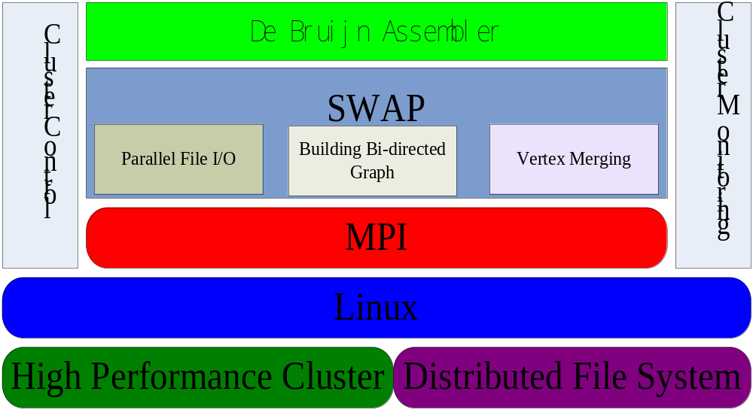
Gene Assembly
Architecture

Slide 22
Performance Analysis
Performance:
Supercomputer: Dawning 5000 (40 16-core servers with 32GB memory)
Data：
50x coverage of Yeast: containing 17 million reads, 255M nodes
50x coverage of C. elegans: containing 141 million reads, 2G nodes
Error rate 1%, and the length of reads from 36bp to 50bp.

Slide 23
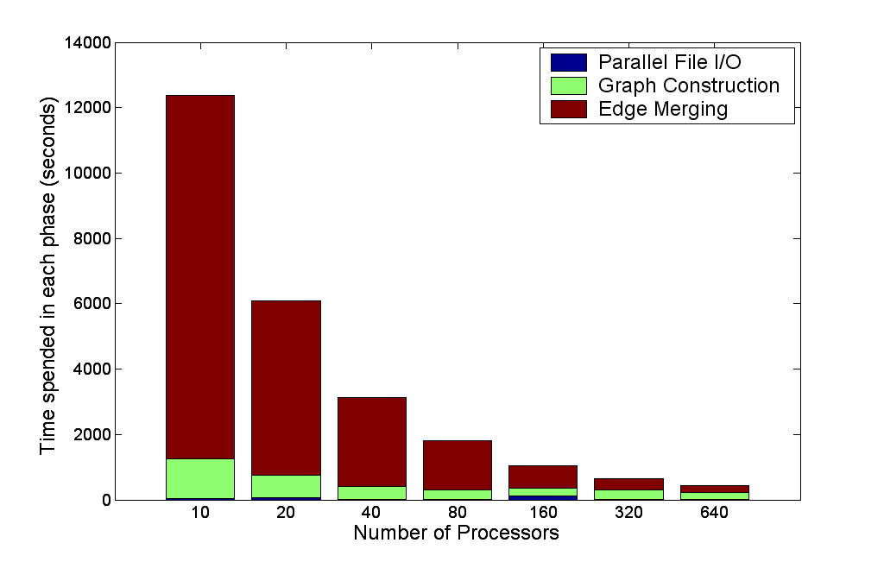
Performance Analysis
Performance:
the speedup in edge merging is about 35 and the overall runtime was reduced by a factor of 20.
Time usage analysis in three phase on C.elegans dataset

Slide 24
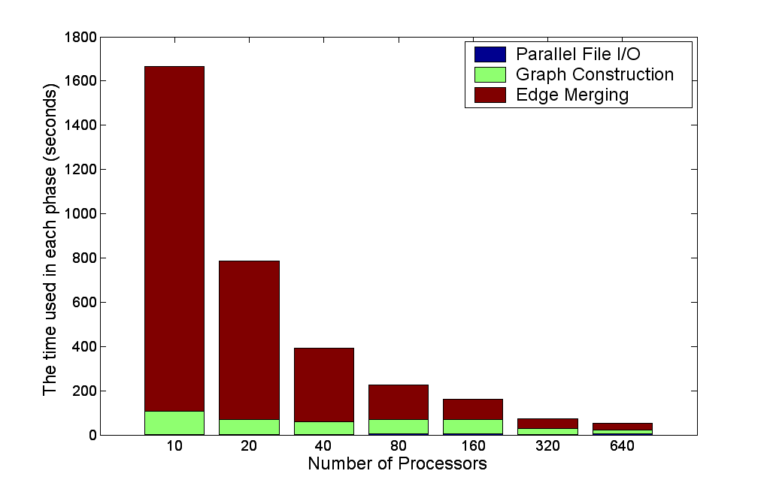
Performance Analysis
Performance:
the speedup in edge merging is about 50 and the overall runtime was reduced by a factor of 30.
Time usage analysis in three phase on Yeast dataset

Slide 25
Performance Analysis
Performance: test on SC@ANL
Simulated data, 50X, 36pb reads, 1% error:
Ecoli: 981 MB dataset; 221.2 million base pairs:
Yeast: 2.5 GB dataset; 583.8 million base pairs
Real data:
SRC000601: 7.5 GB dataset; 2.5 billion base pairs
Machine:
InfiniBand cluster@ANL
Pavan Balaji performed the test

Slide 26
Performance Analysis
Performance: test on SC@ANL
Efficiency: the bigger the data, the higher the efficiency
Simulated data has higher efficiency
(red numbers use 32 core as base)
CPU No. | Ecoli | Yeast | SRC000601
8 | 100 | 100 | NA
16 | 100 | 95 | NA
32 | 90 | 90 | 100
64 | 78 | 81 | 97
128 | 77 | 84 | 86
256 | 66 | 72 | 77
512 | 53 | 65 | 71
1024 | 48 | 59 | 65
2048 | 29 | 44 | 50
2048 | 32 | 49 | 50

Slide 27
Future works
Combine two threads into one – Optimization (30-40% increase of efficiency)
Using MPI-3 RMA and active messages – Optimization
Error removal steps – Biologically important
More …

Slide 28
Acknowledgement
My profile:
Jintao Meng, Ph.D student @SIAT
Collaborators:
YJ Wei, JR Yuan, Jf Cheng, SIAT
Bingqiang Wang, Yan Li, Beijing Genome Institute
Pavan Balaji, Argonne National Lib
Francis YL Chin, SM.Yiu, U of HongKong
Advisor:
Shengzhong Feng, SIAT
Ninghui Sun, ICT
Fund and computer resources from Center for High Performance Computing, SIAT

Slide 29
Questions

Slide 30

감사합니다

